Slide 1
PS4106:
Data Science for Psychology & Neuroscience
Justin Ales

Slide 2
Assessments
2 assessments.
Programming excercise: 25% due Thursday 1pm, week 7
Final Project: 75%, Thursday, 1pm, week 11

Slide 3
Assessments
Programming exercise will be a set of problems for you to answer. These will be submitted as a “Jupyter Notebook” (We will introduce these this week)

Slide 4
Final Project
The last few weeks of devoted to developing your own mini data science project. The exact topic will be free for you to choose.
I encourage you to pick something aligned with your dissertation topic.
Submission will be a Jupyter notebook that implements your project

Slide 5
AI
Large Language Models are an exciting technology
Use of AI will be allowed during the module both for exercises and for assessments.

Slide 6
AI Warning
Large Language Models are designed to convince you not to be correct. They do get some things right and some things wrong. But it almost always looks convincing.
Be skeptical (good advice for everything in data science actually).
AI does not correctly perform all tasks in this module (I’ve checked). At least not yet.

Slide 7
AI Requirements
If you do utilize AI you must disclose its use and describe how you use it.
You also must not blindly trust its outputs and provide explicit tests/checks you did to verify.
You are ultimately responsible for everything you submit.

Slide 8
AI
AI is rapidly evolving and this is brand new.
There is not much prior experience in using AI therefore use of AI is experimental and subject to change.

Slide 9
David Stromberg
Stockholm University
Victor Lei
The University of Hong Kong - University of Hong Kong
Yanhui Wu
University of Hong Kong; Centre for Economic Policy Research (CEPR)

Slide 10
The Generative AI Learning Penalty: Evidence from Chinese Secondary Education
David Stromberg, Victor Lei, Yanhui Wu
SSRN

Slide 11
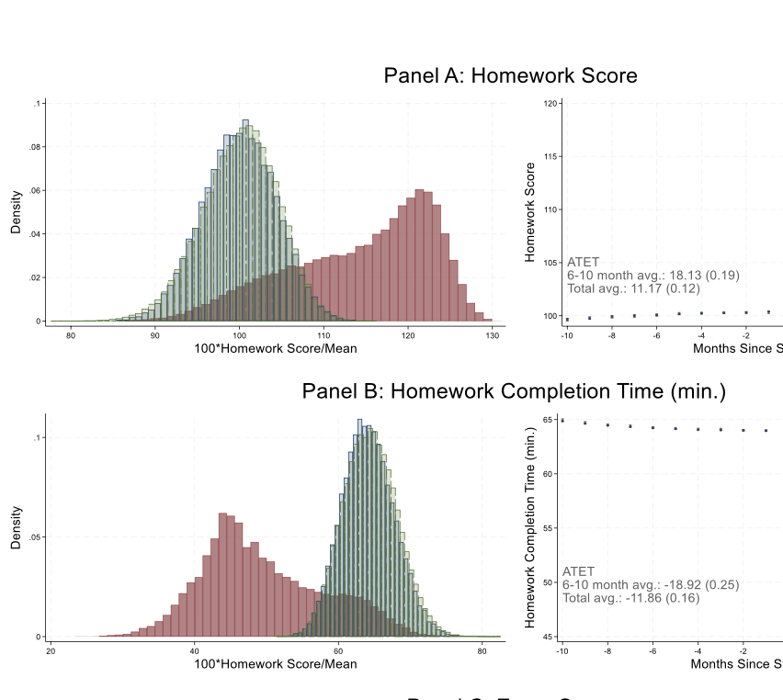


Slide 12
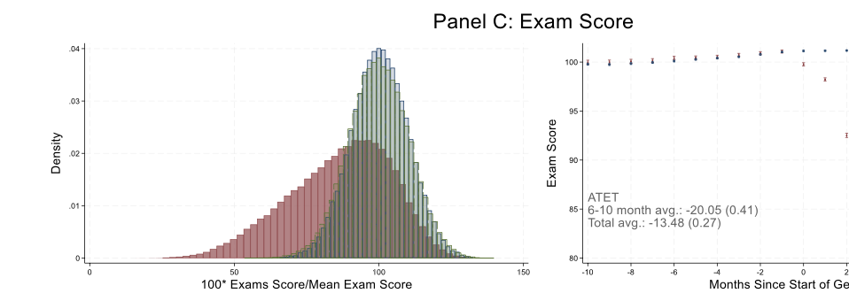

Slide 13
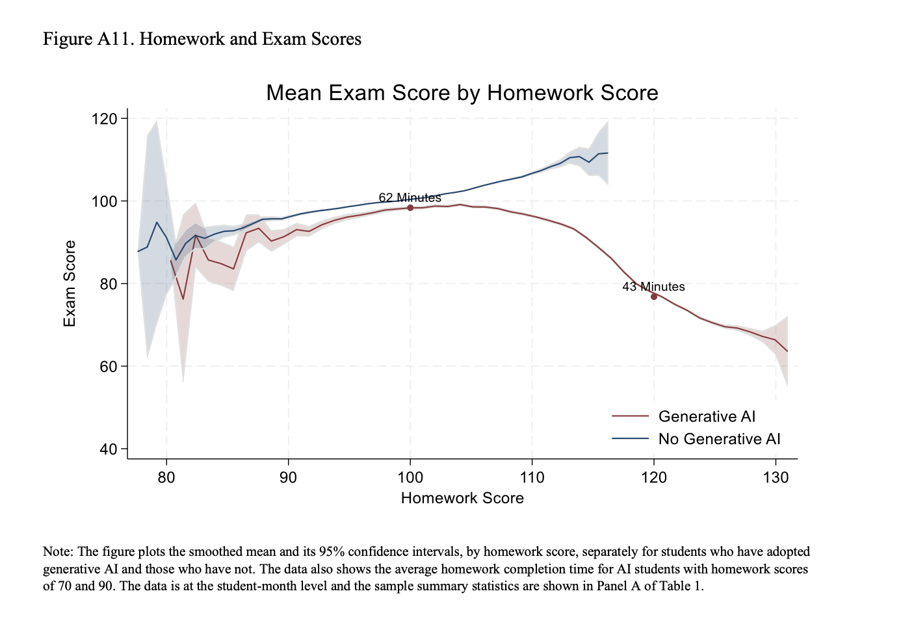

Slide 15

What is
Data science is a fundamentally interdisciplinary field.
It is the application of data centric, computational, and inferential thinking to:
  Understand the world (science).
  Solve problems (engineering).
It involves exploration, prediction, and inference.
Source: Data 100 Fal 2019 Slides
Notes:
Just the slide itself

Slide 16
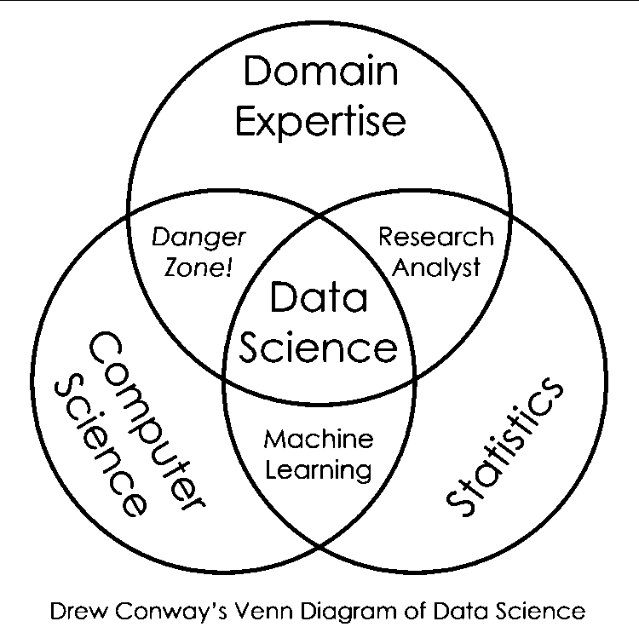
Drew Conway’s Data Science Venn Diagram
source: http://drewconway.com/zia/2013/3/26/the-data-science-venn-diagram
Notes:
source: http://drewconway.com/zia/2013/3/26/the-data-science-venn-diagram
Just having domain and statistics knowledge is not enough. CS skills are needs to be able to do powerful things technology allows us to do.
The intersection of CS and statistics can be called machine learning but not completely data science. A data scientist needs to ask and answer questions in a field and make inferences based on data. Just doing the math without the application in a domain is not data science.
The intersection of Computer Science and Domain Expertise is the area where you "know enough to be dangerous" With domain expertise, you probably will know what you are looking for. You probably know enough CS to manipulate data and maybe even run a linear regression. But the issue is you might not know what the coefficients of the regression mean, or how valid your approach is.
It is the intersection of all 3 that is the interdisciplinary field of Data Science.

Slide 17
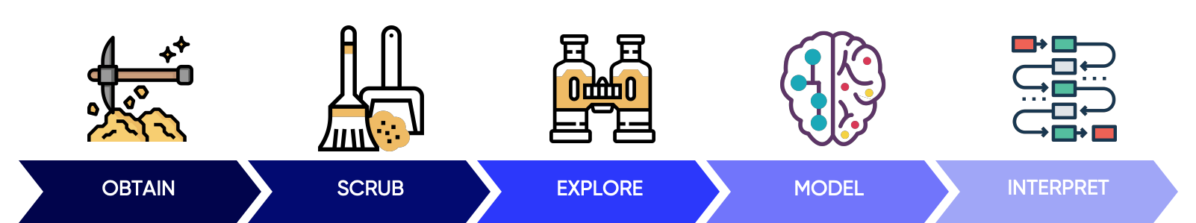
Doing Data Science & Course flow
Data Sources
Data Cleaning and pandas
Visualization and Exploration
Formatting your research question and
Multiple Linear Regression
Interpretation of your Model Results, Ethics
Graphic Source: Hilary Mason and Chris Wiggins

Slide 18
Data science can be hard.

Slide 19
Productive Struggle
This is not an easy topic for most people.
Productive Struggle is “Effortful practice that goes beyond passive reading, listening, or watching – that builds useful, lasting understanding and skill.” - Hiebert & Grouws, 2007

Slide 20
Productive Struggle
Leads to understanding
Makes learning goals feel attainable and effort seem worthwhile
Yields results
Leads students to feelings of empowerment and efficacy
Creates a sense of hope
Destructive Struggle
Leads to frustration
Makes learning goals feel hazy and out of reach
Feels fruitless
Leaves students feeling abandoned and on their own
Creates a sense of inadequacy

Slide 21
Productive Struggle
Leads to understanding
Makes learning goals feel attainable and effort seem worthwhile
Yields results
Leads students to feelings of empowerment and efficacy
Creates a sense of hope
Destructive Struggle
Leads to frustration
Makes learning goals feel hazy and out of reach
Feels fruitless
Leaves students feeling abandoned and on their own
Creates a sense of inadequacy

Slide 22
Productive Struggle
“Teachers sometimes perceive student frustration or lack of immediate success as indicators that they have somehow failed their students. As a result, they jump in to ‘rescue’ students by breaking down the task and guiding students step by step through the difficulties. Although well-intentioned, such ‘rescuing’ undermines the efforts of students, lowers the cognitive demand of the task, and deprives students of opportunities to engage fully in making sense of [the topic].”
  NCTM, Principles to Actions

Slide 23
Productive Struggle: Student’s Job
Don’t be afraid to take risks and know that it is acceptable to struggle with some ideas and to make mistakes.
Recognize that mistakes are a means to learning.
Try to explain your ideas and question solutions that don’t make sense.

Slide 24
Now to begin our Data Science Journey

Slide 25
Data Science Lifecycle
1) Ask a question
2) Obtain some data
3) Understand the data
4) Understand the World
5) Report Results

Slide 26
Data Science Lifecycle
1) Ask a question
2) Obtain some data
3) Understand the data
4) Understand the World
5) Report Results

Slide 27
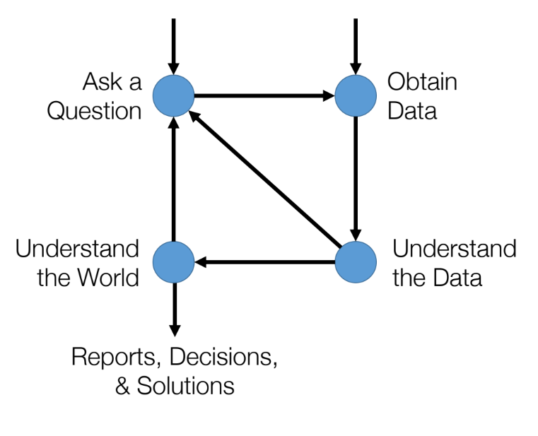
Data Science Lifecycle

Slide 28

Today
Today’s excercises are intended to be light touch and mainly provide introduction to the environment and ensure technology is working.

Slide 29




Today
Today’s excercises are intended to be light touch and mainly provide introduction to the environment and ensure technology is working.

Slide 30
Jupyter – Literate Computing
Jupyter notebooks combine executable code, code outputs, and text into one connected file.
It is a very powerful paradigm that we will be using the entire term.
Rather than organizing code solely for the computer’s execution of the code, literate programming treats a program as literature understandable to human beings, prioritizing the programmer’s own thought process.
https://programminghistorian.org/en/lessons/jupyter-notebooks

Slide 31
Python and Jupyter Demo

