Slide 1
Plotly A flexible framework for creating interactive graphs and 3D plots using virtually any language (or none!)
“workshop for biologists who can't code good but wanna learn to do bioinformatics too”
Jared Andrews
August 10th, 2017

Slide 2
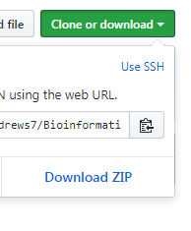
First Off
Go here: https://github.com/j-andrews7/Bioinformatics_Seminar
Click:
Then:

Slide 3
The Issue
Too often do poorly made figures obfuscate trends in data or the point to be made.
Some real life examples:

Slide 4
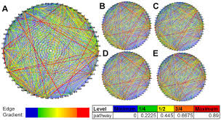
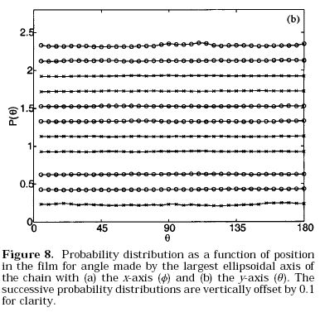

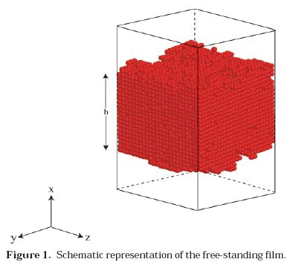
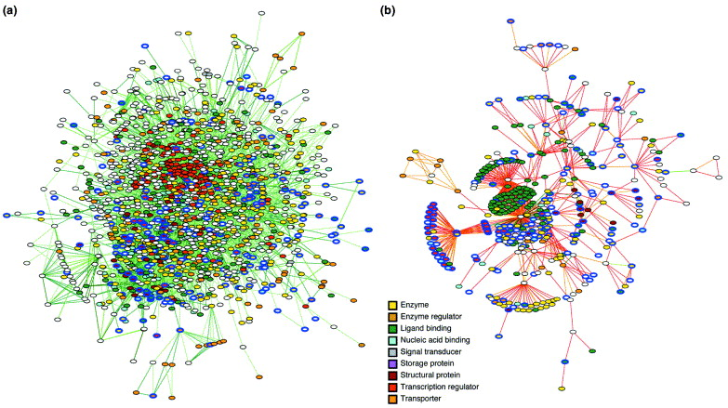

Slide 5
The Other Issue
Figures are static.
Investigating interesting trends or outliers can be tedious and time-consuming and can’t be easily done in real time.
But what if you could check the corresponding data behind a given point, sample, line immediately?

Slide 6
The Answer: plotly
High-quality interactive graphs, plots, and more that can be made with no coding, fully-coded, or somewhere in between.
Excellent documentation, tons of examples, and see the code (in R, python, MATLAB, or javascript) behind any graph or chart, even those made in the online editor.

Slide 7
An Example:
https://plot.ly/~jackluo/3592/
Used in this Nature paper.

Slide 8
A Personal Example of Wading Through Data
Open the example.html file downloaded earlier.

Slide 9
Organize Your Paper
plotly has Dashboards where multiple figures can be viewed and interacted with:
Example
Organizing these can get kinda wonky and usually requires resizing the graphs to be more square or rectangular before they look right.

Slide 10
Incorporating plot.ly into Presentations
plotly has its own basic presentation software that allows plotly figures to be embedded and maintain their interactivity.
It also has an Excel/Powerpoint Add-on that unfortunately only works (sometimes) on Windows (and isn’t interactive during presentation mode).

Slide 11
For Coders
Dynamically plotting your data at the end of a run becomes super simple if you utilize R or Pandas dataframes.
Graphs can be embedded in Jupyter notebooks.
Those not familiar with coding – don’t be afraid to try to utilize programmatic plotting.
Python is very readable and easy to follow, and the plotly documentation is straight-forward and extensive.

Slide 12
Plotly as a Web-Dev Tool
Dash is a really simple Python package that can help you put together a rich data exploration and visualization web-based app in very few (30-200) lines of code.
See this example or several others here.

