Slide 1
Time Series Analysis: Hybrid Econometric-Machine Learning Models for Improved Financial Forecasting
School of East London University
Presenter Joanna Marie Diaz

Slide 2
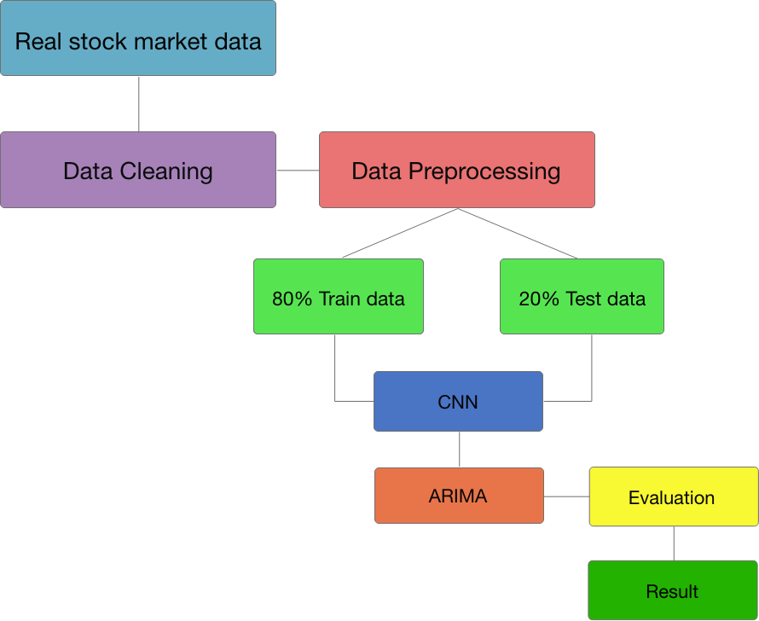
Objective
This study aims to develop a Hybrid model which uses technical analysis that rely on historical stock price activity to predict the probability of future price movement.
Project Architecture

Slide 3
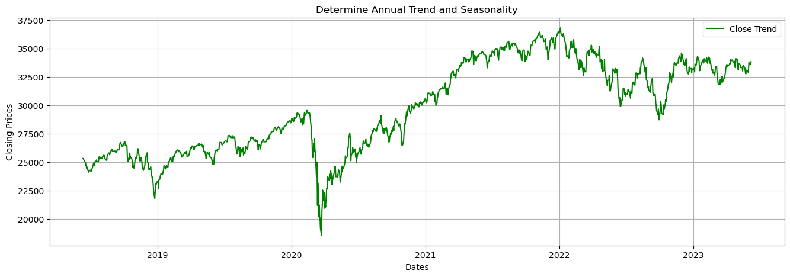
Introduction
Time series is defined as a time-oriented or chronological sequence of observations on a variable of interest (Montgomery et al., 2015).

Slide 4
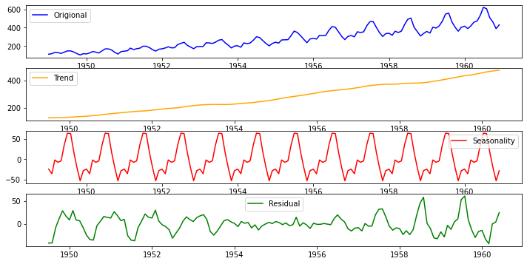
Challenges
A time series datasets consist of the following attribute
Non-Stationarity
Seasonality and Trends
Noise and Outliers
Data Sparsity and Missing
Values

Slide 5
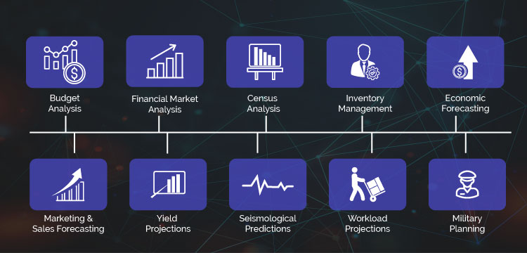
Time Series Analysis Application

Slide 6
Financial time series analysis is concerned with the theory and practice of asset valuation over time (Tsay, 2010).
Stock prices are one form of financial time series that are recorded at regular intervals, typically daily or minute-by-minute during trading hours (Hayes, 2022). It enable company’s asset to be traded publicly and raise capital (Yahoo finance).
Produce capital for companies.
Promotes economic growth.
Can raise capital for investors.
Mobilize savings by short-term and long-term investment for stock traders.

Slide 7
Stock prices are unpredictable because of many factors that influence its behavior such as:
Company’s earning reports
Economic indicators
Market sentiments
Supply and demand
Dividends
Political events
Commodity prices
Currency exchange rate
Etc.

Slide 8
Motivation
Improved Accuracy
Robustness
Adaptability
Reduced Overfitting
Flexibility

Slide 9
Data Preparation
Collected stock datasets from Yahoo finance which comprises of 8 years from 2015 ~ 2023.
Removed mis-aligned trading days and filled missing value.
Normalize data using StandardScaler().
Set “Target” variable for up and down trends.
Train, validation, and test split by 60%-20%-20% on CNN model, while 80% training and 20% test set on both ARIMA model and Hybrid model.

Slide 10
Proposed Hybrid Model

Slide 11
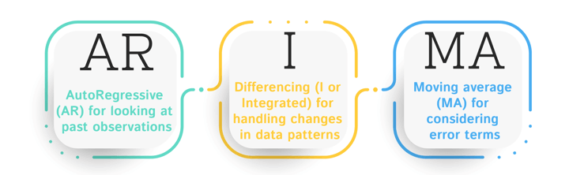
ARIMA Model
It is based on determining it’s three component parameter for time series analysis and forecasting.
AR (p) – Autoregressive component of a time series for past significant correlation.
I (d) – Number of differencing to make the series stationary.
MA (q) - The time series is regressed with residuals of the past observations.

Slide 12
Proposed ARIMA Model
Time Series
No
Yes
Stationary?
Regular / Seasonal Differencing
ACF & PACF Plots
p,d,q: P,D,Q
ARIMA(p, d, q) Development
Stationary?
No
Yes
Forecasting and Predictability Evaluation
Predicted Result

Slide 13
Determine ARIMA parameter (p, d, q) with:
Augmented Dickey Fuller test (ADF) to test the null hypothesis for each differencing.
Observing AR and MA lag by Autocorrelation function (ACF) and Partial Autocorrelation Function (PACF).
Model development
Model Verification (MAPE, MSE, RMSE)
Trend Prediction

Slide 14
ARIMA model result
Based on the determined value for the best model of ARIMA for the given dataset, the evaluated results are:

Slide 15

Convolutional Neural Network (CNN)
CNN is one subgroup of machine learning that is commonly used for image object detection.
They are made up of node layers, containing an input layer, one or more hidden layers, and an output layer (IBM).
It is performed best in a complex and large dataset.

Slide 16
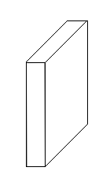
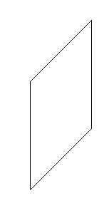
Proposed CNN Architecture
Conv
1x22
MaxPool
2x1
Conv
3x1
MaxPool
2x1
Conv
3x1
MaxPool
3x1
Flatten
Output
Input 60x22
0
1
Feature Maps
60x1x8
Feature Maps
58x1x16
Feature Maps
29x1x16
Feature Maps
27x1x32
Feature Maps
13x1x32
Feature Maps
11x1x32
Feature Maps
5x1x32
Fully Connected

Slide 17
The CNN model is based on the study proposed by Hoseinzade and Haratizadeh (2019) that predict if the succeeding trend is downward (0) or upward (1).
The dataset composed of 22 features, a target variable for up and down trend and a total of 1,787 rows. 60 day window was used for cycle validation and basis of information for the last 60 days.
There are 3 convolution layer with kernel size of 3x1, ReLu as the activation function and a max pooling size of 2x1.

Slide 18
CNN model result

Slide 19
Support Vector Machine (SVM)
Support vector machine is a supervise machine learning technique that utilizes classification algorithms for two group classification problems (Stecanella, 2017).
SVM model will be use for final model prediction using the predicted result of the two previous model.

Slide 20
Hybrid Model Architecture
Time Series Dataset
Preprocessing
ARIMA model
CNN Model
ARIMA Residuals
Support Vector Machine
Prediction

Slide 21
Experiment and Result

Slide 22
On the left is the confusion matrix graph and model evaluation result (right) after training the dataset. The graph shows that there are 25 FP (False Positive), 30 TP (True Positive), 1 FP (False Negative), 13 TN (True Negative). The model accuracy has risen to almost 60% and a loss of 40% with the F1-score of 67%.

Slide 23
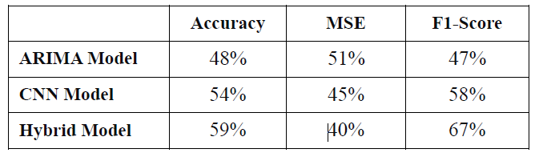
Performance Evaluation and Model Summary
Based on the table, the accuracy and F1-score are increasing as the model is shifted from traditional model to machine learning models. Furthermore, the model’s loss is also decreasing by about 5%. This shows that the combination of traditional models and machine learning models can achieve a more accurate result compared to stand alone models.

Slide 24
Conclusion
Based on the results, the hybrid model performs better compared on using econometric model or machine learning model alone.

Slide 25
Thank you

