Slide 1
Time Series Analysis: Hybrid Econometric-Machine Learning Models for Improved Financial Forecasting
School of East London University
Presenter Joanna Marie Diaz

Slide 2
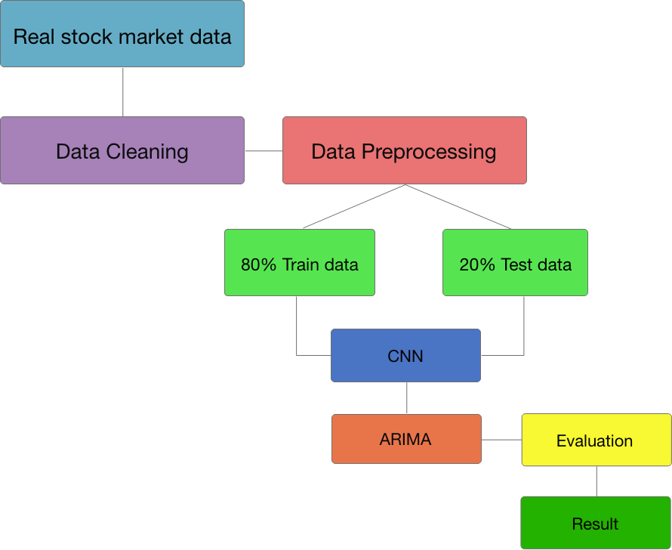
Objective
This study aims to develop a Hybrid model that uses technical analysis that rely on historical stock price activity to predict the probability of future price movements.
Project Architecture

Slide 3
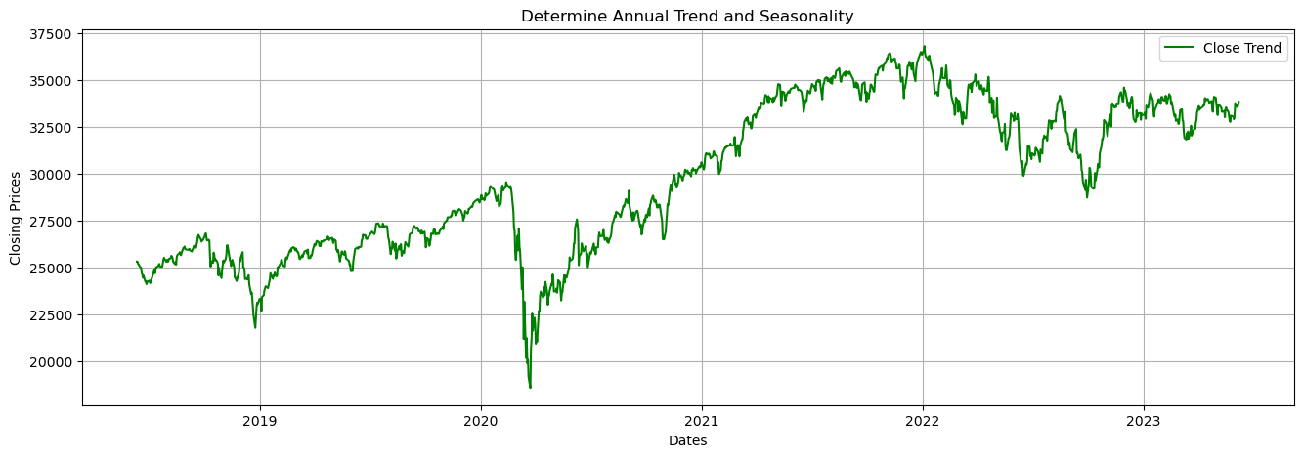
Introduction
Time series is defined as a time-oriented or chronological sequence of observations on a variable of interest (Montgomery et al., 2015).

Slide 4
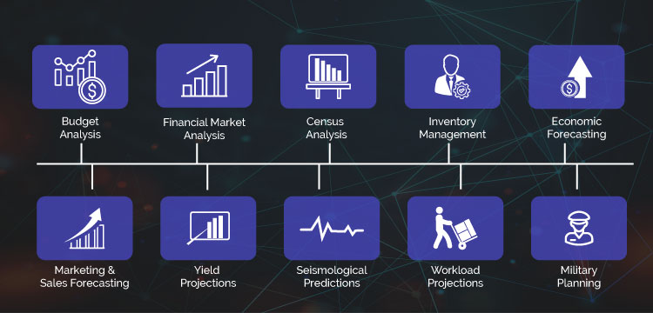
Time Series Analysis Application

Slide 5
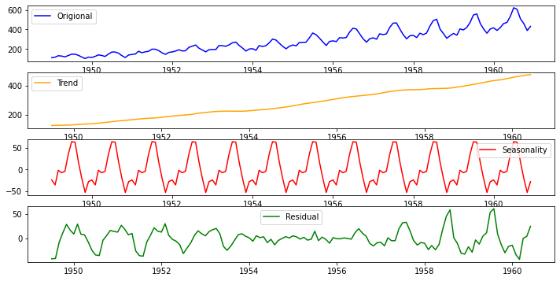
Challenges
A time series datasets consist of the following attribute
Non-Stationarity
Seasonality and Trends
Noise and Outliers
Data Sparsity and Missing Values

Slide 6
Stock prices are one form of a time series that are recorded at regular intervals, typically daily or minute-by-minute during trading hours.
Stock markets enable companies to be traded publicly and raise capital. (Yahoo finance)
Produce capital for companies.
Promotes economic growth.
Can raise capital for investors.
Mobilize savings by short-term and long-term investment for stock traders.

Slide 7
Stock prices are unpredictable because of many factors that influence its behavior such as
Company’s earning reports
Economic indicators
Market sentiments
Supply and demand
Dividends
Political events
Commodity prices
Currency exchange rate
Etc.

Slide 8
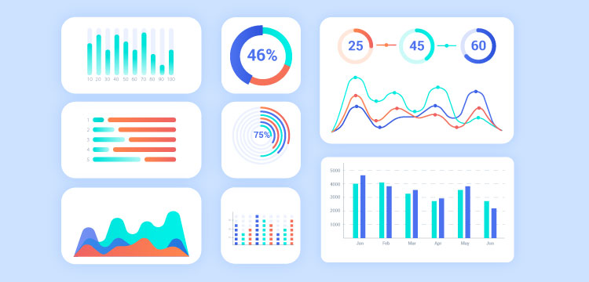
By analyzing the data trend and pattern with respect to time, analysts can evaluate possible risk and data inflation in financial industry.

Slide 9
Motivation
Improved Accuracy
Robustness
Adaptability
Reduced Overfitting
Flexibility

Slide 10
Data Preparation
Filling Missing value.
Normalize data using StandardScaler.
Uses Support Vector Machine (SVM) to detect outliers.
Train, validation, and test split by 60-20-20 respectively.

Slide 11
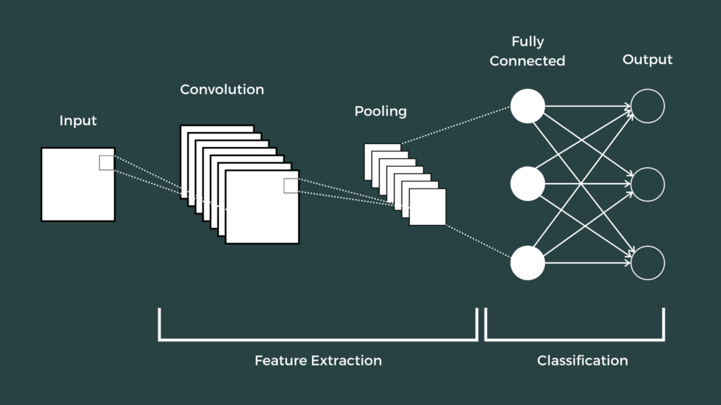
Convolutional Neural Network
(Image from Reader, 2021)

Slide 12
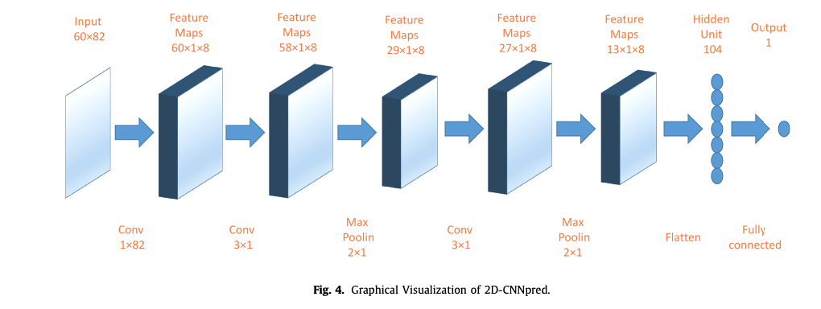
Proposed Hybrid Model
2D-CNNpred model
60x21
1x21

Slide 13
It is based on a study proposes by Hoseinzade and Haratizadeh (2019) that predict if the succeeding trend is downward (0) or upward (1).
The CNN flatten layer produced a 2-dimensional output that has 1430 by 40 for the train set and 358 by 40 for the test set.

Slide 14
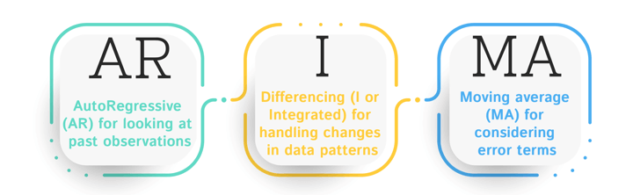
ARIMA Model
AR (p) - The time series is regressed with its previous values.
I (d) - The time series uses differencing to make it stationary.
MA (q) - The time series is regressed with residuals of the past observations.

Slide 15
Proposed ARIMA Model
Time Series
SVM Outlier detection
No
Yes
Stationary?
Regular / Seasonal Differencing
SAC & SPAC Plots
p,d,q: P,D,Q
Model Development
Stationary?
No
Yes
Model Verification
No
Yes
Forecasting and Predictability Evaluation

Slide 16
Extracted feature is converted to time series then is feed into ARIMA model.
Outlier detection using SVM.
Determine ARIMA parameter (p, d, q) with:
Autocorrelation function (ACF), Partial Autocorrelation Function (PACF)
Apply differencing for stationarity.
Augmented Dickey Fuller test (ADF).
Model development
Model Verification (MAPE, MSE, RMSE)
Model Prediction

Slide 17
Hybrid Model
Time Series Dataset
Preprocessing
CNN Feature Extraction
ARIMA model
Time Series Creation
Prediction

Slide 18
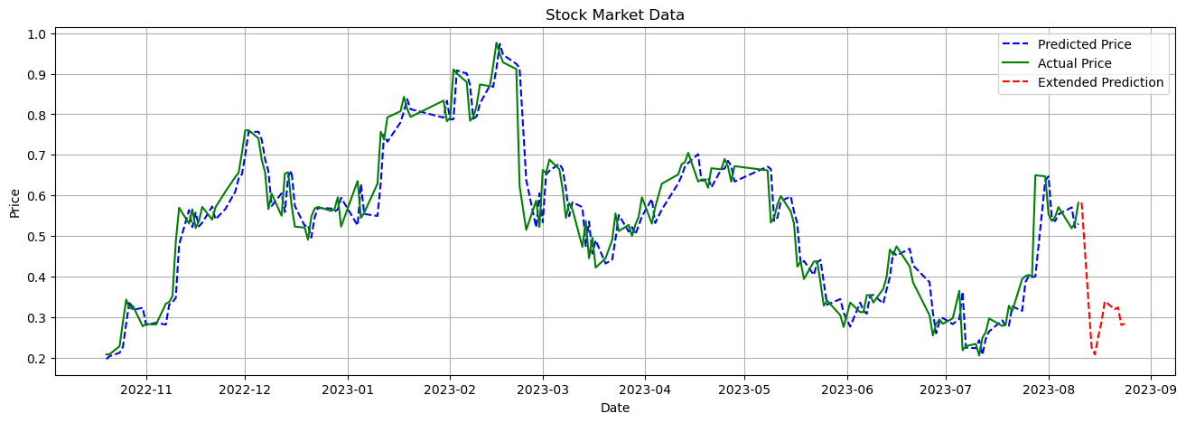
Experiment and Result

Slide 19
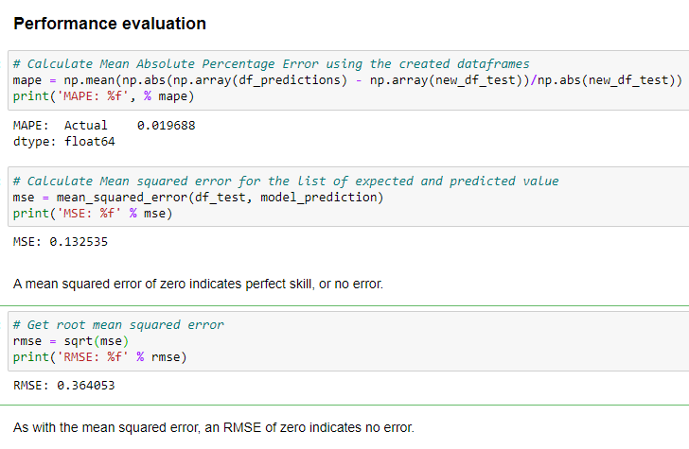
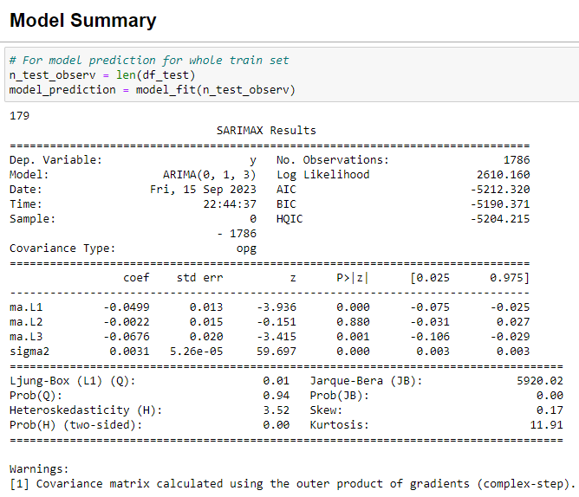
Performance Evaluation and Model Summary

Slide 20
Conclusion
Hybrid model performs better rather than using econometric model or machine learning model alone.
In this study the creation of a new time series dataset from extracted feature is the most challenging task for building the hybrid model.

Slide 21
Thank you

