Slide 1
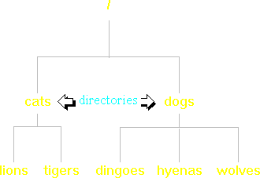
Directory structure
Before we explore the commands used to manipulate the Linux environment, we should take a quick look at the structure of the environment itself.
Microsoft Windows users will find the Linux file system to be a familiar structure because it is basically the same. You can think of a Linux file system as an upside-down tree. See the diagram to the right.
Okay, so it doesn't look a lot like a tree, but try to keep an open mind. In this diagram, dogs and cats are directories. Dogs contains three files, while cats contains two files.

Slide 2
Directory structure
Probably the most often used command in Linux is the "ls" command. It is used to list the contents of a directory.
For example, if your current directory were "cats" and you wanted to see what it contained, you would type "ls". The output would be the following:
lions tigers
Unlike many other operating systems, Linux is case-sensitive. In other words, if you type "LS" instead of "ls", Linux will not recognize the command. This applies to filenames, like "lions" and "tigers", as well.

Slide 3
Directory structure
Probably the most often used command in Linux is the "ls" command. It is used to list the contents of a directory.
For example, if your current directory were "cats" and you wanted to see what it contained, you would type "ls". The output would be the following:
lions tigers
Unlike many other operating systems, Linux is case-sensitive. In other words, if you type "LS" instead of "ls", Linux will not recognize the command. This applies to filenames, like "lions" and "tigers", as well.

Slide 4

Directory structure
Now, before you get bored, let's put you in an imaginary situation where you can put your Linux skills to work.
Imagine that you are a zoo administrator and the zoo has recently purchased a Linux system to keep track of its animals. You've been asked to create a file structure which contains a file for each type of animal in the zoo. Your first attempt was to create a "flat" file structure with all of the animals in the same directory. This structure is shown to the right, with the files represented by pictures of animals to make things more interesting.
Upon further consideration, you realize that as you add more and more animals to the structure, it will be easier to manage if you put all animals of the same family, such as primates, in separate directories.

Slide 5
Directory structure
Now, let's see what this would look like in a Linux interface.
Type the command which lists the contents of your current directory, then hit the Enter key. Remember to type the command in lower-case.

Slide 6
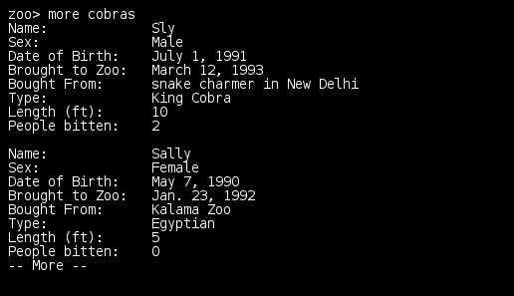
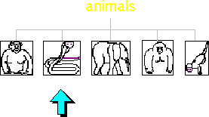
Directory structure
Before we start moving the files around, let's take a look in one of them to see what it contains. We'll look at the cobras file to make sure it has the proper information in it.
The "more" command is used to view the contents of a file. For example, to see the contents of the "cobras" file, you would type
more cobras
It is called "more" because after it has displayed a page of text, it pauses and puts "-- More --" at the bottom of the screen to let you know that there is more text yet to be shown. To see the next page of text, you just hit the spacebar.
Click the right arrow.

Slide 7
Directory structure
Okay, it's time to start organizing our animal files. First, we'll create a directory under "animals" called "primates". The command to create a directory is "mkdir" which is short for "make directory".
For example, to make a directory named dogs, you would type
mkdir dogs
Now type the command to create directory "primates".

Slide 8
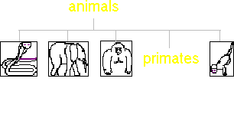
Directory structure
Now, let's move all of the primate files into our newly created directory.
To move a file, you just use the "mv" command. For example, to move a file called "wolves" into directory "dogs", you would type
mv wolves dogs
Renaming files is simply a case of "moving" a file from one name to another. For example, to rename file "wolves" to "coyotes", you would type
mv wolves coyotes
Let's start by moving "chimps" into the "primates" directory. Type the command to move file "chimps" into directory "primates".

Slide 9
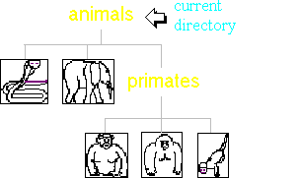
Directory structure
Rather than let things get tedious by having you type the commands to move the other two primate files into the "primates" directory, we'll assume that you've already typed them.
Now, we want to go into the "primates" directory and admire our handiwork. To change directories, use the "cd" command, which stands for -- you guessed it -- "change directory".
For example, to change to directory "dogs", you would type
cd dogs
At the "zoo>" prompt, type the command to change to directory "primates".

Slide 10
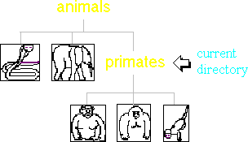
Directory structure
Some people modify their personal Linux configuration so that whenever they change to another directory, the command prompt changes to reflect it. The prompt shown to the right is an example of one. It lists the machine name first (zoo), then a ':', and finally the current directory (primates). If you do not have this sort of configuration, then you will need to learn a command which tells you where you are in the directory structure.
To find out where you are, use the "pwd" command, which stands for "print working directory".
Type it at the command prompt to verify your current location. Then, at the second prompt, type the command which lists the contents of the current directory, so we can be sure that everything was moved into this directory properly.

Slide 11
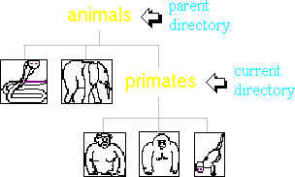
Directory structure
Now that we know everything is as it should be, let's go back up one level to the "animals" directory to do some more organizing.
To change to your previous directory (also known as the "parent" directory), you need to use a special "argument" to the "cd" command. You would type
cd ..
Wherever you see "..", it refers to the directory above your current directory.
Note that you always have to put a space between a command and its argument. Windows Command Prompt users might find this irritating, since Windows does not have this requirement. So, for example, Windows allows you to enter "cd..". Linux would give you an error message.

Slide 12
Directory structure
Type the command to change to directory "animals", then type the command which prints your working directory to make sure you ended up in the right place.

Slide 13
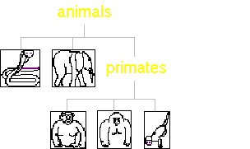
Directory structure
You've already accomplished quite a bit of organizing. Now, you might want to create a place to put your "cobras" file. Suppose you choose to put it in a directory called "reptiles".
You can accomplish this in two steps:
1) Make directory "reptiles".
2) Move the "cobras" file into directory
"reptiles".
Type the commands to execute the two actions listed above; then we'll have a quiz on the commands you've learned so far.

Slide 14

Directory structure

Slide 15

Directory structure

Slide 16
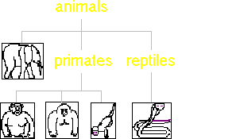
Directory structure
It would make more sense to have more specific directories such as "snakes", "lizards", etc. You probably would not have made this mistake.
There is a very simple way to accomplish this task, but we want to demonstrate a few more concepts and commands, so we're going to use a slightly more complicated method, and we'll show you the easy way when we're finished.
First make directory "snakes".

Slide 17
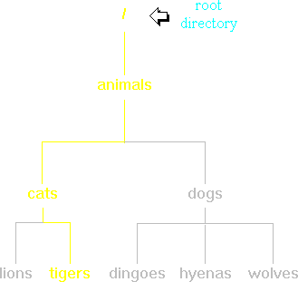
Directory structure
Now we have to take a time-out to explain "pathnames".
So far we have only been manipulating files that are in our current directory. But sometimes you might want to manipulate files that are not in your current directory. For example, you may be doing a lot of work in the "dogs" directory, but you remember that you wanted to rename "tigers" to "siberians". You could accomplish this by using these commands:
cd ..
cd cats
mv tigers siberians
cd ..
cd dogs
(continue working in "dogs")

Slide 18
Directory structure
That's an awful lot of work just to perform a simple task. Fortunately, there's a way to accomplish this task with only one command instead of five.
You can refer to a filename by its "pathname". This means that you specify what "path" to follow down the tree to find the file. The path to "tigers" is marked in yellow in the tree at the right. That path is represented like this:
/animals/cats/tigers
We built this pathname by starting at the top of the tree with the "root" ('/') and adding "animals" to it. Then we added a "slash" ('/') every time we moved down the tree another level.
We can use this pathname to accomplish our task with only one command:
mv /animals/cats/tigers
/animals/cats/siberians

Slide 19
Directory structure
Note that the command above would actually be on one line, but we don't have enough room for it on this narrow page.
Typing in a full pathname can be tedious, though, especially if you are a long way down the tree. That's why it is often easier to specify a "relative pathname". It is called "relative" because it specifies a filename relative to your current location, rather than from the root directory. If you don't put a '/' at the beginning of a pathname, then Linux knows that you are using a relative pathname. For example, if you were in the "animals" directory and you wanted to rename "tigers" to "siberians", you could do so with this command:
mv cats/tigers cats/siberians
In this case, you specified your pathnames relative to the "animals" directory (your current directory), so you didn't need to include "animals" in them.
So far we haven't shown you how to use relative pathnames from the "dogs" directory, which was our current directory in the original example. There is a way to do it by using something we learned a few pages ago.
mv ../cats/tigers ../cats/siberians
Recall that ".." refers to the directory above your current directory.

Slide 20
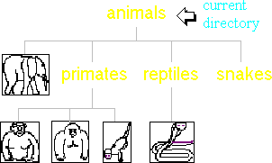
Directory structure
All right, enough theory -- it's time for practice. We need to move "cobras" from the "reptiles" directory to the "snakes" directory, but out of paranoia, we're going to copy it and then remove the original file after we're sure that it was copied correctly. The copy command is "cp" and it has the same syntax as the "mv" command. For example:
cp apples apples2
We're not in the "reptiles" directory, so you'll have to use a relative pathname in your copy command. Type the command to copy "cobras" from the "reptiles" directory to the "snakes" directory.

Slide 21
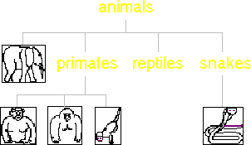
Directory structure
Now we should remove the "reptiles" directory. The "remove directory" command is "rmdir". For example, to remove directory "fish", you would type
rmdir fish
Type the command to remove directory "reptiles".

Slide 22
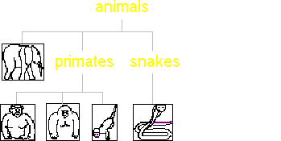
Directory structure
Okay, now that we've shown you a fairly painful way to accomplish this task, it's time to reveal the easy way. You could have just typed "mv reptiles snakes" because the "mv" command can be used to rename directories as well as files. I hope you're not too upset about being led down the garden path -- it was a useful exercise.
Now we have just one task left and that is to create a directory called "pachyderms" and move "elephants" into it. Type the necessary commands and you'll be finished organizing all of the animal files.

Slide 23
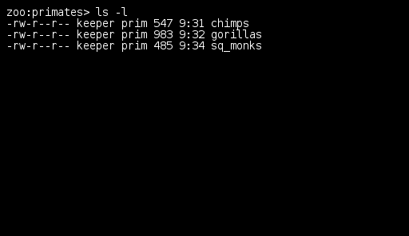
File security
Now it's time to talk about security. Linux is a multi-user operating system, so it has security to prevent people from accessing each other's confidential files.
In our zoo, we don't want anyone to modify the primate files except for those workers who take care of the primates. It will take quite a bit of explanation before we can show you how to arrange this sort of security.
When you execute an "ls" command, you are not given any information about the security of the files, because by default "ls" only lists the names of files. You can get more information by using an "option" with the "ls" command. All options start with a '-'. For example, to execute "ls" with the "long listing" option, you would type
ls -l
When you do so, each file will be listed on a separate line in long format. There is an example in the window on the right.
There are lots of other options you can use with the ls command, but we won't need them to accomplish our goals at the zoo.

Slide 24
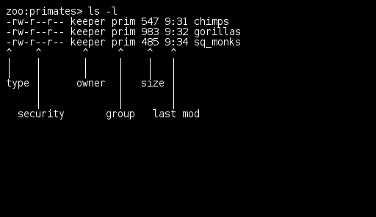
File security
There's a lot of information in those lines (and we've even simplified things for clarity).
The first character will almost always be either a '-', which means it's a file, or a 'd', which means it's a directory. In our example, all three of them are files.
The next nine characters (rw-r--r--) show the security; we'll talk about them on the next page.
The next column shows the owner of the file. In our imaginary zoo, your UserID is "keeper".
The next column shows the group owner of the file. Recall that we want to give the "prim" group of people special access to these files.
The next column shows the size of the file in bytes.
The next column shows the time the file was last modified (in reality, it would also show the date).
And, of course, the final column gives the filename.

Slide 25
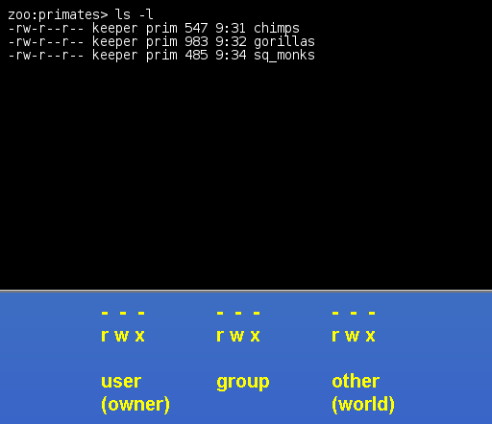
File security
Deciphering the security characters will take a bit more work.
First, you must think of those nine characters as three sets of three characters (see bottom right). Each of the three "rwx" characters refers to a different operation you can perform on the file.
The 'r' means you can "read" the file's contents.
The 'w' means you can "write", or modify, the file's contents.
The 'x' means you can "execute" the file. This permission is given only if the file is a program.
If any of the "rwx" characters is replaced by a '-', then that permission has been revoked.
For example, the owner's permissions for our three primate files are "rw-". This means that the owner of the file ("keeper", i.e. you) can "read" it (look at its contents) and "write" it (modify its contents). You cannot execute it because it is not a program; it is a text file.
Members of the group "prim" can only read the files ("r--"). We want to change the second permission character from '-' to 'w' so that those people can modify the contents of these files as well.
The final three characters show the permissions allowed to anyone who has a UserID on this Linux system. We prefer to refer to this set as "world". Our three primate files are "world-readable", that is, anyone in our Linux world can read their contents, but they cannot modify the contents of the files. This is the way we want to leave it.

Slide 26
File security
The command you use to change the security permissions on files has a horribly cryptic name. It's called "chmod", which stands for "change mode", because the nine security characters are collectively called the security "mode" of the file.
Now it will become clear why we named the three "rwx" sets "user", "group", and "other". The first argument you give to the "chmod" command is 'u', 'g', 'o', or a combination of them which specifies which of the three "rwx" sets you want to modify. For example, if you want to give "execute" permission to the world ("other") for file "gorillas", you would start by typing
chmod o
Now you would type a '+' to say that you are "adding" a permission.
chmod o+
Then you would type an 'x' to say that you are adding "execute" permission.
chmod o+x
Finally, specify which file you are changing.
chmod o+x gorillas
You can also change multiple permissions at once. For example, if you want to take all permissions away from everyone, you would type
chmod ugo-rwx gorillas

Slide 27
File security
Okay, time to get back into action. Type the command to give "write" permission to the prim "group" for file "chimps".
Then type the command to give a long listing of the files so you can check your handiwork.

Slide 28
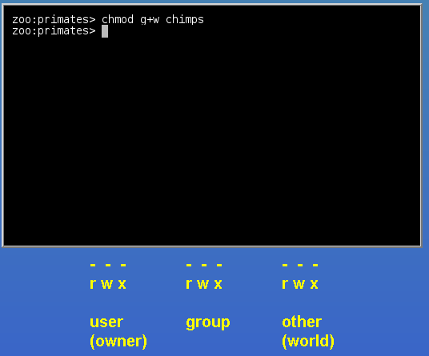
File security
Okay, time to get back into action. Type the command to give "write" permission to the prim "group" for file "chimps".
Then type the command to give a long listing of the files so you can check your handiwork.

Slide 29
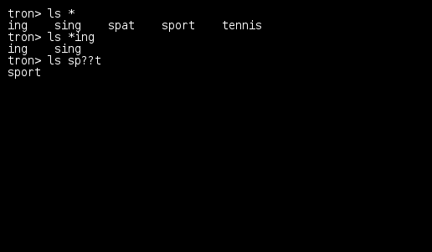
File security
We could get you to type two more "chmod" commands to modify the permissions of "gorillas" and "sq_monks", but there's an easier way using "wildcards".
In case you're wondering what the "tron>" prompt is all about, we're just using another imaginary machine called "tron", which could be a machine similar to "zoo".
A wildcard allows you to specify more than one file at the same time. The '*' matches any number of characters. For example, if you want to execute a command on all files in the current directory, you would specify '*' as the filename. If you want to be more selective and match only files which end in "ing", you would use "*ing". Note that the '*' can even match zero characters, so "*ing" would match "ing" as well as "sing".
The other wildcard, '?', is not used very often, but it can be useful. It matches exactly one character. For example, if you want to match "sport", but not "spat", you would use "sp??t". The first '?' matches the 'a' in "spat", but the second '?' can't match anything, so "spat" fails.

Slide 30
File security
Type the command to give "write" permission to the prim "group" on "all files" in the current directory.
Then type the command to give a long listing of the files.

Slide 31
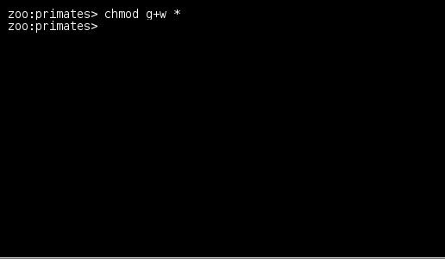
File security
Type the command to give "write" permission to the prim "group" on "all files" in the current directory.
Then type the command to give a long listing of the files.

Slide 32
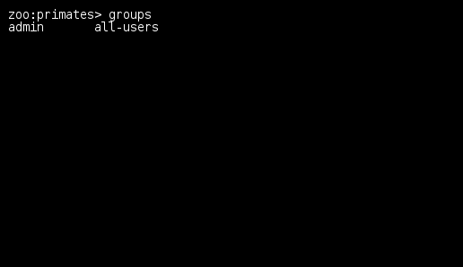
File security
The default Linux security model is a bit inflexible. To give special access (such as modification privileges) to a group of people, you have to get your system administrator to create a group with those people in it. Furthermore, if you would like to give a different set of access privileges (such as read access) to another group of people, you can't do it because you can only assign one group owner per file or directory. To solve this problem, you can use ACLs (Access Control Lists), a topic which is beyond the scope of this tutorial.
While we're on the subject of groups, we should see which groups you're in. To get a listing of your group memberships, type
groups
Try it at the command prompt.

Slide 33
File security
The default Linux security model is a bit inflexible. To give special access (such as modification privileges) to a group of people, you have to get your system administrator to create a group with those people in it. Furthermore, if you would like to give a different set of access privileges (such as read access) to another group of people, you can't do it because you can only assign one group owner per file or directory. To solve this problem, you can use ACLs (Access Control Lists), a topic which is beyond the scope of this tutorial.
While we're on the subject of groups, we should see which groups you're in. To get a listing of your group memberships, type
groups
Try it at the command prompt.

Slide 34

File security

Slide 35
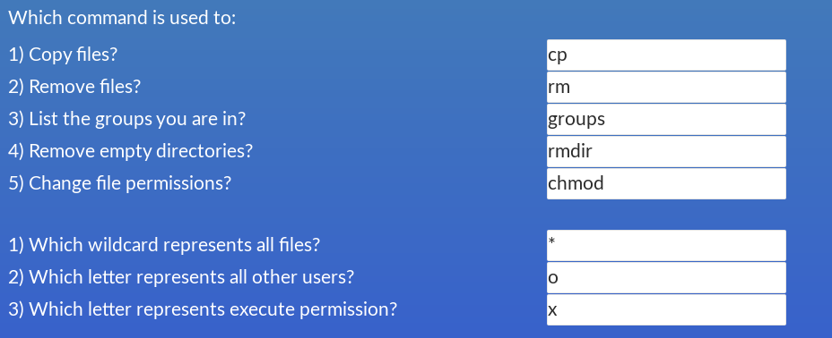
File security

Slide 36
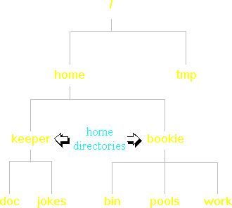
Home directories
Before we get started on our first exercise, we need to introduce the concept of "home directories".
In a multi-user system, it is convenient for each user to have his or her own private place to store files. Linux calls this private place your "home directory". If your Linux network has been set up in a secure manner, then you are the only regular user who can access the files in your home directory. That is, no one other than yourself and the system administrator can even see the names of your files. However, if you would like to give other people access to your files, you can do so using the "chmod" command.
The location of home directories varies greatly between systems. In the diagram to the right, home directories are located under a directory called "/home", but they could just as easily be located under a directory called "/user". We'll show you how to find out where yours is located.
When you login to your Linux system, you are automatically placed in your home directory. So, if you want to display its pathname, simply login, then type "pwd". In our example, the output would be "/home/keeper".

Slide 37
Home directories
Because most people need to refer to their home directories on a regular basis, Linux makes them easy to specify. You can use the tilde (~ - it's above the Tab key on your keyboard) everywhere that you would normally use "/home/keeper".
For example, if you wanted to copy a file called "jokes" from your home directory to the "/tmp" directory, you could just type
cp ~/jokes /tmp
rather than
cp /home/keeper/jokes /tmp
You can even use the tilde to specify another user's home directory. If '~' is immediately followed by a User ID, then it no longer refers to your own home directory; it refer's to User ID's home directory. For example, if you wanted to go into bookie's home directory, you could just type
cd ~bookie
rather than
cd /home/bookie
In fact, '~' by itself is just a short form of "~keeper".

Slide 38
Home directories
Remember that if you put anything after '~' other than '/', Linux will assume that you are referring to another user's home directory. So, in our "cp ~/jokes /tmp" example above, if we had typed
cp ~jokes /tmp
instead, we would have received an error message because there is no User ID called "jokes".
One of the nicest things about using the tilde is that you don't have to know where anyone's home directory is located. Sometimes system administrators will move home directories to new locations to alleviate disk space problems. If you always use the tilde, you might not even notice such moves.

Slide 39
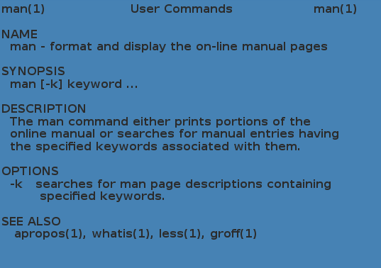
Home directories
Now it's time to work on a task.
The last time you saw your friend Greg, he told you that he had a couple of joke files in his home directory that he thought your kids would like. He also said that he had opened up the permissions on his home directory so that you could look through it. Now you want to find those joke files and print them out, so that you can show them to your kids.
The first step is to figure out Greg's User ID, so you can go skulking in his home directory. You could discover which command will give you this sort of user information by finding a good Linux book to look through, but fortunately, there's an easier way. The entire contents of your system's Linux manual is available online. The command which displays portions of this online documentation is called "man", which stands for "manual".
For example, if you don't know which "ls" option displays hidden files, you can display the manual pages describing "ls" by typing
man ls

Slide 40
Home directories
Obviously, in order to use the "man" command in this way, you already have to know the name of the command that you are interested in. Unfortunately, in this case you don't know the name of the command, so you can't do that. But don't despair. There's an option to "man" which allows you to search for commands which pertain to a particular subject. And how do you figure out which option to "man" allows you to do this? It's simple. Just type
man man
which displays the manual pages describing the "man" command. In other words, you can use "man" to explain itself. A simplified version of the output of this command is shown at right.
The heading begins with "man(1)". The "(1)" means that the "man" command is found in Section 1 of the manual. The number of sections in the online manual varies from system to system, but Section 1 is always the "User Commands" section. In fact, unless you are a programmer or a system administrator, you will probably never need to look in any other section.

Slide 41
Home directories
Here is a description of the different parts of a "man" page:
NAME contains the name of the command and a brief description of what it does.
SYNOPSIS shows the syntax of the command. In the page at right, "[-k]" refers to all of the possible options to the man command. In this case there is only one. The "-k" is surrounded by square brackets because it is an optional part of the command. That is, if you do not include it, the command will still function. The meaning of each option is explained in the OPTIONS section below. Notice the explanation of "-k" at right.
"keyword ..." refers to the possible arguments to the command. Since it is not surrounded by square brackets, it is not optional. That is, you must always include a "keyword" argument to the "man" command. The "..." means that you can specify more than one keyword.

Slide 42
Home directories
DESCRIPTION gives an overview of the purpose of the command.
OPTIONS lists all of the possible options and arguments for this command and what they do.
SEE ALSO is not of direct importance, but it can be quite useful because it lists commands which have a related purpose.
After examining this output, it is obvious that the "-k" option will help you find a command that will show you Greg's User ID. On the next page, you'll find an example of "man -k".

Slide 43
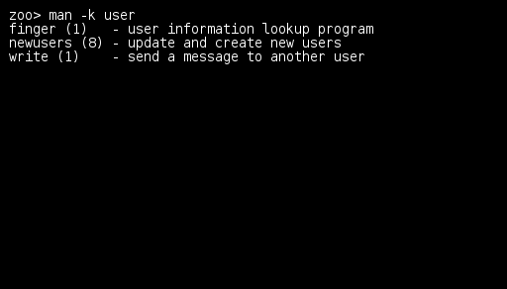
Home directories
If you wanted to figure out which command is used to spell-check a document, you would type
man -k spell
This would show you every command which has the letters "spell" somewhere in its brief description.
Since you want to find the command which will tell you Greg's User ID, you should probably do a manual search on the word "user". Type the appropriate command at the prompt.

Slide 44
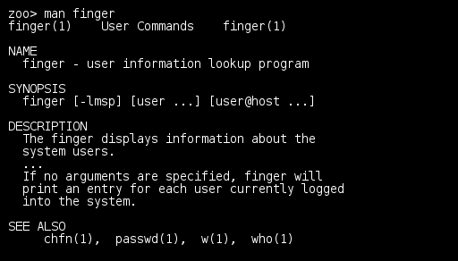
Home directories
Now you should know the name of the command used to find out a person's User ID, but you don't know its syntax. Type the appropriate "man" command at the prompt.

Slide 45
Home directories
Type the command which will show you Greg's UserID.

Slide 46
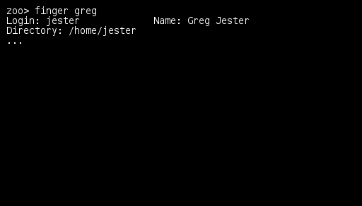
Home directories
Type the command which will show you Greg's UserID.

Slide 47
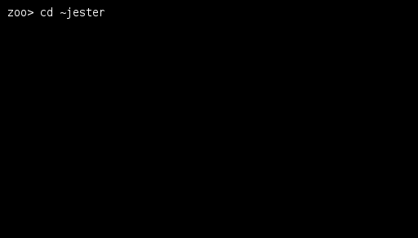
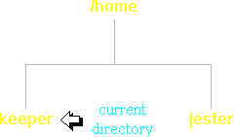
Home directories
Recall that the original reason we wanted to find out Greg's UserID was so that we could search his home directory.
Type the command to change your location to Greg's home directory.

Slide 48
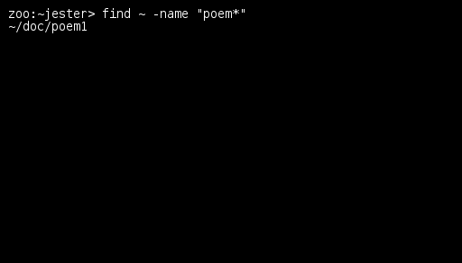
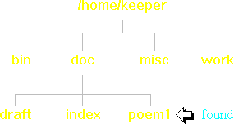
Home directories
The command used to find files is called, appropriately enough, "find". But even though the name is easy to remember, the syntax is quite treacherous. A typical "find" command looks something like this:
find ~ -name "poem*"
This example is shown at right. The first argument you specify is the directory to start the search from. If "find" always searched the entire tree on a system, it would be very inefficient, so this first argument allows you to limit your search. In the above example, it will be started from your home directory (~) and will then search the entire tree under it.
This example is shown at right. The first argument you specify is the directory to start the search from. If "find" always searched the entire tree on a system, it would be very inefficient, so this first argument allows you to limit your search. In the above example, it will be started from your home directory (~) and will then search the entire tree under it.
The "-name" option says that you are searching for a file's name. At first, this might seem obvious and redundant, but you have to understand just how powerful the "find" command is. You can use it to search for files of a particular size, date, owner, and a variety of other criteria.

Slide 49
Home directories
The argument to "-name" can be as simple as "poem" if you know that is the exact name of the file. But, if you're not sure whether the file is called "poem", "poems", or even "poem-favorite", then you can use a wildcard, like '*'. However, when you use a wildcard, you need to surround the argument in quotes. If you don't, you will receive a rude error message.
Now we'll give you a hint that will save you a bit of typing. Your first try at using this command to find joke files in Greg's home directory would probably begin with
find ~jester ...
But there is a simpler way. Remember the '..' symbol which is used to represent a parent directory (e.g. "cd ..")? Well, there is a similar symbol which represents your current directory. It is just a single '.'. So, since you are already in the "~jester" directory, you can begin your command with "find .".
Whew! That was a heck of a lot of explanation for just one command.

Slide 50
Home directories
Here is that example again:
find ~ -name "poem*"
Now it's time to try your luck with "find". By the way, you're pretty sure that Greg's joke files begin with the letters "joke".

Slide 51
Home directories
Here is that example again:
find ~ -name "poem*"
Now it's time to try your luck with "find". By the way, you're pretty sure that Greg's joke files begin with the letters "joke".

Slide 52
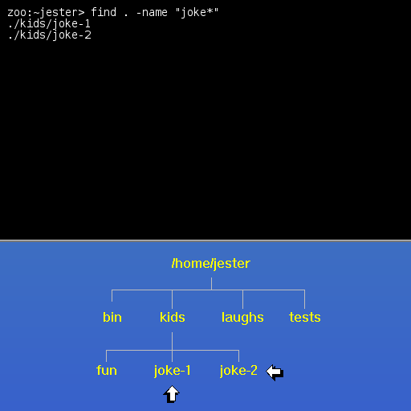
Home directories
Here is that example again:
find ~ -name "poem*"
Now it's time to try your luck with "find". By the way, you're pretty sure that Greg's joke files begin with the letters "joke".

Slide 53
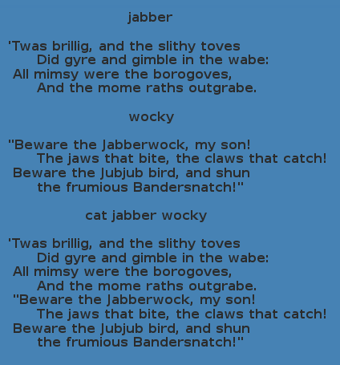
Home directories
Now that you know where Jester's joke files are located, you can send them to the printer. However, if you print each of the joke files separately, then they will be printed on separate pages. In the interest of saving paper, you decide to combine these two files into one and then print the new file. Since you do not have permission to create files in Jester's home directory, you will create the combined file in your own home directory.
Before you begin, we need to explain how to combine files. Another word for "combine" is "concatenate". Since that would be a real pain to spell all of the time, the Linux concatenation command is simply "cat". For example, if you wanted to combine files "jabber" and "wocky", you would type
cat jabber wocky

Slide 54
Home directories
First, go into the directory where Jester's joke files are stored.
Second, print the contents of "joke-1" and "joke-2" to your screen, using "cat".

Slide 55
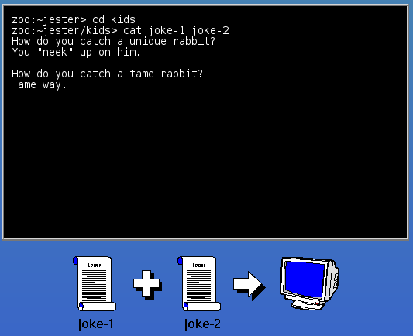
Home directories
First, go into the directory where Jester's joke files are stored.
Second, print the contents of "joke-1" and "joke-2" to your screen, using "cat".

Slide 56
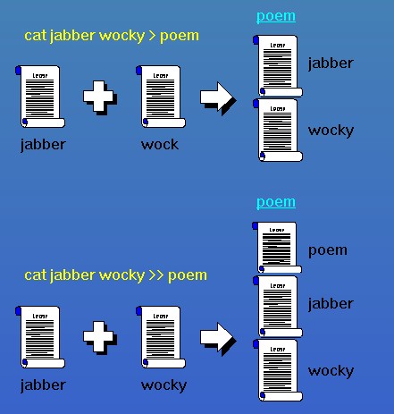
Home directories
To send the output from a command such as "cat" to a file, you can use either '>' or '>>'. For example
cat jabber wocky > poem
would put the contents of "jabber" and "wocky", one after the other, in a new file called "poem". You can think of the '>' as an arrow pointing to where you want the output to go.
In the above example, if "poem" already exists, then it will be over-written (i.e. it will be deleted before it is recreated). Sometimes that is what you want, but often you will want to keep the previous contents of a file and simply append to it (add to the end of it). This can be accomplished by using '>>' rather than '>'.

Slide 57
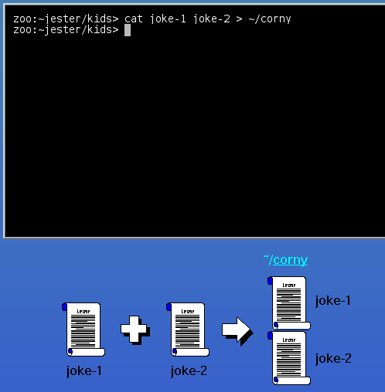
Home directories
Here is the example from the previous page:
cat jabber wocky > poem
At the command prompt, type the command which will concatenate files "joke-1" and "joke-2" and send the output to a file in your home directory called "corny". We know that we do not already have a file named "corny", so don't use the append operator.

Slide 58

Home directories

Slide 59
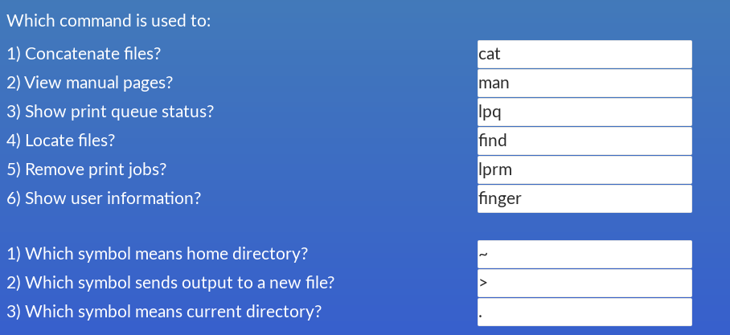
Home directories

Slide 60
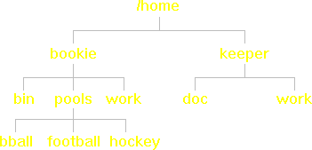
Home directories
Maybe we should give up on Greg Jester for a while and try to get some more interesting files from another friend. It so happens that your friend Belinda Bookie has several sports pools which she keeps online. You decide to copy Belinda's "pools" directory to your home directory, so you can set up your own pools.
The regular "cp" command will not let you copy directories, but if you use the "-r" option, it will. For example, if you wanted to copy a directory called "jokes" from Jester's home directory to your own, you would type
cp -r ~jester/jokes ~
This would copy the entire "jokes" directory tree.
Type the command which will copy Belinda's "pools" directory to your home directory.

Slide 61
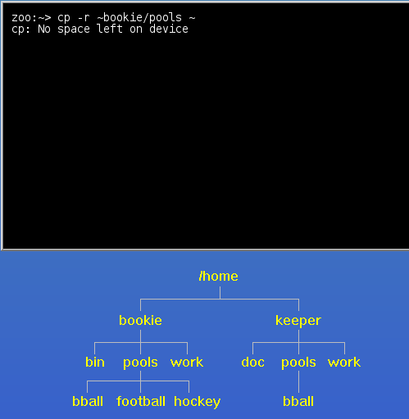
Home directories
Maybe we should give up on Greg Jester for a while and try to get some more interesting files from another friend. It so happens that your friend Belinda Bookie has several sports pools which she keeps online. You decide to copy Belinda's "pools" directory to your home directory, so you can set up your own pools.
The regular "cp" command will not let you copy directories, but if you use the "-r" option, it will. For example, if you wanted to copy a directory called "jokes" from Jester's home directory to your own, you would type
cp -r ~jester/jokes ~
This would copy the entire "jokes" directory tree.
Type the command which will copy Belinda's "pools" directory to your home directory.

Slide 62
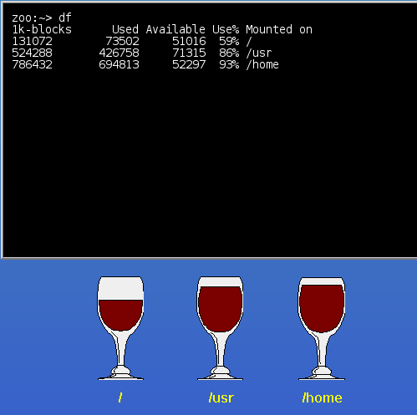
Home directories
To see how much disk space you have left on your system, you need to use the "df" command, which stands for "disk free".
df
As you can see, "df" output is not exactly intuitive -- and we've even simplified it a bit. On a real system, the first column is actually "Filesystem", but that column is totally useless to the average user. In our example, the first three columns show the total disk size, the disk space used, and the available disk space. All of these numbers are in kilobytes. Notice that the "Used" and "Available" columns do not add up to the "1k-blocks" (total) column. That is because a percentage of the disk is always set aside for administrative use. In this case, 5% of each disk is reserved.
Actually, if you just ignore the "1k-blocks" column, everything will make more sense, because it is the only one that deals with total disk space, rather than "user" disk space. Since a regular user doesn't have access to the reserved 5% of a disk anyway, you might as well pretend that it doesn't exist.
The "Use%" column shows the percentage of user space that is currently used.
The "Mounted on" column shows where the disks reside in your filesystem tree. This column raises enough questions to warrant a separate page of explanation.

Slide 63
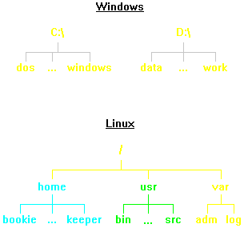
Home directories
The way that hard drives are handled in Linux can be a difficult concept to grasp for Windows users. In Windows, the hard drives are labelled "C:", "D:", etc., and each of them has its own directory tree. As you can see in the diagram at top right, there is absolutely no connection between these trees.
On a Linux system, however, there is only one directory tree. Each hard drive is "mounted" on a particular directory in that tree. For example, the first hard drive is mounted on "/", the root of the tree. Everything contained on that drive has been colored yellow in the diagram at bottom right. The second drive is mounted on "/home". That means that any files or directories under "/home" in the tree will be stored on the second drive rather than on the first one. They are colored blue. Similarly, the third drive has been mounted on "/usr". Its contents have been colored green.
Due to its single-tree approach, the Linux filesystem structure is much more flexible and usable than the Windows structure. This becomes especially evident with networked filesystems, although the details are beyond the scope of this course.

Slide 64
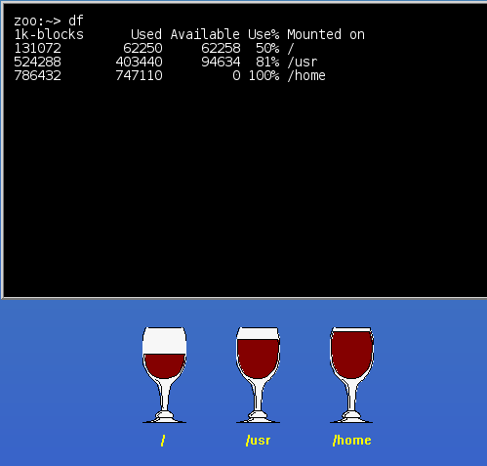
Home directories
Type the command which gives a disk usage listing.

Slide 65
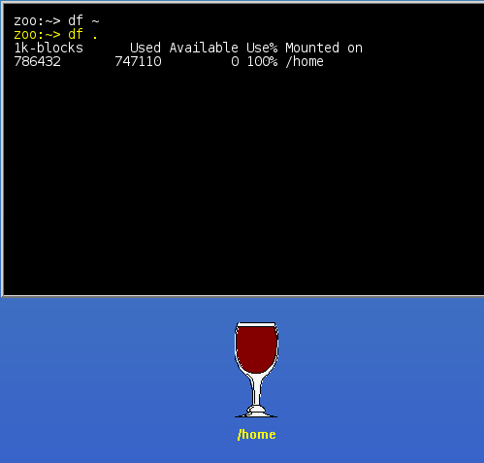
Home directories
One problem with the "df" command is that you get a list of all of the disks on your system, rather than just the one that you are interested in. Even though it was pretty easy to determine which disk contained your home directory on the previous page, it can actually be quite difficult at times to determine which disk particular files are stored on. Fortunately, there is a way to get the "df" command to figure out which disk contains a particular file or directory and then display statistics only for that disk. For example, if you wanted to get statistics for the disk where your home directory resides, you would type
df ~
Type the command to find out how much disk space is free on the disk where your current directory resides.

Slide 66
Home directories
When your "cp -r" command failed due to a lack of disk space, it did not clean up after itself. That is, it did not delete the files which it managed to copy before running out of space. It would be a good idea to clean up this mess ourselves.
Recall that the "rmdir" command only deletes empty directories, so we cannot use it to delete the "pools" directory in one fell swoop, since "pools" contains at least one file. The command that allows you to remove an entire directory tree is "rm -r". For example, to remove a directory called "stocks" and all of its subdirectories and files, you would type
rm -r stocks
Type the command to remove your incomplete "pools" directory.

Slide 67
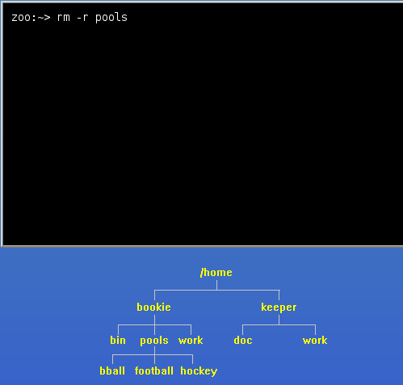
Home directories
When your "cp -r" command failed due to a lack of disk space, it did not clean up after itself. That is, it did not delete the files which it managed to copy before running out of space. It would be a good idea to clean up this mess ourselves.
Recall that the "rmdir" command only deletes empty directories, so we cannot use it to delete the "pools" directory in one fell swoop, since "pools" contains at least one file. The command that allows you to remove an entire directory tree is "rm -r". For example, to remove a directory called "stocks" and all of its subdirectories and files, you would type
rm -r stocks
Type the command to remove your incomplete "pools" directory.

Slide 68
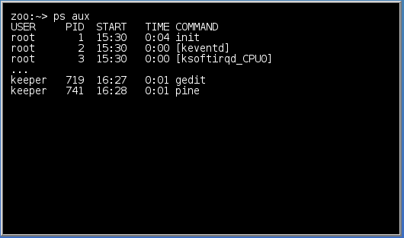
Home directories
Just the other day, your friend Harry Hacker gave you a copy of his brand-new program called "rogue". A couple of minutes ago, you tried running it for the first time, and instantly regretted doing so. It is now clear that this program is out of control and must be terminated.
The command used to examine running programs (or "processes", in Linux lingo) is "ps", which stands for "process status". The "ps" command has a ton of options, but you do not need to know most of them. To get a detailed list of all processes, type
ps aux
You might be wondering if there is a typo in the command above because it's missing a '-' before "aux", but that's actually how you're supposed to type this command. On many systems, it will work if you use "ps -aux", but on some it won't, so you should get in the habit of using "ps aux" instead. To make things even more confusing, there are some "ps" options that do require a '-' and even some that require a "--". If you would like more details, have a look at the man page.

Slide 69
Home directories
As you can see, this command gives a large amount of difficult-to-read output, but we will show you how to make it more user-friendly in a couple of pages.
This output isn't actually as bad as it looks. Here is a summary of the columns:
USER - the process owner
PID - the process ID (you will need this)
START - the date or time when this process started
TIME - the amount of CPU time used by this process
COMMAND - the command that started the process
As usual, we have left out a number of columns which are of no interest to most users. We have also left out the vast majority of processes that you would normally see (thus the "..."). A typical system would show 50 or 100 different processes.

Slide 70
Home directories
The first three processes in our example were started by someone called "root". You can think of "root" as the User ID of the Linux system itself. When a machine is booted up, "root" starts a number of essential processes. You can tell by the PID's of "init", "[keventd]", and "[ksoftirqd_CPU0]" that they were the first three processes started when the machine was booted.

Slide 71
Home directories
Type the command to list all processes.

Slide 72
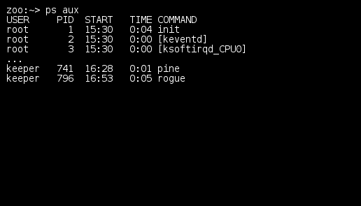
Home directories
Type the command to list all processes.

Slide 73
Home directories
The problem with doing a "ps aux" is the same as the problem with "df", but much worse. It gives you far too much output, when you are interested in only a small fraction of it. Fortunately, you can filter out most of the irrelevant information by using a pipe, "|", and the "grep" command.
Remember the ">"? It was used to send the output of a command to a file rather than to the screen. Well, the "|" (it's above the "\" on your keyboard) is very similar. The only difference is that it sends the output of a command as the input to another command. In other words, it "pipes" data from one command to another.
For example
cat joke-1 joke-2 | grep fox
The output of "cat joke-1 joke-2" is sent directly to grep-filter

Slide 74
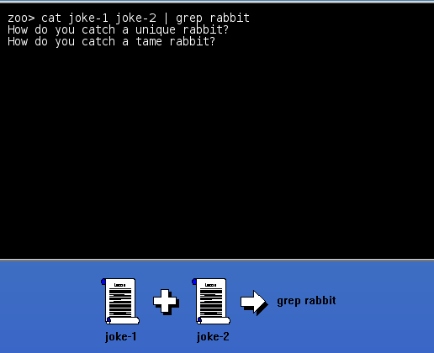
Home directories
The second piece to this puzzle is the "grep" command. This is one of the most obscure and easily-forgotten command names in Linux, but it is also one of the most useful. You can use "grep" to find patterns in data. For example, if you wanted to find every occurrence of the word "gold" in file "metals", you would type
grep gold metals
This would display every line of text in file "metals" that contained the pattern "gold".
To use "grep" with a pipe, you simply leave out the file argument (just like we did with the "lpr -P zephyr" command on the previous page). For example, to list only those lines containing the word rabbit in Jester's joke files, you would type
cat joke-1 joke-2 | grep rabbit
See the example at right.
Actually, an easier way to accomplish this would be to type
grep rabbit joke*
but that wouldn't have illustrated the use of "|".

Slide 75
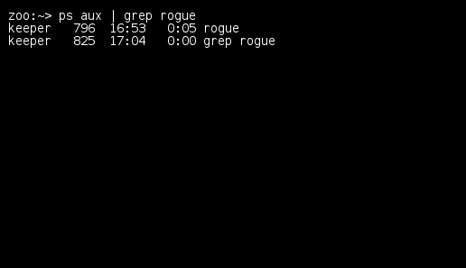
Home directories
The example on the previous page was:
cat joke-1 joke-2 | grep rabbit
Okay, enough talk. Recall that our goal is to kill a runaway process called "rogue". Type the command sequence which will list only those processes which contain the word "rogue".

Slide 76
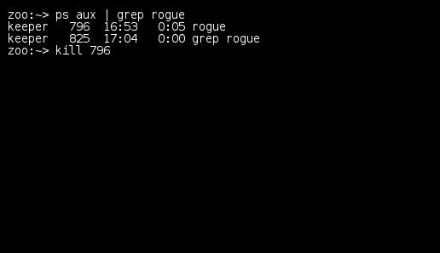
Home directories
Now all we have to do is kill "rogue" before it craters our Linux system. First note the PID of the "rogue" process. This is your cue to say, "Hey, what happened to the column headings?" Well, "grep" didn't display the line of headings because it didn't contain the word "rogue". Luckily, it's easy to remember which column contains the PID -- it's the first one with a number (i.e. it's the column to the right of "keeper").
To kill a process, simply type
kill PID
where PID is the ID of the process you want to kill.
Type the command to kill the "rogue" process.

Slide 77
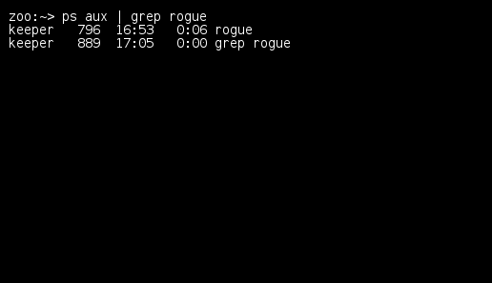
Home directories
To see whether "rogue" actually died or not, we need to look for the "rogue" command in a list of processes again.
Execute the command to see whether or not the "rogue" process is still running.

Slide 78
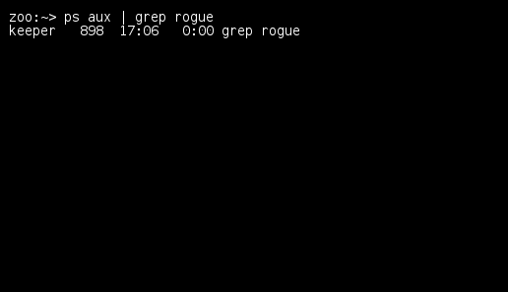
Home directories
Now we just have to make sure that "kill -9" worked. Believe it or not, sometimes even a "kill -9" won't eliminate a process. If that happens, then it's probably time to give your friendly system administrator a call and let her worry about it.
Type the command to see whether or not the "rogue" process is still running.

Slide 79

Home directories

Slide 80

Home directories

