Slide 1
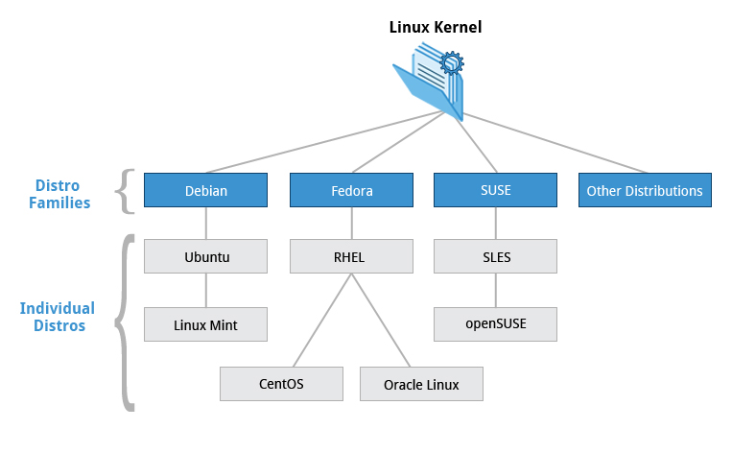
Course Software Requirements

