Slide 1
Fantasy Football Analysis
Jonah Barofski

Slide 2
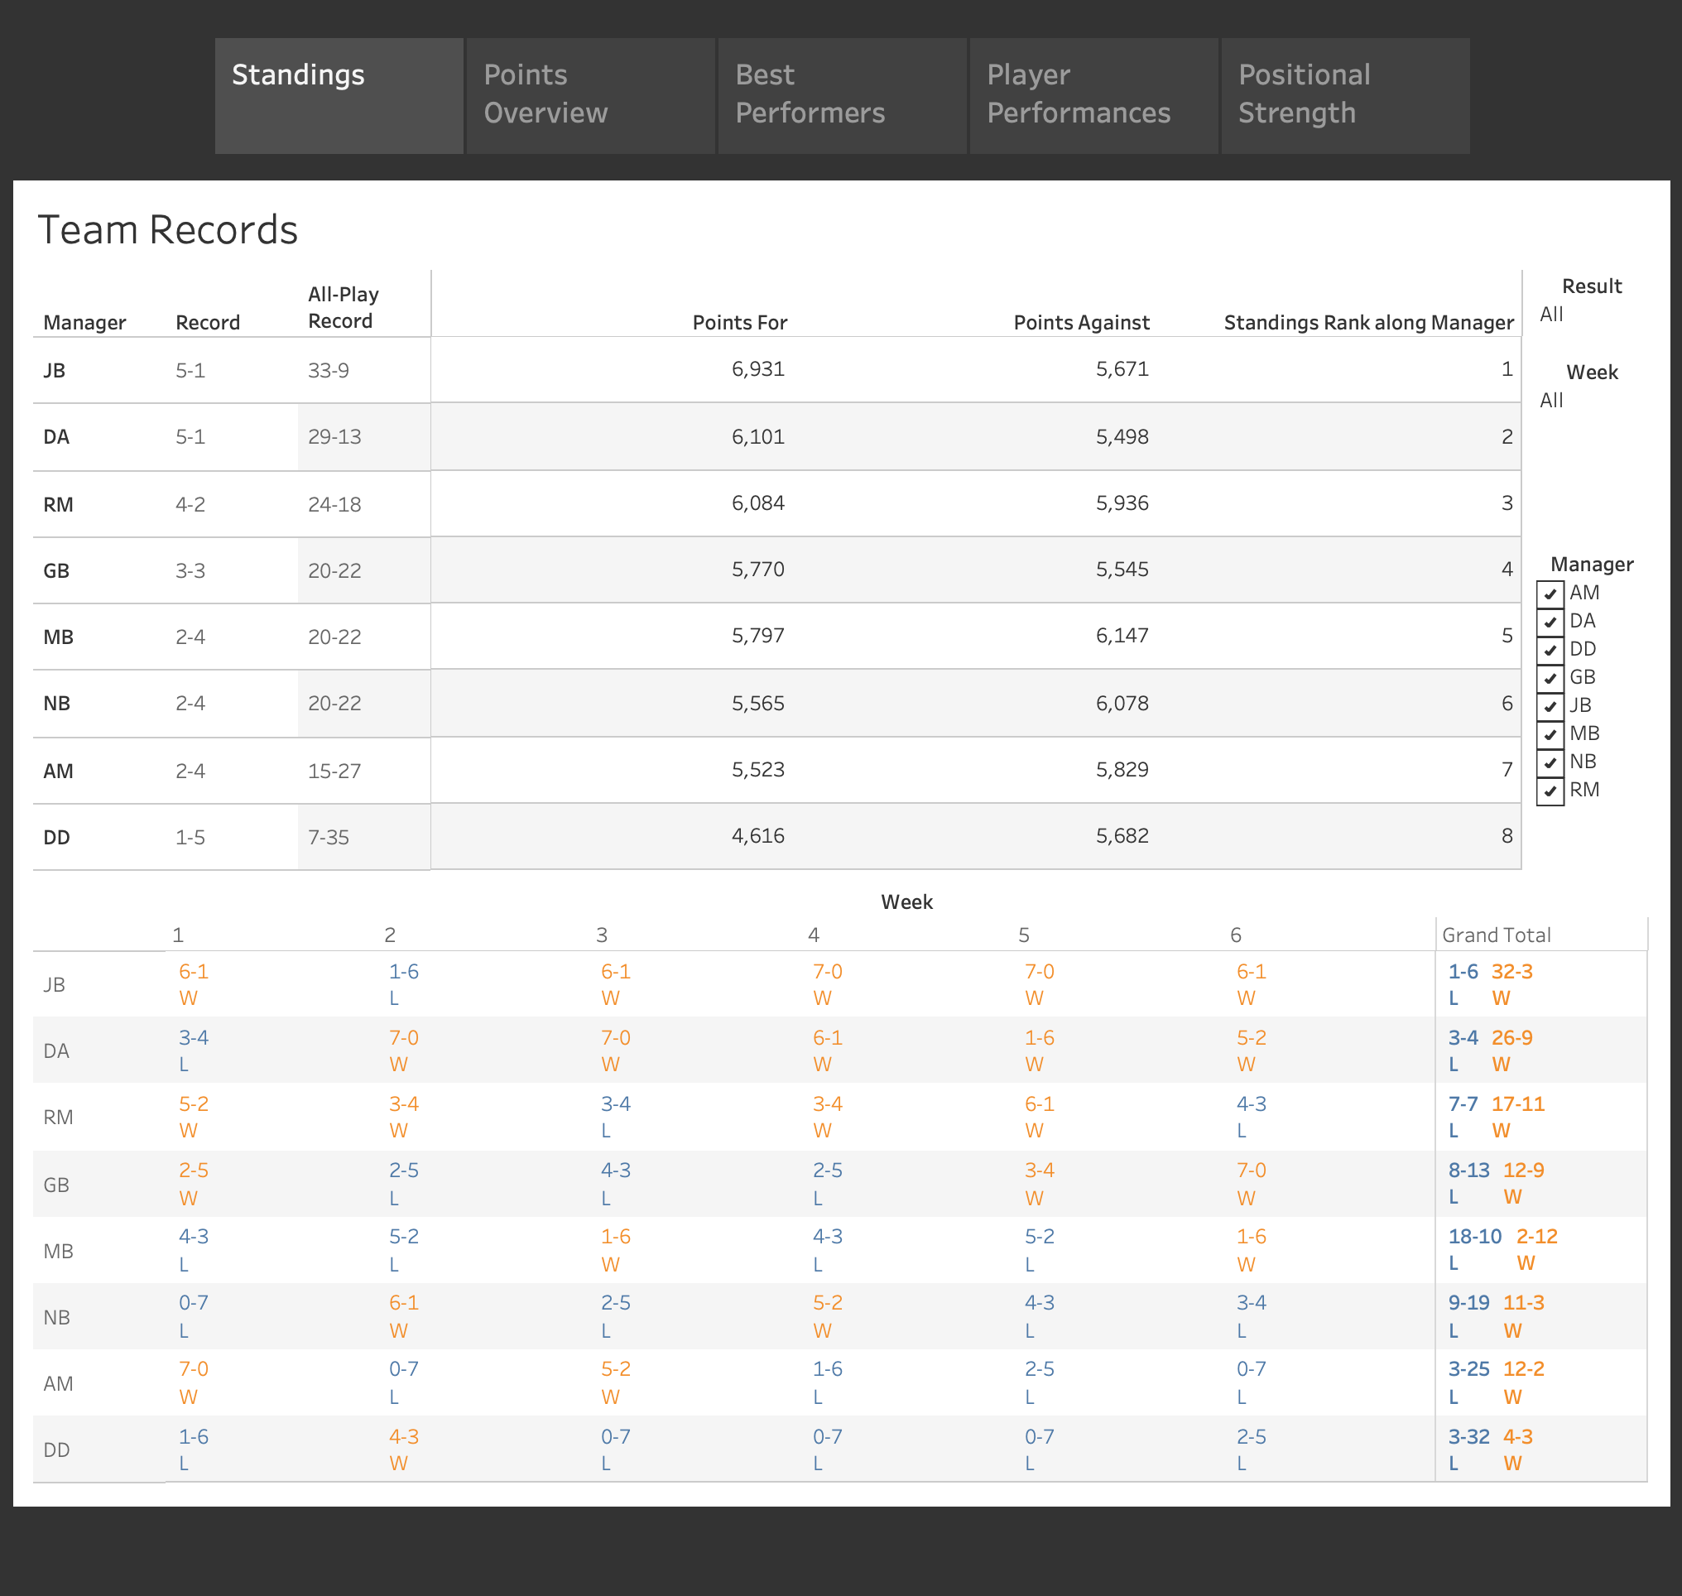
Standings
Shows the rankings of all the teams by their record
Tiebreaker is the total amount of points for
All-play record is what a team’s record would be if they played every other team each week
As expected, teams with better all-play records have the most wins
MB’s team is the lone outlier here. They have a winning all-play record in losses yet a losing all-play record in wins. Also, both of their wins would be losses if they played against any other team.

Slide 3
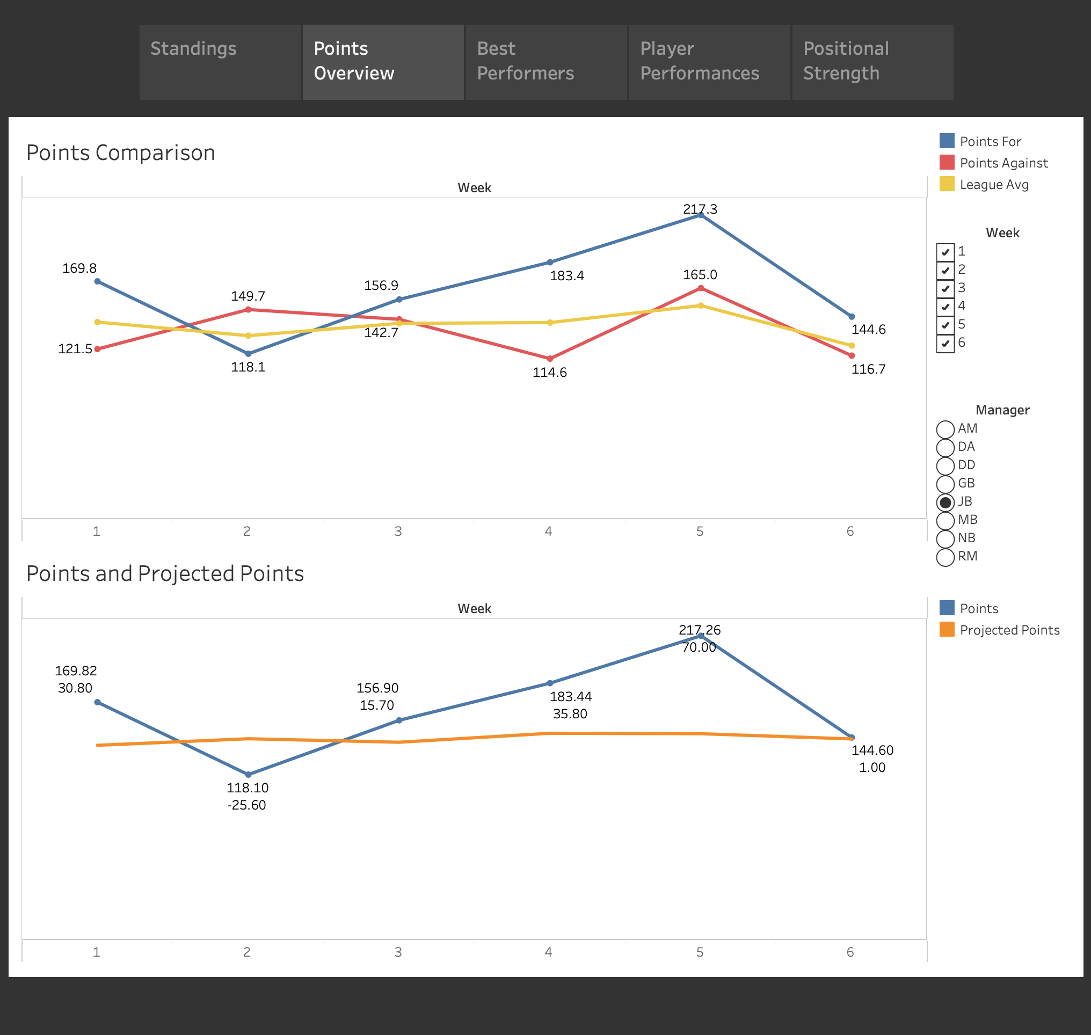
Points Overview
Compares the team’s points scored with their opponent’s, the league average, and their projected points
Shows when the team overperforms or underperforms
Whether they got ”lucky” or not with their opponent’s performance
Here JB’s team has been above average and mostly overperforming leading to 5 wins

Slide 4
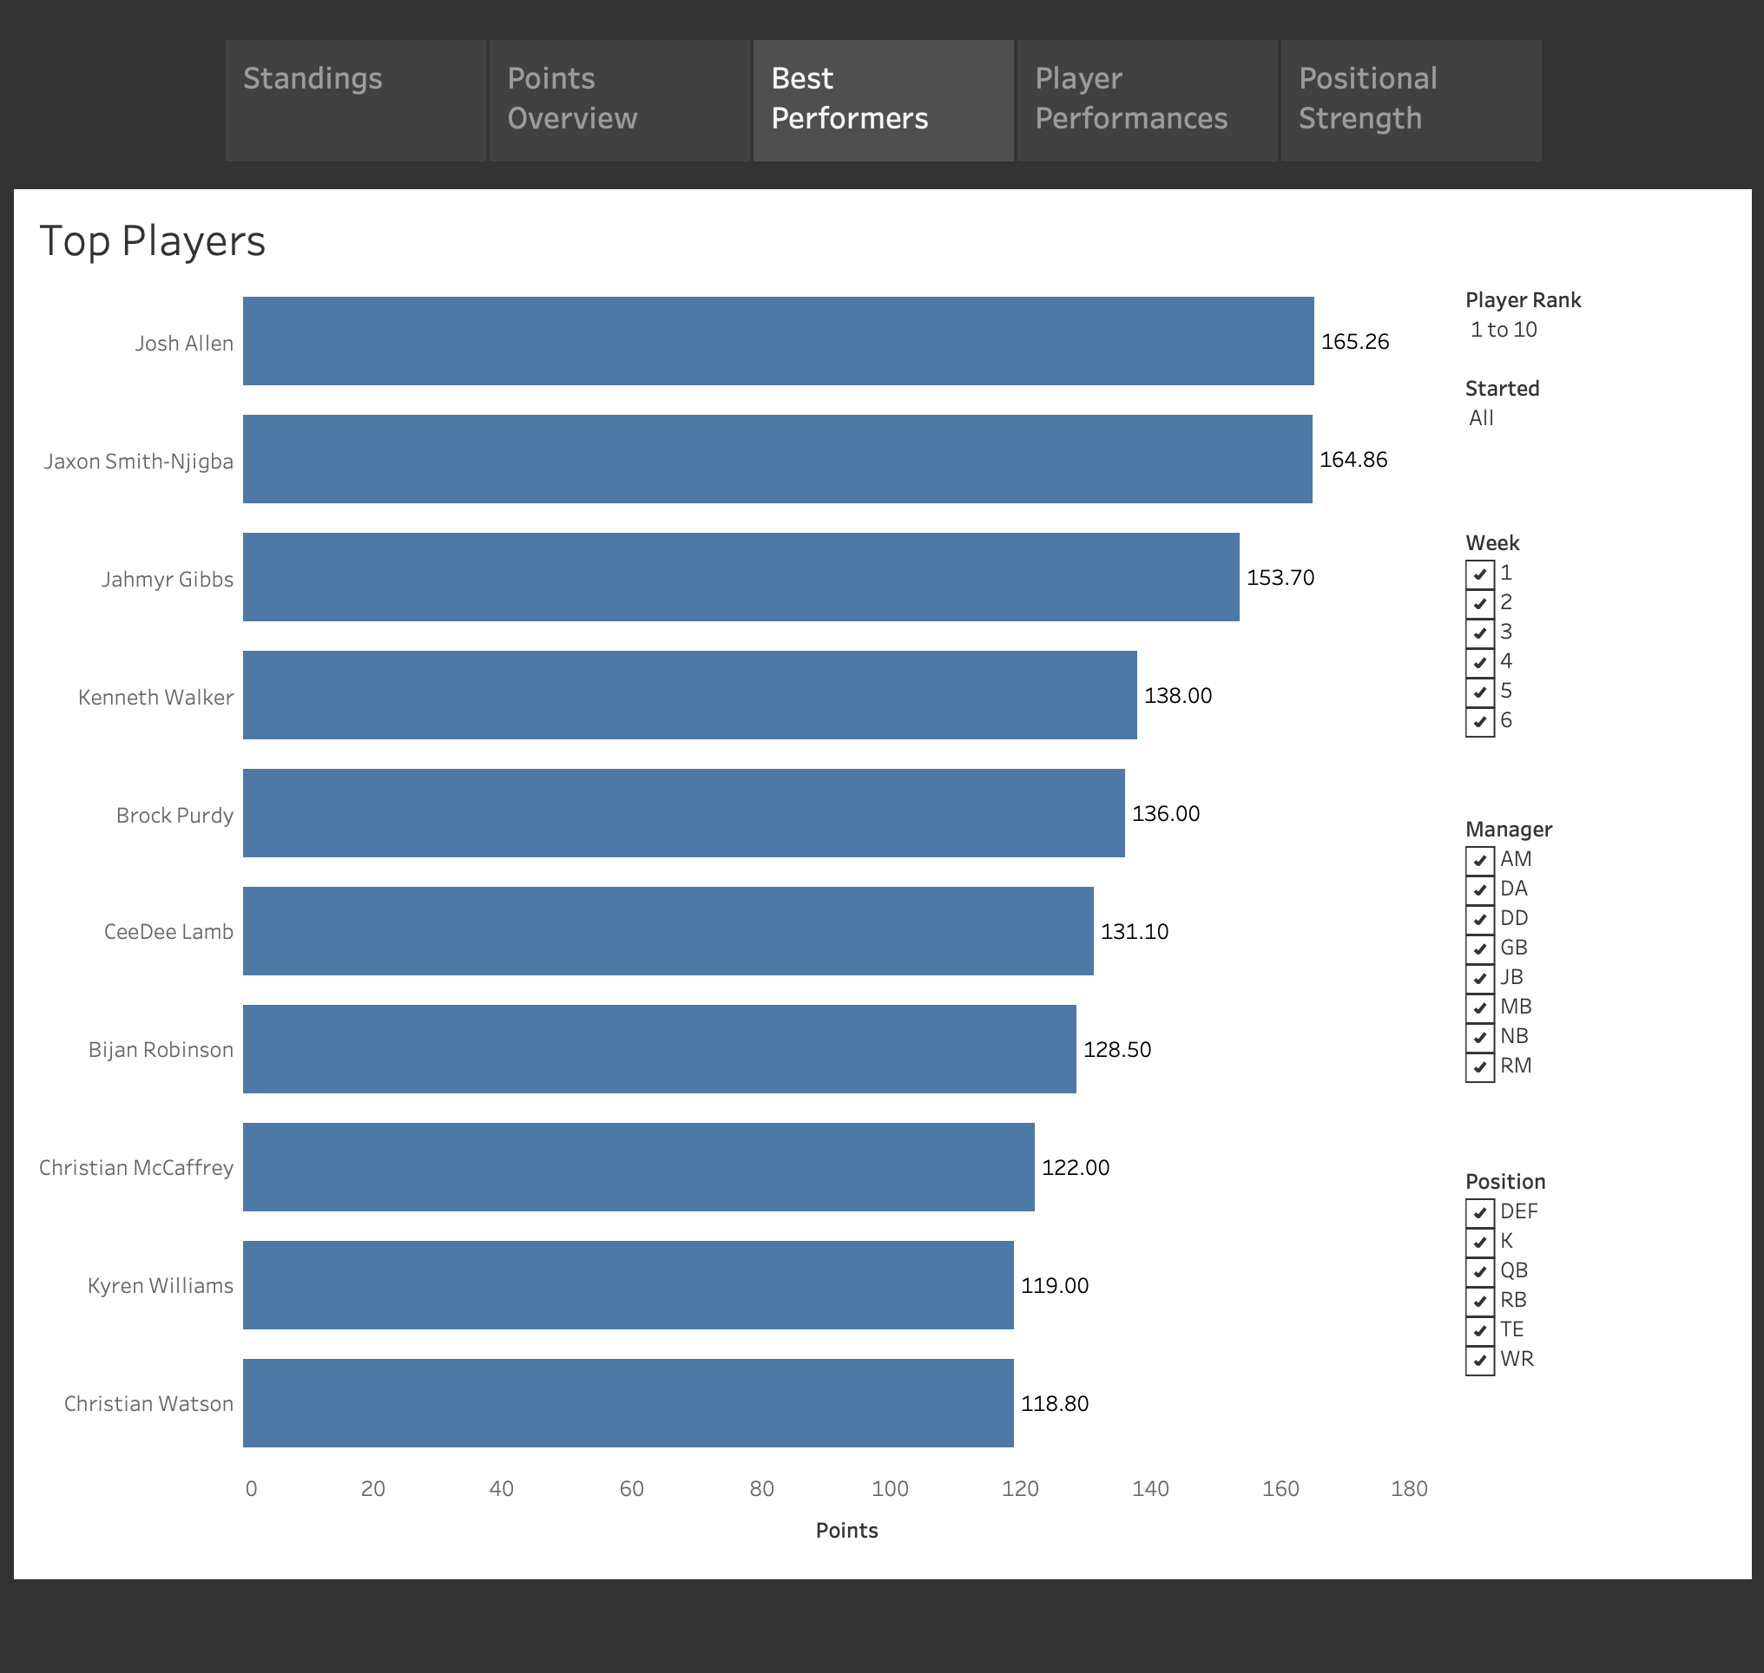
Best Performers
Basic chart that ranks the players with the most points
Choose different ranks
Points when they started, just when they were benched, or both
Top players by each week
Best players for each manager
Rank by position
5 RBs in the top 10, 3 WRs, and 2 QBs. GB’s team has the most players in the top 10, but is 4th in the standings

Slide 5
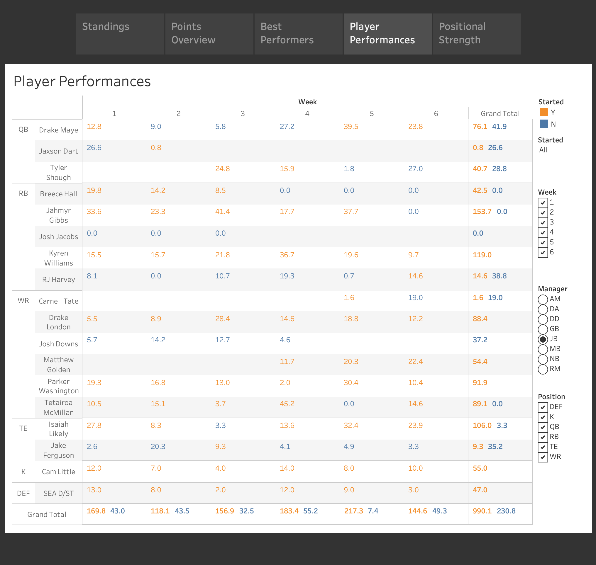
Player Performances
The number of points each team’s players score each week
Groups by position and starters have an orange color
Easy to evaluate the team’s best players for each position
My team’s lineups are doing well

Slide 6
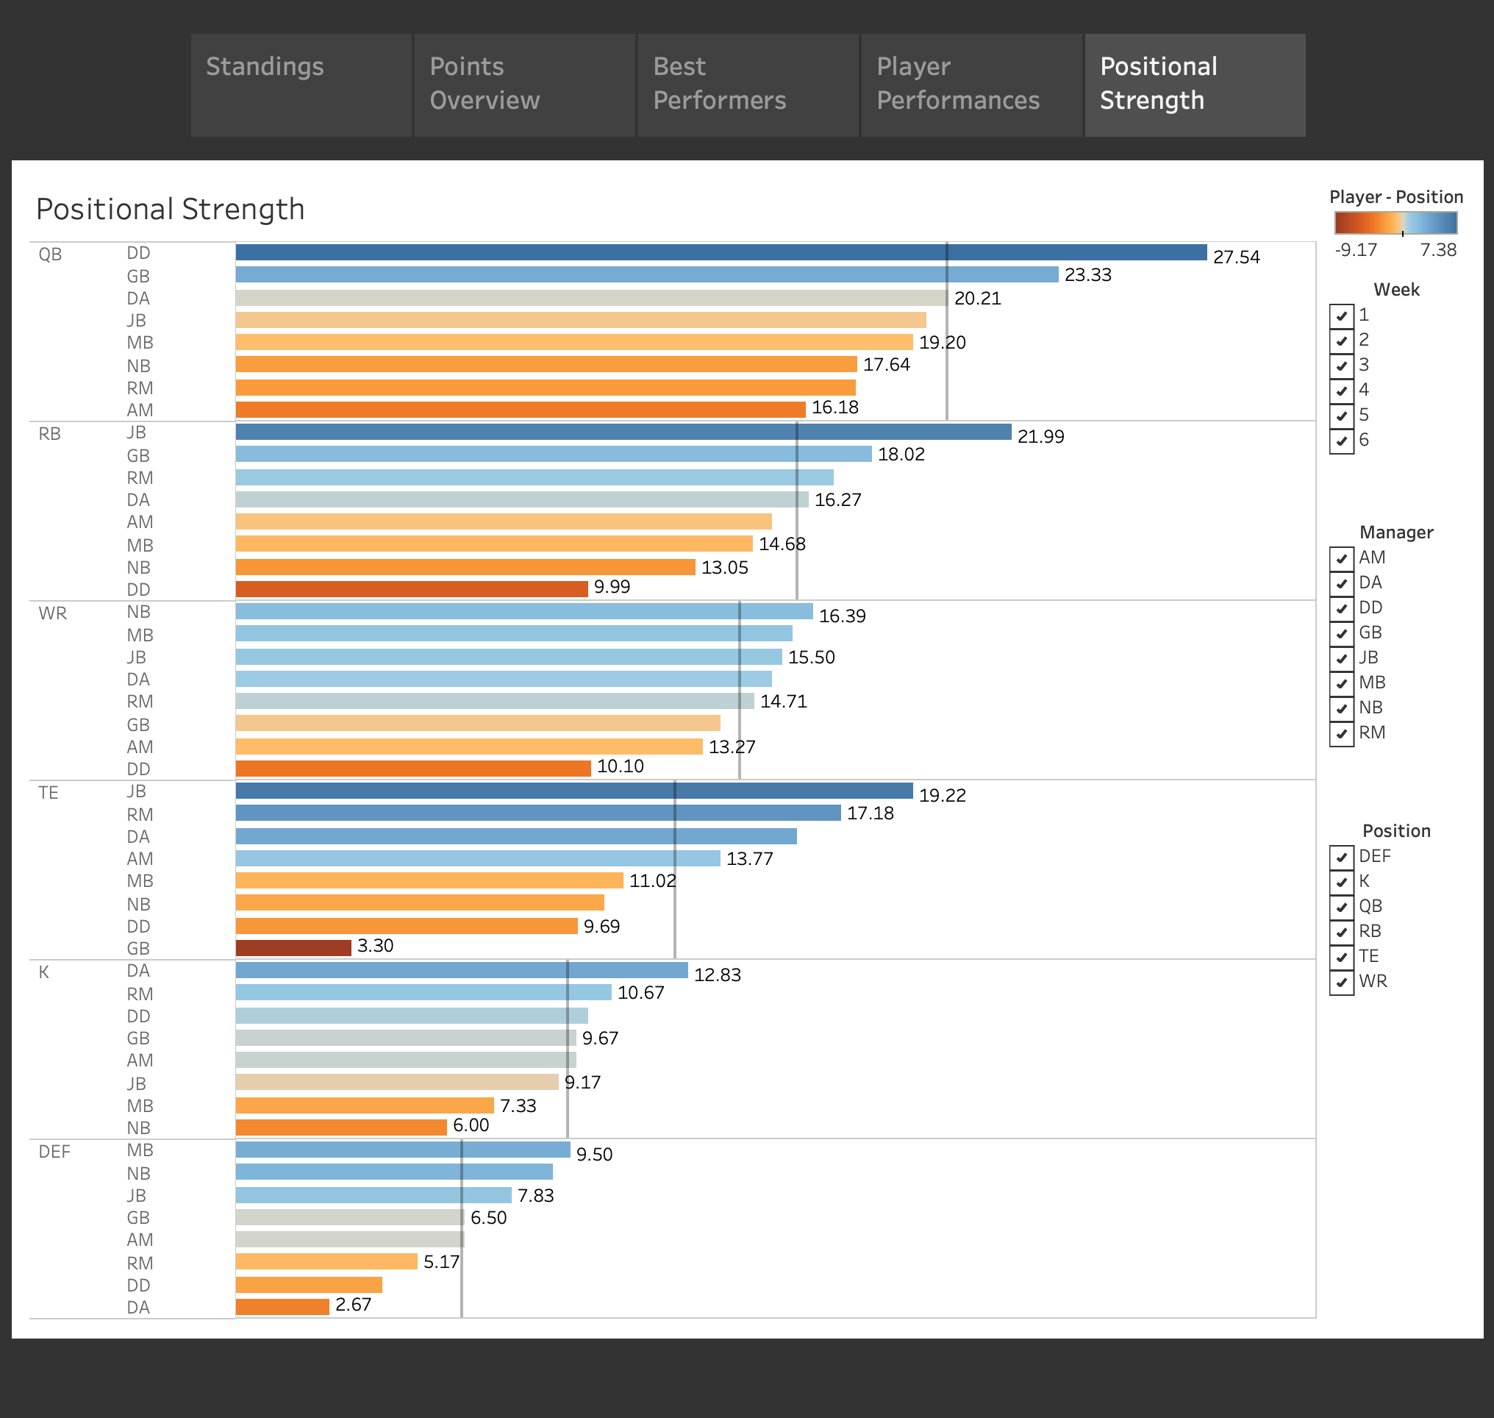
Positional Strength
See who has the most points for each position
Average is included
Find where every team’s biggest positional weak point is
My best positions are RB and TE, while my weakest is the K (kicker).
GB’s TE position is a glaring weakness compared to the rest of their team

