Slide 1
#2.2: Creating an RNA-seq analysis pipeline
SLURM scripting and processing
Using bioinformatics tools to process RNA-seq data
Transferring files between CHPC and personal computer
IGV

Slide 2
Access the slides and files here:
https://github.com/j-berg/bioinformatics_bootcamp

Slide 3
Introduction to SLURM
Schedule jobs to be run on high-performance compute nodes
Keeps the usage fair for everyone
If you’ve run a bunch of jobs recently, you are put at the end of the queue
Submit a SLURM script (a modified bash script)

Slide 4
Scratch Directory
Temporary file storage
Unlimited space
Be sure to clear out files you don’t need!
If using human/mouse samples, need to build your index here due to storage constraints
Location:
$ mkdir /scratch/general/lustre/uNID

Slide 5
SLURM job header
#!/bin/bash <-tell script where to find bash
#SBATCH --time=72:00:00 <- script time-out
#SBATCH --nodes=1 <- how many nodes to use
#SBATCH -o /uufs/chpc.utah.edu/common/home/uNID/slurmjob-%j <- Where to write the job log
#SBATCH --partition=notchpeak <- Where to run the job
source /uufs/chpc.utah.edu/common/home/uNID/miniconda3/etc/profile.d/conda.sh
source activate class <- Access conda environment
----------------------------------------------------------------------------------------------
% is a magic character -- %j will auto-fill SLURM job ID

Slide 6
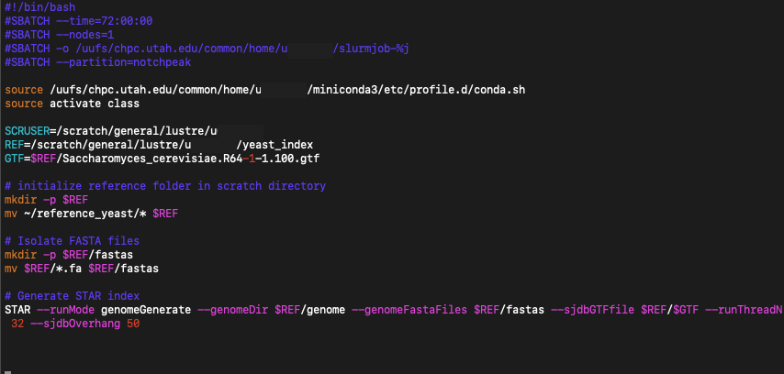
Create a workflow for genome indexing

Slide 7

Run a workflow for genome indexing

Slide 8
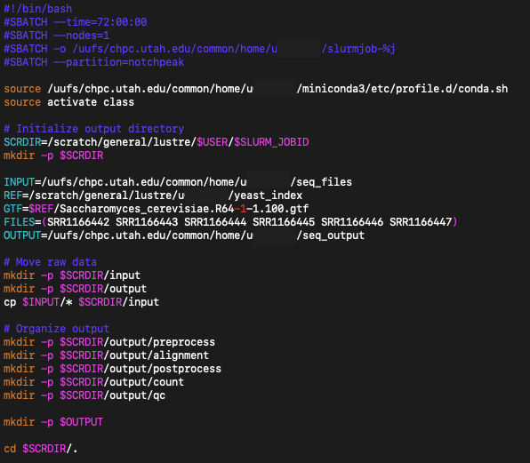
Creating an analysis workflow

Slide 9
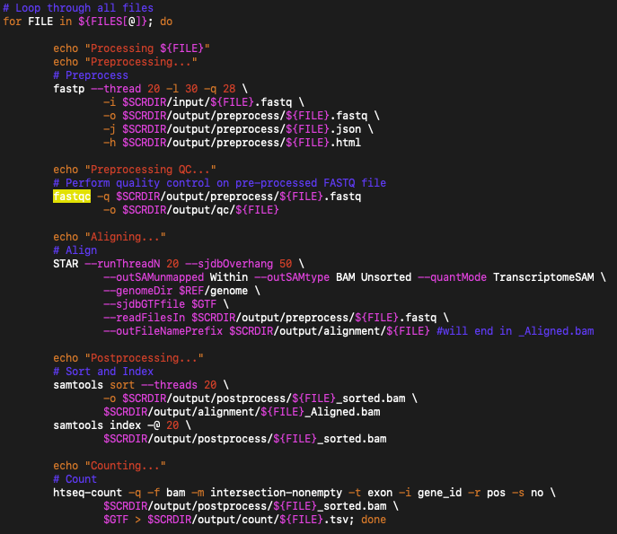
Creating an analysis workflow

Slide 10
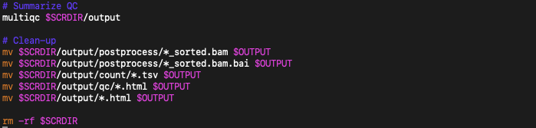
Creating an analysis workflow

Slide 11
Helpful SLURM commands
Start a slurmjob:
$ sbatch jobid
Cancel a slurmjob:
$ scancel jobid
See your jobs in queue:
$ squeue -u uNID
Live update of queue:
$ watch -n1 squeue -u uNID

Slide 12
Transferring files to your personal computer
From your personal computer/terminal
$ scp uNID@notchpeak.chpc.utah.edu:~/path/to/file.bam ./
$ scp uNID@notchpeak.chpc.utah.edu:~/path/to/file.bam.bai ./

Slide 13
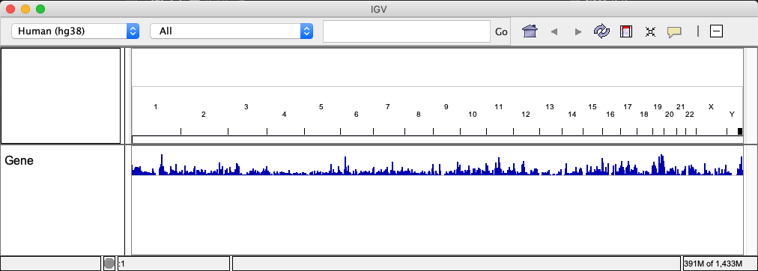
Visualizing read pile-ups with IGV
Download IGV:
https://software.broadinstitute.org/software/igv/download
Drag and drop BAM file into viewer

Slide 14
Homework
For the dataset you previously downloaded, download the appropriate reference files for that model organism
Generate a genome index and store in the Scratch directory
Create and run a script that processes each of the files you downloaded
Transfer one of the alignment files to your personal computer and open in IGV. Find a gene whose transcripts (isoforms) seem to be differentially expressed.

