Slide 1
#2.1: Scripting and data preparation
SRA-toolkit
Scripting
Downloading source files

Slide 2
Access the slides and files here:
https://github.com/j-berg/bioinformatics_bootcamp

Slide 3
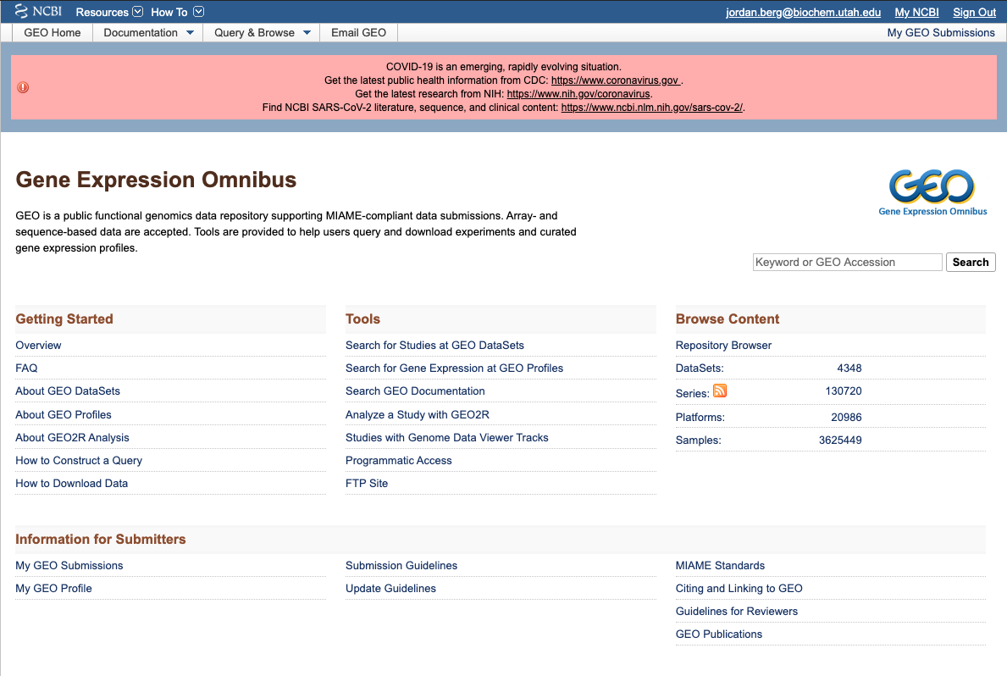
Downloading publicly available data
Any published NIH-funding
sequencing datasets *should*
appear here

Slide 4
Downloading publicly available data
SRA-toolkit
Download and unpackage
$ curl -OL http://ftp-trace.ncbi.nlm.nih.gov/sra/sdk/current/sratoolkit.current-centos_linux64.tar.gz
$ tar -zxvf sratoolkit.current-centos_linux64.tar.gz
Rename
$ mv sratoolkit.2.10.7-centos_linux64 sratoolkit
Make SRA-toolkit findable to you anywhere in supercomputer
$ echo 'export PATH="/uufs/chpc.utah.edu/common/home/u0690617/sratoolkit/bin:$PATH"' >> ~/.bashrc

Slide 5

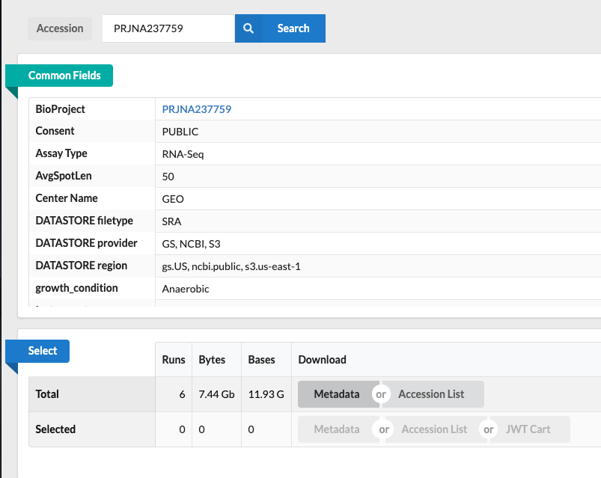
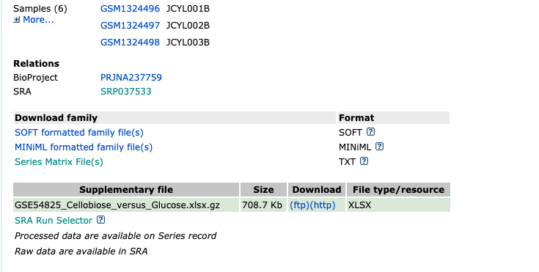

Slide 6
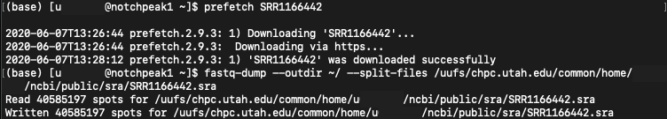
Download a file by SRR accessor

Slide 7
Writing your first bash script
$ vim download_seqs.sh <-- let’s write a new bash script (.sh)
Commands:
You will start in viewer mode
Tap “d” twice = delete a line
Arrow keys to move cursor
Tap “i” to enter editor mode
Write your code
Press escape to exit editor mode
Type “:wq” to save (write) and quit
Type “:q” to quit without saving
If you made changes and want to quit without saving, you will need to use “:q!”

Slide 8
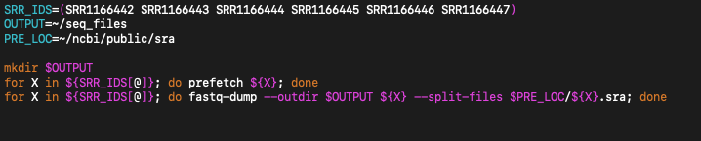
Downloading sequencing files
$ vim download_seq.sh
Press “i”
Press Escape + “wq”, then Enter

Slide 9
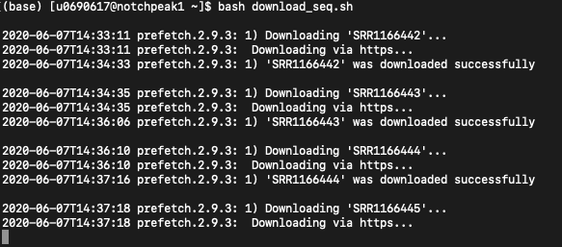
Downloading sequencing files

Slide 10
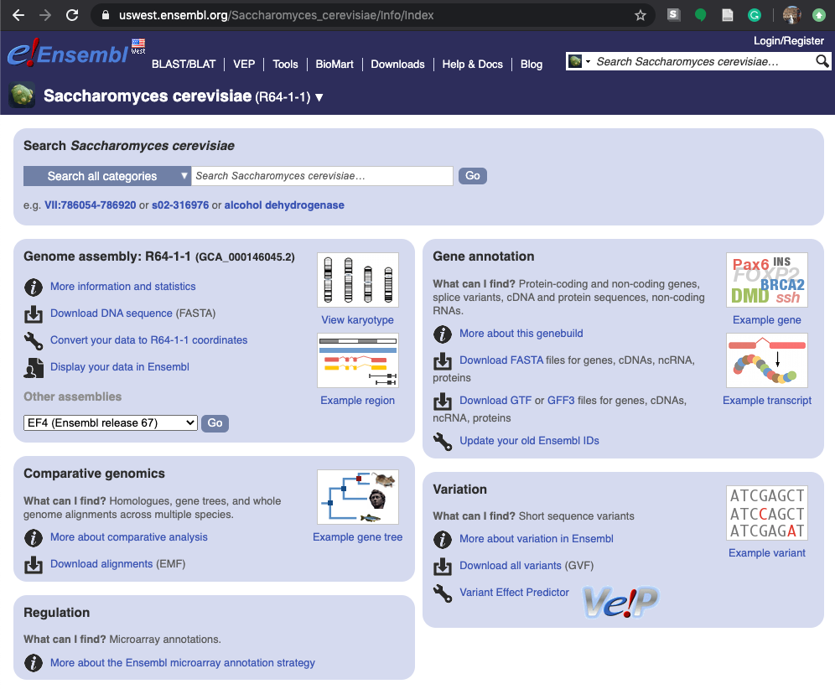
Downloading reference files

Slide 11
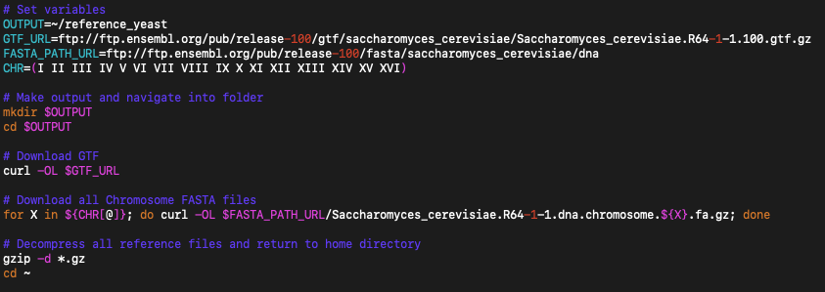
Downloading reference files
$ vim download_refs.sh
Press “i”
Press Escape + “wq”, then Enter

Slide 12
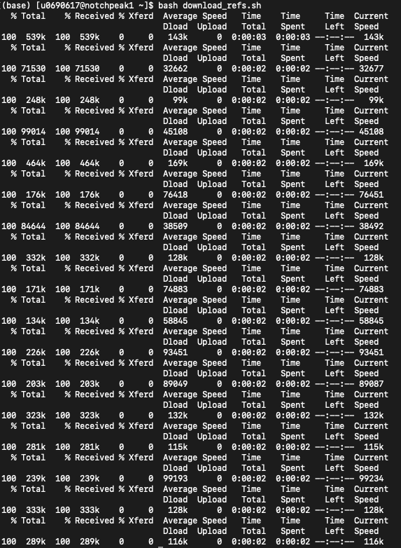
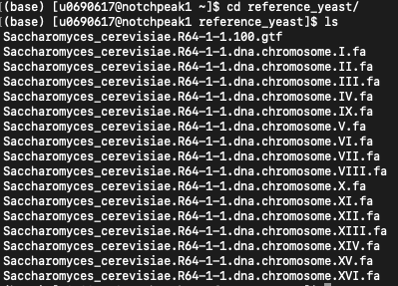
Downloading reference files

Slide 13
Genome vs RNA-seq
RNA
Genome
Intron
Intron
Different conditions sometimes call for different tools

Slide 14
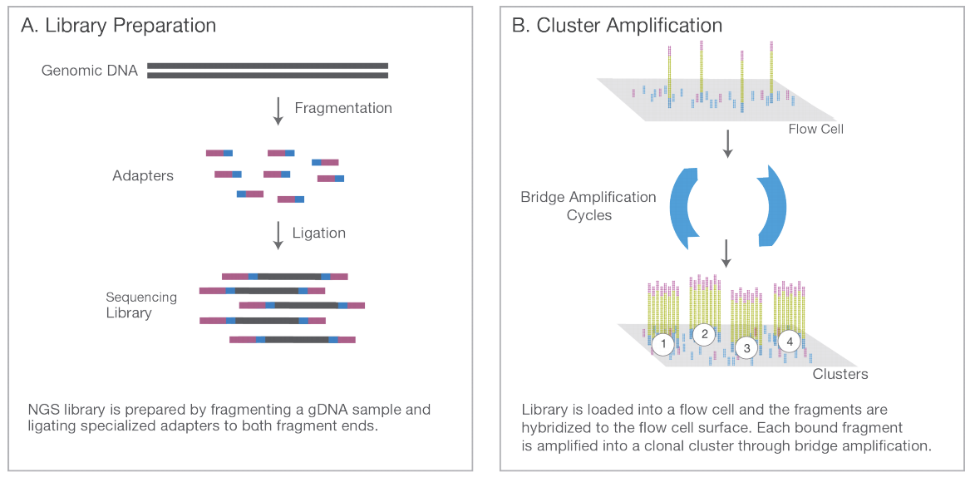
Steps: Pre-processing
Fastp
Remove adapters (will prevent alignment with synthetic sequence)
Remove low quality bases and short reads

Slide 15
Steps: Splice-aware Alignment
STAR
Generate a genome index
Perform splice-aware alignment of sequencing reads to genome index
{
}
RNA
0: ATGACTAGGCTCTA
1: GGATCTGAGAGTT 2: CGGATTAGGAGCT
3: GGGGCTCTGTAGA
4: CGCGGCAGGATCT
5:TATATATCGGATAAT
Intron
Intron

Slide 16
Steps: Post-processing
Samtools
Sort alignments and index

Slide 17
Steps: Quantification
HTSeq-count
Generate read counts for each gene
Gene A:
6 reads = 6 counts

Slide 18
Steps: Quality Control
FASTQC
MultiQC
Make sure sequencing library is high-quality and reliable

Slide 19
Downloading required software for RNA-seq
Make sure channel priority is set
$ conda activate class
$ conda install fastp STAR samtools htseq multiqc fastqc

Slide 20
Homework:
Find an RNA-seq GEO dataset with 8 or fewer total samples
Create a new folder for the dataset
Copy the class sequence file download script and modify as needed to download each of the files from the GEO dataset
Copy one of the files with a new name and decompress the file
Use the head command to determine the average length of the first 10 reads of this copied file
Delete the copied file (but do not remove the original downloads)
To a new directory in your home folder on CHPC, download the GTF and genome FASTA files for the organism used in your downloaded RNA-seq dataset

