Slide 1
#1.2: Bioinformatics File Types and their manipulation

Slide 2
Access the slides and files here:
https://github.com/j-berg/bioinformatics_bootcamp

Slide 3
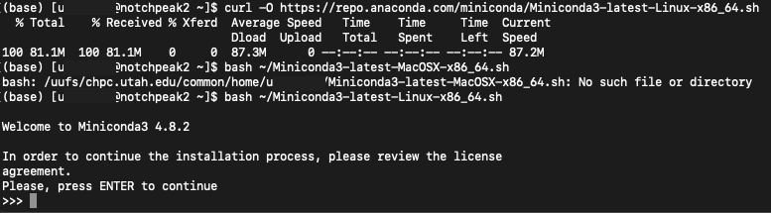
Package Managers
Allow you to quickly download pre-compiled software
Download the installer
$ curl -OL => download file as is, make sure to not just download a link but the actual file
2. Run the installer
$ bash => run shell script (.sh)
3. Accept the license and let it set the PATH for you
~ => shortcut for home directory

Slide 4
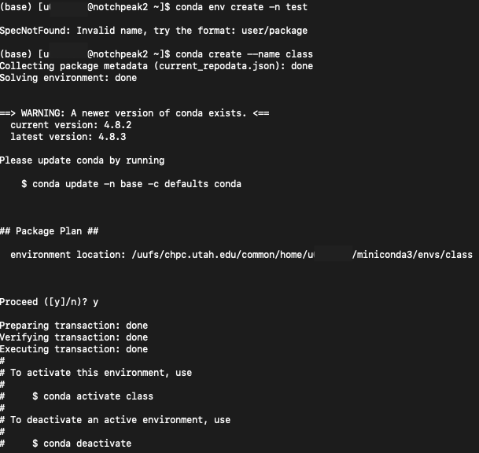
Use conda to install a package
Make an environment to avoid package clashing:
$ conda create --name class
Activate the environment:
$ conda activate class
Will need to do this every time you log onto the supercomputer if you want to use the environment

Slide 5
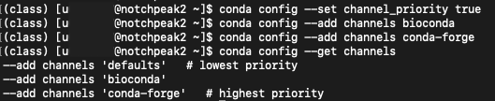
Use conda to install a package
Install a package to the environment:
$ conda install -c bioconda samtools
-c tells conda the channel to search for the package in

Slide 6
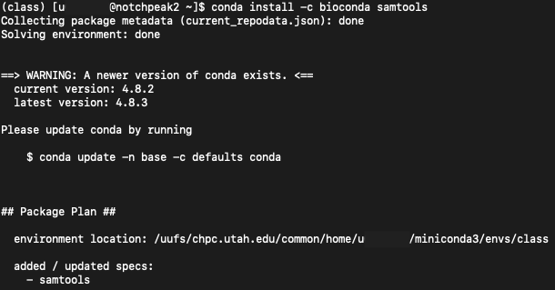
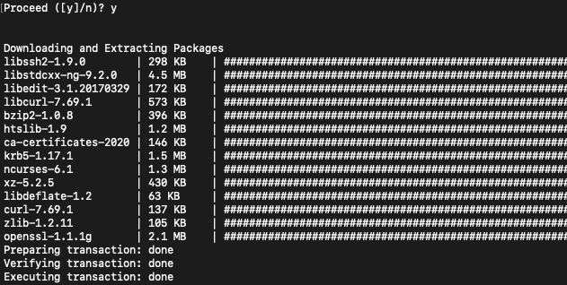

Slide 7
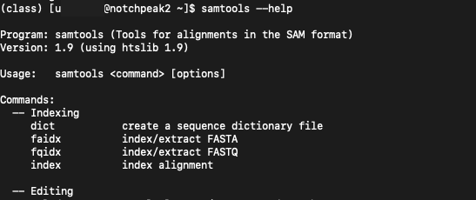
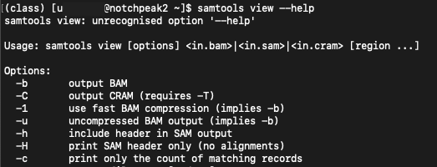
Accessing a tools documentation
Standard command line tools:
$ man wc
Other tools:
$ samtools --help
$ samtools view --help

Slide 8
Connecting tasks
The Pipe
$ samtools view filename | wc -l | head
Do this, then this, then this…

Slide 9
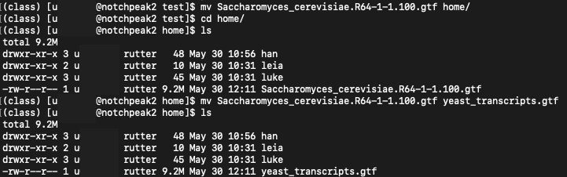
Moving and renaming files
$ mv

Slide 10
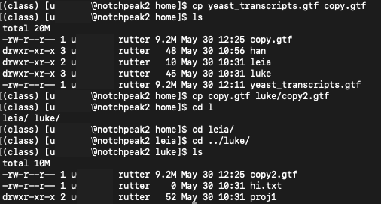
Copying Files
$ cp

Slide 11
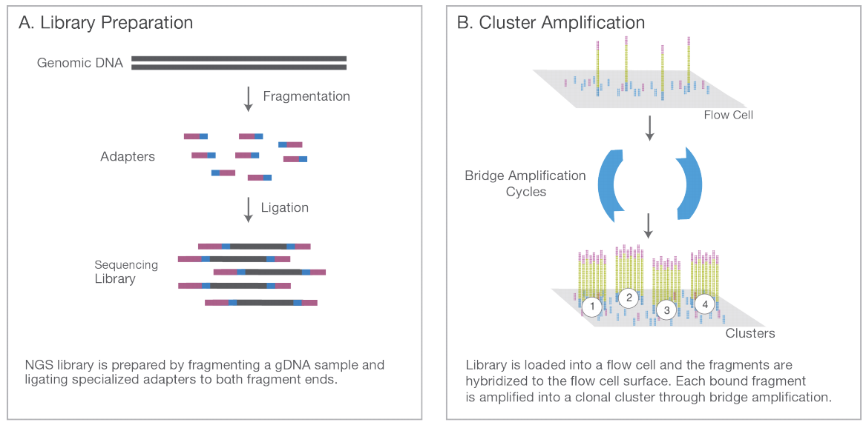
Sequencing
https://www.illumina.com/content/dam/illumina-marketing/documents/products/illumina_sequencing_introduction.pdf

Slide 12
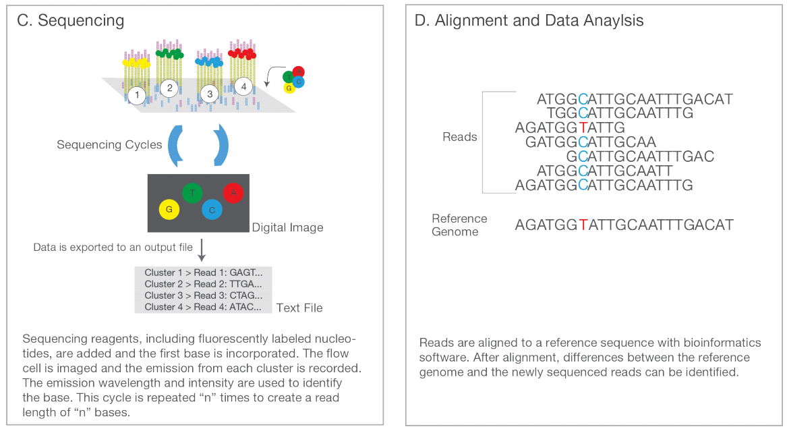
https://www.illumina.com/content/dam/illumina-marketing/documents/products/illumina_sequencing_introduction.pdf

Slide 13
Bioinformatics File Types

Slide 14
FASTA
A nucleotide sequence file
> indicates record ID/name
Second line is the sequence
One file can have this pattern repeat for multiple FASTA records
>record
ATATGTGTATACTCTATAGAGAGGATCTAGAGTATAGC
TCGCGTATAGAGATCTTCGCGATATAGAGAGTCTGCG
AAGGCTCTCGCGCGCAAAGAGAGAGATATTCGCGC

Slide 15
FASTQ
A sequencing file with paired nucleotide sequence and quality score for each read
@SRR2075930.2:UMI_NTGCG HS1:450:C5WTEACXX:7:1101:1276:2113 length=50
CTACGTGTGGAGGCTCANGCAGCGCTTCTGGCTGGAACGGGGAA
+
:@<??@?:>??<=??@>#189==?????>?<??<??>??55985
Line 1: read ID (will start with an @)
Line 2: read sequence
Line3: spacer (sometimes will have the the read ID repeated)
Line4: The corresponding PHRED score

Slide 16
PHRED
Base call confidence score
ASCII characters alongside the read sequences
https://en.wikipedia.org/wiki/Phred_quality_score
https://en.wikipedia.org/wiki/Fred_Flintstone#/media/File:Fred_Flintstone.png

Slide 17
SAM/BAM/CRAM file
Sequence Alignment Map
Binary Alignment Map
YOU NEED SAMTOOLS TO READ BAM FILES
CRAM: lossy compression BAM file
Tab-delimited
To view BAM files, we need samtools (downloaded previously)
$ samtools view sample.bam | column -t -s $'\t' | less -N -S
separate out data by tabs

Slide 18
SAM/BAM file
Leftmost
mapping
position
Flags indicating
mapping quality
Mate read info
(for paired-end)
Other metadata
chr
mapping
quality
Nucleotide
sequence
read ID
PHRED score
mapping
metadata

Slide 19
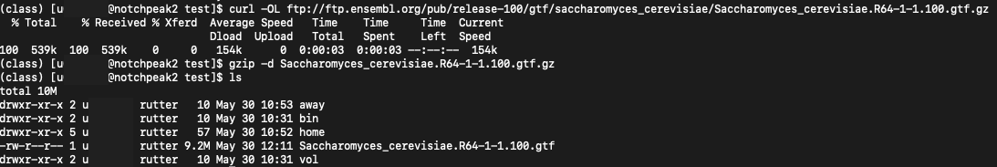
GTF
gzip: compression file format and tool for compression/decompression
gzip filename -> compress
gzip –d filename -> decompress
Transcriptome Annotation File (Gene Transfer File)
$ gzip -d => Unzip a compressed file (.gz)

Slide 20
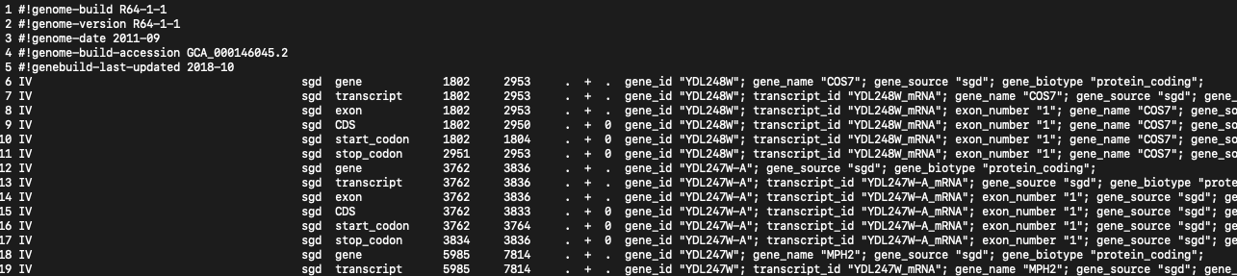
$ cat Saccharomyces_cerevisiae.R64-1-1.100.gtf | column -t -s $'\t' | less -N -S
annotation
metadata
score
frame
chr
annotation
source
record
type
left/right
coordinates
strand
record metadata
Notes:
The score of the feature, a floating point number. As in earlier versions of the format, the semantics of the score are ill-defined. It is strongly recommended that E-values be used for sequence similarity features, and that P-values be used for ab initio gene prediction features.

Slide 21
Delimited file
.csv => comma separated file
.tsv => tab separated file
.txt
Used for data tables

Slide 22
Samtools
View alignment records
$ samtools view filename.bam| less –S
$ samtools view filename.bam| head –n 40 | less -S

Slide 23
Determining sex of individual
samtools view NA06984.454.MOSAIK.SRP000033.2009_11.bam | grep "Y" | column -t -s $'\t' | wc -l
1098
samtools view NA06984.454.MOSAIK.SRP000033.2009_11.bam | grep ”X" | column -t -s $'\t' | wc -l
32012
Why are there such fewer reads for the Y chromosome in this individual?

Slide 24
Homework
Run and copy these commands and outputs to a file
Log into the supercomputer
Download a 3 BAM files from the Thousand Genomes Project
https://www.internationalgenome.org/data/
Determine the sex of the individual
Remove the BAM files to free up the space from your home directory
The size of a user's home directory space is enforced with a quota. There is a soft quota of 50GB and a hard quota of 75GB. Once a user's directory exceeds the soft quota, they have seven days to clean up and return to below the soft quota amount. After 7 days, they will no longer be able to write in their home directory until they clean up so that they are under the soft quota. If an user exceeds the hard quota, they immediately will no longer be able to write to their home directory until they clean up so they are not longer over this quota.

