Slide 1
Rutter Lab Isolation Bootcamp
#2: Introduction to the command line, continued
Slides with “ARQ” are copied or adapted from Aaron R. Quinlan

Slide 2
Access the slides and files here:
https://github.com/j-berg/rutter_lab_coding_bootcamp
Or on fileserver at LAB INFO > Jordan’s Coding Bootcamp > Zoom

Slide 3
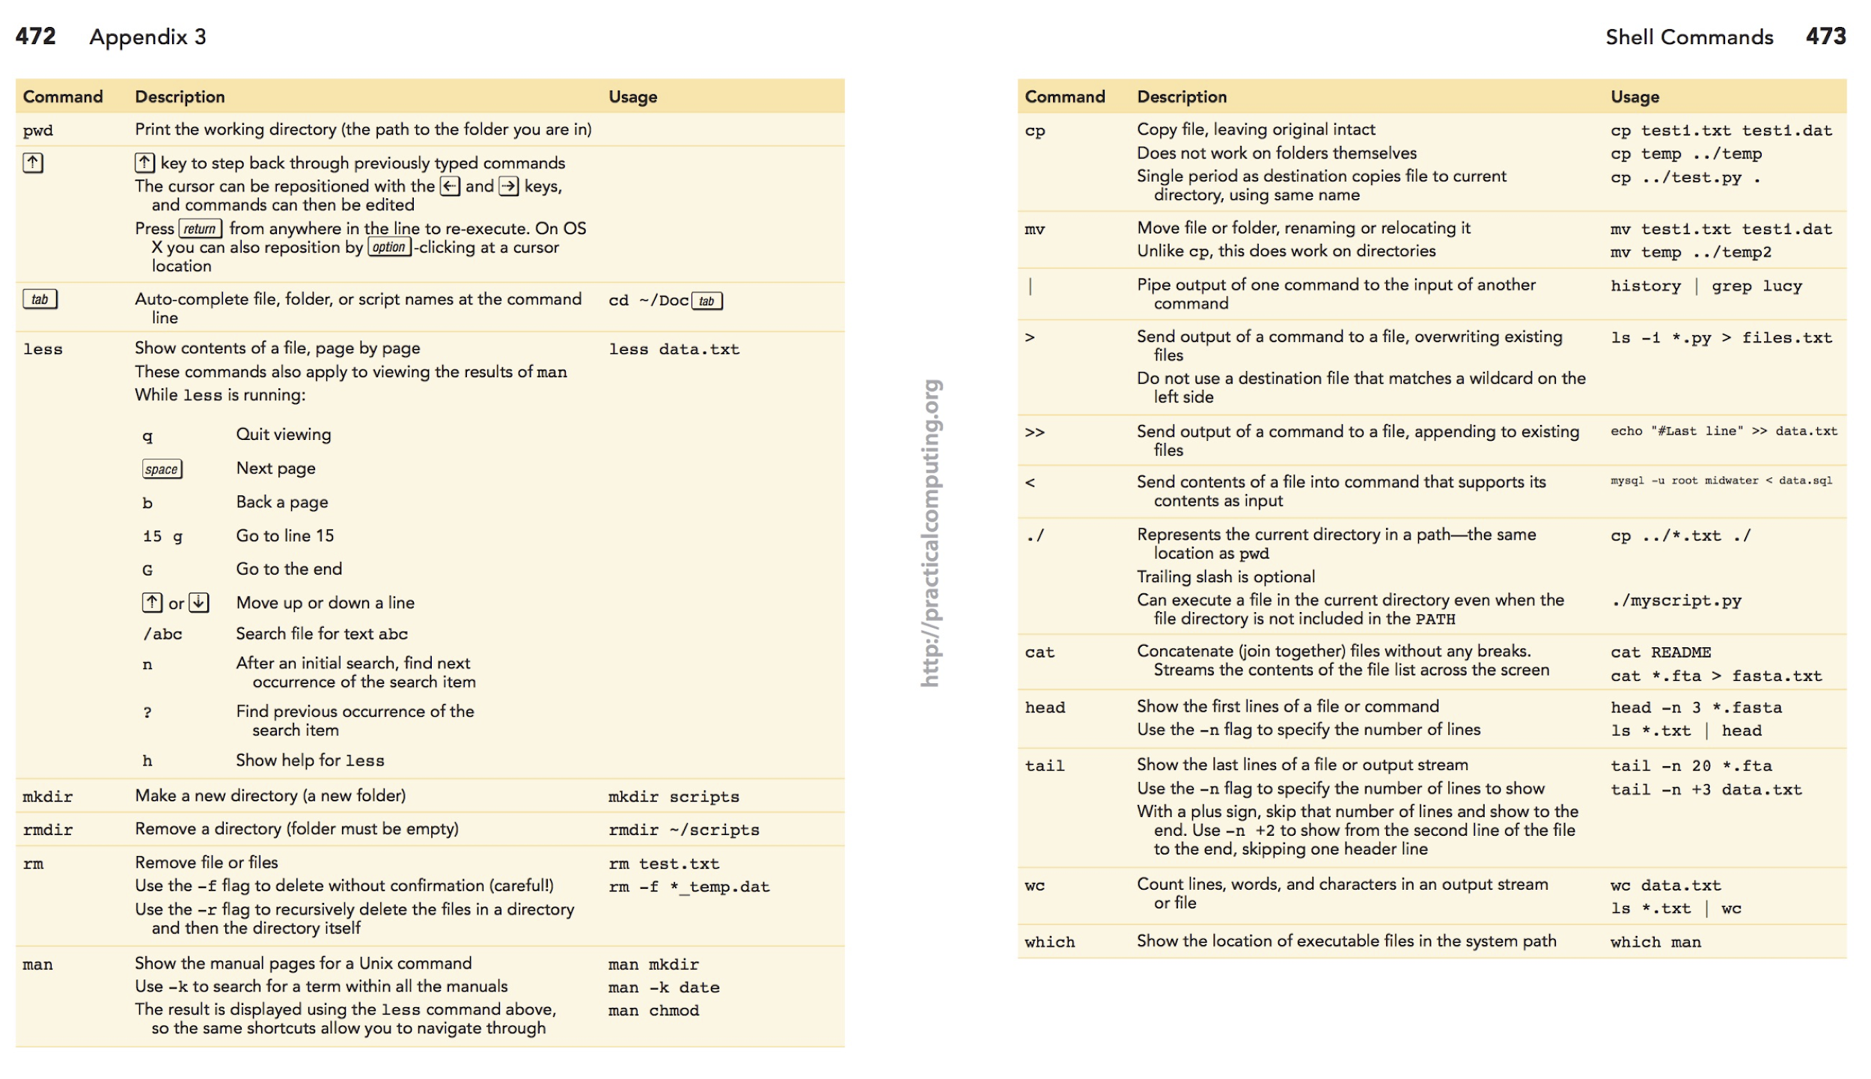
Unix reference “cheat sheet”: (print/mark the link below!)
ARQ
http://practicalcomputing.org/files/PCfB_Appendices.pdf

Slide 4
Important reminders
Spaces matter!
Capitalization matters!
The computer is a dumb robot that needs very specific instructions to do anything correctly
https://en.wikipedia.org/wiki/Bender_(Futurama)#/media/File:Bender_Rodriguez.png

Slide 5
cp (copy)
Copy a file from one location to another
$ cp file.txt ../../file.txt
or
$ cp file.txt ../../
Can specify a different name for the copied file
$ cp file.txt ../../file_copy.txt
Or
$ cp file.txt ./file_copy.txt (“.” is a shortcut for current directory, this is optional here)

Slide 6
mv (move)
Move a file
$ mv ./file.txt ../
or
$ mv file.txt ..
Can be used to rename a file
$ mv file.txt new_name.txt

Slide 7
rm (remove)
BE CAREFUL!!!!
BE CAREFUL!!!!
Don’t accidently wipe your whole desktop or someone else’s data. A file or directory removed with “rm” is NOT RECOVERABLE. Always double-check the command before executing. Don’t leave a space where it shouldn’t be. DOUBLE CHECK EVERY TIME!
Remove a file
$ rm file.txt
Remove a directory
$ rm –r directory_name/ (-r means recursive remove)

Slide 8
But what about doing
something useful?
ARQ

Slide 9
Let’s imagine you are studying gene regulation in human muscle development.
You will need a list of genes and transcripts in the human genome.
How would we get to the file, figure out what it is called, and see its contents?
ARQ
Notes:
To reproduce:
curl ftp://ftp.ensembl.org/pub/release-87/gtf/homo_sapiens/Homo_sapiens.GRCh38.87.gtf.gz > human.genes.gtf.gz gzip -d human.genes.gtf.gz; mv human.genes.gtf genes.gtf

Slide 10
Downloading a file
curl: “Client URL”; transfer file from URL to system
-O output file as is to current working directory
-o output file as named target to target location
-L If file location has moved, get file from new location (prevent just downloading a URL link)
gzip: compression file format and tool for compression/decompression
gzip file -> compress
gzip –d file -> decompress
$ curl –OL ftp://ftp.ensembl.org/pub/release-99/gtf/homo_sapiens/Homo_sapiens.GRCh38.99.gtf.gz
$ gzip –d Homo_sapiens.GRCh38.99.gtf.gz
Notes:
The name stands for "Client URL”
File transfer

Slide 11
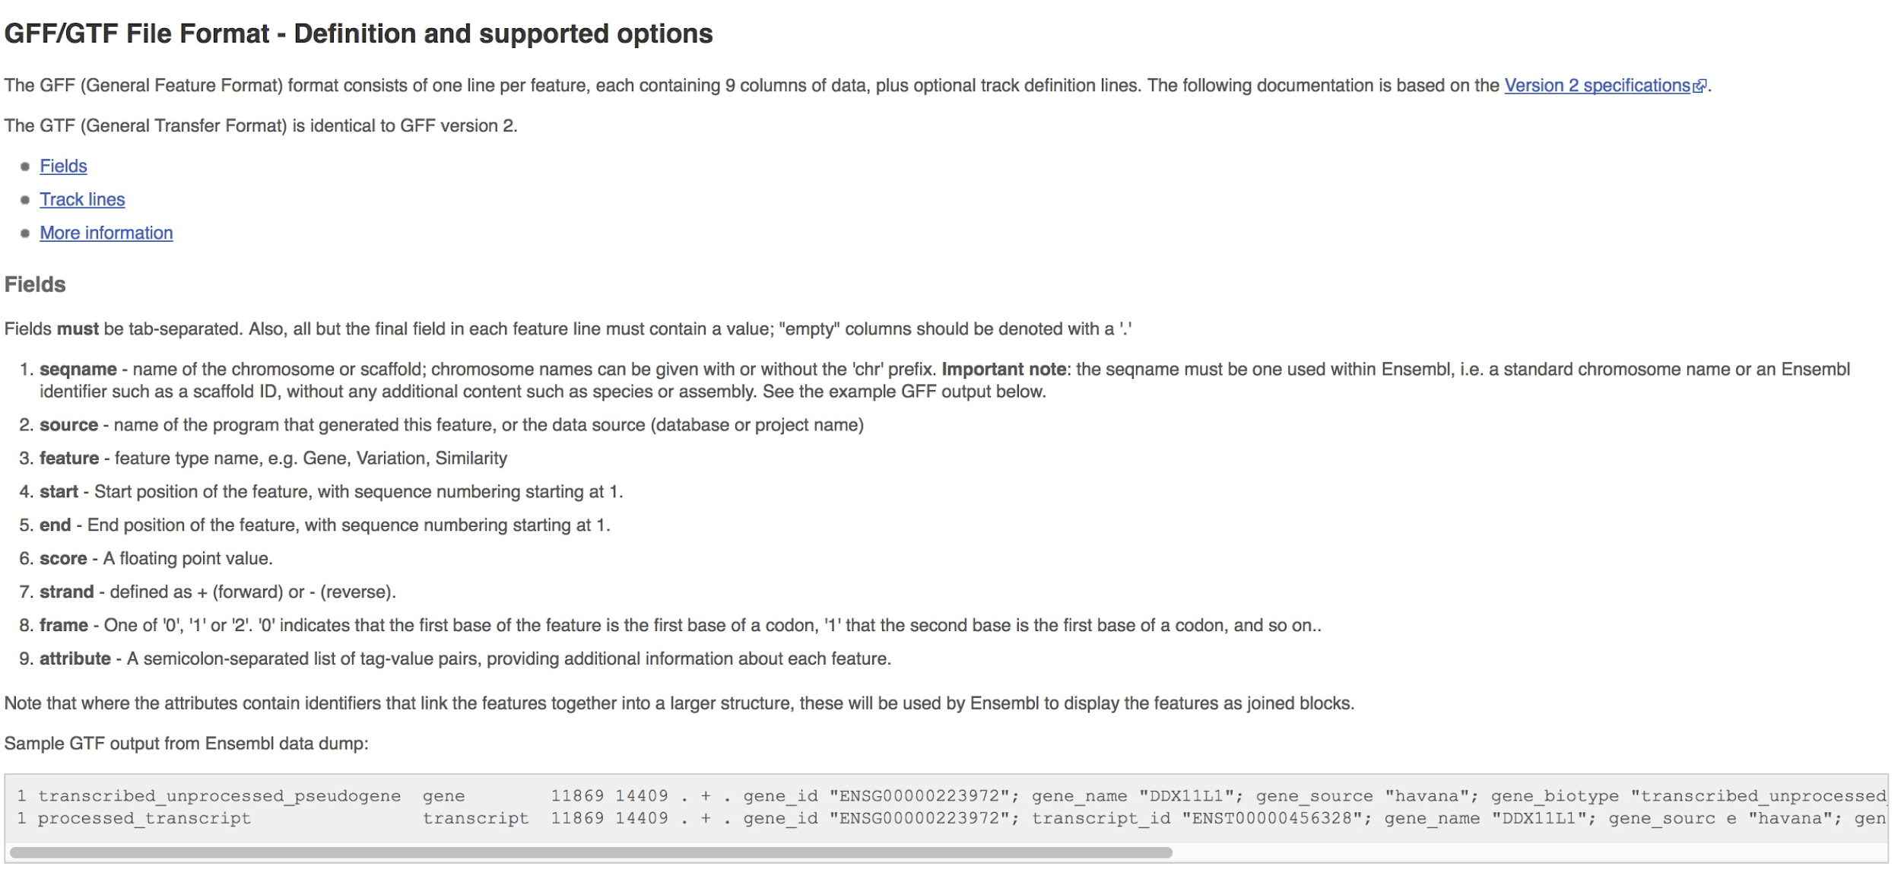
The GFF format
ARQ
http://uswest.ensembl.org/info/website/upload/gff.html

Slide 12
The man command
man is the manual viewer; it can be used to display manual pages for options, scroll up and down, search for occurrences of specific text, and other useful functions.
ARQ
$ man less
LESS(1) LESS(1)
NAME
less - opposite of more
SYNOPSIS
less -?
less --help
less -V
less --version
less [-[+]aABcCdeEfFgGiIJKLmMnNqQrRsSuUVwWX~]
[-b space] [-h lines] [-j line] [-k keyfile]
[-{oO} logfile] [-p pattern] [-P prompt] [-t tag]
[-T tagsfile] [-x tab,...] [-y lines] [-[z] lines]
[-# shift] [+[+]cmd] [--] [filename]...
(See the OPTIONS section for alternate option syntax with long option
names.)
DESCRIPTION
Less is a program similar to more (1), but which allows backward movement
in the file as well as forward movement. Also, less does not have to read
Tips:
One navigates the man page using the same keys (i.e., space, up, down, as “less”)
Quit out of the manual by pressing “q”
So, how do we find any documentation about OPTIONS (hint) to deal with wrapped (hint) lines in the less command?
(That is, besides google)
Notes:
Other non-unix tools are name --help

Slide 13
The less command
(scroll through the contents of files page by page. less is “more” , because you can go forwards and backwards)
ARQ
#!genome-build GRCh38.p7
#!genome-version GRCh38
#!genome-date 2013-12
#!genome-build-accession NCBI:GCA_000001405.22
#!genebuild-last-updated 2016-06
1 havana gene 11869 14409 . + . gene_id "ENSG00000223972"; gene_version "5"; gene_name "DDX11L1"; gene_source "havana"; gene_biotype "transcribed_unprocessed_pseudogene"; havana_gene "OTTHUMG00000000961"; havana_gene_version "2";
1 havana transcript 11869 14409 . + . gene_id "ENSG00000223972"; gene_version "5"; transcript_id "ENST00000456328"; transcript_version "2"; gene_name "DDX11L1"; gene_source "havana"; gene_biotype "transcribed_unprocessed_pseudogene"; havana_gene "OTTHUMG00000000961"; havana_gene_version "2"; transcript_name "DDX11L1-002"; transcript_source "havana"; transcript_biotype "processed_transcript"; havana_transcript "OTTHUMT00000362751"; havana_transcript_version "1"; tag "basic"; transcript_support_level "1";
1 havana exon 11869 12227 . + . gene_id "ENSG00000223972"; gene_version "5"; transcript_id "ENST00000456328"; transcript_version "2"; exon_number "1"; gene_name "DDX11L1"; gene_source "havana"; gene_biotype "transcribed_unprocessed_pseudogene"; havana_gene "OTTHUMG00000000961"; havana_gene_version "2"; transcript_name "DDX11L1-002"; transcript_source "havana"; transcript_biotype "processed_transcript"; havana_transcript "OTTHUMT00000362751"; havana_transcript_version "1"; exon_id "ENSE00002234944"; exon_version "1"; tag "basic"; transcript_support_level "1";
1 havana exon 12613 12721 . + . gene_id "ENSG00000223972"; gene_version "5"; transcript_id "ENST00000456328"; transcript_version "2"; exon_number "2
$ less __file__.gtf
$ less –S __file__.gtf
Tips:
Hit the space key to move to the next page, or enter to move to the next line.
Hit “q” to quit and return to the prompt
Hit the up and down arrows to move backwards and forwards in the file, respectively
Hit ”d” to go down a page, or “u” to go up a page
Notes:
-S prevents wrap, side arrows to scroll over

Slide 14
The less command (searching)
ARQ
$ less –S genes.gtf
#!genome-build GRCh38.p7
#!genome-version GRCh38
#!genome-date 2013-12
#!genome-build-accession NCBI:GCA_000001405.22
#!genebuild-last-updated 2016-06
1 havana gene 11869 14409 . + . gene_id "ENSG00000223972"; gene_version "5"; gene_name "DDX11L1"; gene_source "havana"; gene_biotype "transcribed_unprocessed_pseudogene"; havana_gene "OTTHUMG00000000961"; havana_gene_version "2";
1 havana transcript 11869 14409 . + . gene_id "ENSG00000223972"; gene_version "5"; transcript_id "ENST00000456328"; transcript_version "2"; gene_name "DDX11L1"; gene_source "havana"; gene_biotype "transcribed_unprocessed_pseudogene"; havana_gene "OTTHUMG00000000961"; havana_gene_version "2"; transcript_name "DDX11L1-002"; transcript_source "havana"; transcript_biotype "processed_transcript"; havana_transcript "OTTHUMT00000362751"; havana_transcript_version "1"; tag "basic"; transcript_support_level "1";
1 havana exon 11869 12227 . + . gene_id "ENSG00000223972"; gene_version "5"; transcript_id "ENST00000456328"; transcript_version "2"; exon_number "1"; gene_name "DDX11L1"; gene_source "havana"; gene_biotype "transcribed_unprocessed_pseudogene"; havana_gene "OTTHUMG00000000961"; havana_gene_version "2"; transcript_name "DDX11L1-002"; transcript_source "havana"; transcript_biotype "processed_transcript"; havana_transcript "OTTHUMT00000362751"; havana_transcript_version "1"; exon_id "ENSE00002234944"; exon_version "1"; tag "basic"; transcript_support_level "1";
1 havana exon 12613 12721 . + . gene_id "ENSG00000223972"; gene_version "5"; transcript_id "ENST00000456328"; transcript_version "2"; exon_number "2
Searching the file:
If you type “/” (i.e., forward slash) after you have opened the file with less, this tells less that you want to search for a specific “pattern”. After typing “/”, then type the pattern you want to search for (e.g., “exon”) and then type Enter. Less will jump to the first occurrence of that pattern.
Typing “n” will take you to the next occurrence of the pattern.
Repeat ad infinitum

Slide 15
I recommend using less for viewing file output, otherwise it will try to print the entire file to stdout

Slide 16
The grep command (this is VERY useful)
(find lines in an input file or stream that match a specific pattern you are looking for)
ARQ
$ grep "exon" genes.gtf
1 havana exon 11869 12227 . + . gene_id "ENSG00000223972"; gene_version "5"; transcript_id "ENST00000456328"; transcript_version "2"; exon_number "1"; gene_name "DDX11L1"; gene_source "havana"; gene_biotype "transcribed_unprocessed_pseudogene"; havana_gene "OTTHUMG00000000961"; havana_gene_version "2"; transcript_name "DDX11L1-002"; transcript_source "havana"; transcript_biotype "processed_transcript"; havana_transcript "OTTHUMT00000362751"; havana_transcript_version "1"; exon_id "ENSE00002234944"; exon_version "1"; tag "basic"; transcript_support_level "1";
1 havana exon 12613 12721 . + . gene_id "ENSG00000223972"; gene_version "5"; transcript_id "ENST00000456328"; transcript_version "2"; exon_number "2"; gene_name "DDX11L1"; gene_source "havana"; gene_biotype "transcribed_unprocessed_pseudogene"; havana_gene "OTTHUMG00000000961"; havana_gene_version "2"; transcript_name "DDX11L1-002"; transcript_source "havana"; transcript_biotype "processed_transcript"; havana_transcript "OTTHUMT00000362751"; havana_transcript_version "1"; exon_id "ENSE00003582793"; exon_version "1"; tag "basic"; transcript_support_level "1";
1 havana exon 13221 14409 . + . gene_id "ENSG00000223972"; gene_version "5"; transcript_id "ENST00000456328"; transcript_version "2"; exon_number "3"; gene_name "DDX11L1"; gene_source "havana"; gene_biotype "transcribed_unprocessed_pseudogene"; havana_gene "OTTHUMG00000000961"; havana_gene_version "2"; transcript_name "DDX11L1-002"; transcript_source "havana"; transcript_biotype "processed_transcript"; havana_transcript "OTTHUMT00000362751"; havana_transcript_version "1"; exon_id "ENSE00002312635"; exon_version "1"; tag "basic"; transcript_support_level "1";
...
Result:
Only lines that contain the text "exon" anywhere in the line will be returned.

Slide 17
See grep matches with --color
ARQ
$ grep --color "exon" genes.gtf
1 havana exon 11869 12227 . + . gene_id "ENSG00000223972"; gene_version "5"; transcript_id "ENST00000456328"; transcript_version "2"; exon_number "1"; gene_name "DDX11L1"; gene_source "havana"; gene_biotype "transcribed_unprocessed_pseudogene"; havana_gene "OTTHUMG00000000961"; havana_gene_version "2"; transcript_name "DDX11L1-002"; transcript_source "havana"; transcript_biotype "processed_transcript"; havana_transcript "OTTHUMT00000362751"; havana_transcript_version "1"; exon_id "ENSE00002234944"; exon_version "1"; tag "basic"; transcript_support_level "1";
1 havana exon 12613 12721 . + . gene_id "ENSG00000223972"; gene_version "5"; transcript_id "ENST00000456328"; transcript_version "2"; exon_number "2"; gene_name "DDX11L1"; gene_source "havana"; gene_biotype "transcribed_unprocessed_pseudogene"; havana_gene "OTTHUMG00000000961"; havana_gene_version "2"; transcript_name "DDX11L1-002"; transcript_source "havana"; transcript_biotype "processed_transcript"; havana_transcript "OTTHUMT00000362751"; havana_transcript_version "1"; exon_id "ENSE00003582793"; exon_version "1"; tag "basic"; transcript_support_level "1";
1 havana exon 13221 14409 . + . gene_id "ENSG00000223972"; gene_version "5"; transcript_id "ENST00000456328"; transcript_version "2"; exon_number "3"; gene_name "DDX11L1"; gene_source "havana"; gene_biotype "transcribed_unprocessed_pseudogene"; havana_gene "OTTHUMG00000000961"; havana_gene_version "2"; transcript_name "DDX11L1-002"; transcript_source "havana"; transcript_biotype "processed_transcript"; havana_transcript "OTTHUMT00000362751"; havana_transcript_version "1"; exon_id "ENSE00002312635"; exon_version "1"; tag "basic"; transcript_support_level "1";
...
Tips:
Use the right and left arrows to move towards the end and beginning of a line, respectively.

Slide 18
See grep matches with --color
ARQ
$ grep --color "gene" genes.gtf
#!genebuild-last-updated 2016-06
1 havana gene 11869 14409 . + . gene_id "ENSG00000223972"; gene_version "5"; gene_name "DDX11L1"; gene_source "havana"; gene_biotype "transcribed_unprocessed_pseudogene"; havana_gene "OTTHUMG00000000961"; havana_gene_version "2";
1 havana transcript 11869 14409 . + . gene_id "ENSG00000223972"; gene_version "5"; transcript_id "ENST00000456328"; transcript_version "2"; gene_name "DDX11L1"; gene_source "havana"; gene_biotype "transcribed_unprocessed_pseudogene"; havana_gene "OTTHUMG00000000961"; havana_gene_version "2"; transcript_name "DDX11L1-002"; transcript_source "havana"; transcript_biotype "processed_transcript"; havana_transcript "OTTHUMT00000362751"; havana_transcript_version "1"; tag "basic"; transcript_support_level "1";
1 havana exon 11869 12227 . + . gene_id "ENSG00000223972"; gene_version "5"; transcript_id "ENST00000456328"; transcript_version "2"; exon_number "1"; gene_name "DDX11L1"; gene_source "havana"; gene_biotype "transcribed_unprocessed_pseudogene"; havana_gene "OTTHUMG00000000961"; havana_gene_version "2"; transcript_name "DDX11L1-002"; transcript_source "havana"; transcript_biotype "processed_transcript"; havana_transcript "OTTHUMT00000362751"; havana_transcript_version "1"; exon_id "ENSE00002234944"; exon_version "1"; tag "basic"; transcript_support_level "1";
1 havana exon 12613 12721 . + . gene_id "ENSG00000223972"; gene_version "5"; transcript_id "ENST00000456328"; transcript_version "2"; exon_number "2"; gene_name "DDX11L1"; gene_source "havana"; gene_biotype "transcribed_unprocessed_pseudogene"; havana_gene "OTTHUMG00000000961"; havana_gene_version "2"; transcript_name "DDX11L1-002"; transcript_source "havana"; transcript_biotype "processed_transcript"; havana_transcript "OTTHUMT00000362751"; havana_transcript_version "1"; exon_id "ENSE00003582793"; exon_version "1"; tag "basic"; transcript_support_level "1";
By default, grep reports a pattern match anywhere it find it on the line.
What if we want to match "gene" but not things like "gene_name"?

Slide 19
Matches flanked by "whitespace" with -w
ARQ
$ grep --color "gene" -w genes.gtf
1 havana gene 11869 14409 . + . gene_id "ENSG00000223972"; gene_version "5"; gene_name "DDX11L1"; gene_source "havana"; gene_biotype "transcribed_unprocessed_pseudogene"; havana_gene "OTTHUMG00000000961"; havana_gene_version "2";
1 havana gene 14404 29570 . - . gene_id "ENSG00000227232"; gene_version "5"; gene_name "WASH7P"; gene_source "havana"; gene_biotype "unprocessed_pseudogene"; havana_gene "OTTHUMG00000000958"; havana_gene_version "1";
1 mirbase gene 17369 17436 . - . gene_id "ENSG00000278267"; gene_version "1"; gene_name "MIR6859-1"; gene_source "mirbase"; gene_biotype "miRNA";
1 ensembl_havana gene 29554 31109 . + . gene_id "ENSG00000243485"; gene_version "4"; gene_name "MIR1302-2"; gene_source "ensembl_havana"; gene_biotype "lincRNA"; havana_gene "OTTHUMG00000000959"; havana_gene_version "2";
1 havana gene 34554 36081 . - . gene_id "ENSG00000237613"; gene_version "2"; gene_name "FAM138A"; gene_source "havana"; gene_biotype "lincRNA"; havana_gene "OTTHUMG00000000960"; havana_gene_version "1";
1 havana gene 52473 53312 . + . gene_id "ENSG00000268020"; gene_version "3"; gene_name "OR4G4P"; gene_source "havana"; gene_biotype "unprocessed_pseudogene"; havana_gene "OTTHUMG00000185779"; havana_gene_version "1";
1 havana gene 62948 63887 . + . gene_id "ENSG00000240361"; gene_version "1"; gene_name "OR4G11P"; gene_source "havana"; gene_biotype "unprocessed_pseudogene"; havana_gene "OTTHUMG00000001095"; havana_gene_version "2";
1 ensembl_havana gene 69091 70008 . + . gene_id "ENSG00000186092"; gene_version "4"; gene_name "OR4F5"; gene_source "ensembl_havana"; gene_biotype "protein_coding"; havana_gene "OTTHUMG00000001094"; havana_gene_version "2";
By default, grep reports a pattern match anywhere it find it on the line.
What if we want to match "gene" but not things like "gene_name"?

Slide 20
Report lines that lack a pattern with -v
ARQ
$ grep "gene" -v genes.gtf
#!genome-build GRCh38.p7
#!genome-version GRCh38
#!genome-date 2013-12
#!genome-build-accession NCBI:GCA_000001405.22
Why are these the only lines that are reported?

Slide 21
Report lines that lack a pattern with -v and -w
ARQ
$ grep "gene" -v -w genes.gtf
#!genome-build GRCh38.p7
#!genome-version GRCh38
#!genome-date 2013-12
#!genome-build-accession NCBI:GCA_000001405.22
#!genebuild-last-updated 2016-06
1 havana transcript 11869 14409 . + . gene_id "ENSG00000223972"; gene_version "5"; transcript_id "ENST00000456328"; transcript_version "2"; gene_name "DDX11L1"; gene_source "havana"; gene_biotype "transcribed_unprocessed_pseudogene"; havana_gene "OTTHUMG00000000961"; havana_gene_version "2"; transcript_name "DDX11L1-002"; transcript_source "havana"; transcript_biotype "processed_transcript"; havana_transcript "OTTHUMT00000362751"; havana_transcript_version "1"; tag "basic"; transcript_support_level "1";
1 havana exon 11869 12227 . + . gene_id "ENSG00000223972"; gene_version "5"; transcript_id "ENST00000456328"; transcript_version "2"; exon_number "1"; gene_name "DDX11L1"; gene_source "havana"; gene_biotype "transcribed_unprocessed_pseudogene"; havana_gene "OTTHUMG00000000961"; havana_gene_version "2"; transcript_name "DDX11L1-002"; transcript_source "havana"; transcript_biotype "processed_transcript"; havana_transcript "OTTHUMT00000362751"; havana_transcript_version "1"; exon_id "ENSE00002234944"; exon_version "1"; tag "basic"; transcript_support_level "1";
...

Slide 22
Matching patterns that include quotes
ARQ
$ grep --color ”PTPN22" genes.gtf
What if we want to find lines with a specific gene name (note that the GFF has gene names in quotes). We need to tell grep to treat quote characters literally!
1 ensembl_havana gene 113813811 113871759 . - . gene_id "ENSG00000134242"; gene_version "15"; gene_name "PTPN22"; gene_source "ensembl_havana"; gene_biotype "protein_coding"; havana_gene "OTTHUMG00000011936"; havana_gene_version "2";
1 havana transcript 113813811 113871712 . - . gene_id "ENSG00000134242"; gene_version "15"; transcript_id "ENST00000460620"; transcript_version "5"; gene_name "PTPN22"; gene_source "ensembl_havana"; gene_biotype "protein_coding"; havana_gene "OTTHUMG00000011936"; havana_gene_version "2"; transcript_name "PTPN22-002"; transcript_source "havana"; transcript_biotype "protein_coding"; havana_transcript "OTTHUMT00000033016"; havana_transcript_version "2"; tag "basic"; transcript_support_level "1";
1 havana exon 113871537 113871712 . - . gene_id "ENSG00000134242"; gene_version "15"; transcript_id "ENST00000460620"; transcript_version "5"; exon_number "1"; gene_name "PTPN22"; gene_source "ensembl_havana"; gene_biotype "protein_coding"; havana_gene "OTTHUMG00000011936"; havana_gene_version "2"; transcript_name "PTPN22-002"; transcript_source "havana"; transcript_biotype "protein_coding"; havana_transcript "OTTHUMT00000033016"; havana_transcript_version "2"; exon_id "ENSE00001835701"; exon_version "1"; tag "basic"; transcript_support_level "1";
1 havana CDS 113871537 113871623 . - 0 gene_id "ENSG00000134242"; gene_version "15"; transcript_id "ENST00000460620"; transcript_version "5"; exon_number "1"; gene_name "PTPN22"; gene_source "ensembl_havana"; gene_biotype "protein_coding"; havana_gene "OTTHUMG00000011936"; havana_gene_version "2"; transcript_name "PTPN22-002"; transcript_source "havana"; transcript_biotype "protein_coding"; havana_transcript "OTTHUMT00000033016"; havana_transcript_version "2"; protein_id "ENSP00000433141"; protein_version "1"; tag "basic"; transcript_support_level "1";

Slide 23
Matching patterns that include quotes
ARQ
$ grep --color \”PTPN22\" genes.gtf
What if we want to find lines with a specific gene name (note that the GFF has gene names in quotes). We need to tell grep to treat quote characters literally!
To do so, we must "escape" them.
Note this match from our last attempt disappeared. Why?
1 ensembl_havana gene 113813811 113871759 . - . gene_id "ENSG00000134242"; gene_version "15"; gene_name "PTPN22"; gene_source "ensembl_havana"; gene_biotype "protein_coding"; havana_gene "OTTHUMG00000011936"; havana_gene_version "2";
1 havana transcript 113813811 113871712 . - . gene_id "ENSG00000134242"; gene_version "15"; transcript_id "ENST00000460620"; transcript_version "5"; gene_name "PTPN22"; gene_source "ensembl_havana"; gene_biotype "protein_coding"; havana_gene "OTTHUMG00000011936"; havana_gene_version "2"; transcript_name "PTPN22-002"; transcript_source "havana"; transcript_biotype "protein_coding"; havana_transcript "OTTHUMT00000033016"; havana_transcript_version "2"; tag "basic"; transcript_support_level "1";
1 havana exon 113871537 113871712 . - . gene_id "ENSG00000134242"; gene_version "15"; transcript_id "ENST00000460620"; transcript_version "5"; exon_number "1"; gene_name "PTPN22"; gene_source "ensembl_havana"; gene_biotype "protein_coding"; havana_gene "OTTHUMG00000011936"; havana_gene_version "2"; transcript_name "PTPN22-002"; transcript_source "havana"; transcript_biotype "protein_coding"; havana_transcript "OTTHUMT00000033016"; havana_transcript_version "2"; exon_id "ENSE00001835701"; exon_version "1"; tag "basic"; transcript_support_level "1";
1 havana CDS 113871537 113871623 . - 0 gene_id "ENSG00000134242"; gene_version "15"; transcript_id "ENST00000460620"; transcript_version "5"; exon_number "1"; gene_name "PTPN22"; gene_source "ensembl_havana"; gene_biotype "protein_coding"; havana_gene "OTTHUMG00000011936"; havana_gene_version "2"; transcript_name "PTPN22-002"; transcript_source "havana"; transcript_biotype "protein_coding"; havana_transcript "OTTHUMT00000033016"; havana_transcript_version "2"; protein_id "ENSP00000433141"; protein_version "1"; tag "basic"; transcript_support_level "1";

Slide 24

Piping Unix commands together with "|"
The sum is greater than its parts.
ARQ
# find the first 10 "gene" matches
$ grep "gene" genes.gtf | head
$ cat genes.gtf | grep “gene” | head
# how many total "gene" matches?
$ grep "gene" genes.gtf | wc -l
# alphabetically sort the "gene" match lines and report the first 10 in alphabetical order
$ grep "gene" genes.gtf | sort | head | less -S
Notes:
Jump to 1:09

Slide 25
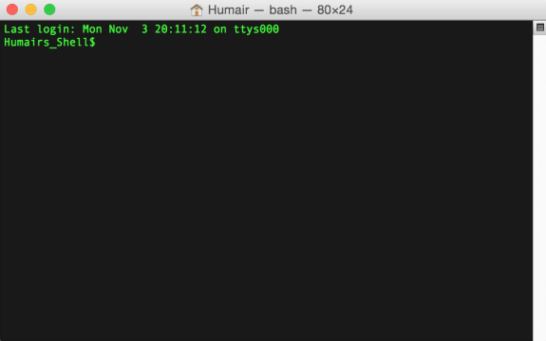
Piping Unix commands together with "|"
The sum is greater than its parts.
ARQ
# alphabetically sort the "gene" match lines and report the first 10 in alphabetical order
$ grep "gene" genes.gtf | sort | head
command 1
command 2
command 3
"stdout"
Notes:
Jump to 1:09

Slide 26
How many lines contain PTPN22?
ARQ
$ grep --color \”PTPN22\" genes.gtf | wc -l

Slide 27
How many exon records are there for PTPN22?
ARQ
$ grep --color \”PTPN22\" genes.gtf | grep -w exon | wc -l

Slide 28
ARQ
The ability to pipe together many simple tools to create something quite complex is one of UNIX's key strengths.
Notes:
Jump to 1:09

Slide 29
The cut command
(cut out specific columns/fields from a file or input stream)
ARQ
So far, we have been working with entire lines of files. Many times we want to just explore specific subsets of information in a file. The grep command helps to isolate specific lines. The cut command helps us to extract specific columns from lines.
The cut command assumes that your file or input stream (in the case of a pipe) is tab-delimited.

Slide 30
The cut command
(cut out specific columns/fields from a file or input stream)
ARQ
$ less -S genes.gtf
#!genome-build GRCh38.p7
#!genome-version GRCh38
#!genome-date 2013-12
#!genome-build-accession NCBI:GCA_000001405.22
#!genebuild-last-updated 2016-06
1 havana gene 11869 14409 . + . gene_id "ENSG00000223972"; gene_version "5"; gene_name "DDX11L1"; gene_source "havana";
1 havana transcript 11869 14409 . + . gene_id "ENSG00000223972"; gene_version "5"; transcript_id "ENST00000456328"; tr
1 havana exon 11869 12227 . + . gene_id "ENSG00000223972"; gene_version "5"; transcript_id "ENST00000456328"; transcript
1 havana exon 12613 12721 . + . gene_id "ENSG00000223972"; gene_version "5"; transcript_id "ENST00000456328"; transcript
1 havana exon 13221 14409 . + . gene_id "ENSG00000223972"; gene_version "5"; transcript_id "ENST00000456328"; transcript
1 havana transcript 12010 13670 . + . gene_id "ENSG00000223972"; gene_version "5"; transcript_id "ENST00000450305"; tr
1 havana exon 12010 12057 . + . gene_id "ENSG00000223972"; gene_version "5"; transcript_id "ENST00000450305"; transcript
1 havana exon 12179 12227 . + . gene_id "ENSG00000223972"; gene_version "5"; transcript_id "ENST00000450305"; transcript
1 havana exon 12613 12697 . + . gene_id "ENSG00000223972"; gene_version "5"; transcript_id "ENST00000450305"; transcript
1 havana exon 12975 13052 . + . gene_id "ENSG00000223972"; gene_version "5"; transcript_id "ENST00000450305"; transcript
1 havana exon 13221 13374 . + . gene_id "ENSG00000223972"; gene_version "5"; transcript_id "ENST00000450305"; transcript
1 havana exon 13453 13670 . + . gene_id "ENSG00000223972"; gene_version "5"; transcript_id "ENST00000450305"; transcript
1 havana gene 14404 29570 . - . gene_id "ENSG00000227232"; gene_version "5"; gene_name "WASH7P"; gene_source "havana"; g
1 havana transcript 14404 29570 . - . gene_id "ENSG00000227232"; gene_version "5"; transcript_id "ENST00000488147"; tr
1 havana exon 29534 29570 . - . gene_id "ENSG00000227232"; gene_version "5"; transcript_id "ENST00000488147"; transcript
1 havana exon 24738 24891 . - . gene_id "ENSG00000227232"; gene_version "5"; transcript_id "ENST00000488147"; transcript
1 havana exon 18268 18366 . - . gene_id "ENSG00000227232"; gene_version "5"; transcript_id "ENST00000488147"; transcript
1 havana exon 17915 18061 . - . gene_id "ENSG00000227232"; gene_version "5"; transcript_id "ENST00000488147"; transcript
1 havana exon 17606 17742 . - . gene_id "ENSG00000227232"; gene_version "5"; transcript_id "ENST00000488147"; transcript
Invisible tab (\t) characters

Slide 31
The cut command identifies columns by number
ARQ
$ less -S genes.gtf
The long strings of text at the end of each line are treated as a single column. Why?
Because the text within is separated by spaces, not tabs.
#!genome-build GRCh38.p7
#!genome-version GRCh38
#!genome-date 2013-12
#!genome-build-accession NCBI:GCA_000001405.22
#!genebuild-last-updated 2016-06
1 havana gene 11869 14409 . + . gene_id "ENSG00000223972"; gene_version "5"; gene_name "DDX11L1"; gene_source "havana";
1 havana transcript 11869 14409 . + . gene_id "ENSG00000223972"; gene_version "5"; transcript_id "ENST00000456328"; tr
1 havana exon 11869 12227 . + . gene_id "ENSG00000223972"; gene_version "5"; transcript_id "ENST00000456328"; transcript
1 havana exon 12613 12721 . + . gene_id "ENSG00000223972"; gene_version "5"; transcript_id "ENST00000456328"; transcript
1 havana exon 13221 14409 . + . gene_id "ENSG00000223972"; gene_version "5"; transcript_id "ENST00000456328"; transcript
1 havana transcript 12010 13670 . + . gene_id "ENSG00000223972"; gene_version "5"; transcript_id "ENST00000450305"; tr
1 havana exon 12010 12057 . + . gene_id "ENSG00000223972"; gene_version "5"; transcript_id "ENST00000450305"; transcript
1 havana exon 12179 12227 . + . gene_id "ENSG00000223972"; gene_version "5"; transcript_id "ENST00000450305"; transcript
1 havana exon 12613 12697 . + . gene_id "ENSG00000223972"; gene_version "5"; transcript_id "ENST00000450305"; transcript
1 havana exon 12975 13052 . + . gene_id "ENSG00000223972"; gene_version "5"; transcript_id "ENST00000450305"; transcript
1 havana exon 13221 13374 . + . gene_id "ENSG00000223972"; gene_version "5"; transcript_id "ENST00000450305"; transcript
1 havana exon 13453 13670 . + . gene_id "ENSG00000223972"; gene_version "5"; transcript_id "ENST00000450305"; transcript
1 havana gene 14404 29570 . - . gene_id "ENSG00000227232"; gene_version "5"; gene_name "WASH7P"; gene_source "havana"; g
1 havana transcript 14404 29570 . - . gene_id "ENSG00000227232"; gene_version "5"; transcript_id "ENST00000488147"; tr
1 havana exon 29534 29570 . - . gene_id "ENSG00000227232"; gene_version "5"; transcript_id "ENST00000488147"; transcript
1 havana exon 24738 24891 . - . gene_id "ENSG00000227232"; gene_version "5"; transcript_id "ENST00000488147"; transcript
1 havana exon 18268 18366 . - . gene_id "ENSG00000227232"; gene_version "5"; transcript_id "ENST00000488147"; transcript
1 havana exon 17915 18061 . - . gene_id "ENSG00000227232"; gene_version "5"; transcript_id "ENST00000488147"; transcript
1 havana exon 17606 17742 . - . gene_id "ENSG00000227232"; gene_version "5"; transcript_id "ENST00000488147"; transcript
1
2
3
4
5
6
7
8
9

Slide 32
Use cut to extract solely the second column
ARQ
$ cut -f 2 genes.gtf | head –n 20
#!genome-build R64-1-1
#!genome-version R64-1-1
#!genome-date 2011-09
#!genome-build-accession GCA_000146045.2
#!genebuild-last-updated 2018-10
havana
havana
havana
havana
havana
havana
havana
havana
havana
havana
havana
havana
havana
havana
havana
Why were the first 5 lines reported?
How could we prevent that?

Slide 33
Let's omit the header lines first.
ARQ
$ grep -v "#\!gen" genes.gtf | cut -f 2 | head -n 20
havana
havana
havana
havana
havana
havana
havana
havana
havana
havana
havana
havana
havana
havana
Havana
havana
havana
havana
havana
havana
The more specific the command, the better (maybe another line later has a “#” included that we wouldn’t want to miss

Slide 34
Saving results to files with >
ARQ
So far, every command we have run reports the output to the screen (i.e., standard output or "stdout").
Obviously, once an analysis is working the way we want, we typically wish to save the results to a file.
We do this with the "redirect to a file operator": >

Slide 35
Saving results to files with >
ARQ
$ grep -v "#" genes.gtf | cut -f 2 | head -n 20 > column2.first20.txt
$ cat column2.first20.txt
havana
havana
havana
havana
havana
havana
havana
havana
havana
havana
havana
havana
havana
havana
Havana
havana
havana
havana
havana
havana

Slide 36
The results are just a plain old file!
ARQ
$ head -n 2 column2.first20.txt
havana
havana

Slide 37
Homework
Submit CHPC application
https://www.chpc.utah.edu/documentation/gettingstarted.php
Choose /bin/bash for environment shell

