Slide 1
Access the slides and files here:
https://github.com/j-berg/bioinformatics_bootcamp

Slide 2
#3.1
Transferring files between CHPC and personal computer
IGV
Data types
Functions
Internal and External libraries

Slide 3
Transferring files to your personal computer
From your personal computer/terminal
$ scp uNID@notchpeak.chpc.utah.edu:~/path/to/file.bam ./
$ scp uNID@notchpeak.chpc.utah.edu:~/path/to/file.bam.bai ./

Slide 4
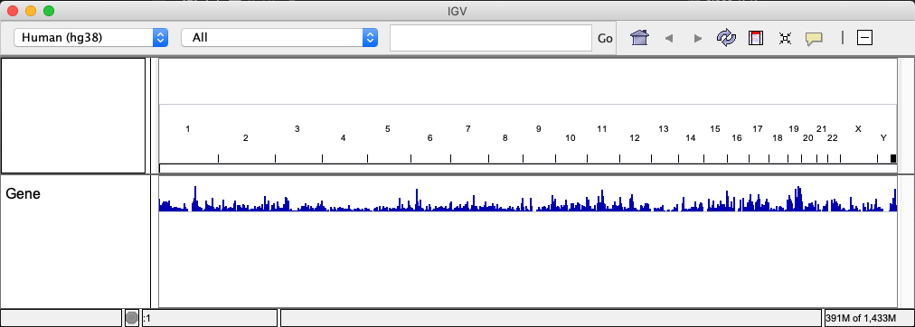
Visualizing read pile-ups with IGV
Download IGV:
https://software.broadinstitute.org/software/igv/download
Drag and drop BAM file into viewer

Slide 5
Open python in terminal or write a script
$ python
>>>
$ python script.py

Slide 6
The foundations of coding
Data types:
Integers
Floats & Doubles
Strings
Arrays
Sets
Dictionaries
Objects

Slide 7
Integers
Numeric types refer to the precision of the value
Integers: whole numbers
>>> x = 1
>>> type(x)
<class 'int’>
>>> y = int(1.0)
>>> type(y)
<class 'int’>

Slide 8
Floats
Floating point value
Represents a fractional value
Depending on your system, can have increased precision
Ever wonder what the difference is between a 32-bit and 64-bit OS?
32-bit can access 2³² memory addresses
64-bit can access 2⁶⁴ memory addresses

Slide 9
Let’s talk about how memory works
A bit is can be equal to 0 or 1 determined by an presence or absence or an electrical charge at a given position on the computer chip
A byte is a collection of 8 bits that represent a higher value
A byte can store ”A”, or “X”, or “$”, etc.
0010 0001 = “!”
0011 0000 = “0”
In general: add 1 bit, double the number of patterns
1 bit - 2 patterns
2 bits - 4
3 bits - 8
4 bits - 16
5 bits - 32
6 bits - 64
7 bits - 128
8 bits - 256 - one byte
Mathematically: n bits yields 2^{n} patterns (2 to the nth power)
https://web.stanford.edu/class/cs101/bits-bytes.html
https://www.colocationamerica.com/images/bit-byte-comparison.jpg

Slide 10
Floats and doubles
Floating point value
Represents a fractional value
Depending on your system, can have increased precision
Ever wonder what the difference is between a 32-bit and 64-bit OS?
32-bit can access 2³² memory addresses
64-bit can access 2⁶⁴ memory addresses
Float -> up to 32 points of precision
Double -> up to 64 points of precision (Python will call this a “float”)
By being able to represent higher precision values, able to develop more complicated procedures, etc

Slide 11
Mixing data types
Combining datatypes may lead to incompatibilities, errors, so be aware!
Converting a float to an integer will lose precision
>>> x = 1.234567890123456789
>>> y = int(x)
>>> print(x)
1.2345678901234567
>>> type(x)
<class 'float’>
>>> type(y)
<class 'int’>
>>> print(y)
1

Slide 12
Strings
Represents text instead of numbers
Generally indicated with quotes
Can force integers and floats/doubles to strings
>>> x = “Hello world!”
>>> print(x)
Hello world!
>>> y = 1.23456789
>>> y = str(y)
>>> print(x, y)
Hello world! 1.23456789

Slide 13
Arrays
A sequential, ordered list of values
>>> x = [1,2,3]
>>> y = [‘a’, ‘b’, ‘c’]
>>> z = [1, 2, 3, “d”, “e”]
What happens when we try this?
>>> zz = [x, y]
[[ 1 , 2 , 3 ],
[‘a’, ‘b’, ‘c’]]
Access something from an array
What does this do?
>>> zz[1][1]
Why is the output ‘b’?

Slide 14
Indexing
Indices start at 0 in Python
This will vary language to language (R starts at 1)

Slide 15
Sets
Try this:
>>> v = set([1,2,3,4,4])
Or
>>> v = {1,2,3,4,4}
>>> v
{1, 2, 3, 4}
Why does this happen? Let’s talk about another similar data type

Slide 16
Dictionaries (or hashes)
>>> d = {}
>>> d[“a”] = “Hello”
>>> d[“b”] = “world!”
>>> d
{'a': 'Hello', 'b': 'world'}
>>> d[“a”]
‘Hello’
>>> d[“a”] = “Goodbye”
>>> d
{'a': Goodbye ', 'b': 'world'}

Slide 17
How to dictionaries, hashes, and sets work?
One value associated with a given key
Unordered (unlike a list/array)
Two identical values go to same place in memory, so only returns one iteration
What does a hash do?
A function that converts a given input to another (such as a position in memory)
The hash function is constant, the same input will always give the same output
Able to map a value of variable size to a fixed-size output
https://en.wikipedia.org/wiki/Hash_function

Slide 18
Array vs dictionary performance
As arrays are ordered, they are searched in order
n steps
A dictionary finds if a value is set because it translates the string to a hash position to see if its set
One step
Dictionary keys are converted to a hash which corresponds to a given spot in the computer memory
To search for the value associated with a key, it only has to re-hash the key value you give it, go straight to that position in memory to check for a value, and return the value if it exists

Slide 19
Array vs dictionary performance
For example, you want to find Sal’s office, but don’t know the office number, so you have to search office by office until you find Sal’s office -> array/list
Or, you know Sal’s office number already, so you go straight there -> dictionary/hash
https://unsplash.com/photos/NIrgENd0sAY?utm_source=unsplash&utm_medium=referral&utm_content=creditCopyText

Slide 20
Functions: A not-so-black box
x
y
x
y, z
x, y
z

Slide 21
Functions
Useful for commonly run tasks
Useful for functions others might want to run themselves
Packaged and distributed as “libraries”

Slide 22
Libraries
A collection of functions
Download as follows:
Basic packages:
Included with Python
External packages:
Download with conda
$ conda install pandas

Slide 23
Loading a library
Need to give the session or script access to the functions from the library
>>> import os
>>> import pandas

Slide 24
Homework
Transfer one of the alignment files to your personal computer and open in IGV. Find a gene whose transcripts (isoforms) seem to be differentially expressed.
Create a dictionary of a mock classroom of students and their test scores.
Create an array of students’ names, include names that were not in the dictionary.
Access each student in the array, determine if they are in the dictionary programmatically, and print out a sentence that states “[student] got a [score] on their test.”

