Slide 1
Access the slides and files here:
https://github.com/j-berg/bioinformatics_bootcamp

Slide 2
#5.1
R Studio
Bioconductor
Libraries & Documentation
Variables, loops, functions, etc.
Outputting analyses

Slide 3
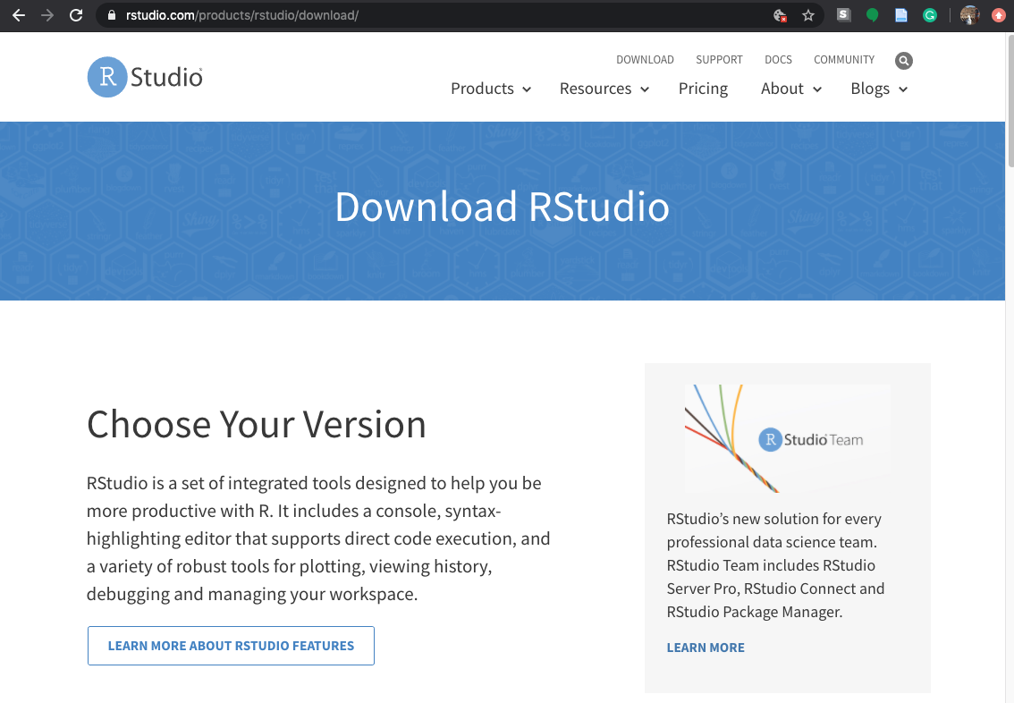
Downloading RStudio

Slide 4
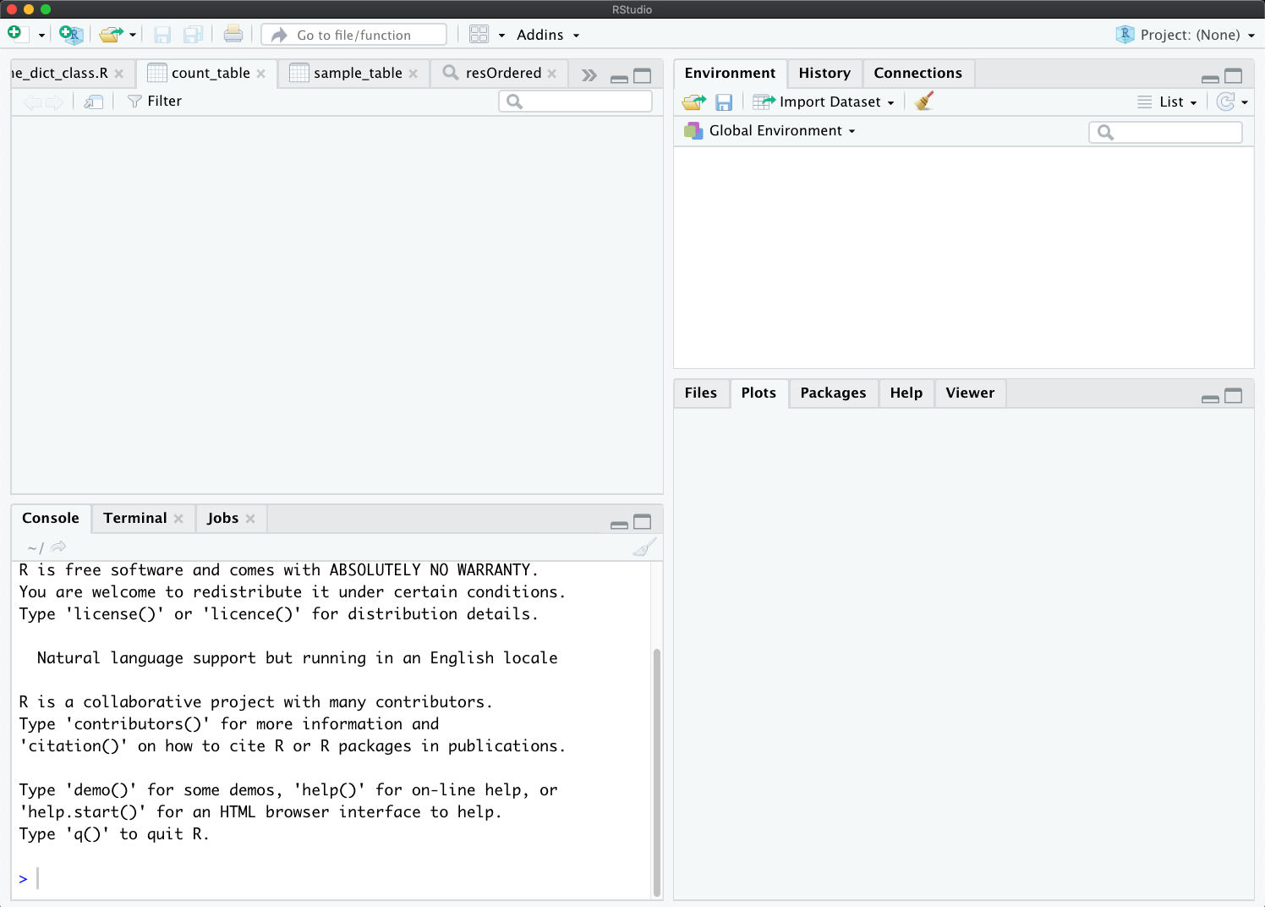
Using RStudio
View data here ->
<- View environment
variables here
<- View files, plots, and
help menus
Enter commands here ->

Slide 5
Integers
Numeric types refer to the precision of the value
Integers: whole numbers
> x <- 1
> type(x)
> y <- as.integer(x)
> type(y)
> type(y)

Slide 6
Mixing data types
Combining datatypes may lead to incompatibilities, errors, so be aware!
Converting a float or double to an integer will lose precision
> x <- 1.234567890123456789
> y <- as.integer(x)
> type(x)
> type(y)
> print(x)
> print(y)

Slide 7
Strings
Represents text instead of numbers
Generally indicated with quotes
Can force integers and floats/doubles to strings
> x <- “Hello world!”
> print(x)
> y <- 1.23456789
> toString(y)
> paste(x, toString(y), sep="!!!")

Slide 8
Arrays
A sequential, ordered list of values
> x <- c(1, 2, 3)
> y <- c(“a”, “b”, “c”)
> z <- c(1, 2, 3, “d”, “e”)
Notice this converts your integers to strings
What happens when we try this?
> zz <- array(c(x, y),dim = c(3,2))
Access something from an array
What does this do?
> zz[2,1]

Slide 9
Sets
Try this:
> v <- c(1,1,2,3,4,4,5,6)
> unique(v)
Why does this happen? Let’s talk about another similar data type

Slide 10
Dictionaries (or hashes)
> library(hash)
> h <- hash()
> h[[“a”]] <- “Hello”
> h[[“b”]] <- “world!”
> h
> h[[“a”]]
> h[[“a”]] <- “Goodbye”
> h

Slide 11
Libraries
A collection of functions
External
Internal (we’ll talk about this later)
Download as follows:
Basic packages:
Tools -> Packages -> enter package name and install
Download “data.table”
Bioinformatics packages
Google “download DESeq2” and click on the Bioconductor link
Run the installation code block
If it asks you whether you want to update all/some/none, “none” is usually okay

Slide 12
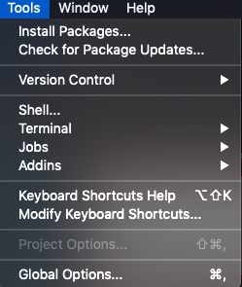
Install general R packages

Slide 13
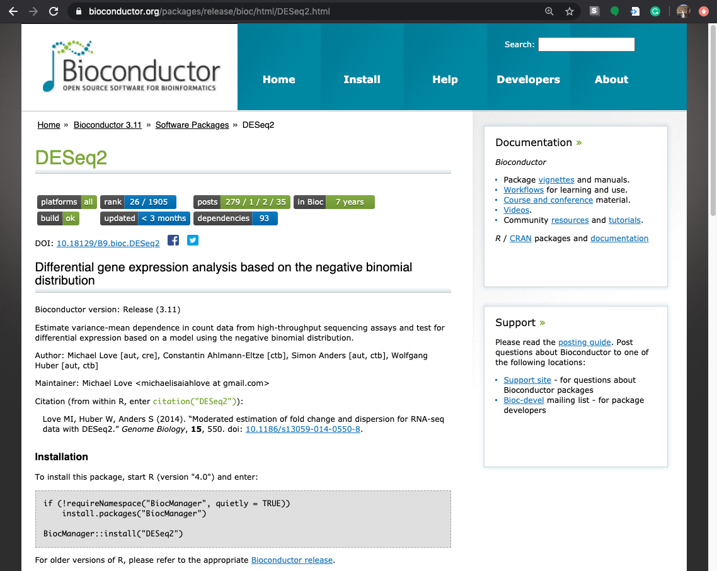
Install bioinformatics software
Run these commands
to install ->

Slide 14
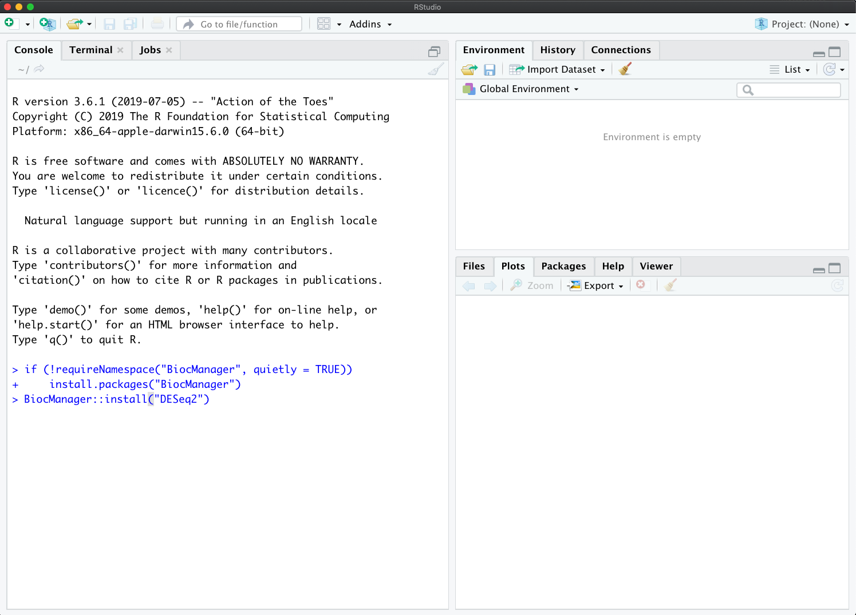
Installing DESeq2

Slide 15
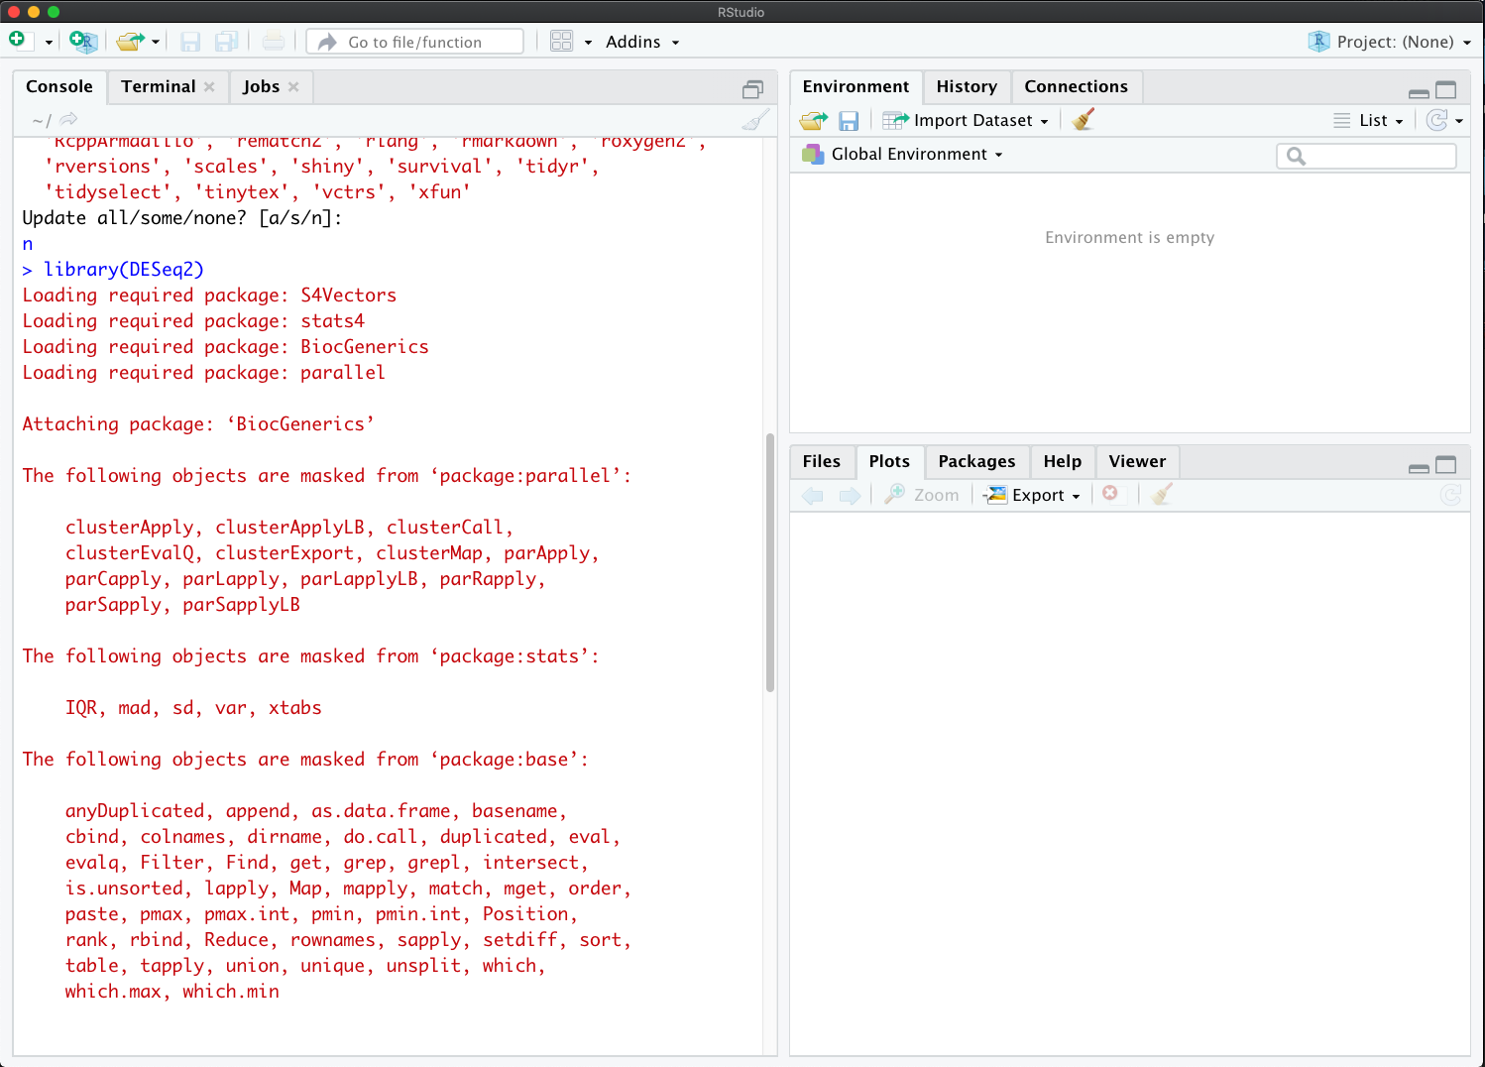
Installing DESeq2

Slide 16
Loading a library
Need to give the session or script access to the functions from the library
> library(data.table)
> library(DESeq2)

Slide 17
Getting help
StackOverflow
Library documentation
Usually opened with a “?” before the function name (sometimes a “??”)
Viewing the help menus
> ?data.table
> ??DESeq2
> ?estimateSizeFactors
> browseVignettes("DESeq2")
-> DESeq2::counts

Slide 18
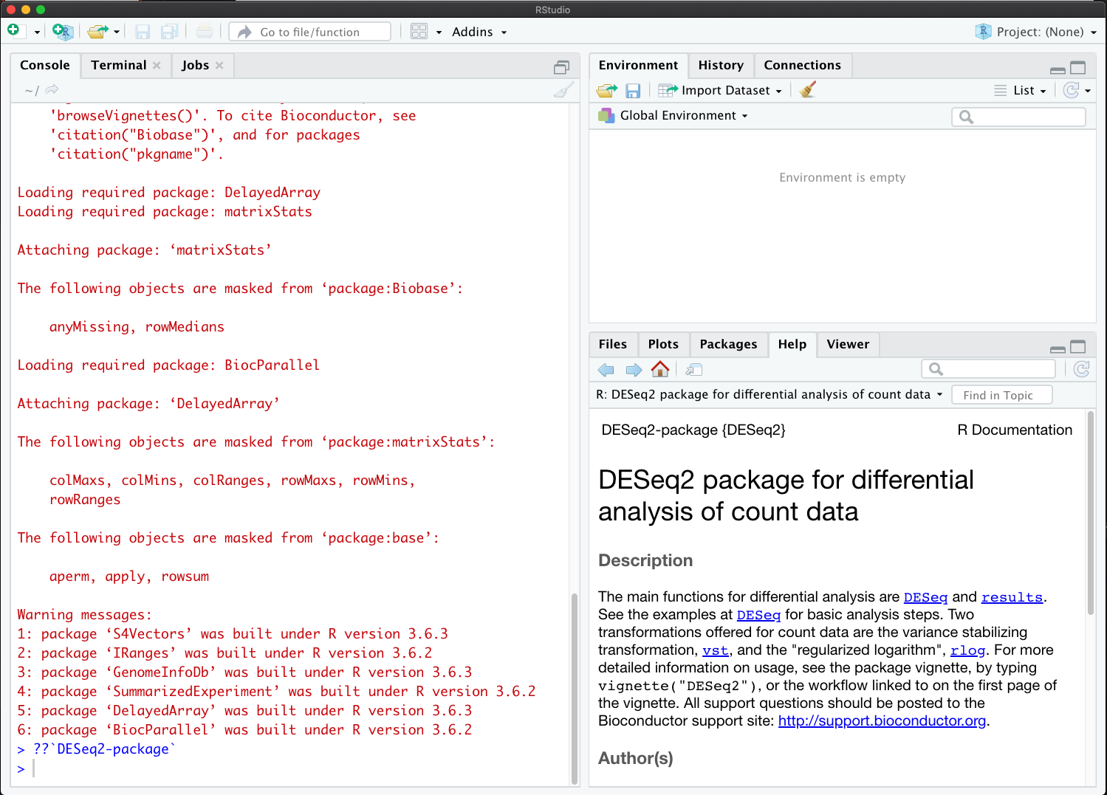
Accessing Bioconductor tool help menu

Slide 19
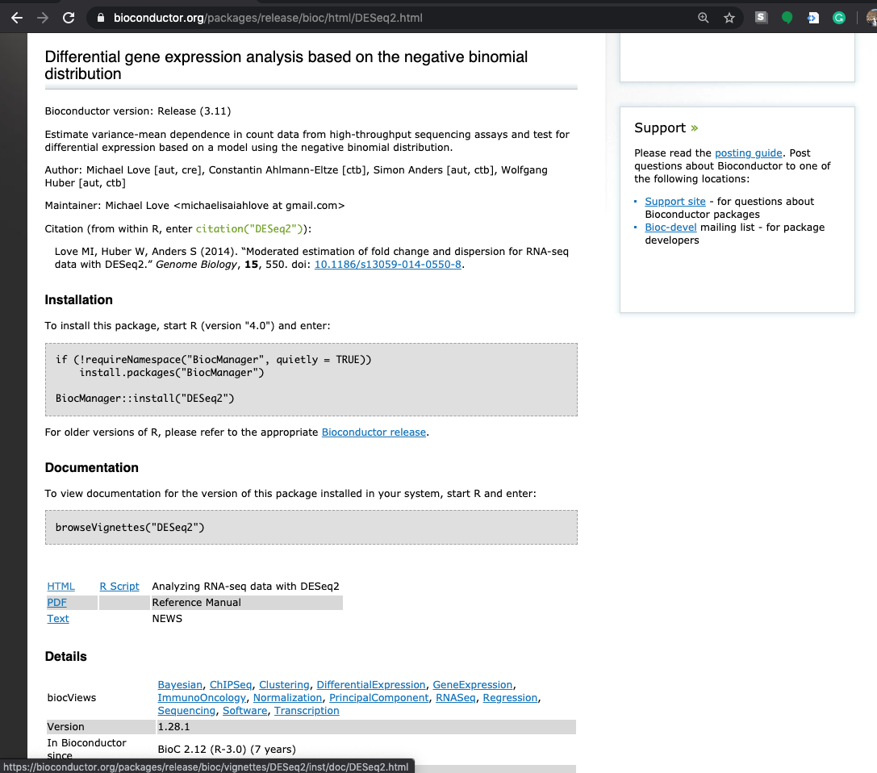
Accessing Bioconductor tool help menu

Slide 20
if/else conditionals
Say we want to get the output of a function and depending on that output, perform one of two options
For example, we only want to run the next step if the output is less than 100. We will need if/else logic, and will need to use operators
> y <- function(x)
> if (y < 100) {do this} else {do this}

Slide 21
Let’s break this down and go over some edge cases
> if (y < 100) {do this} else {do this}
Structure
The statement being evaluated is in parantheses
The task to run if the statement is true is in curly brackets
The syntax of how to do this will differ language to language
“else” covers all leftover options – this can be left blank

Slide 22
Operators
>: greater than
<: less than
>=: greater than or equal to
<=: less than or equal to
==: equal to
!=: not equal to
&: and
|: or
https://www.statmethods.net/management/operators.html

Slide 23
What if there are several options you want to encode?
> if (y < 100) {
do this
} else if (y > 100 & y <= 200) {
do this
} else if (y > 200 & y <= 300) {
do this
} else {
do this
}

Slide 24
For loops
Used to repeat a task for a defined list of values
> A <- c(“Hello”, “world”, “!”)
> for (x in A) {print(x)}
This can be combined with conditions
> for (x in A) {
if (nchar(x) > 2) {
print(x)
}
}
Thought exercise: What will this print out?

Slide 25
While loops
What if we don’t know how many iterations we want to run?
> y <- 0 # We initialize the counting variable here
> while (y < 10) {
print(“Hello”)
y <- y + 1
}
> print(”Goodbye”)
However, this is flexible, if we changed the iterator to only add 0.5, would run 2x loops

Slide 26
> addone <- function(x) {
x <- x + 1
return(x)
}
> addone(1)
> x
Variables set or called in function are only available for that function call, will not set or modify outside variables (usually)

Slide 27
What about multiple inputs?
> addtwo <- function(x, y) {
z <- (x + 1) / y
return(z)
}
> addtwo(1, 2)
If we want to save the output from the function, we need to set a new variable
> output <- addtwo(1, 2)
> print(output)

Slide 28
What about multiple outputs?
> multitask <- function(x) {
if (x > 100) {
x <- x / 2
y <- “large number”
} else {
y <- “small number”
}
output_array <- c(x, y)
return(output_array)
}
> multitask(1)
> multitask(101)

Slide 29
How about saving multiple outputs?
R only allows for returning one object from a function, so we have to pass out an array of all the output values
> outputs <- multitask(101)
> outputs[1]
> outputs[2]

Slide 30
Writing a library of your own functions
Save functions to a file ending in “.r”
Run:
> setwd(“~/Desktop/”) # or where ever the hello.r script is
> source(“custom.r”)
> sayHello()

Slide 31
Homework
Write an R script with the following functions (a separate function for each task:
Print “Hello world”
Print “Goodbye world”
Take a user input and add 5. If the output if over 10, return 10, else return the modified input value
Take a user input and print “100” if input is less than 100, “200” if input is between 100 and 200, “300” if input is between 200 and 300, or “other” for anything else
Print a list of values, each time pre-pended with “value #:” where # is the position in the list of that value being printed
Run these functions with various inputs that will give all possible outputs and save these commands to a txt file.

