Slide 1
Access the slides and files here:
https://github.com/j-berg/bioinformatics_bootcamp

Slide 2
#5.2
DESeq2
Multiple Hypothesis Testing
Data normalization
Scatter Plots

Slide 3
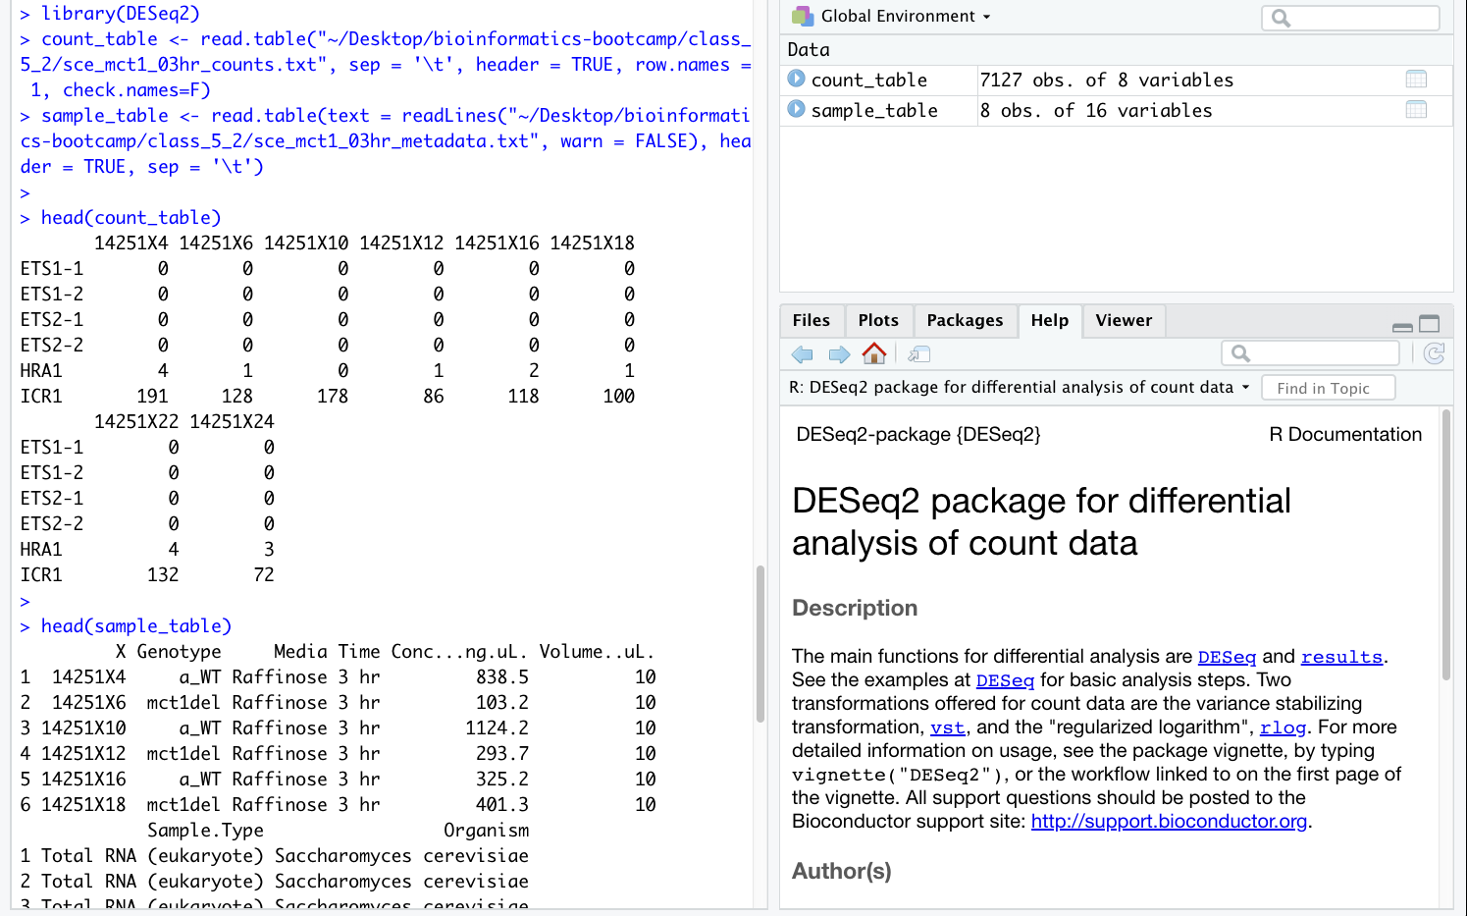
Analyzing count data using DESeq2

Slide 4
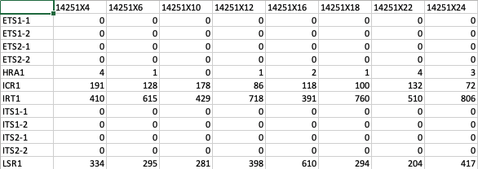
Counts

Slide 5
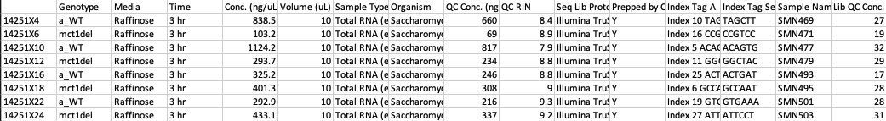
Metadata

Slide 6
Commands
library(DESeq2)
count_table <- read.table("~/Desktop/bioinformatics-bootcamp/class_5_2/sce_mct1_03hr_counts.txt", sep = '\t', header = TRUE, row.names = 1, check.names=F)
head(count_table)
sample_table <- read.table(text = readLines("~/Desktop/bioinformatics-bootcamp/class_5_2/sce_mct1_03hr_metadata.txt", warn = FALSE), header = TRUE, sep = '\t’)
head(sample_table)

Slide 7
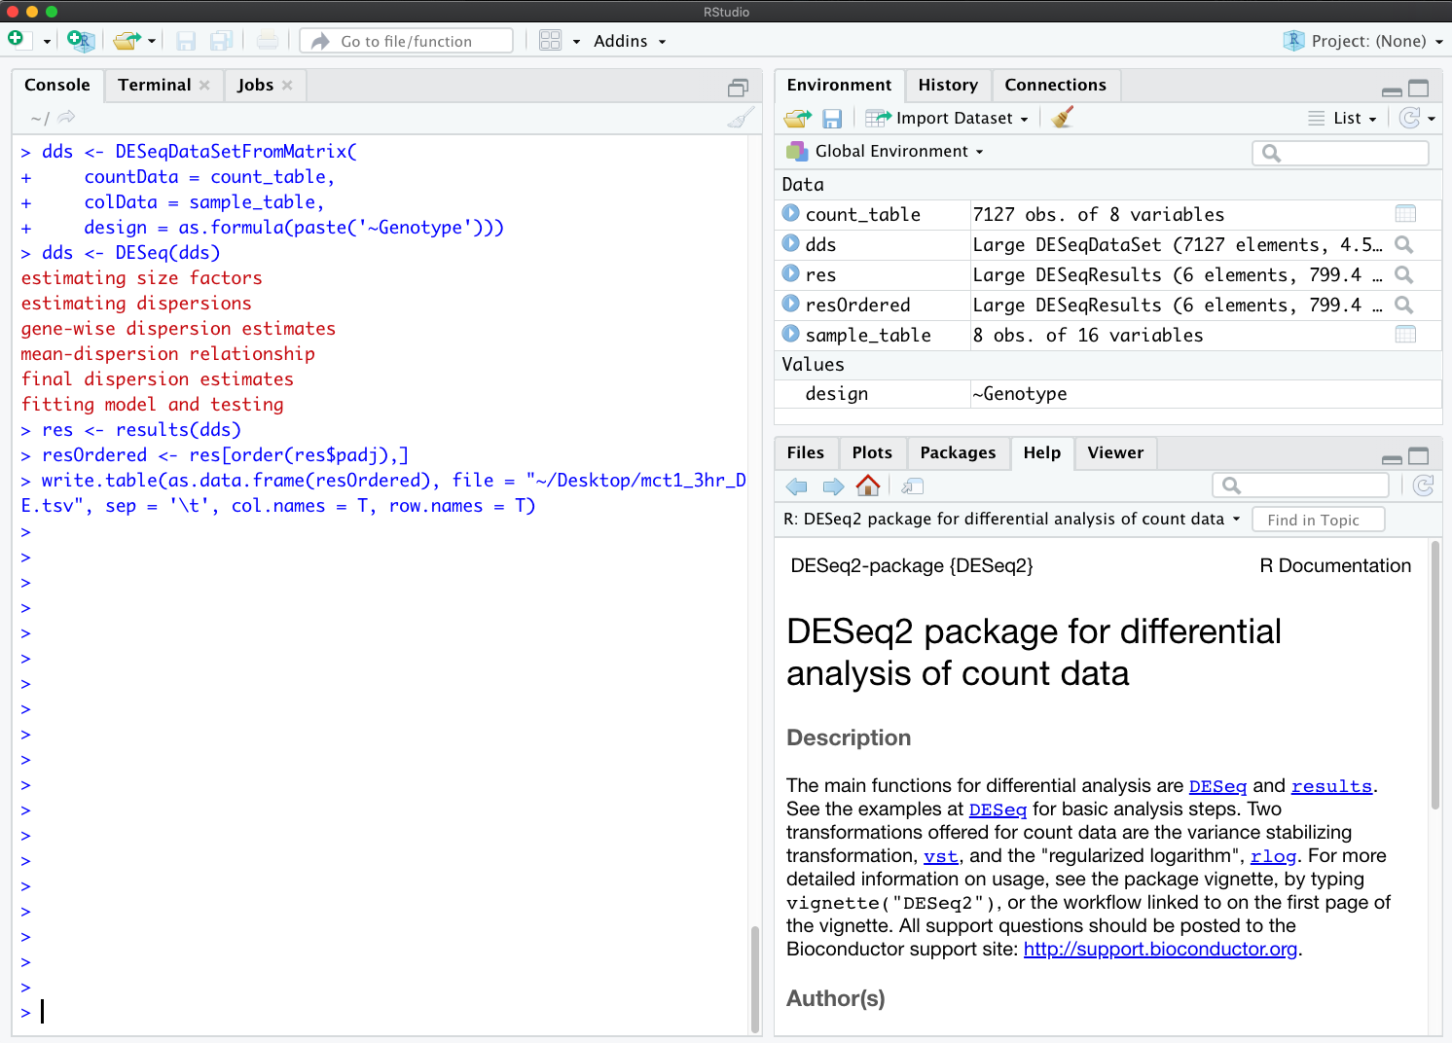
Analyzing count data using DESeq2

Slide 8
Commands
dds <- DESeqDataSetFromMatrix(
countData = count_table,
colData = sample_table,
design = ~Genotype)
dds <- DESeq(dds)
res <- results(dds)
resOrdered <- res[order(res$padj),]
write.table(as.data.frame(resOrdered), file = "~/Desktop/mct1_3hr_DE.tsv", sep = '\t', col.names = T, row.names = T)

Slide 9
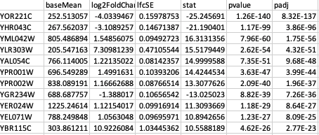
Output
Note: Your file paths for inputs and outputs may differ based on operating system

Slide 10
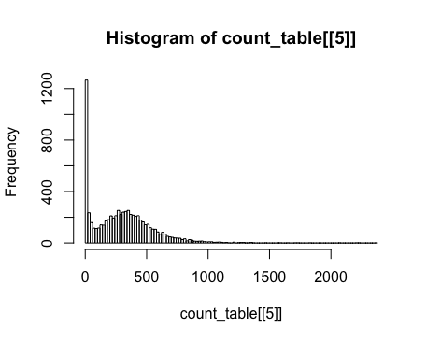
Biases in sequence libraries
Gene counts for a given RNA-seq sample follow a negative binomial distribution
Need to run appropriate statistical tests
!!! Do not use a T-test, this assumes data is
normally distributed which it is not!
DESeq2 properly accounts for this

Slide 11
Library normalization
The number of reads and the length of transcripts influence the number of measured reads
A gene may have 500 counts between two samples, but if one sample had 100K reads and another had 100M total reads, 500 would account for different fractions of total reads
A transcript that is 10kb will naturally fragment into 10x reads as a transcript that is only 1kb
See https://www.rna-seqblog.com/rpkm-fpkm-and-tpm-clearly-explained/

Slide 12
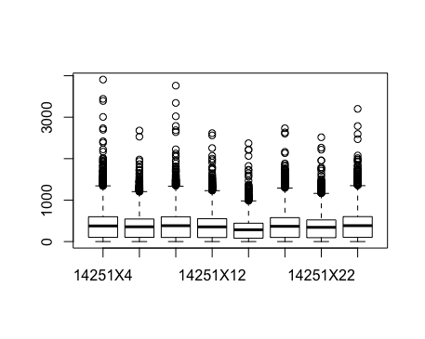
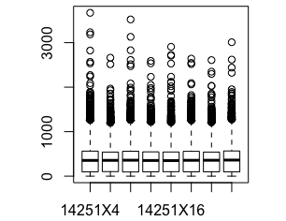
Performing normalization in R
Since we will only be running a comparison of each gene to each other, we will demonstrate RPM to factor out library size variability
BiocManager::install("tweeDEseq")
library(tweeDEseq)
norm <- normalizeCounts(count_table, method="TMM")
boxplot(norm)
boxplot(as.matrix(count_table))

Slide 13
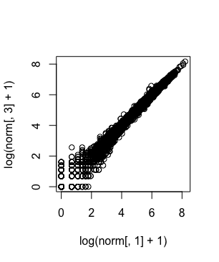
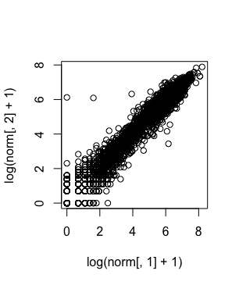
Scatter plots to compare replicates in R
REPLICATES:
plot(log(norm[,1] + 1), log(norm[,3] + 1))
NOT REPLICATES:
plot(log(norm[,1] + 1), log(norm[,2] + 1))

Slide 14
Homework
Perform differential expression analysis of your read count table from before. Identify the 25 most up-regulated and down-regulated genes from your dataset. Do these make sense in the context of the model?
Verify biological replicates look similar using scatter plots

