Slide 1
Access the slides and files here:
https://github.com/j-berg/bioinformatics_bootcamp

Slide 2
#4.1
Importing a datatable
Making a gene dictionary
Mapping gene IDs and gene names
Reusable script

Slide 3
Modularity
Plan how to break up complex tasks using pseudocode and make each task a function
Goals:
Use an organism’s GTF file as input
Parse out matching gene IDs and names
Import user datatable
Map gene dictionary to row names
Output modified table

Slide 4
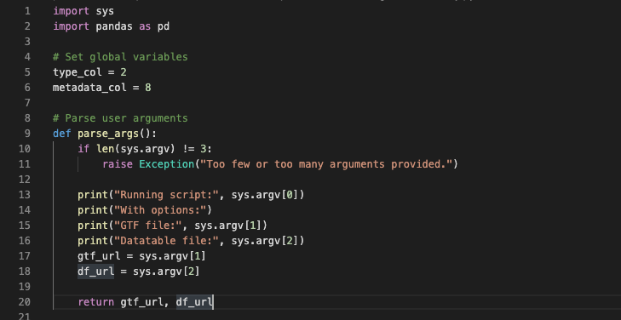
Getting a user’s inputs

Slide 5
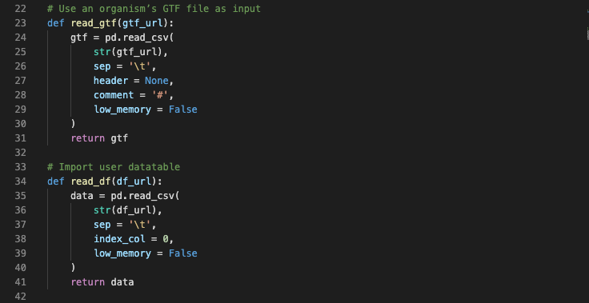
Importing data

Slide 6
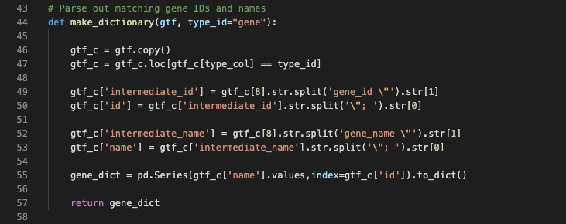
Making a gene dictionary

Slide 7
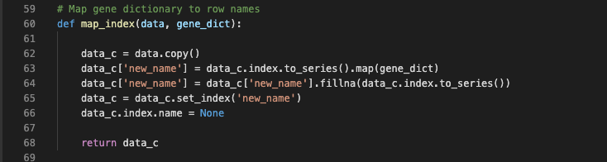
Mapping gene IDs and gene names

Slide 8
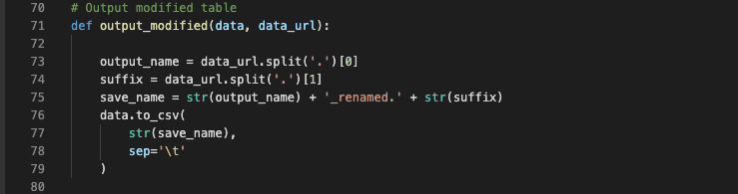
Output Data

Slide 9
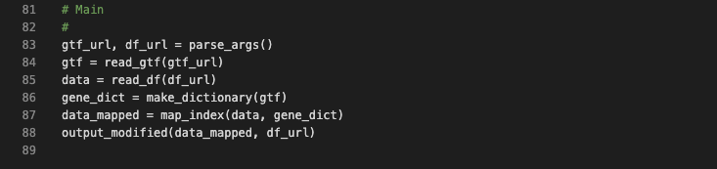
Tying it all together

Slide 10

Reusable scripts

Slide 11
Homework
Take your RNA-seq data table that was mapped to gene IDs from before and remap to gene names
- if you haven’t gotten that far, an example data table is available in the folder for this lesson on the GitHub repository

