Slide 1
#6.2
Volcano Plots
Kaplan Meier Curves
Density Curves

Slide 2
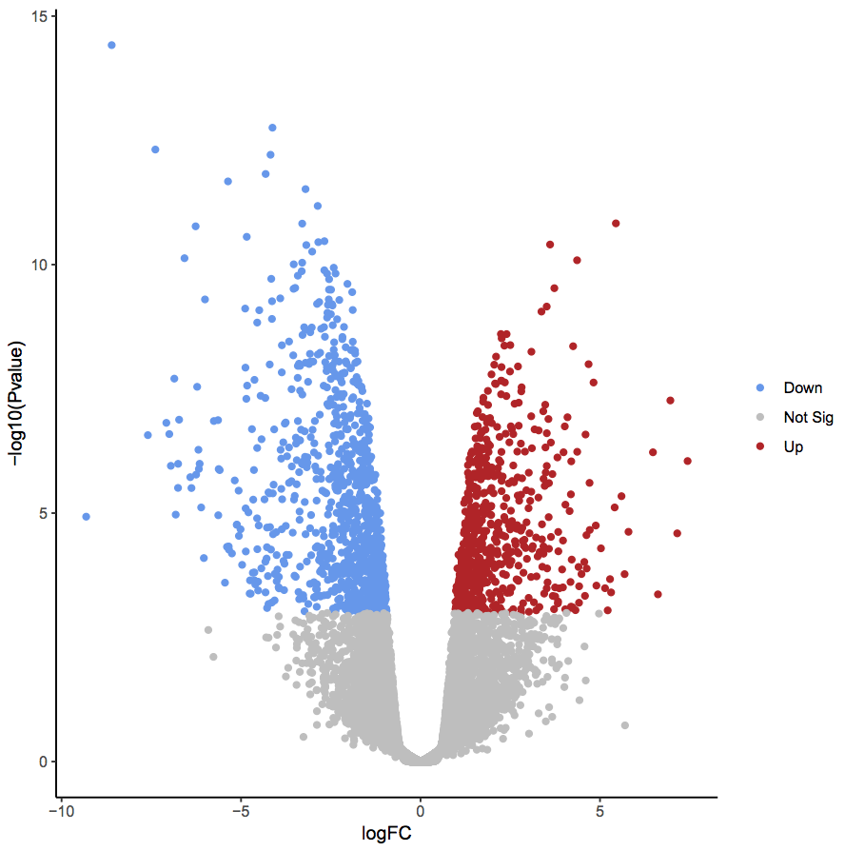
Volcano Plots
Useful, convenient way to visualize magnitude and significance at the same time
Statistical values should be platform-appropriate
Remember: RNA-seq is not normally distributed!

Slide 3
Volcano Plots
1. Take RNA-seq differential expression data from DESeq2
2. Download the EnhancedVolcano package from BioConductor
BiocManager::install(‘EnhancedVolcano’)

Slide 4
> library(DESeq2)
> count_table <- read.table(
"C:\\Users\\jorda\\Desktop\\projects\\bioinformatics-bootcamp\\class_6_2\\sce_mct1_03hr_counts.txt",
sep = '\t’,
header = TRUE,
row.names = 1,
check.names=F)
> sample_table <- read.table(
text = readLines(
"C:\\Users\\jorda\\Desktop\\projects\\bioinformatics-bootcamp\\class_6_2\\sce_mct1_03hr_metadata.txt",
warn = FALSE),
header = TRUE,
sep = '\t’)
> dds <- DESeqDataSetFromMatrix(
> countData = count_table,
> colData = sample_table,
> design = ~Genotype)
> dds <- DESeq(dds)
> res <- results(dds)
> resOrdered <- res[order(res$padj),]

Slide 5
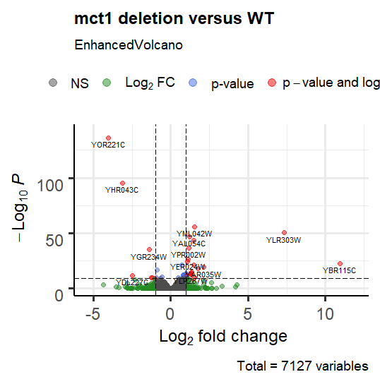
Volcano Plots
> library(EnhancedVolcano)
> EnhancedVolcano(
resOrdered,
lab = rownames(resOrdered),
x = 'log2FoldChange’,
y = 'padj’,
title = 'mct1 deletion versus WT’,
pCutoff = 10e-10,
FCcutoff = 1)
Some notes:
Use gene names
Label axes correctly (“FDR” or “p-adj”, not just “p”)
Check the documentation for more information:
https://github.com/kevinblighe/EnhancedVolcano

Slide 6
Kaplain-Meier Curves
Estimate survival as a function of a condition
Is a drug having a significant effect on outcome?
Does a genotype or phenotype improve outcome?
There are a lot of open source
resources like this!
> install.packages('survminer’)
> BiocManager::install('RTCGA.clinical’)
> library(survminer)
> library(survival)
> library(RTCGA.clinical)
See: https://cran.r-project.org/web/packages/survminer/vignettes/Informative_Survival_Plots.html

Slide 7
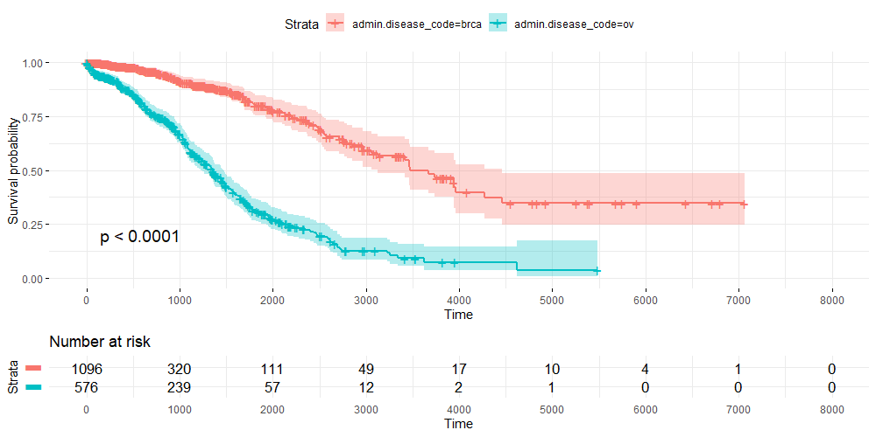
Kaplain-Meier Curves
> survivalTCGA(BRCA.clinical, OV.clinical, extract.cols = "admin.disease_code")
> fit <- survfit(Surv(times, patient.vital_status) ~ admin.disease_code, data = BRCAOV.survInfo)
> ggsurvplot(
fit,
data = BRCAOV.survInfo,
risk.table = TRUE,
pval = TRUE,
conf.int = TRUE,
break.time.by = 1000,
ggtheme = theme_minimal(),
risk.table.y.text.col = T,
risk.table.y.text = FALSE)

Slide 8
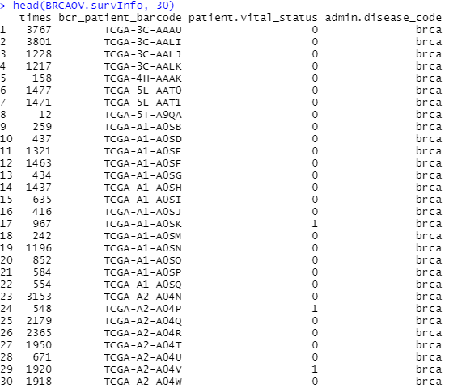
Kaplain-Meier Curves
Breaking down the inputs
Metadata-based:
Phenotype/genotype information
Survival time after diagnosis
Cumulative probability that at time x, someone is still alive/healthy/etc.

Slide 9
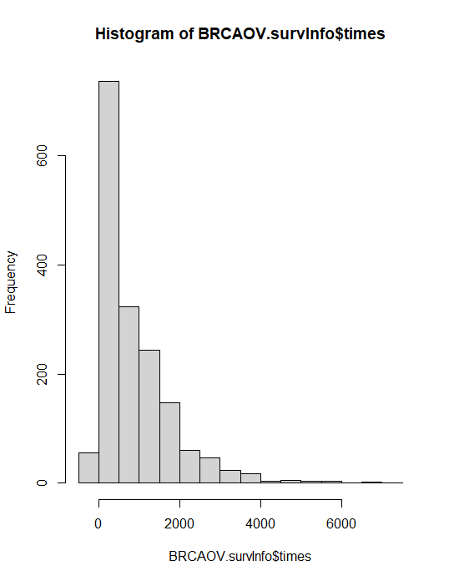
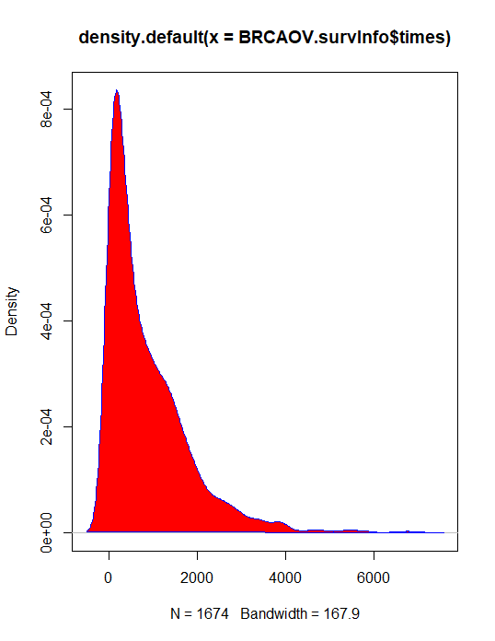
Density Curve
Number at a time
> hist(BRCAOV.survInfo$times)
Proportion at a time
> d <- density(BRCAOV.survInfo$times)
> plot(d)
> polygon(d, col=‘red’, border=‘blue’)

Slide 10
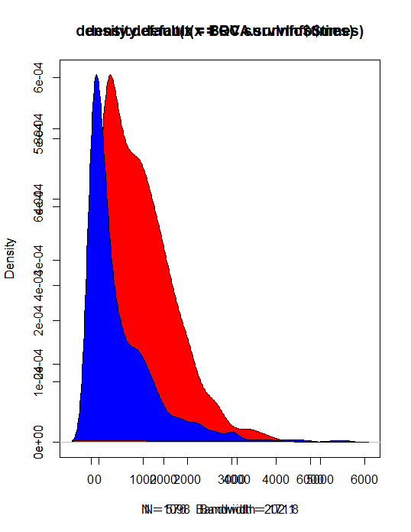
Overlapping plots
> d1 <- density(OV.survInfo$times)
> d2 <- density(BRCA.survInfo$times)
> plot(d1)
> polygon(d1, col='red')
> par(new=TRUE)
> plot(d2)
> polygon(d2, col='blue')

