Slide 1

WebAssembly
Julian Arz - 21.10.2022

Slide 2
What is WebAssembly?
WebAssembly is a portable binary format.
It lets you run languages other than JavaScript in the browser.
But also:
WebAssembly is not assembly, and it is also not (only) for the web.

Slide 3
Topics
History & Goals
Demo
Use cases
Languages

Slide 4




History: C++ in Browser
2011
2013
2015
2017
2019
2021
emscripten
asm.js
Browser support
W3C Standard
SIMD
  C++ to JS
  Simulate memory model
  Ugly, but well JITable
Specifically optimize on
emscripten-generated code
WebAssembly
Multi-
threading
browser
support
Goals
  Portable, wide range of platforms
  Size- and load time efficient
  Native speeds
  Integrate with existing web tech
MVP with C++, later other languages
PNaCl
WASI announced
  Sandboxed
  Only Chrome
  Requires Plugin

Slide 5
Why new Standard? Limitations of JS
Dynamic typing: optimizer has to check types at runtime
JIT introduces overhead & requires a few cycles to warm up
Entire script has to be downloaded before parsing can begin
GC introduces overhead & unpredictable slowdowns

Slide 6
LLVM
Compiler for C/C++, later also Rust. Today a lot more.
C
C++
Rust
…
x86
ARM
…
…
intermediate representation (IR)
?

Slide 7
Demo
Hello World (C++)
Heron (C++)
Sobel operator (Go)
Labyrinth

Slide 8
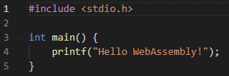

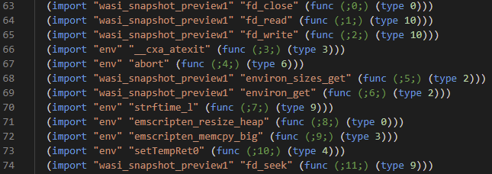
Demo: Hello World
$ emcc hello.cpp -o hello.html
Text format:
WebAssembly has no library, imports everything from environment -> portability

Slide 9
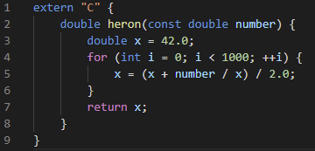
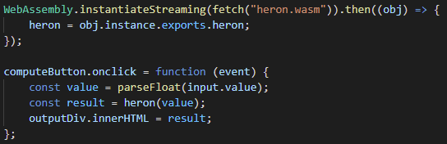
Demo: Heron
optimize for size, dce
$ emcc heron.cpp --no-entry -Os -s EXPORTED_FUNCTIONS=[_heron] -o heron.wasm
no main method
make it callable from JS
Call from JS:
Browser API

Slide 10
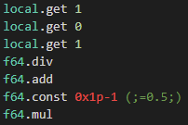
Demo: Heron
Code: Reverse Polish Notation (stack machine semantics)
It‘s not JavaScript, but is also not assembly!
Close to assembly, allows compiling while downloading

Slide 11

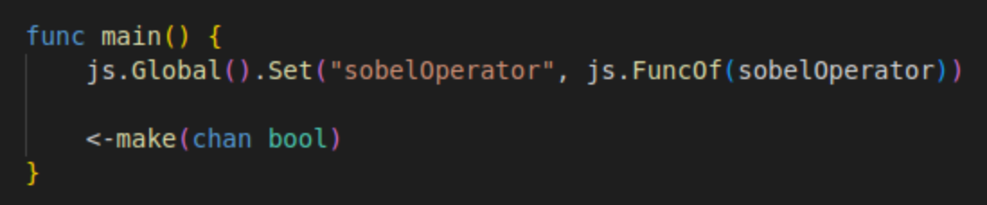
Demo: Sobel (Go)
Build with main Go compiler
$ GOOS=js GOARCH=wasm go build -o build/convolve.wasm .
$ cp "$(go env GOROOT)/misc/wasm/wasm_exec.js" build/wasm_exec.js
Register method in global JS-object
Let application run forever
No support for export/import idiom of WebAssembly
Not compatible with WASI
TinyGo is an alternative
Currently no Multithreading

Slide 12
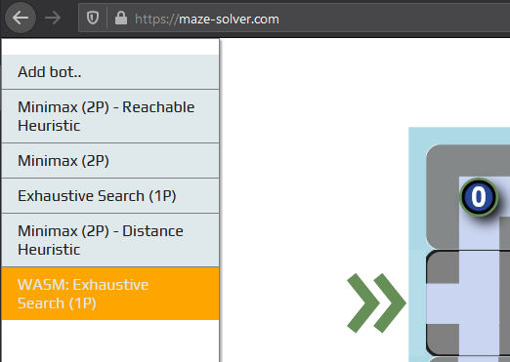
Demo: Labyrinth
Hello World & simple functions: easy
Pass / return complex data types: tricky
My first experiences (around 2019):
No clear guidelines, bad documentation, no debugging capabilities
Also a C++ - issue. Go is better. Maybe Rust best?
Today (2022):
Better documentation, both Chrome and Firefox have debuggers

Slide 13
Demo: Labyrinth
Opens new possibilities
Choose the right tool for the job

Slide 14
How does WebAssembly relate to…
… JavaScript?
Goal: complement of JS, not replacement
Releases feature pressure from JS (e.g. SIMD, multithreading, …)
Use cases: high performance, low start-up
gaming
virtual / augmented reality
cryptography
CAD
language interpreters
AI / machine learning
scientific computing
VMs
video editing
cryptography

Slide 15
How does WebAssembly relate to…
… the JVM?
Java Applets: heavy-weight, slow startup
WebAssembly: use existing functionalities of browsers
WebAssembly is not limited to the Web
  Runtimes outside of browser: wasmtime, Wasmer, lucet
  Standardization process – WebAssembly System Interface (WASI)
Java had a similar goal: „Write once, run anywhere“

Slide 16
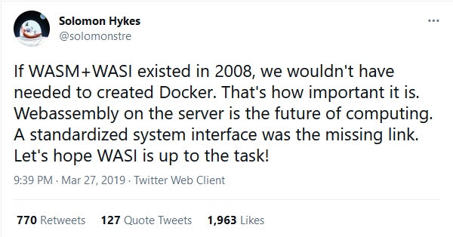
How does WebAssembly relate to…
… Docker?
Containers: isolated OS-Level virtualized sandbox
WebAssembly (+ WASI): sandboxed, isolated execution of binary files
Can WebAssembly replace Docker?
Can WebAssembly replace Docker containers?
  Maybe some of them
  e.g. serverless: faster startup
  Krustlet

Slide 17
Performance
It depends
Benchmarks (see Appendix): up to factor 2 to 4 faster, some also slower
  V8 builds on 10 years of experience
If raw execution speed is the only criterion: it might not be worth it
Smaller file size, faster startup, no JIT overhead, no GC
  predictable performance (same across all browsers)
Comparing inter-language performance is tricky
  A programming language does not have a velocity
  Implementation, language, compiler, runtime, hardware
  Port and compare? Or two independent implementations?
  C++ has language features tailored to performance

Slide 18
Security
WebAssembly is designed to be safe
  Sandboxed, application has to import functionality
  Heap is separated from rest of memory
  Multiple other mitigations
Malicious software harder to detect than JS
  e.g. in-browser crypto-mining
Vulnerabilities have been found (language-specific)
  e.g. stack buffer overflows
  compromise the attacked web-app (not the host)

Slide 19
Languages
Stable
Unstable, but usable
C/C++, Rust (both via LLVM)
Go (WASI with TinyGo)
C# (Blazor)
A few more …
Python (e.g. pyodide)
Java?

Slide 20
Languages
Difficult to adopt: dynamic typing, garbage collection
Work in progress: add GC to WebAssembly
  Idea: let host system do GC
But then, how do Python and C# do it?
In general, two options:
Compile language to WebAssembly, or
Compile runtime/interpreter to WebAssembly

Slide 21
Languages
Compile language to WebAssembly, or
Compile runtime/interpreter to WebAssembly
Stable
Unstable, but usable
C/C++, Rust (both via LLVM)
Go (WASI with TinyGo)
C# (Blazor), .NET
A few more …
Python (e.g. pyodide)
Java
  TeaVM, JWebAssembly
  CheerpJ
Some more
  (Ruby, Swift, PHP, …)

Slide 22
Conclusion
WebAssembly is a W3C standard for a binary format, designed to be memory-safe, portable, and fast.
Not only in browser
Main use cases: portability and performance
High potential for big impact in web and cloud

Slide 23
Sources
Articles & Presentations
https://hacks.mozilla.org/2017/02/a-cartoon-intro-to-webassembly/
http://kripken.github.io/mloc_emscripten_talk/
https://adlrocha.substack.com/p/adlrocha-can-wasm-become-the-new
https://hacks.mozilla.org/2019/03/standardizing-wasi-a-webassembly-system-interface/
Projects
https://wasmtime.dev/
https://wasmer.io/
https://github.com/bytecodealliance/lucet
https://emscripten.org/
https://blazor.net/
Talks
RustConf 2019: Clark, L. (2019). Closing Keynote https://www.youtube.com/watch?v=IBZFJzGnBoU
Podcasts
In Software Engineering Daily: Meyerson, J. (2021, March 23). Suborbital: WebAssembly Infrastructure with Connor Hicks (No. 1226)
In Software Engineering Daily: Meyerson, J. (2019, June 20). WebAssembly Compilation with Till Schneidereit (No. 855)
In Software Architecture Radio: Stine, M. (2019, March 27). WebAssembly with Brian Sletten (No. 7)
In CppCast: Turner, J & Irving, R. (2015, July 9). WebAssembly with JF Bastien (No. 15)
In CppCast: Turner, J & Irving, R. (2020, June 11). WebAssembly with Ben Smith (No. 251)

Slide 24
Sources
Misc
https://webassembly.org/docs
https://twitter.com/solomonstre/status/1111004913222324225
https://github.com/appcypher/awesome-wasm-langs
https://madewithwebassembly.com/
https://github.com/golang/go/issues/25612
Security
https://webassembly.org/docs/security/
Lehmann, Daniel, Johannes Kinder, and Michael Pradel. "Everything old is new again: Binary security of webassembly." 29th {USENIX} Security Symposium ({USENIX} Security 20). 2020.
https://www.virusbulletin.com/virusbulletin/2018/10/dark-side-webassembly/
https://spectrum.ieee.org/tech-talk/telecom/security/more-worries-over-the-security-of-web-assembly

Slide 25
Benchmarks
https://medium.com/@torch2424/webassembly-is-fast-a-real-world-benchmark-of-webassembly-vs-es6-d85a23f8e193
Real world benchmark of GameBoy emulator
Two ROMs, multiple devices, three browsers, comparing JS vs. WebAssembly
Desktop: WebAssembly is 67% faster than JS on Chrome, on FF even 11 times faster. Results for mobile show greater speed-up.
https://developers.google.com/web/updates/2019/02/hotpath-with-wasm
Rotating a 16 MP image, JS vs WebAssembly.
Browsers have different execution speeds in JS (different JS-engines). WebAssembly has same speed across all browsers -> predictable performance
Measuring one-shot times, not allowing JS to be optimized from the start
Even in fastest browser WebAssembly is 20% faster than JS
https://surma.dev/things/js-to-asc/
blurring images
Rust and C - compiled WebAssembly slightly slower than fastest JS-Compiler (TurboFan)
TurboFan 50times faster than Ignition.
https://medium.com/vacatronics/webassembly-in-go-vs-javascript-a-benchmark-6deb28f24e9d
WebAssembly compiled from Go and C
is_primrecursive fibonacci: WebAssembly 3times slower than JS
iterative e: WebAssembly 4times faster than JS
https://dev.to/linkuriousdev/to-wasm-or-not-to-wasm-3803
n-body-problem: WebAssembly compiled from C, Rust, and AssemblyScript.
WebAssembly 20% to 50% slower than native, and 20% slower than JS.
https://www.youtube.com/watch?v=aC_QLLilwso
Calculating prime numbers: C++ native 2 times faster than JS, WebAssembly slightly slower than native. JS warmup is discussed.

