Slide 1
A GIS-based method for assessing the economics of utility-scale photovoltaic systems for Southeast styria
Based on the Paper from: Pablo Benalcazar, Aleksandra Komorowska, Jacek Kami´ nski
Published: 1st January 2024
Birkle Kornelia
Breitler Julian
Paar Nico
Sturm Cornelia
GIS analysis techniques 2
WS 2025/26

Slide 2


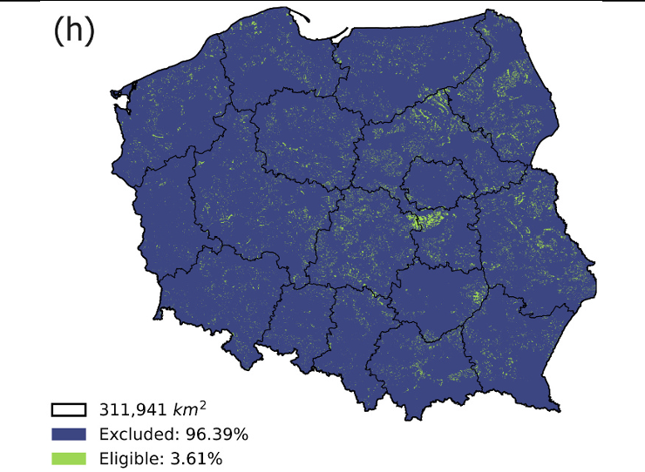
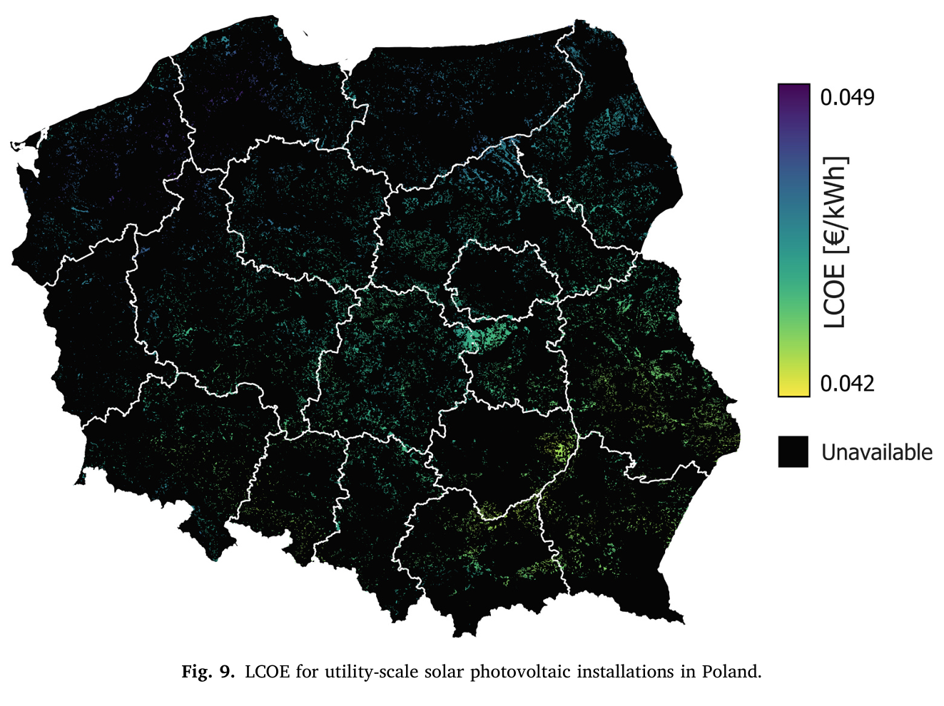
Original Study
GIS-based framework for land eligibility assessment using 20 exclusion criteria
Techno-economic potential of utility-scale PV-Systems
Spatial analysis at 100m resolution
Identification of economically viable solar sites
Application across NUTS-2 administrative regions
Adaptation for Southeast Styria
Original Study | Workflow | Results | Reproducibility & Conclusion | 2

Slide 3
Workflow
Data Acquisition and Central Configuration
OpenStreetMap,Natura 2000, Digital Elevation Model
Data Preprocessing
Clean, clip, and reproject (EPSG: 32633)
Economic Evaluation
Calculate LCOE raster
Visualization
Map of study area
Configuration of path, structure and parameters
Resample (100m x 100m)
Slope calculation (> 30°)
Buffer distances
Converting shps to raster
Apply land-use efficiency factors (35-50 MW/km²)
Estimate capacity and annual electricity generation potential (GWh/year)
Eligible vs. excluded areas
LCOE heatmap of PV potential
Original Study | Workflow | Results | Reproducibility & Conclusion | 3

Slide 4
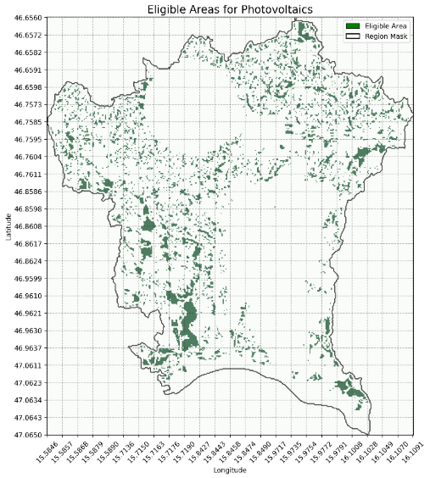
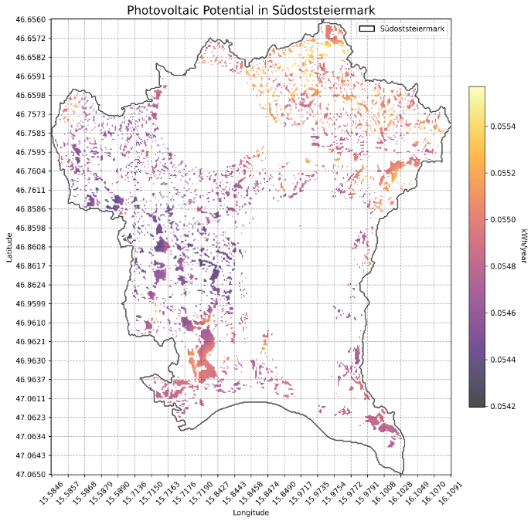
Results
Study Area: ~987 km2
Suitable Area: ~106 km2 (10.74%)
Excluded Area: ~881 km2 (89.26%)
Original Study | Workflow | Results | Reproducibility & Conclusion | 4

Slide 5
Reproducibility and ConClusion
Easily available data
Code was adaptable and worked well
Formulas in the paper made calculation steps clear
Corine Landcover could also be included
Agricultural land as exclusion
Data was often reprojected
New raster file later on
Control of right coordinate system (otherwise reprojection)
Input handling was difficult (different file paths etc.)
Map of all excluded datasets could be added
Could have been done for whole Styria
Original Study | Workflow | Results | Reproducibility & Conclusion | 5

Slide 6
References
Benalcazar, Pablo; Komorowska, Aleksandra; Kamiński, Jacek (2024): A GIS-based method for assessing the economics of utility-scale photovoltaic systems. In: Applied Energy 353, S. 122044. DOI: 10.1016/j.apenergy.2023.122044.
Thank you for the attention!
Original Study | Workflow | Results | Reproducibility & Conclusion | 6

