Slide 1


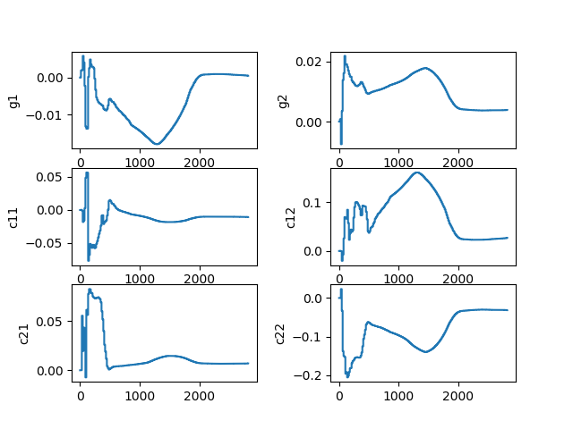
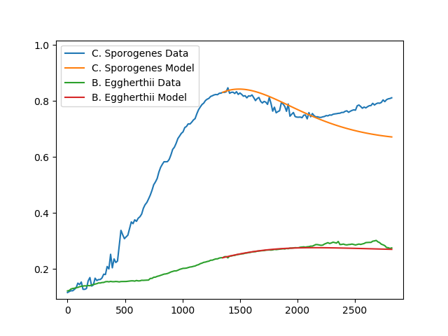
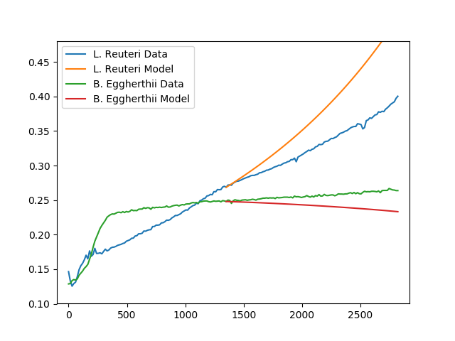
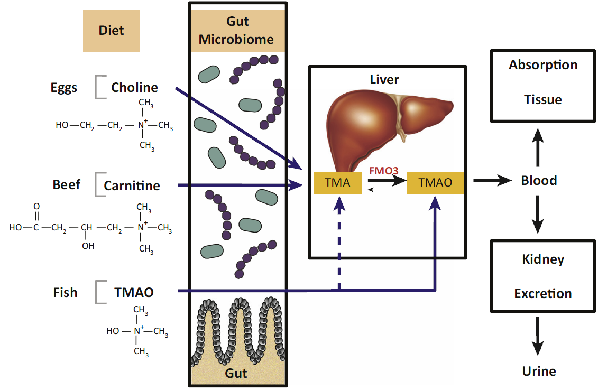
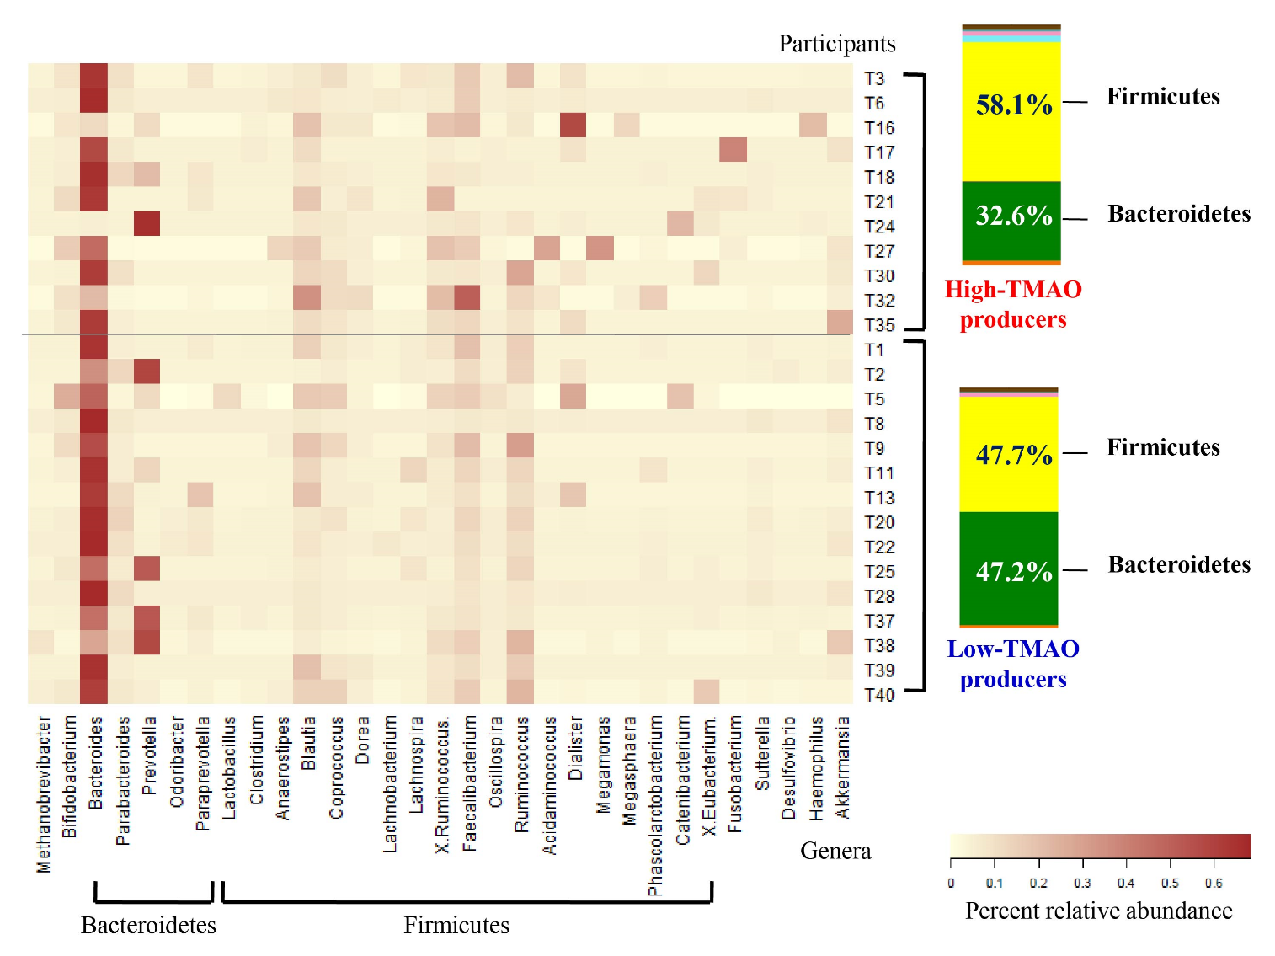
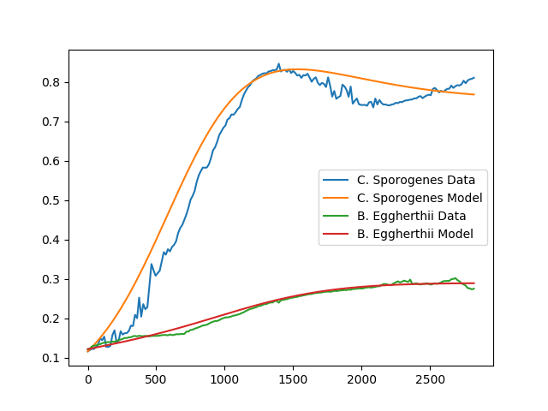
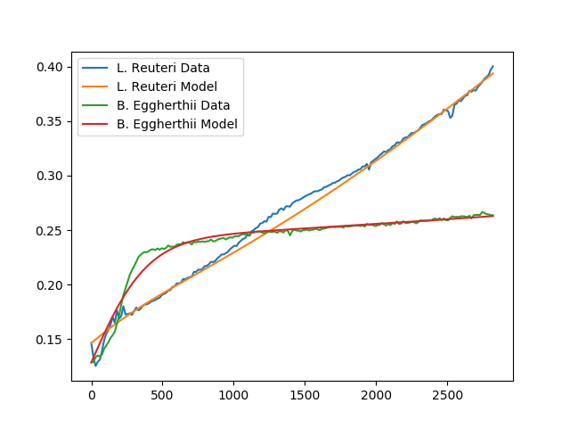
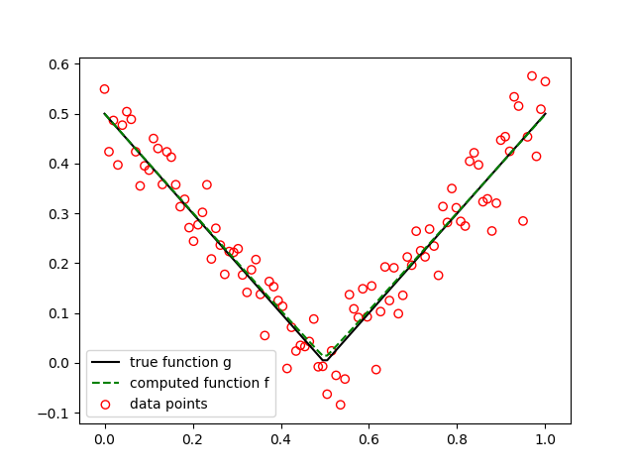
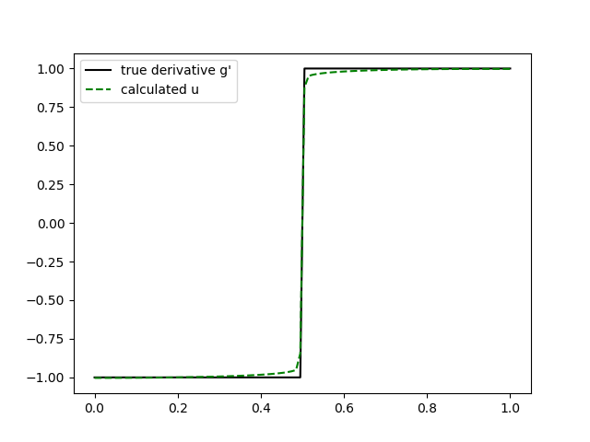
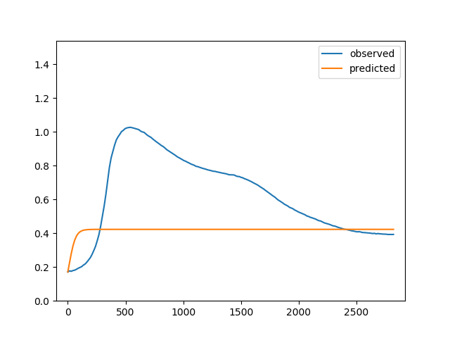



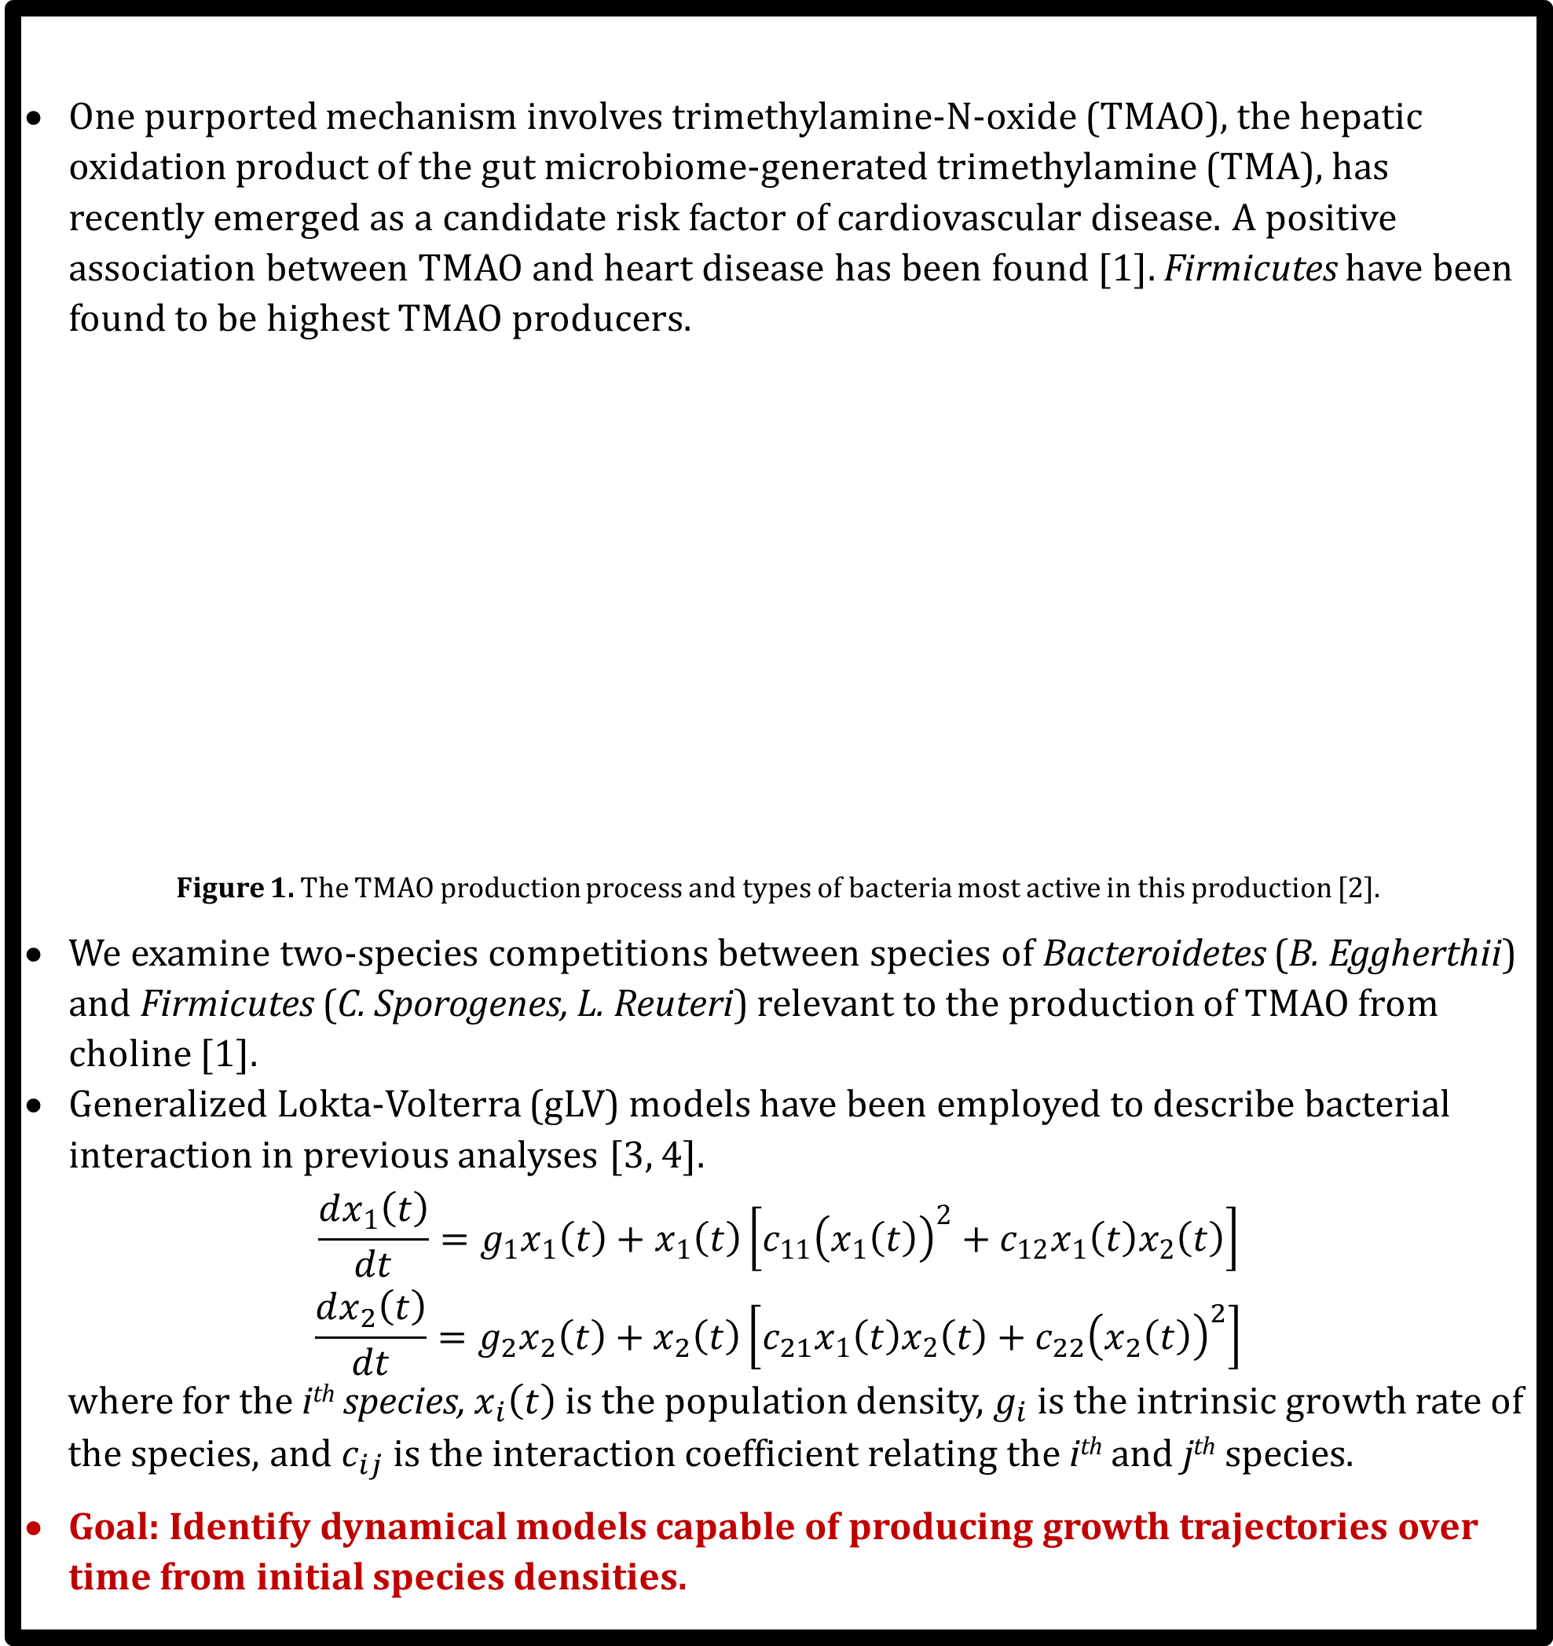
Inferring Bacterial Interaction Dynamics Using Data Assimilation Algorithms
Jacob Bryan¹, Nicholas Shikuma², Clara Cho³, Geordie Richards⁴
Introduction
None of the algorithms tested were particularly robust to receiving only a partial data set. However, the end behavior of the of the least squares solutions tended to best match the data trajectories.
One purported mechanism involves trimethylamine-N-oxide (TMAO), the hepatic oxidation product of the gut microbiome-generated trimethylamine (TMA), has recently emerged as a candidate risk factor of cardiovascular disease. A positive association between TMAO and heart disease has been found [1]. Firmicutes have been found to be highest TMAO producers.
Figure 1. The TMAO production process and types of bacteria most active in this production [2].
We examine two-species competitions between species of Bacteroidetes (B. Eggherthii) and Firmicutes (C. Sporogenes, L. Reuteri) relevant to the production of TMAO from choline [1].
Generalized Lokta-Volterra (gLV) models have been employed to describe bacterial interaction in previous analyses [3, 4].
$$\frac{dx_{1}\left(t\right)}{dt}=g_{1}x_{1}\left(t\right)+x_{1}\left(t\right)\left[c_{11}{\left(x_{1}\left(t\right)\right)}^{2}+c_{12}x_{1}\left(t\right)x_{2}\left(t\right)\right]$$
$$\frac{dx_{2}\left(t\right)}{dt}=g_{2}x_{2}\left(t\right)+x_{2}\left(t\right)\left[c_{21}x_{1}\left(t\right)x_{2}\left(t\right)+c_{22}{\left(x_{2}\left(t\right)\right)}^{2}\right]$$
where for the i^{th} species, $x_{i}\left(t\right)$ is the population density, $g_{i}$ is the intrinsic growth rate of
the species, and $c_{ij}$ is the interaction coefficient relating the i^{th} and j^{th} species.
Goal: Identify dynamical models capable of producing growth trajectories over time from initial species densities.
Extended Kalman Filter (EKF)
The Kalman filter and its variations estimate the true state of a system by taking an average of noisy observations weighted by their respective uncertainties.
The gLV interaction coefficients are appended to the state vector of an EKF. As the filter is updated with observations, a new estimate of the mean and of the model coefficients is made, approaching constant values over time [4].
$$c_{k}\left(t_{k}\right)→c_{k} as t_{k}→t_{final}$$
Figure 3. Convergence of gLV model coefficients using the augmented state EKF algorithm.
Figure 7. Partial set regression and trajectories.
Sparse Regression
Performs an iterative process of least squares regression and thresholding of the resulting coefficients to identify a model that is sparse in the space of available functions [6].
Does not require the selection of a specific model like the least squares regression or EKF methods discussed, instead using a “library” of functions from which to choose.
Choose a threshold value and a library of functions
Least squares regression was nearly always the best method for selecting model coefficients based on the model validation we performed.
EKF methods were sensitive to the amount of the time series data set exposed to the model. Using a sufficiently small portion of the data, the model coefficients do not converge as the coefficient convergence plots (Figure 3) are truncated.
The sparse regression algorithm produced favorable results. However, it was found that the results were very sensitive to the choice of threshold value, and this method was the most prone to overfitting.
Perform least squares regression on remaining functions to obtain coefficients
Set all coefficients below threshold to zero
Conclusions
Return the coefficient matrix
Are any of the coefficients below the threshold value?
No
Yes
Future Work
The Lotka-Volterra model used in this study provide a reasonable first-order approximation for the in vitro competitive dynamics of the species studied, but the findings of the study are limited by the amount of available data. We hope to expand on these findings by collecting a much more extensive data set with a wider variety of initial population densities, which will support a much more robust validation effort.
We seek to refine the accuracy of our model by including more complex versions of the gLV system by including interaction coefficients that depend on species frequency as motivated by previous findings [3].
The algorithms implemented in this study have applications to many physical systems outside of the biological sciences. In particular, the authors plan to apply these algorithms to create gravitational potential models of irregular celestial bodies using onboard telemetry.
Methods
Figure 4. Sparse regression algorithm flowchart.
Least Squares Regression
We performed a least squares regression to select g₁, g₂, and {c_{ij}}_{i, j = 1, 2} such that the time derivatives of the bacterial densities, $\frac{dx_{1}(t)}{dt}$ and $\frac{dx_{2}(t)}{dt}$, are well-approximated by the polynomial functions of the bacterial densities, $x_{1}(t)$ and $x_{2}(t)$, as found on the right-hand side of the gLV equation system.
The derivatives of the data were calculated numerically using a total variation regularized differentiation method.
Results
Verification
Least squares regression, the simplest method we explored, provided the most consistent results. Solving the gLV model forward from the initial species densities using Runge-Kutta integration successfully reproduces the trajectory of the data.
Figure 5. Population density model verification using models inferred through least squares
regression. Least squares regression tended to outperform the other methods explored.
Total Variation Regularized Derivative
The derivative is computed as the minimizer of the functional
$$F\left(u\right)= α\int_{0}^{L}{\left|u′\right|+ \frac{1}{2}\int_{0}^{L}{{\left|Au−f\right|}^{2}}}$$
where u is the derivative of function f, A is the antidifferentiation operator
such that $Au\left(x\right)= \int_{0}^{x}{u}$, and α is a constant that controls the balance of the
two terms. The first term penalizes noise in u, and the second term is the L2
norm [5].
Noise in the derivative is minimized while allowing for jump discontinuities in the derivative.
Figure 2. An application of the total variation regularized derivative to $y=\left|x−0.5\right|$ for 100
uniformly-distributed points on [0, 1] with added Gaussian noise (μ = 0, σ = 0.05).
Literature Cited
[1]Cho CE, Taesuwan S, Malysheva OV, Bender E, Tulchinsky NF, Yan J, et al. Trimethylamine-N-oxide (TMAO) response to animal source foods varies among healthy young men and is influenced by their gut microbiota composition: A randomized controlled trial. Mol Nutr Food Res. 2017;61.
[2] Ley RE, Backhed F, Turnbaugh P, Lozupone CA, Knight RD, Gordon JI. Obesity alters gut microbial ecology. Proc Natl Acad Sci U S A. 2005;102:11070-5.
[3] X.-Y. Li, C. Pietschke, S. Fraune, P. M. Altrock, T. C. G. Bosch, and A. Traulsen, “Which games are growing bacterial populations playing?,” Journal of The Royal Society Interface, vol. 12, no. 108, p. 20150121, Jul. 2015.
[4] M. Alshawaqfeh, E. Serpedin, and A. B. Younes, “Inferring microbial interaction networks from metagenomic data using SgLV-EKF algorithm,” BMC Genomics, vol. 18, no. S3, Mar. 2017.
[5] R. Chartrand, “Numerical Differentiation of Noisy, Nonsmooth Data,” ISRN Applied Mathematics, vol. 2011, pp. 1–11, 2011.
[6] S. L. Brunton, J. L. Proctor, and J. N. Kutz, “Discovering governing equations from data: Sparse identification of nonlinear dynamical systems,” Proceedings of the National Academy of Sciences, vol. 113, no. 15, pp. 3932–3937, Apr. 2016.
Validation
The least squares models predicted the equilibrium state of the single-species in vitro cultures but did not capture the intermediate dynamics well. See Figure 6.
The robustness of the algorithm to fewer data is tested by applying the algorithm to the first half of the data set and attempting to reproduce the second half. See Figure 7.
Figure 6. Single-species culture validation of least squares model.
¹ Undergraduate Student, Utah State University, Department of Mechanical and Aerospace Engineering
² Assistant Professor, San Diego State University
³ Assistant Professor, Utah State University, Department of Nutrition, Dietetics, and Food Science
⁴ Assistant Professor, Utah State University, Department of Mechanical and Aerospace Engineering

