Slide 1
Introduction to Red Hat JBoss Fuse
Richard Stroop
Enterprise Integration Architect
June 2016

Slide 2
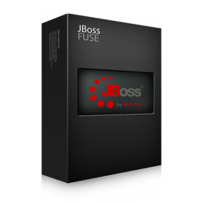
What is JBoss Fuse?
Lightweight open source Enterprise Service Bus (ESB) platform
Reliable Messaging
Integration
150+ Connectors
Transformation
Mediation
Flexible deployment
On premise
Distributed
Cloud

Slide 3
Why use JBoss Fuse?
Connect large systems together
Integrate legacy software with new software
Manage large scale deployments by splitting the load into manageable services
Easily create running applications with as little as a few lines of XML

Slide 4
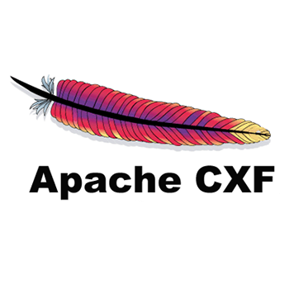


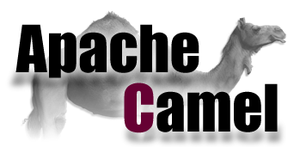

JBoss Fuse Core Components
Fuse utilizes a number of Open Source projects as its backbone

Slide 5
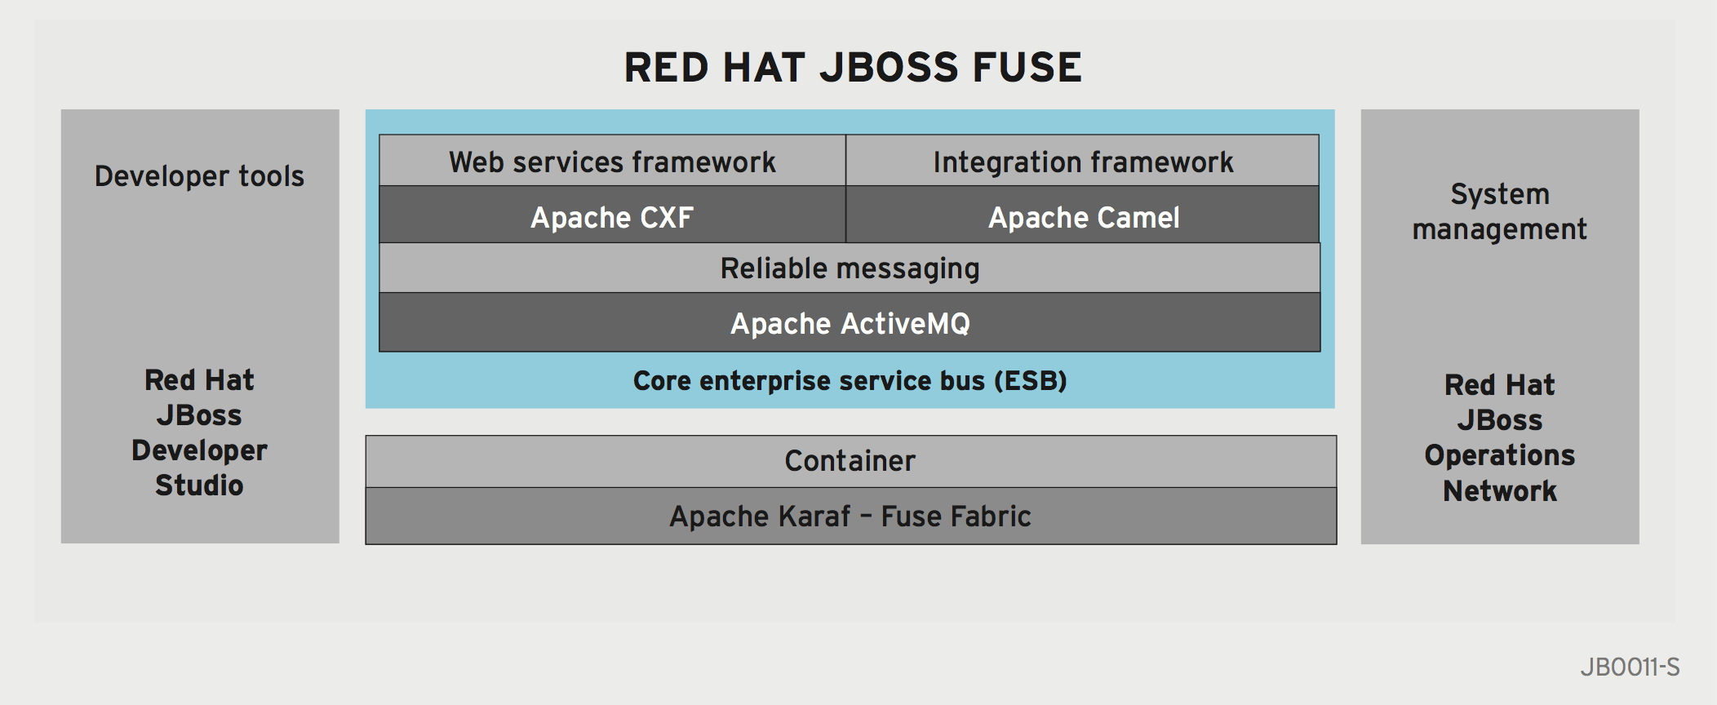
Fuse Ecosystem

Slide 6
JBoss Fuse Container

Slide 7
Apache Karaf
Lightweight OSGi container
Features
Application deployer
Dynamic configuration
Logging
Provisioning
Extensible shell console
Remote access
Security framework based on JAAS

Slide 8
OSGi
Open Services Gateway Initiative
Dynamic module and services framework for Java
Started in 1999 with specifications maintained by the OSGi Alliance
Initially targeted embedded devices
Known for its use in the Eclipse IDE

Slide 9
Why OSGi?
A solution for a number of issues with the Java EE architecture
Dependency Management
Issues with the native Java class loader model
Conflicting dependencies
Handling of versions
Dynamic behavior of applications
Control the component lifecycle
Desire for modularity
Limited support from the JVM
JAR’s can be a black box

Slide 10
Java Class Loader
Bootstrap Class Loader
Extensions Class Loader
System Class Loader
User Defined Class Loader
User Defined Class Loader
User Defined Class Loader
User Defined Class Loader

Slide 11
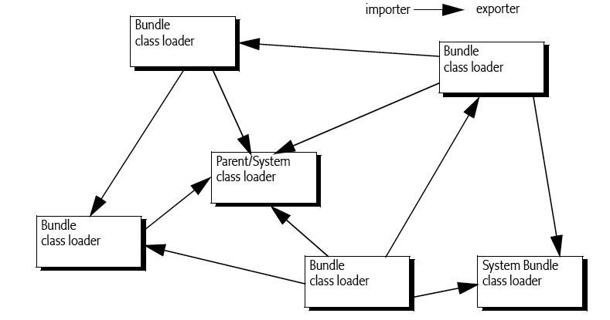
OSGi Class Loader

Slide 12
Bundles
The mechanism for accomplishing modularity
OSGi modules (Think LEGO© blocks)
Lowest level of deployment
A typical JAR file with additional information in the MANIFEST
Must declare any dependencies and what it provides
Typically in the form of Java packages
All packages are internal unless otherwise declared
Inaccessible by other bundles

Slide 13
Bundle Manifest
Manifest-Version: 1.0
Bnd-LastModified: 1401502217366
Build-Jdk: 1.7.0_55
Bundle-Activator: com.redhat.training.osgi.basic.provider.activator.Basic
ServiceProviderActivator
Bundle-ManifestVersion: 2
Bundle-Name: Fuse Advanced Services - Basic Provider
Bundle-SymbolicName: fuse-advanced-services-basic-provider
Bundle-Version: 1.0.0.SNAPSHOT
Created-By: Apache Maven Bundle Plugin
Export-Package: com.redhat.training.osgi.basic.provider.service;
version= "1.0.0.SNAPSHOT"
Import-Package: org.osgi.framework;version="[1.6,2)",org.slf4j;
version=" [1.7,2)"
Tool: Bnd-2.1.0.20130426-122213

Slide 14
Bundles
Export-Package
com.redhat.training
1.0
Import-Package
com.redhat.training
[1.6,2.0]
Export-Package
com.redhat.training
2.0
Notes:
Semantic Versioning

Slide 15
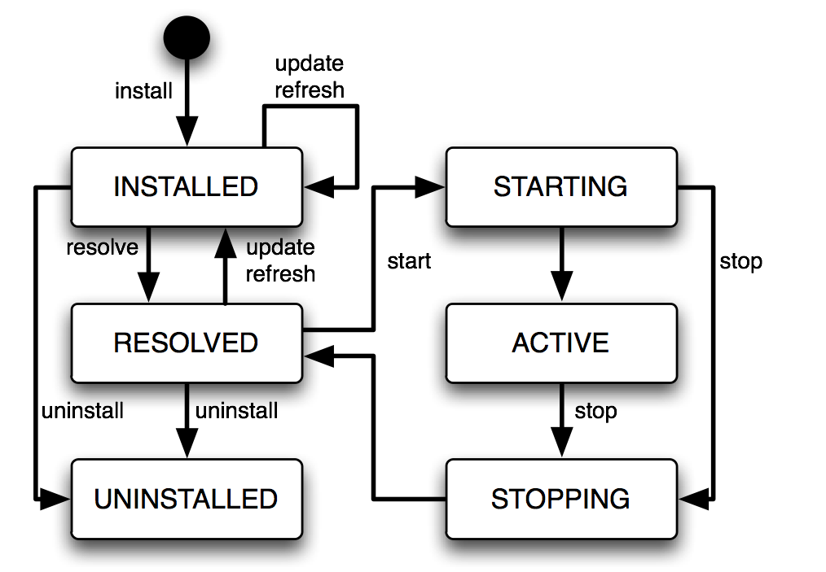
Bundle Lifecycle

Slide 16
Services
Mechanism for communicating between bundles
Services are plain old Java objects - POJO’s
API style interfaces
Services stored in a central service registry
A bundle can publish or consume services
Reference existing service published in the container
Promotes loose coupling as there is no direct connection of the producer and consumer
“SOA in the JVM”

Slide 17
Services
Bundles can register multiple services
Multiple implementations per service interface
Services can be assigned and referenced using properties
Service Registry
Register
Lookup
Service Provider
Service Consumer
Notes:
Keyword is referenced. The consumer does not instantiate the service, but references an existing service already published in the container

Slide 18
Services in Practice
Registering and acquiring reference to DataSource
Register a new DataSource for MySQL
Service interface (required) and optional properties
objectClass=javax.sql.DataSource
Service Interface
osgi.jndi.service.name=jdbc/mysql
Service Properties
MySQL DataSource
Bundle
Notes:
Keyword is referenced. The consumer does not instantiate the service, but references an existing service already published in the container

Slide 19
Services in Practice
Registering and acquiring reference to DataSource
Register a second DataSource for Postgres
Unique service properties to differentiate services
objectClass=javax.sql.DataSource
objectClass=javax.sql.DataSource
osgi.jndi.service.name=jdbc/mysql
osgi.jndi.service.name=jdbc/postgres
MySQL DataSource
Bundle
PostgreSQL DataSource
Bundle

Slide 20
Services in Practice
Registering and acquiring reference to DataSource
Reference the MySQL service using an LDAP filter
serviceFilter=(&(objectClass=javax.sql.DataSource)(org.jndi.service.name=jdbc/mysql)
Consumer Bundle
objectClass=javax.sql.DataSource
objectClass=javax.sql.DataSource
osgi.jndi.service.name=jdbc/mysql
osgi.jndi.service.name=jdbc/postgres
MySQL DataSource
Bundle
Postgres DataSource
Bundle

Slide 21
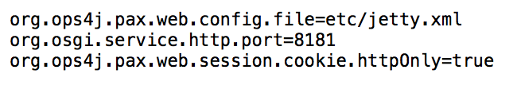
Configuration Admin
Service which allows externalized values to be injected into components
Configuration files (with .cfg extension) are scanned from the $FUSE_HOME/etc folder
Name of the file (excluding extension) is used as the Persistent Identifier (PID) to define a group of configurations
Configuration files and their attributes can be managed from the Fuse CLI
A ManagedService can be used to track when the configuration file changes and to update components

Slide 22
Dependency Injection
Design paradigm (also known as Inversion of Control [IoC]) for initializing and configuring applications
Configuration files written in XML declare the components
Instantiate Java classes
Constructor arguments and object setters are used to configure class values
Reduces the amount of code that is required to configure the application environment
Supported technologies
Blueprint
Spring DM

Slide 23
Blueprint
Standardized Dependency Injection framework for OSGi
Fuse uses the Blueprint implementation from the Apache Aries project
Similar syntax to Spring
Spring | Blueprint
id | id
class | class
property | property
constructor-arg | argument

Slide 24
Blueprint Example
<cm:property-placeholder id="fuse-bootcamp-config"
persistent-id="com.redhat.fuse.bootcamp"
update-strategy="reload">
<cm:default-properties>
<cm:property name="secret" value="redhat"/>
</cm:default-properties>
</cm:property-placeholder>
<!-- Bean -->
<bean id="foo"
class="com.redhat.fuse.bootcamp.HelloBean">
<property name="secret" value="${secret}" />
</bean>

Slide 25
Maven
Build and reporting tool. Plays a role in almost every step of the Fuse development lifecycle
Project templating (archetypes) and organization
Compilation of Java bytecode
Generation of OSGi bundle metadata
maven-bundle-plugin
Provisioning of Fuse container

Slide 26
Provisioning
Deployment of applications through the use of “features”
Repository – XML descriptor defining a list of features (applications)
Bundles - Primary unit of deployment in an OSGi environment
Configurations– Deployment configuration of the Configuration Admin service
Configuration Files – Externalized properties for the Configuration Admin service

Slide 27
URL Handlers
Mechanism for resolving remote resources to provision the Fuse container.
file:///var/local/fuse/fuse-bootcamp-bundle-1.0.0-SNAPSHOT.jar
http://repository.jboss.org/nexus/content/groups/public/com/redhat/fuse/fuse-bootcamp-bundle/1.0.0-SNAPSHOT/fuse-bootcamp-bundle-1.0.0-SNAPSHOT.jar
mvn:com.redhat.fuse/fuse-bootcamp-bundle/1.0.0-SNAPSHOT

Slide 28
Features File Example
<?xml version="1.0" encoding="UTF-8"?>
<features name='fuse-bootcamp-features-${project.version}' encoding='${project.version}'>
<feature name='com.redhat.fuse.bootcamp' version='${project.version}’ resolver=”(obr)">
<feature version='${camel.version}’>camel</feature>
<feature version='${camel.version}’>camel-blueprint</feature>
<configfile filename='/etc/com.redhat.fuse.bootcamp.bundle.cfg’ override=”true">
mvn:com.redhat.fuse/fuse-bootcamp-bundle/${project.version}/cfg/bootcamp
</configfile>
<bundle>mvn:com.redhat.fuse/fuse-bootcamp-bundle/${project.version}</bundle>
</feature>
</features>

Slide 29
Fuse Management Console (Hawtio)
Web interface to configure and manage core components of Fuse.
Components
ActiveMQ
Camel
JMX
OSGi
Log viewer
Emulated Karaf terminal
Hawtio – Underlying project of the Fuse Management Console

Slide 30
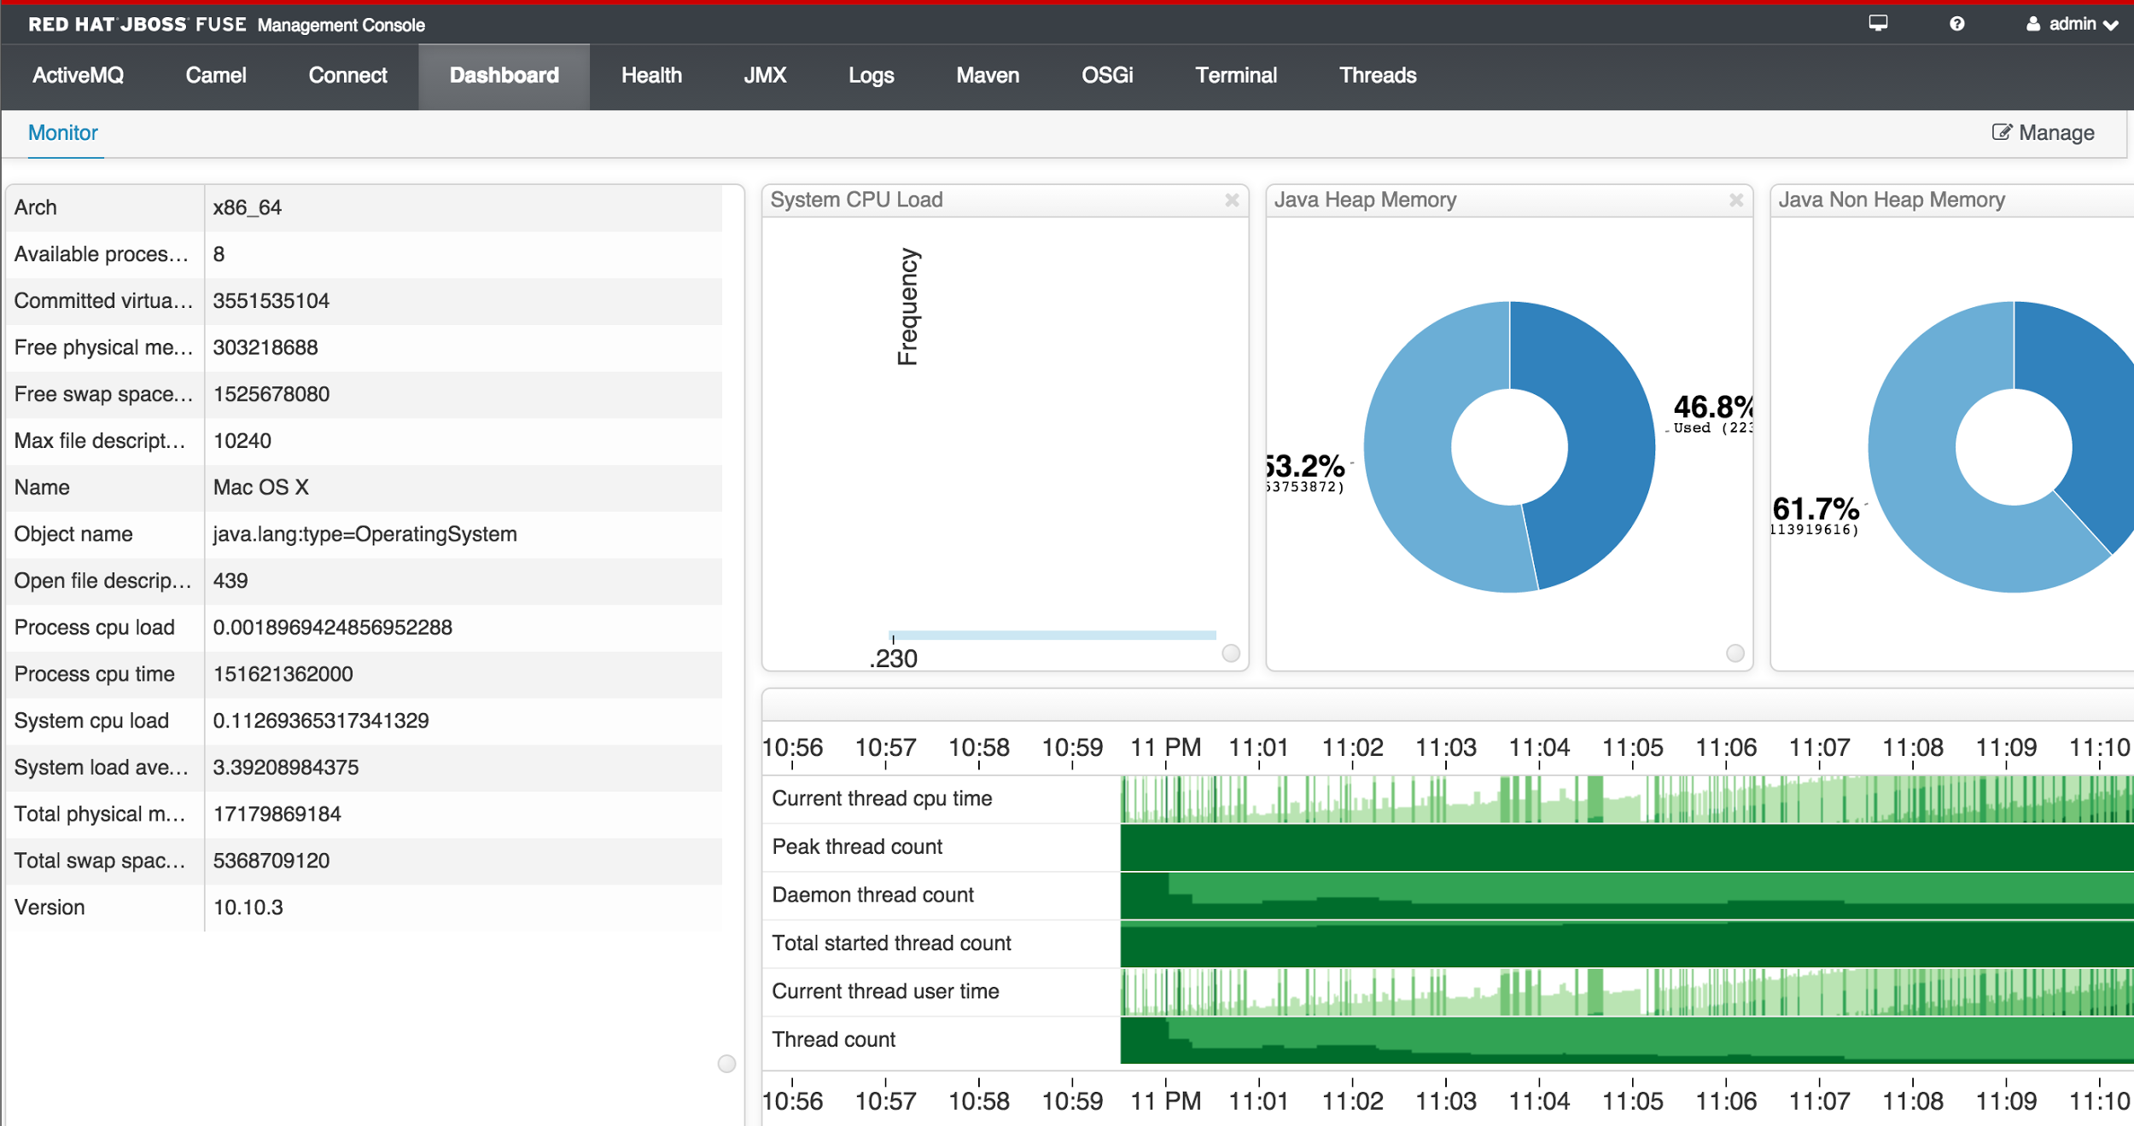
Fuse Management Console (Hawtio)

Slide 31
Apache Camel
The Mailman

Slide 32
Apache Camel
An integration framework
A routing engine builder
Allows users to define routing rules
Allows users to decide from which sources to accept messages
Allows users to determine how to process and send those messages to other destinations
Uses an integration language that allows users to define complex routing rules
Makes no assumptions about the type of data that needs to be processed

Slide 33
Enterprise Integration Patterns
Implement design patterns that are used to solve common problems within messaging
Are used to solve integration and routing problems
While components are typically used at the start and exit points within a route, EIPs are exclusively used within the routes themselves
EIPs are like design patterns from object oriented programming, but for the enterprise integration world
Use Camel’s built-in EIP implementations rather than creating your own
Camel implements most EIPs as easy-to-use DSL terms, which allows you to focus on the actual business problem rather than the integration architecture

Slide 34
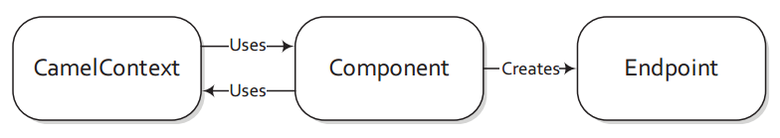
Camel Components
Are typically the entrance and exit points for a route
Are the primary extension point in Camel
Allow you to bridge to many different APIs, protocols, data formats, and so on
The main responsibility of a component is to be a factory for endpoints

Slide 35
Camel Syntax
Camel has different syntax based on the Domain Specific Language (DSL)
Java allows for more powerful and customized code within workflows
XML allows for easy simple set up of routes
Both can be used together

Slide 36
Camel Syntax
XML
<blueprint xmlns="http://www.osgi.org/xmlns/blueprint/v1.0.0">
<camelContext xmlns="http://camel.apache.org/schema/blueprint">
<route>
<from uri="timer:test" />
<transform>
<simple>“Hello World"</simple>
</transform>
<to uri="log:test" />
</route>
</camelContext>
</blueprint>
Notes:
Routes
URI
etc

Slide 37
Camel Syntax
Java
import org.apache.camel.builder.RouteBuilder;
public class MyRouteBuilder extends RouteBuilder {
public void configure() {
from("timer:test")
.transform().simple(“Hello World")
.to("log:test");
}
}
Notes:
Routes
URI
etc

Slide 38
Camel in the Fuse Management Console
Allows you to:
Manage contexts and routes
View metrics
Trace and debug routes

Slide 39
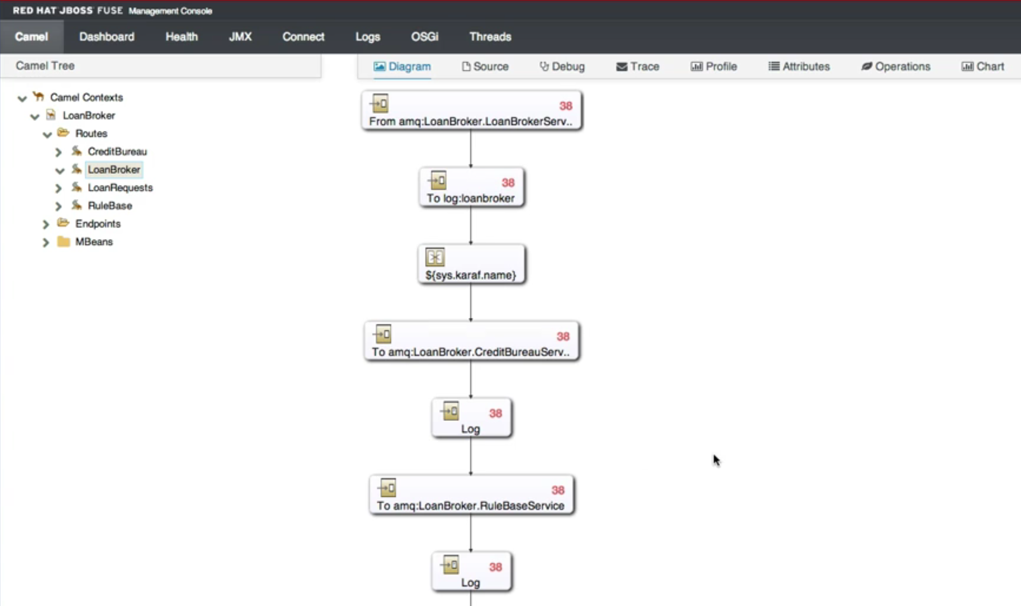
Camel in the Fuse Management Console

Slide 40
Apache CXF
The Mailbox

Slide 41
Apache CXF
CXF consumer is message payload agnostic
Can use a multitude of transports to consume web services
The bean component's configuration is simple
Provides the fastest method to implement web services

Slide 42
CXF Syntax
<cxf:cxfEndpoint id="routerEndpoint"
address="http://localhost:9003/CamelContext/RouterPort"
serviceClass="org.apache.hello_world_soap_http.GreeterImpl"/>
<cxf:cxfEndpoint id="serviceEndpoint"
address="http://localhost:9000/SoapContext/SoapPort"
wsdlURL="testutils/hello_world.wsdl"
serviceClass="org.apache.hello_world_soap_http.Greeter"
endpointName="s:SoapPort"
serviceName="s:SOAPService"
xmlns:s="http://apache.org/hello_world_soap_http" />
<camelContext id="camel" xmlns="http://camel.apache.org/schema/spring">
<route>
<from uri="cxf:bean:routerEndpoint" />
<to uri="cxf:bean:serviceEndpoint" />
</route>
</camelContext>
Notes:
Routes
URI
etc

Slide 43
JBoss A-MQ (Apache ActiveMQ)
The Post Office

Slide 44
JBoss A-MQ
Enterprise level messaging platform
Designed for high performance clustering, client-server, peer based communication
Supports a variety of Cross Language Clients and Protocols
Easy to use with Enterprise Integration Patterns
Fully supports the JMS 1.1 standard
Very fast persistence with JDBC

Slide 45
Java Message Service (JMS)
A Java Message Oriented Middleware (MOM) API
Sends messages between two or more clients
Part of the Java Platform Enterprise Edition clearly defined under JSR 914
Messaging standard that allows application components based on the Java Enterprise Edition (Java EE) to create, send, receive, and read messages
Allows the communication between different components of a distributed application to be loosely coupled, reliable, and asynchronous.

Slide 46
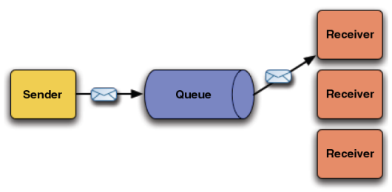
Queues and Topics
Queue
A single message received by exactly one receiver

Slide 47
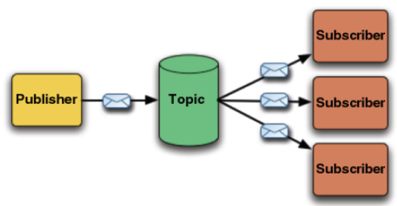
Queues and Topics
Topic
A single message is received by all subscribers

Slide 48
Queues and Topics
ActiveMQ component
Can connect to a Broker or stand up a local Broker
Allows messages to be sent to a Queue or Topic
Can consume from a Queue or Topic
Supports transactions and caching
URI: activemq:topic:Stocks.Prices

Slide 49
ActiveMQ in the Fuse Management Console
Allows you to:
Manage Brokers
View metrics on Queues and Topics
Trace and debug messages

Slide 50
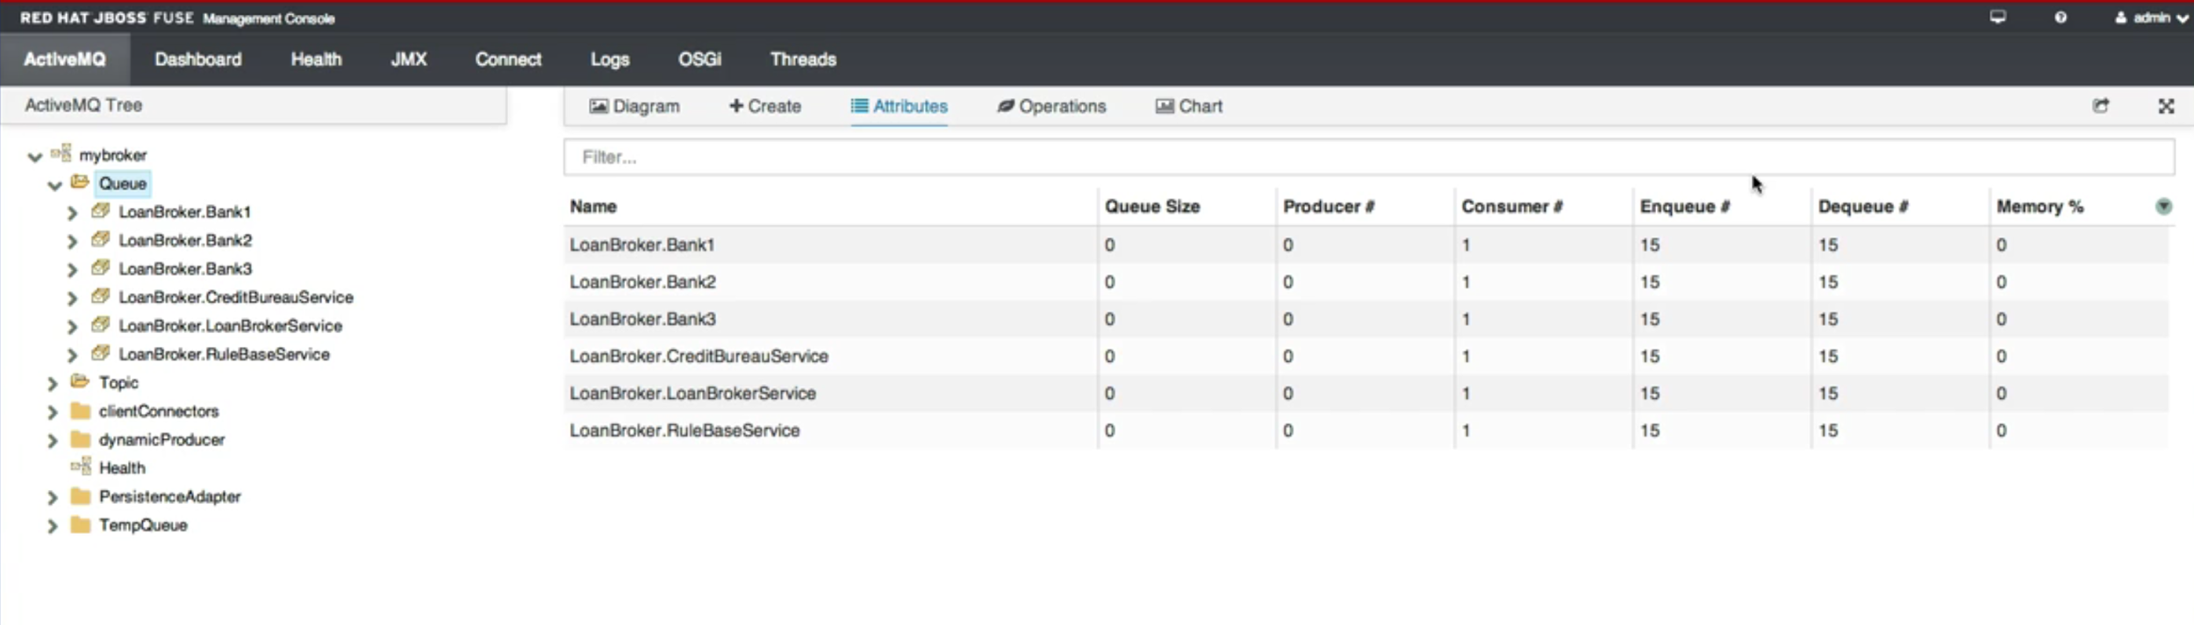
ActiveMQ in the Fuse Management Console

Slide 51
Fuse Fabric

Slide 52
Fabric Concepts
Technology layer that allows a group of containers to form a cluster
Shares a common set of configuration information
Shares a common set of repositories for artifacts
Managed by a Fabric Agent that installs a set of bundles
Repositories are managed using a Maven proxy
Profiles are kept in sync with Zookeeper and Git
Deployments can be done through Web Console or CLI

Slide 53
Fabric Profiles
Create a list of bundles that should be deployed on a container
Add profiles to a container and Fabric will deploy bundles
OSGi handles resolution and duplication
Allows for multiple versions of Fabric so that updates can be pushed or reverted easily

Slide 54
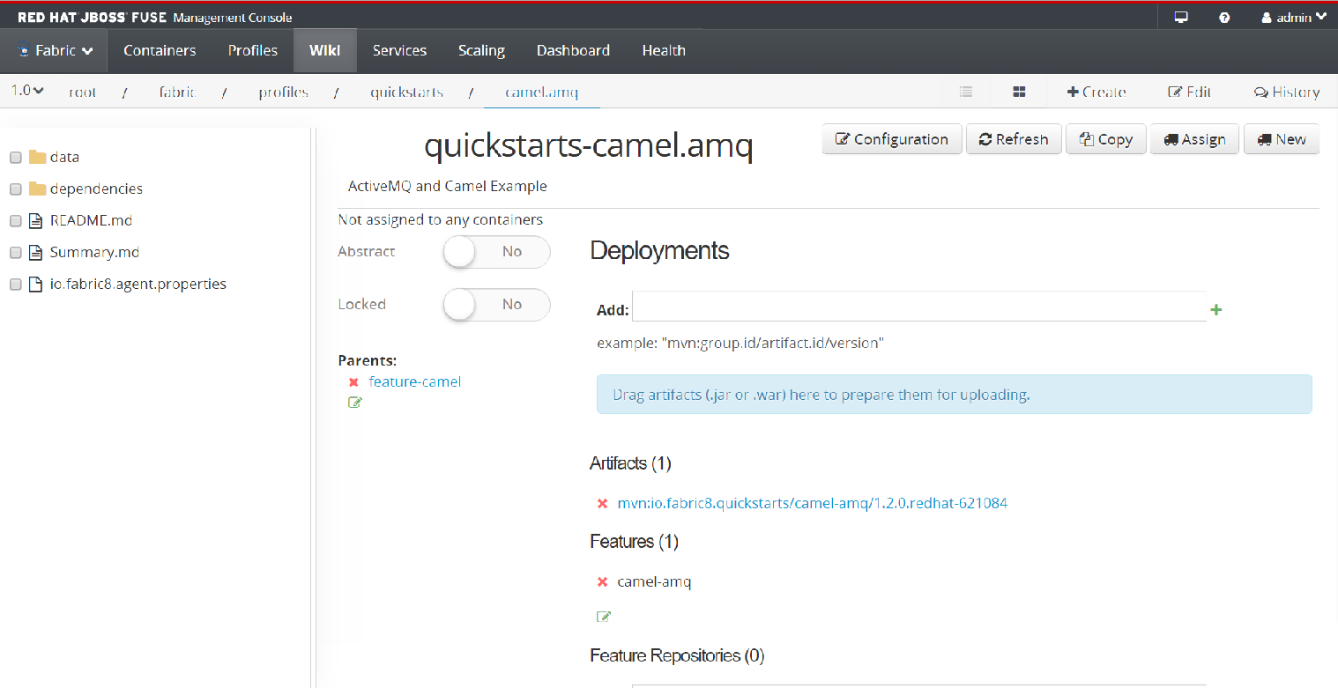
Fabric Profile View

Slide 55
Fabric Container Provisioning
Fabric Repository
Container 1
Profile A
Profile B
Profile A
*Bundle 1
*Bundle 2
Maven Repository
Bundle 1
Profile B
*Bundle 3
*Bundle 4
Bundle 2
Container 2
Profile B
Profile C
Bundle 3
Bundle 4
Profile C
*Bundle 2
*Bundle 3

Slide 56
Fuse on OpenShift

Slide 57
xPaaS
Fuse Integration Services enables development, deployment, and management of integration microservices within OpenShift
An application deployment with FIS consists of an application and all required runtime components packaged inside a Docker image
A-MQ allows messaging between OpenShift gears or pods
Fabric v2 will move Fabric to OpenShift as well

Slide 58
THANK YOU

