Slide 1
Introduction of a priori domain knowledge in function approximation using shape-constraint P-splines
Jakob Weber

Slide 2
Overview - Agenda
Problem formulation & motivation
Linear models, Regularization & Penalized Least-Squares
B-splines
P-splines
Shape-constraint P-splines
Examples
Summary & Questions

Slide 3
Problem formulation & motivation
Massive increase of process data in the last years
Used to enhance process control concepts based on mathematical models
White-box (first principles) vs. black-box (data)
Specific a priori domain knowledge (AD) often available
Physics based
Knowledge based
Incorporate the AD into the mathematical model → grey-box model
➔ Algorithm for efficient, multi-dimensional static function approximation using a priori domain knowledge

Slide 4
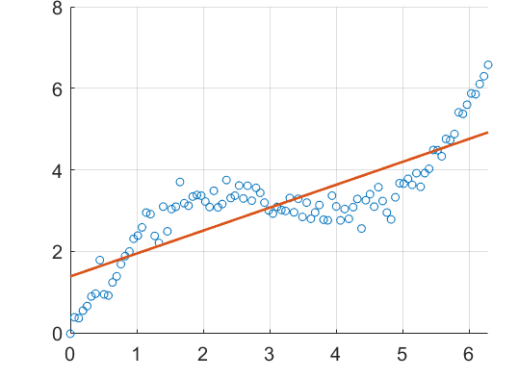




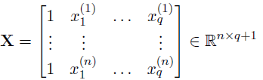

Linear models
Model the data assuming additive noise $ε$
Unknown function $f$ is a linear combination of the inputs
And with the complete data

Slide 5




Least Squares Formulation
Linear model
Least squares loss function
Least squares estimate

Slide 6

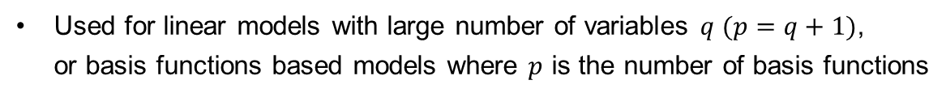
Regularization & Penalized least squares
Restrict the parameter space by adding a penalty term to the loss function
depending on the complexity of the model
with
and
leading to
Used for linear models with large number of variables $q (p=q+1)$,
or basis functions based models where $p$ is the number of basis functions
Notes:
How to cope with non-linear behavior in data ???

Slide 7


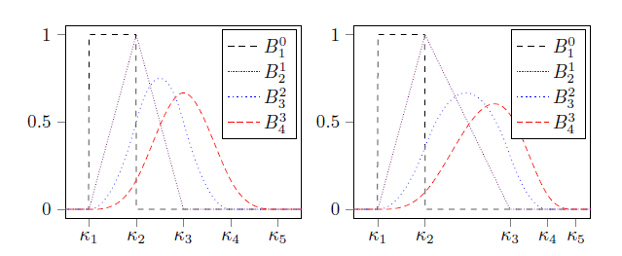
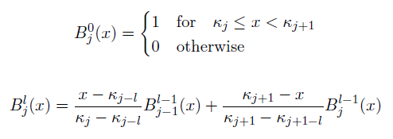
B-spline
Lin. comb. of $d$B-spline basis functions $B_{j}^{l}$ of order $l$ defined on a sequence of knots $K$
Each basis function is defined recursively as

Slide 8
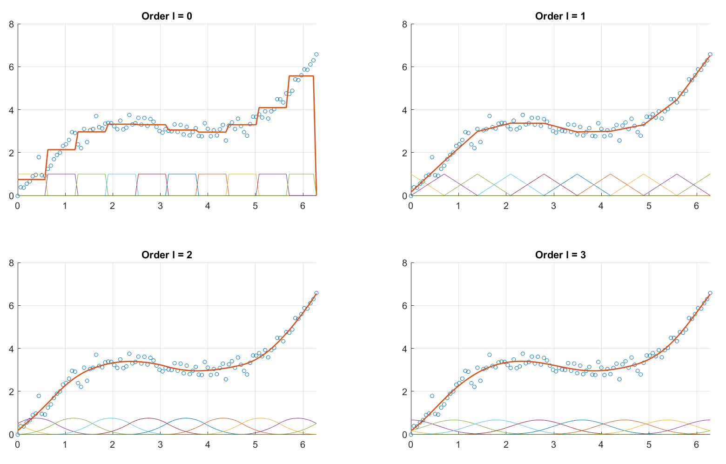

B-splines for $d$ = 10
Notes:
d = 10 basis functions each
100 datapoints x = [0, 2*pi]
y = 1.5 sin(x) + x

Slide 9
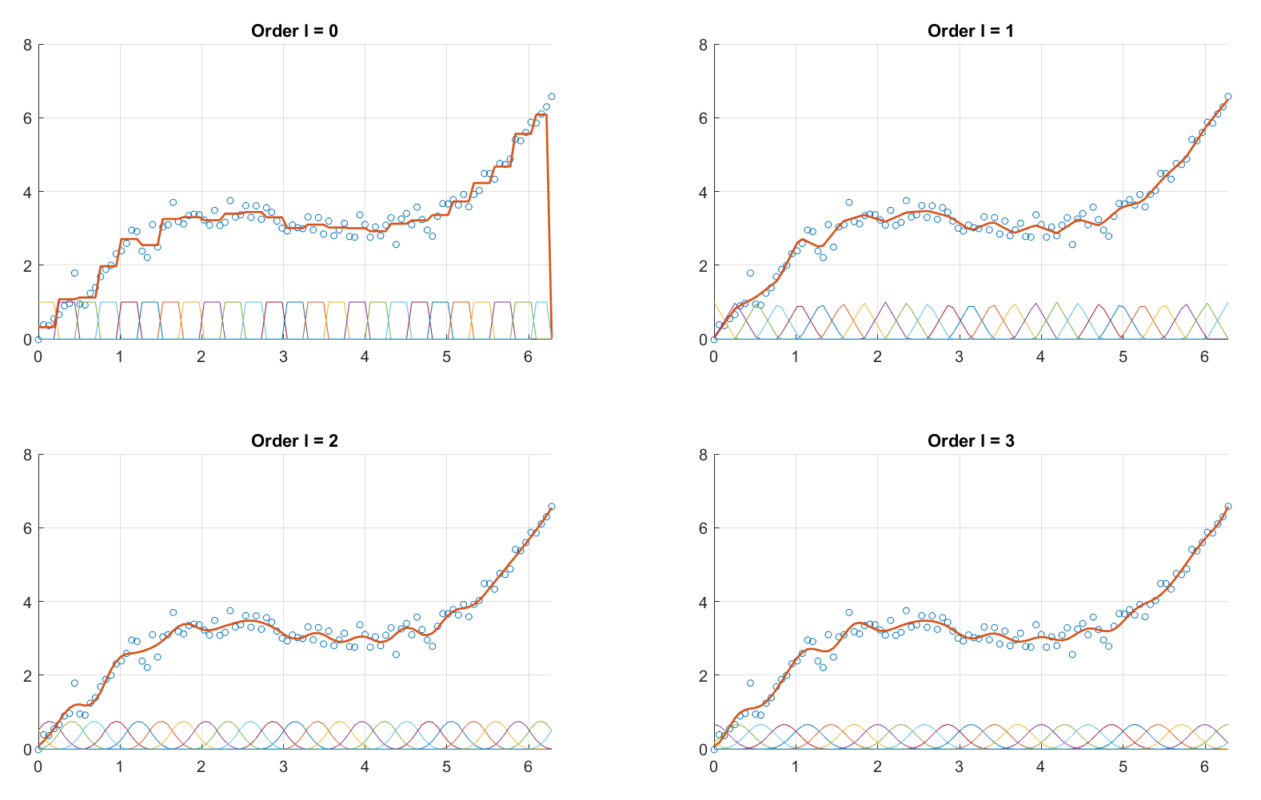

B-splines for $d$ = 25
Notes:
d = 10 basis functions each
100 datapoints x = [0, 2*pi]
y = 1.5 sin(x) + x

Slide 10
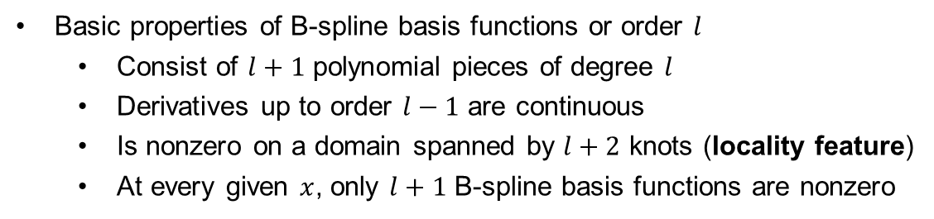
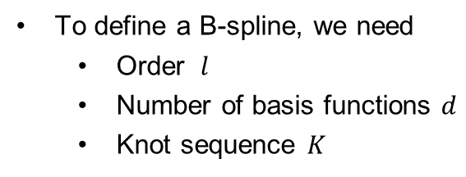
B-spline
To define a B-spline, we need
Order $l$
Number of basis functions $d$
Knot sequence $K$
Basic properties of B-spline basis functions or order $l$
Consist of $l+1$ polynomial pieces of degree $l$
Derivatives up to order $l−1$ are continuous
Is nonzero on a domain spanned by $l+2$ knots (locality feature)
At every given $x$, only $l+1$ B-spline basis functions are nonzero

Slide 11

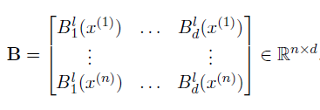


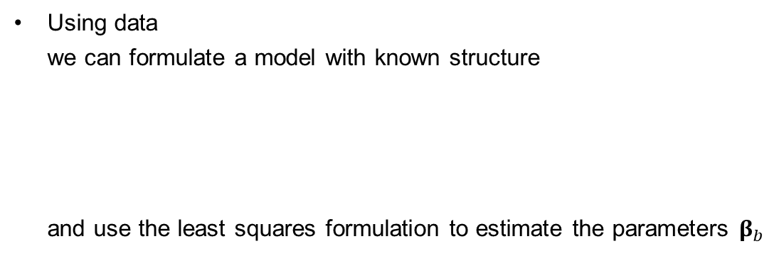
B-spline & Parameter estimation
Using data
we can formulate a model with known structure
and use the least squares formulation to estimate the parameters $β_{b}$
With the B-spline basis matrix

Slide 12
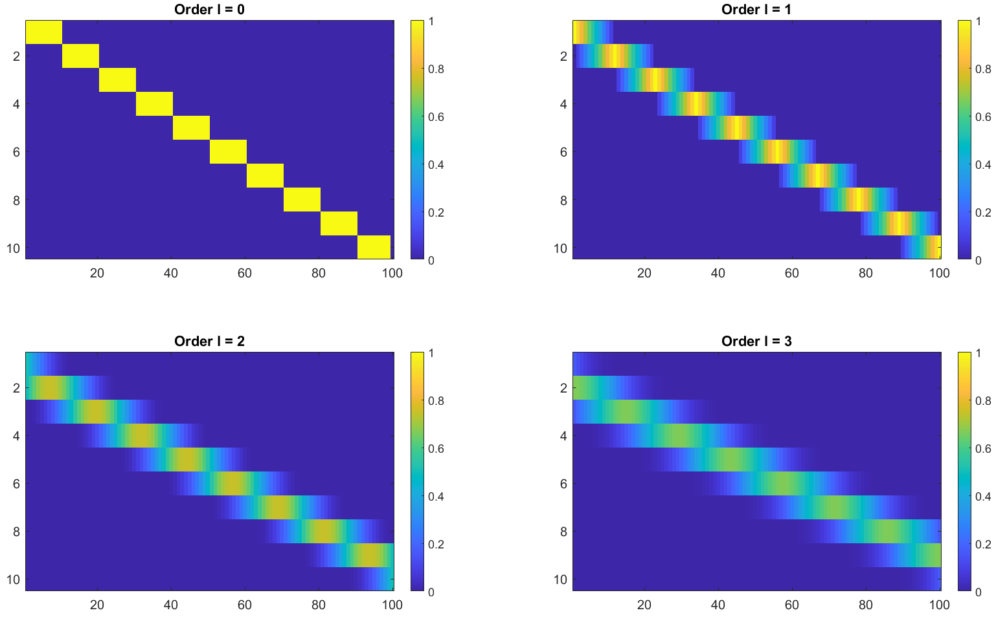
B-spline basis matrix
Notes:
B-spline basis matrices for l=0,1,2,3 and d=10 and n=100
We see that with increasing degree l, the area of influence for each BF increases, but we also see the LOCALITY FEATURE !!! Every blue point is exactly equal to 0.

Slide 13
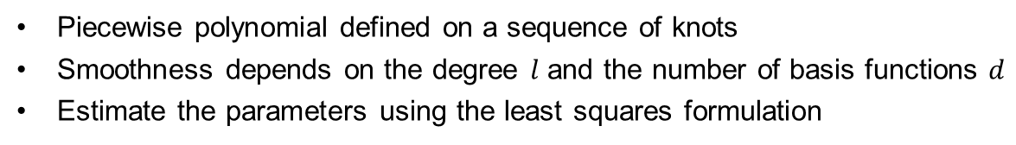
B-spline summary
Piecewise polynomial defined on a sequence of knots
Smoothness depends on the degree $l$ and the number of basis functions $d$
Estimate the parameters using the least squares formulation
Question: Can we use a high number of basis functions
and generate a smooth estimate??

Slide 14


P-splines
Penalize 2nd order derivative to enforce smoothness
Eilers & Marx 1996: base penalty on 2nd order finite differences of adjacent
coefficients to enforce smoothness

Slide 15
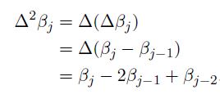
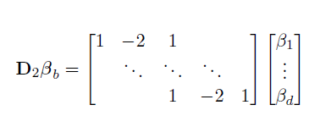


P-splines & PLS formulation

Slide 16
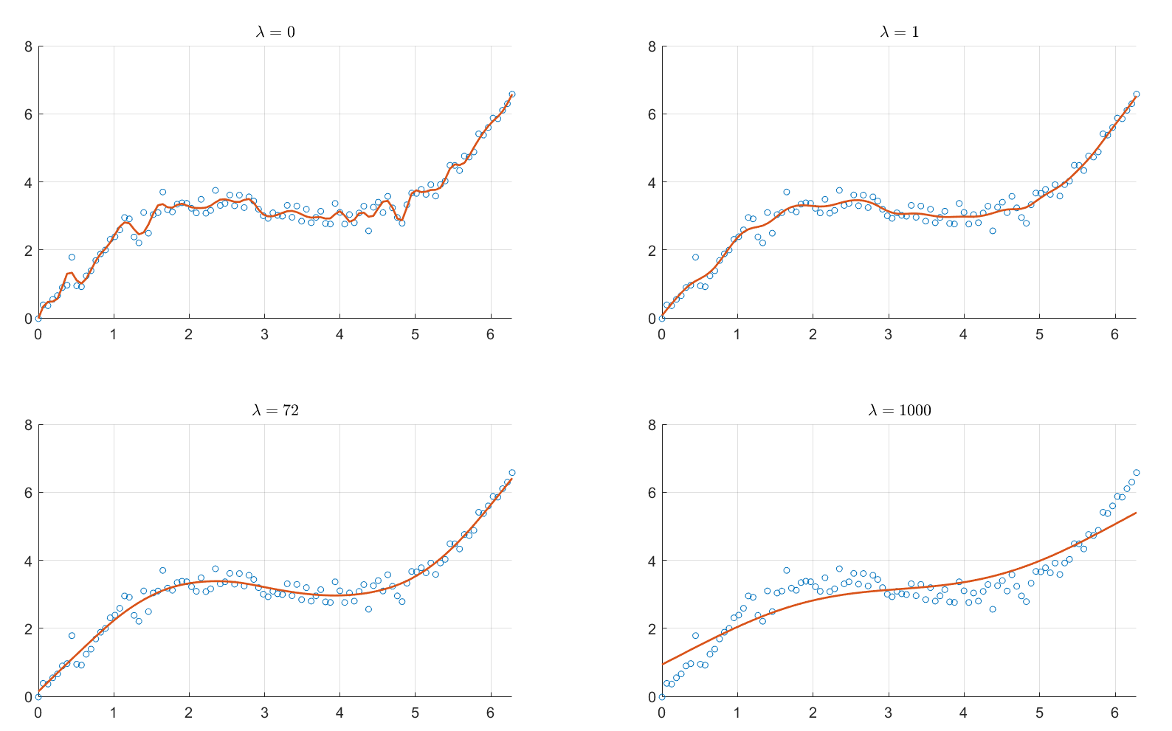
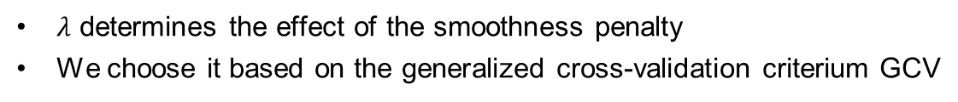

Choosing $λ$
$λ$ determines the effect of the smoothness penalty
We choose it based on the generalized cross-validation criterium GCV

Slide 17
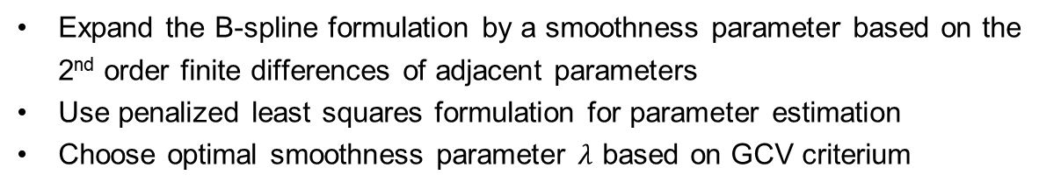
P-spline summary
Expand the B-spline formulation by a smoothness parameter based on the
2nd order finite differences of adjacent parameters
Use penalized least squares formulation for parameter estimation
Choose optimal smoothness parameter $λ$ based on GCV criterium
Question: can we use P-splines and introduce a priori domain knowledge??

Slide 18


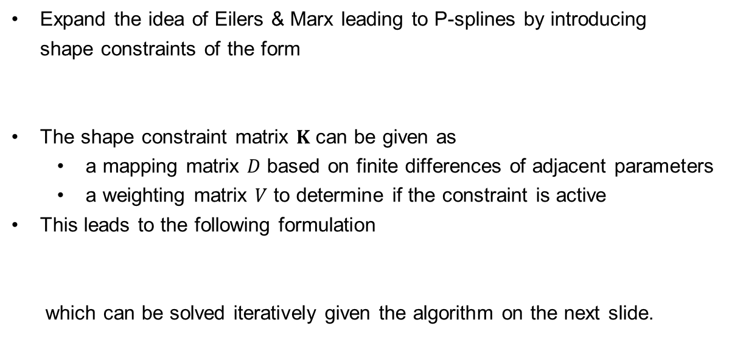
Shape-constraint P-splines
Expand the idea of Eilers & Marx leading to P-splines by introducing
shape constraints of the form
The shape constraint matrix $K$ can be given as
a mapping matrix $D$ based on finite differences of adjacent parameters
a weighting matrix $V$ to determine if the constraint is active
This leads to the following formulation
which can be solved iteratively given the algorithm on the next slide.
with

Slide 19
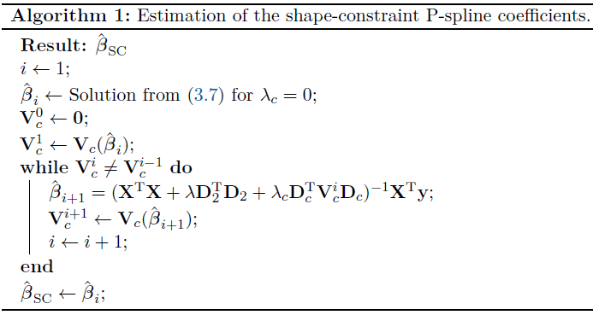

Slide 20

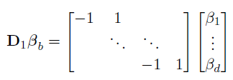

Example Increasing Behaviour
Constraint formulation
Mapping matrix
Weighting matrix

Slide 21
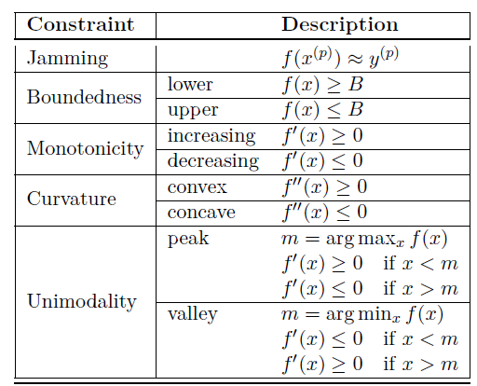

Various constraints
Through the choice of the mapping matrix $D$ and the weighting matrix $V$ various constraints can be incorporated

Slide 22


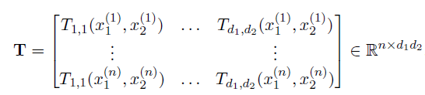

Extension to higher dimensions 1
Tensor-product B-splines for 2d
TP B-spline basis function
TP B-spline basis
TP B-spline basis matrix
Least squares formulation

Slide 23



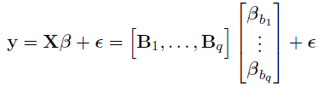
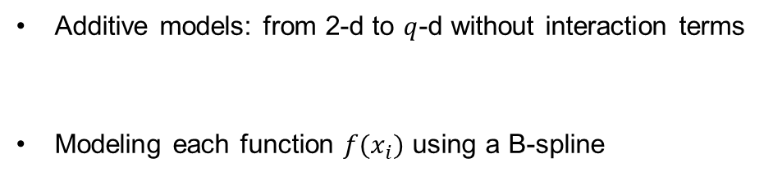
Extension to higher dimensions 2
Additive models: from 2-d to $q$-d without interaction terms
Modeling each function $f(x_{i})$ using a B-spline

Slide 24

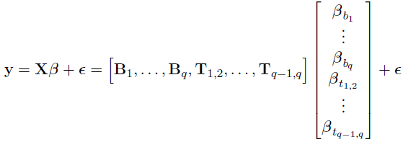
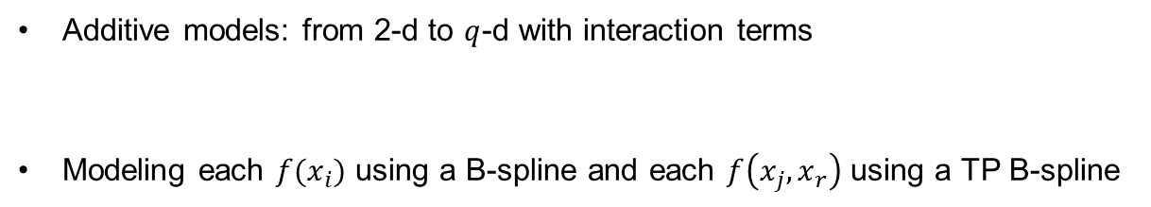
Extension to higher dimensions 2
Additive models: from 2-d to $q$-d with interaction terms
Modeling each $f(x_{i})$ using a B-spline and each $f\left(x_{j}, x_{r}\right)$ using a TP B-spline

Slide 25
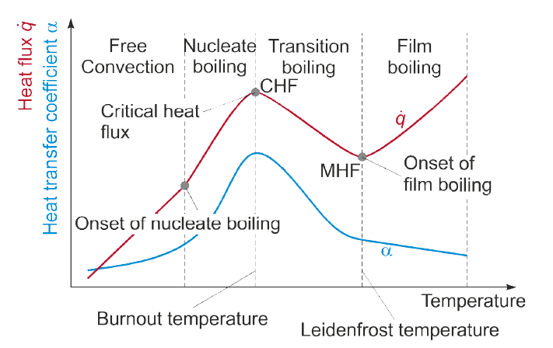
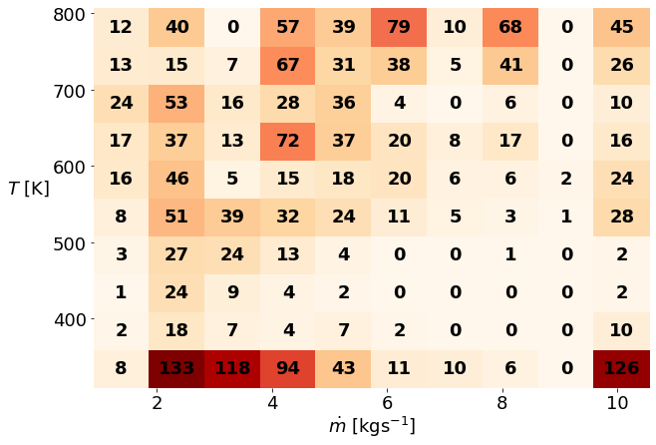
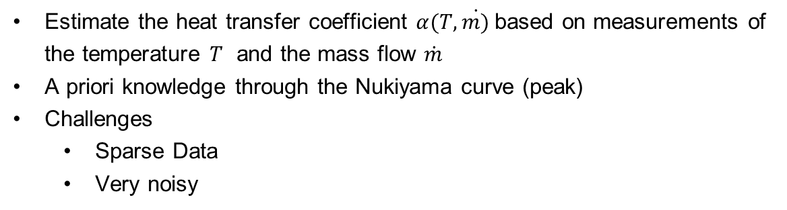
Experiment Heat Treatment process
Estimate the heat transfer coefficient $α(T, \dot{m)}$based on measurements of
the temperature $T$ and the mass flow $\dot{m}$
A priori knowledge through the Nukiyama curve (peak)
Challenges
Sparse Data
Very noisy

Slide 26
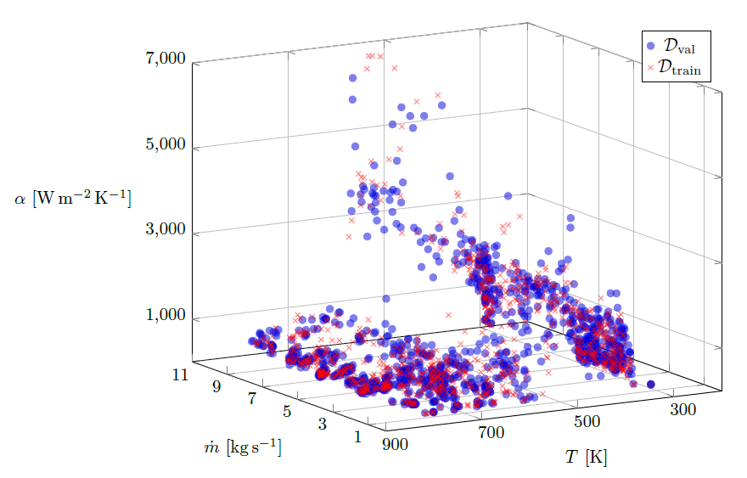
Data

Slide 27
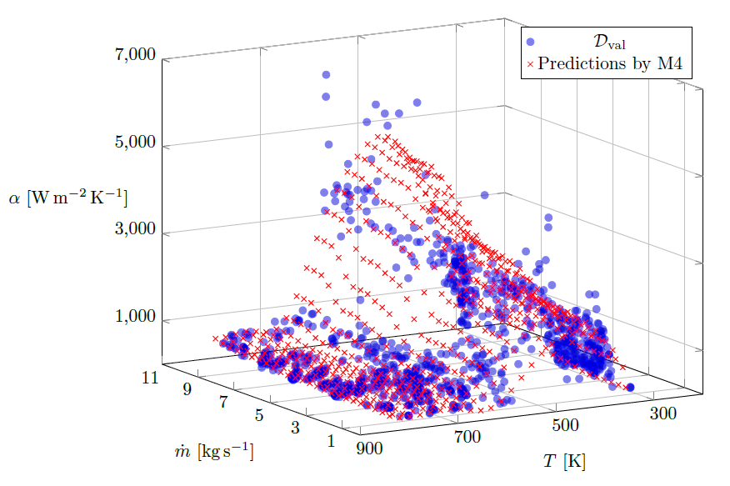
Best fit

Slide 28
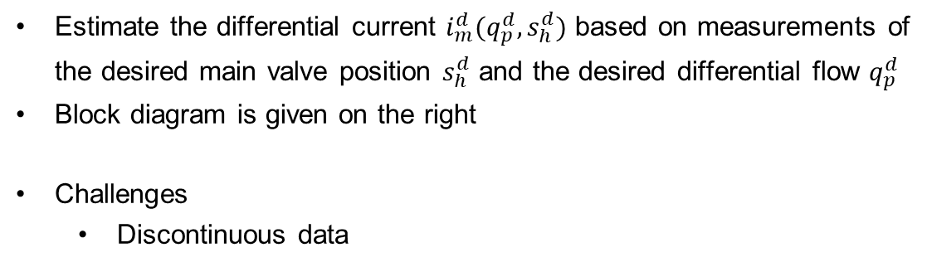
Experiment Hybrid modeling and Control
Estimate the differential current $i_{m}^{d}(q_{p}^{d}, s_{h}^{d})$ based on measurements of
the desired main valve position $s_{h}^{d}$ and the desired differential flow $q_{p}^{d}$
Block diagram is given on the right
Challenges
Discontinuous data

Slide 29
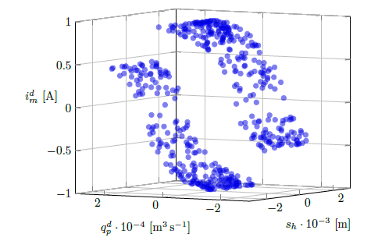
Data

Slide 30
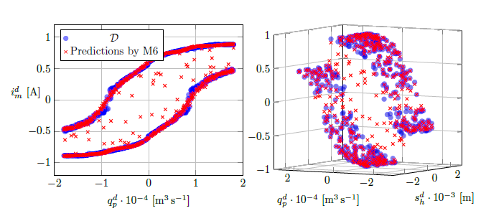
Best fit

Slide 31
summary
Linear models for function approximation
Extension to nonlinear functions using B-splines
Optimal smoothness using P-splines
Incorporation of a priori domain knowledge through shape-constraint P-splines

Slide 32
Thank you! Questions?
Jakob Weber

