Slide 1






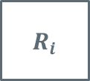




$$\hat{Σ}$$
$${\hat{p}}_{p}$$
$$s_{h}^{d}$$
$$s_{h}$$
$$R_{sh}$$
$$q_{p}^{d}$$
Servo compensation
$$i_{m}^{d}$$
$$R_{i}$$
$$u$$
$$Σ$$
$$i_{p}$$

