Slide 1
Introduction of a priori domain knowledge in function approximation using shape-constraint P-splines
Jakob Weber

Slide 2
Overview - Agenda
Problem formulation & motivation
Linear models, Regularization & Penalized Least-Squares
B-splines & P-splines
Shape-constraint P-splines
Experiments
Summary & Questions

Slide 3
Problem formulation & motivation
Massive increase of process data in the last years
Used to enhance process control concepts based on mathematical models
White-box (first principles) vs. black-box (data)
Specific a priori domain knowledge (AD) often available
Physics based
Heuristics
Incorporate the AD into the mathematical model → grey-box model
➔ Algorithm for efficient, multi-dimensional static function approximation using a priori domain knowledge

Slide 4

Process Model
Data
Physics-based
Data-driven
Physical Knowledge
Hybrid
Prediction
Process Model
Notes:
White Box ->Physics based
Black Box -> Data driven
Grey Box -> Hybrid Modeling

Slide 5
Process Model
Linear Models
Neural Networks
Non-parametric Models
Gaussian Process Regression
Data
Physics-based
Data-driven
Physical Knowledge
Hybrid
First-principle modeling
ODEs & PDEs
Constraints
Prediction
Process Model

Slide 6
Process Model
Linear Models
Neural Networks
Non-parametric Models
Gaussian Process Regression
Data
Physics-based
Data-driven
Physical Knowledge
Hybrid
First-principle modeling
ODEs & PDEs
Constraints
Prediction
Process Model
➔ Algorithm for efficient, multi-dimensional static function approximation using a priori domain knowledge

Slide 7
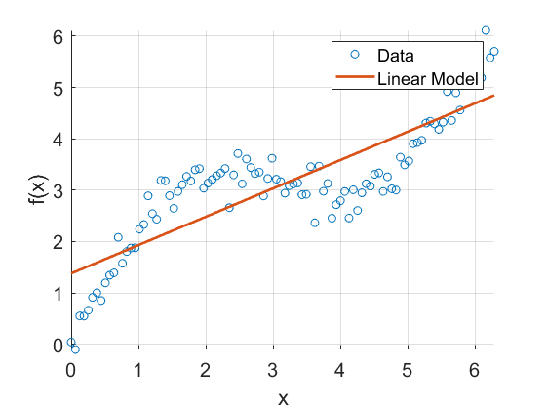




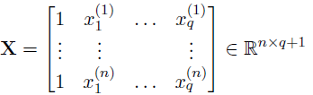

Linear models
Model the data assuming additive noise $ε$
Unknown function $f$ is a linear combination of the inputs
And with the complete data
Notes:
How do I get the red line?

Slide 8




Least Squares Formulation
Linear model
Least squares loss function
Least squares estimate
Notes:
If we now have the situation of having a large number of features (aka. Predictors, variables), especially a larger number of features than that of data points, we can use the concepts of regularization to restrict the parameter space

Slide 9

Regularization & Penalized least squares
Restrict the parameter space by adding a penalty term to the loss function
depending on the complexity of the model
with
and
leading to
Question: How do we cope with non-linear behavior in the data?
Notes:
-e.g. Ridge Regression for K = Identity

Slide 10


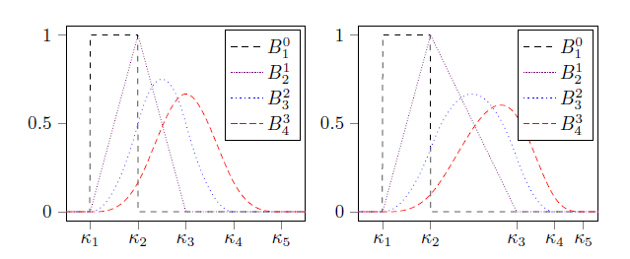
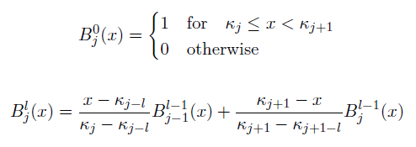
B-splines
Lin. comb. of $d$B-spline basis functions $B_{j}^{l}$ of order $l$ defined on a sequence of knots $K$
Each basis function $B_{j}^{l}$ is a piecewise polynomial and defined recursively as

Slide 11

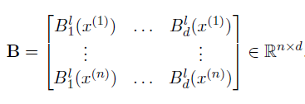


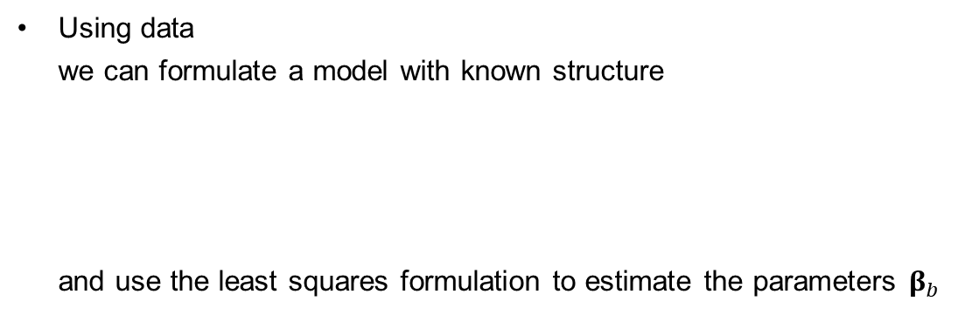
B-spline & Parameter estimation
Using data
we can formulate a model with known structure
and use the least squares formulation to estimate the parameters $β_{b}$
With the B-spline basis matrix

Slide 12
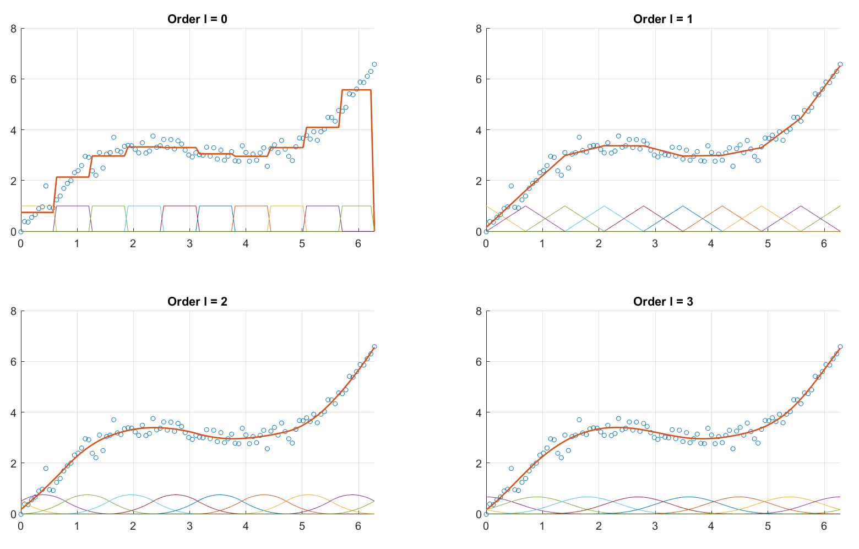
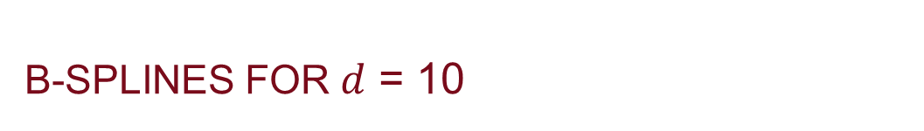
B-splines for $d$ = 10
Notes:
d = 10 basis functions each
100 datapoints x = [0, 2*pi]
y = 1.5 sin(x) + x

Slide 13
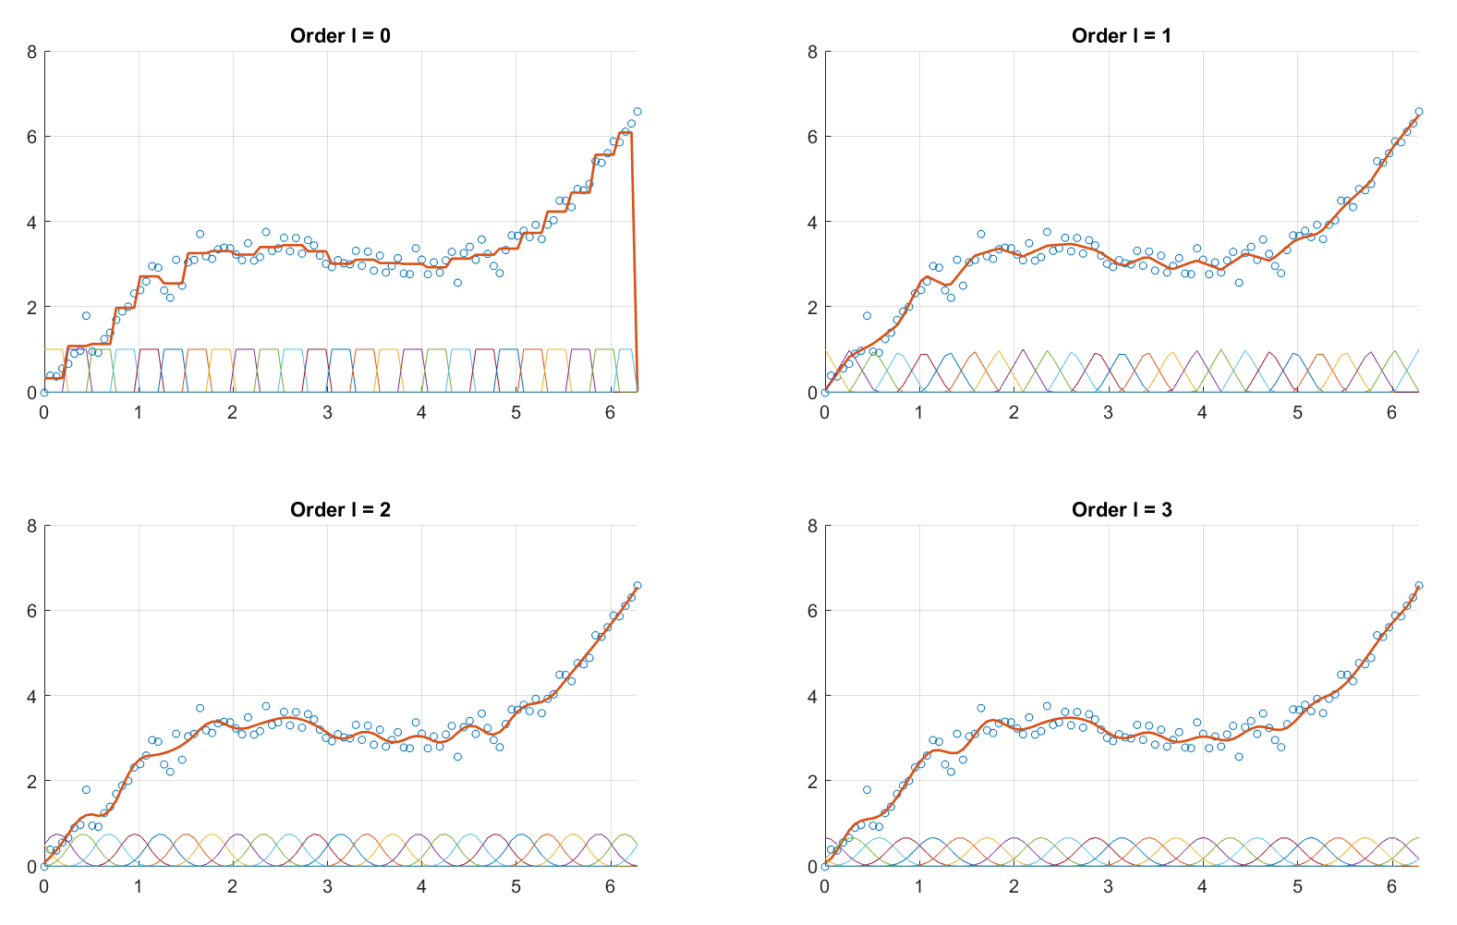
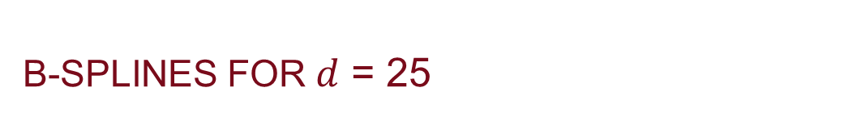
B-splines for $d$ = 25
Notes:
d = 10 basis functions each
100 datapoints x = [0, 2*pi]
y = 1.5 sin(x) + x

Slide 14
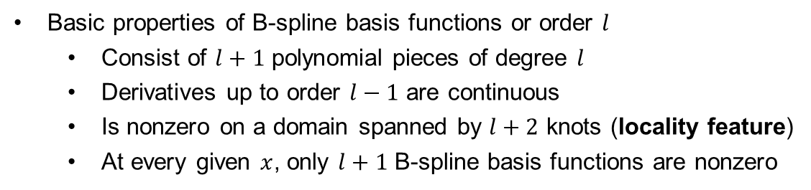
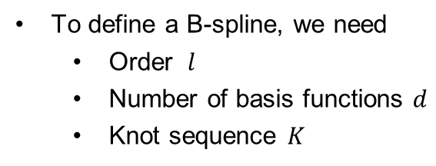
B-spline
To define a B-spline, we need
Order $l$
Number of basis functions $d$
Knot sequence $K$
Basic properties of B-spline basis functions or order $l$
Consist of $l+1$ polynomial pieces of degree $l$
Derivatives up to order $l−1$ are continuous
Is nonzero on a domain spanned by $l+2$ knots (locality feature)
At every given $x$, only $l+1$ B-spline basis functions are nonzero

Slide 15
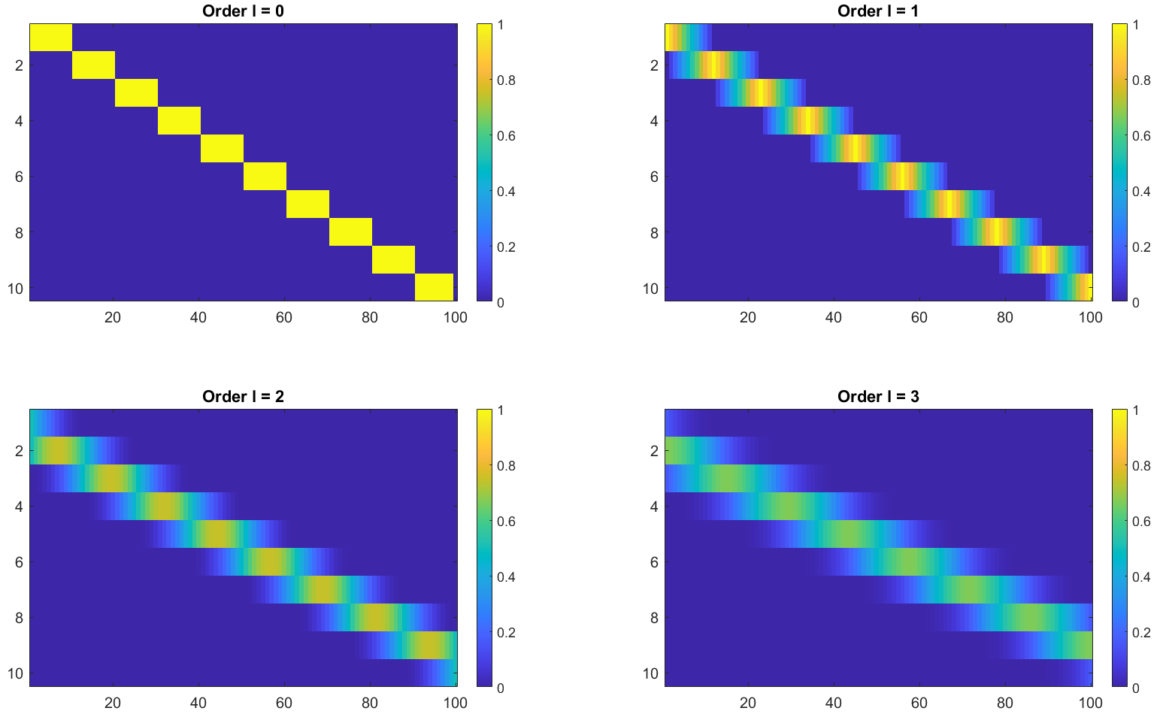
B-spline basis matrix
Notes:
B-spline basis matrices for l=0,1,2,3 and d=10 and n=100
We see that with increasing degree l, the area of influence for each BF increases, but we also see the LOCALITY FEATURE !!! Every blue point is exactly equal to 0.

Slide 16
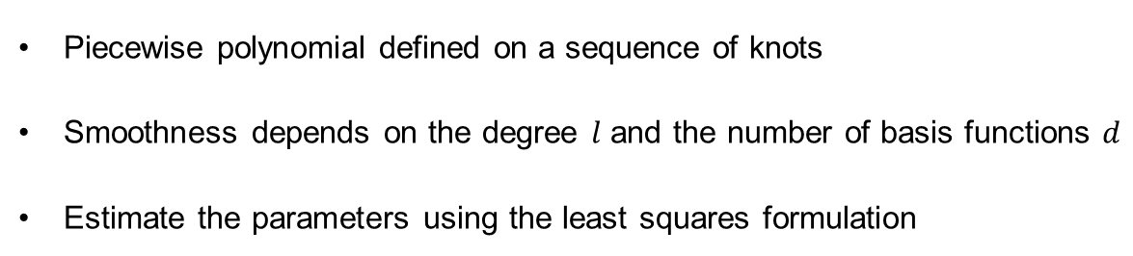
B-spline summary
Piecewise polynomial defined on a sequence of knots
Smoothness depends on the degree $l$ and the number of basis functions $d$
Estimate the parameters using the least squares formulation
Question: Can we use a high number of basis functions
and generate a smooth estimate??

Slide 17


P-splines
Penalize 2nd order derivative to enforce smoothness
Eilers & Marx 1996: base penalty on 2nd order finite differences of adjacent
coefficients to enforce smoothness

Slide 18
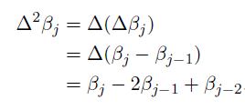
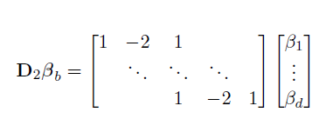


P-splines & PLS formulation

Slide 19
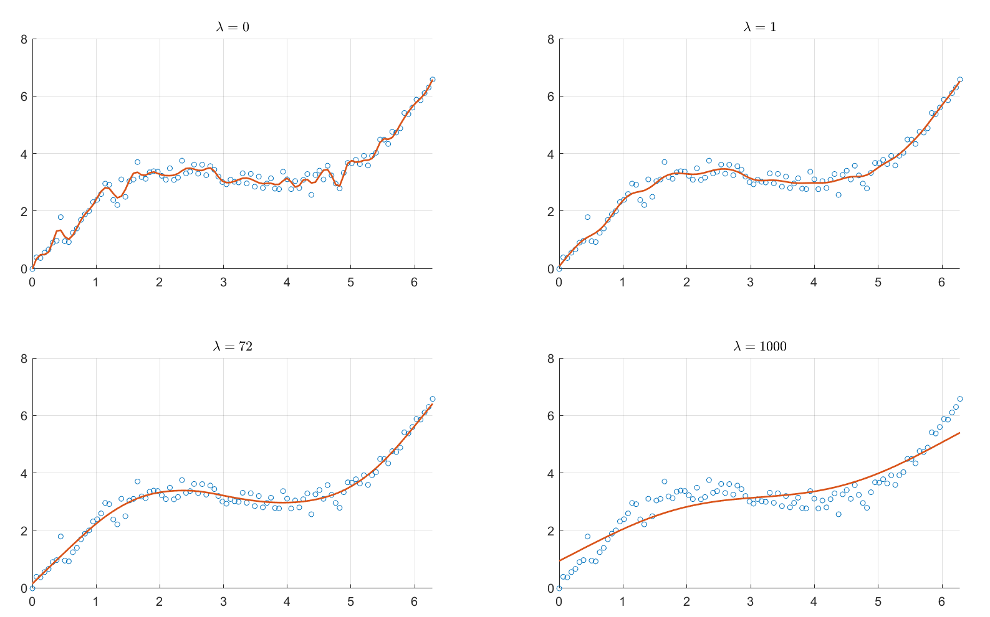
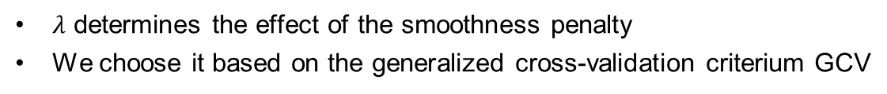

Choosing $λ$
$λ$ determines the effect of the smoothness penalty
We choose it based on the generalized cross-validation criterium GCV

Slide 20
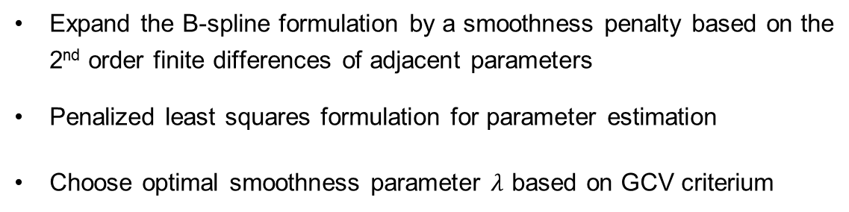
P-spline summary
Expand the B-spline formulation by a smoothness penalty based on the
2nd order finite differences of adjacent parameters
Penalized least squares formulation for parameter estimation
Choose optimal smoothness parameter $λ$ based on GCV criterium
Question: Can we use P-splines and introduce a priori domain knowledge??

Slide 21


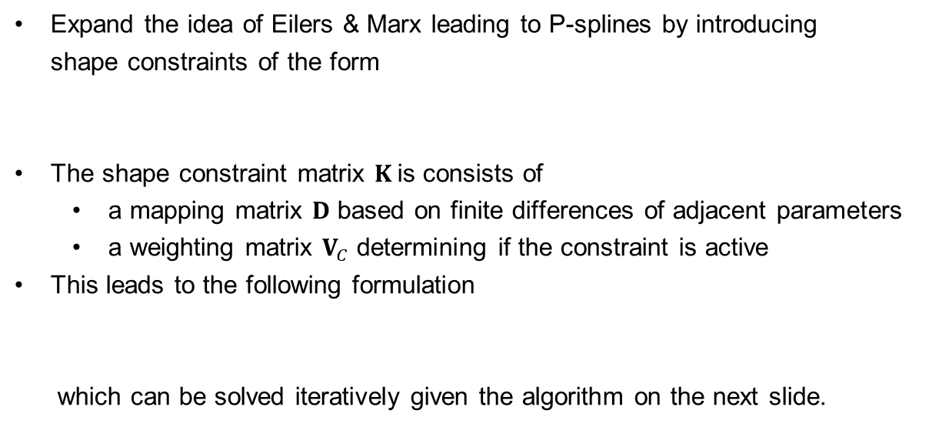
Shape-constraint P-splines
Expand the idea of Eilers & Marx leading to P-splines by introducing
shape constraints of the form
The shape constraint matrix $K$is consists of
a mapping matrix $D$ based on finite differences of adjacent parameters
a weighting matrix $V_{C}$ determining if the constraint is active
This leads to the following formulation
which can be solved iteratively given the algorithm on the next slide.
with

Slide 22
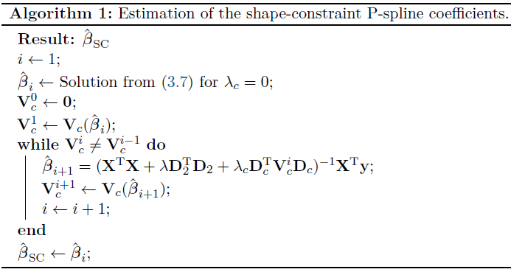

Slide 23

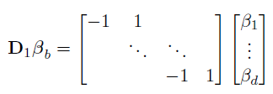

Example Increasing Behaviour
Constraint formulation
Mapping matrix
Weighting matrix

Slide 24
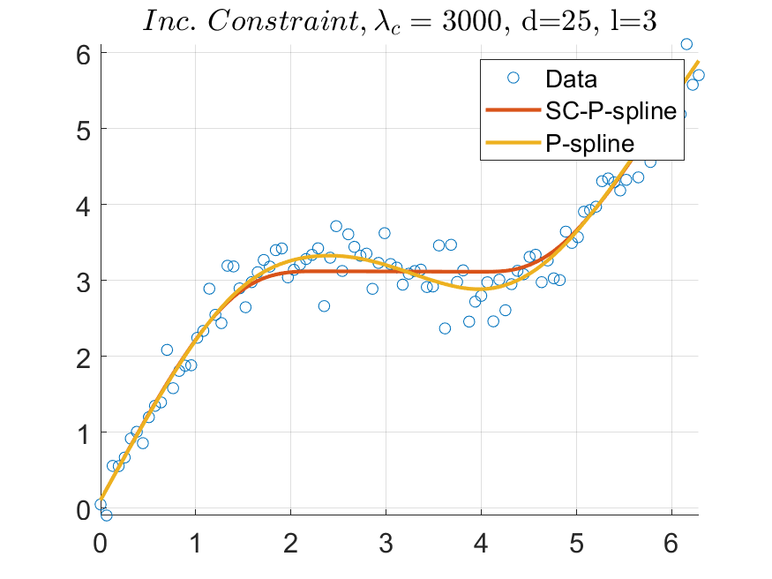

Slide 25
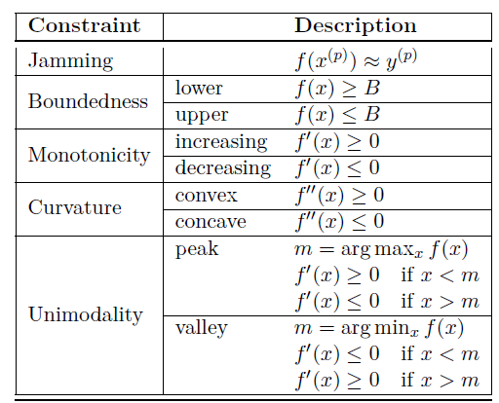

Various constraints
Through the choice of the mapping matrix $D$ and the weighting matrix $V$ various constraints can be incorporated

Slide 26


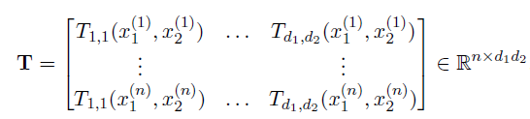

Extension to higher dimensions 1
Tensor-product B-splines for 2d
TP B-spline basis function
TP B-spline basis
TP B-spline basis matrix
Least squares formulation
Notes:
Row-wise Kronecker product
Constraints in different Dimensions

Slide 27
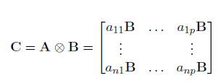
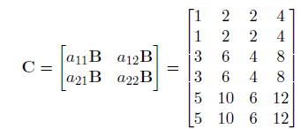
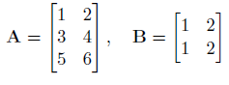
Kronecker product

Slide 28
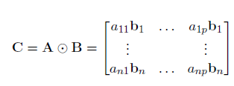
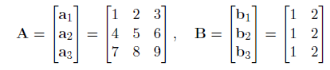

Row-Wise Kronecker product

Slide 29
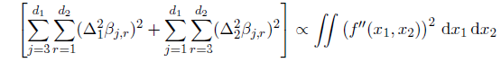

Tensor-product P-spline
Penalize 2nd order derivative in both dimensions to enforce smoothness
Penalized Least Squares formulation
with the penalty matrix

Slide 30
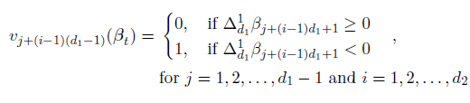

Tensor-product sC-P-spline
Constraints available for
One dimension: e.g. increasing only in dimension 1
Both dimensions: e.g increasing for dimension 1 and decreasing for dimension 2
Example: Increasing behavior in dimension 1

Slide 31



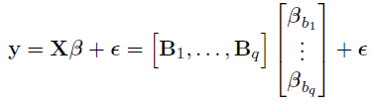
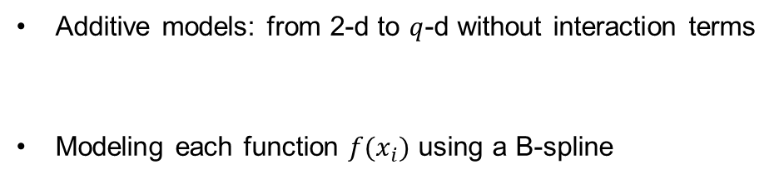
Extension to higher dimensions 2
Additive models: from 2-d to $q$-d without interaction terms
Modeling each function $f(x_{i})$ using a B-spline

Slide 32

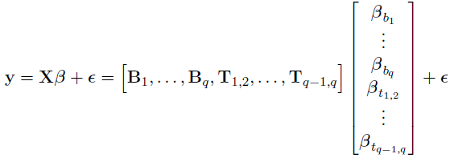
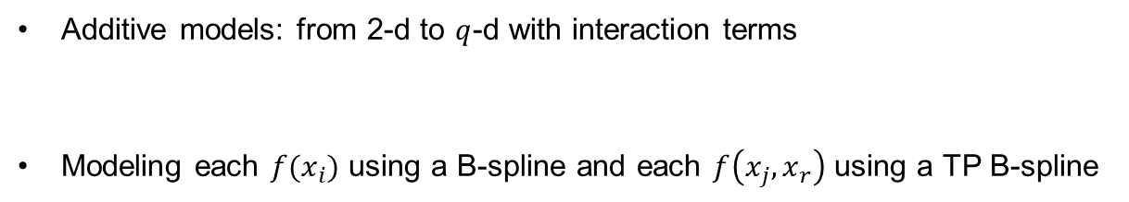
Extension to higher dimensions 3
Additive models: from 2-d to $q$-d with interaction terms
Modeling each $f(x_{i})$ using a B-spline and each $f\left(x_{j}, x_{r}\right)$ using a TP B-spline

Slide 33
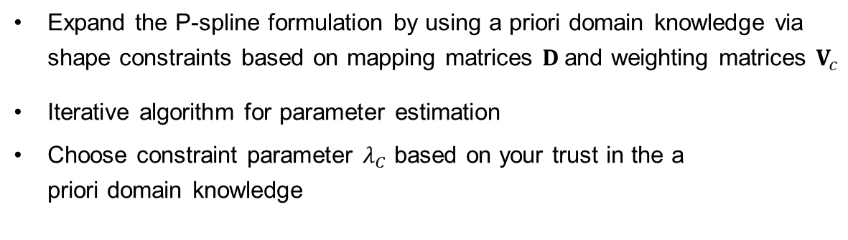
SC-P-splines Summary
Expand the P-spline formulation by using a priori domain knowledge via
shape constraints based on mapping matrices $D$and weighting matrices $V_{c}$
Iterative algorithm for parameter estimation
Choose constraint parameter $λ_{C}$ based on your trust in the a
priori domain knowledge

Slide 34
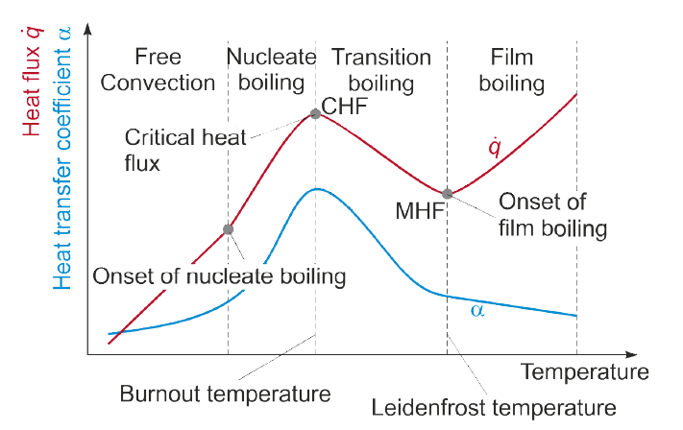
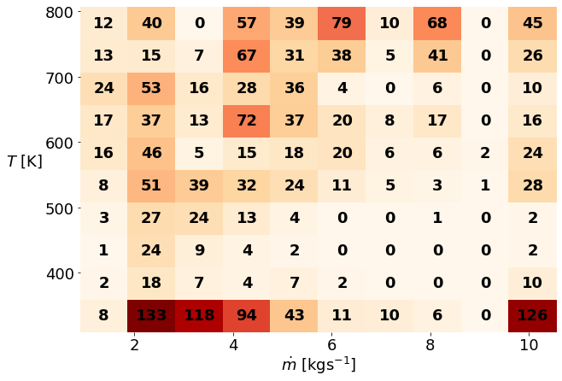
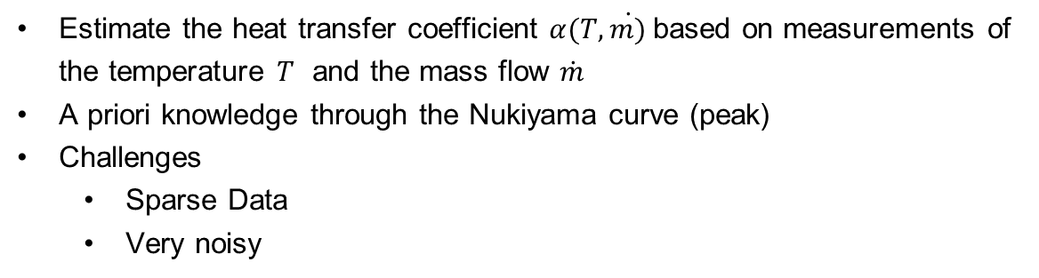
Experiment Heat Treatment process
Estimate the heat transfer coefficient $α(T, \dot{m)}$based on measurements of
the temperature $T$ and the mass flow $\dot{m}$
A priori knowledge through the Nukiyama curve (peak)
Challenges
Sparse Data
Very noisy

Slide 35
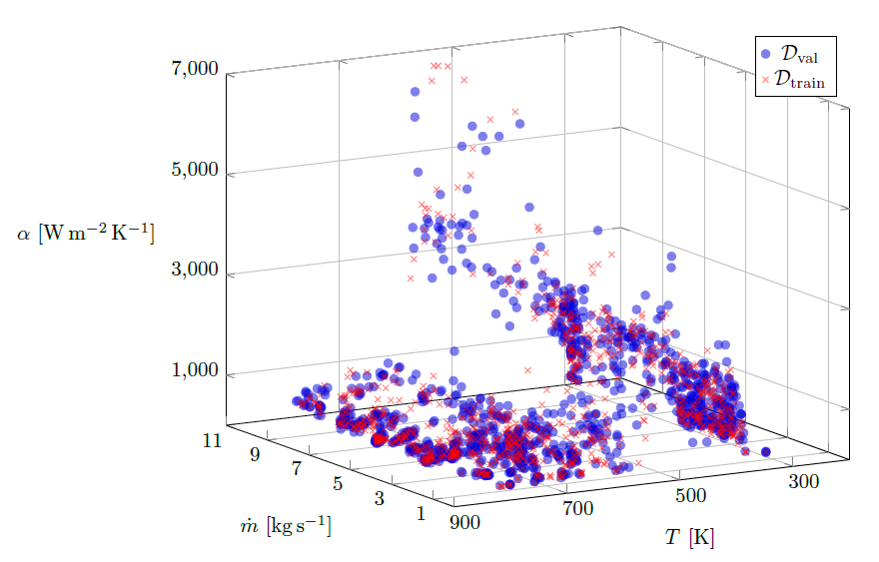
Data

Slide 36
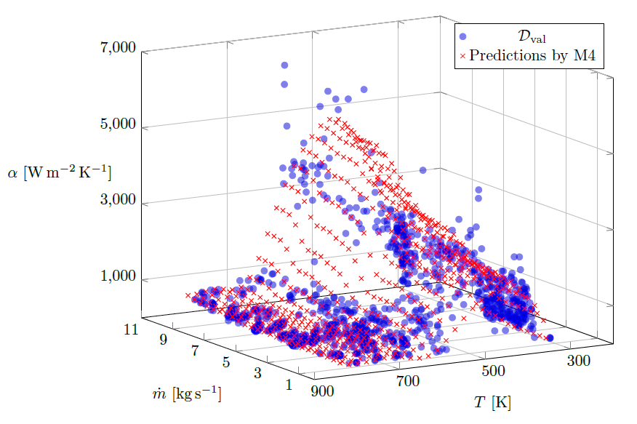
Best Model

Slide 37
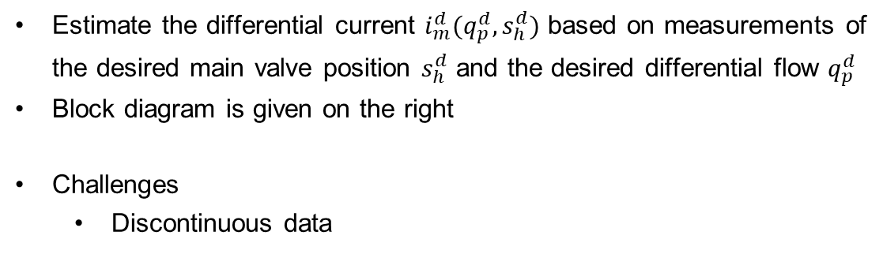
Experiment Hybrid modeling and Control
Estimate the differential current $i_{m}^{d}(q_{p}^{d}, s_{h}^{d})$ based on measurements of
the desired main valve position $s_{h}^{d}$ and the desired differential flow $q_{p}^{d}$
Block diagram is given on the right
Challenges
Discontinuous data

Slide 38
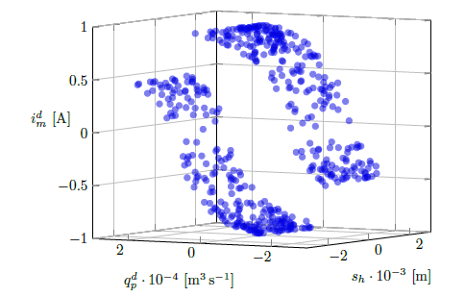
Data

Slide 39
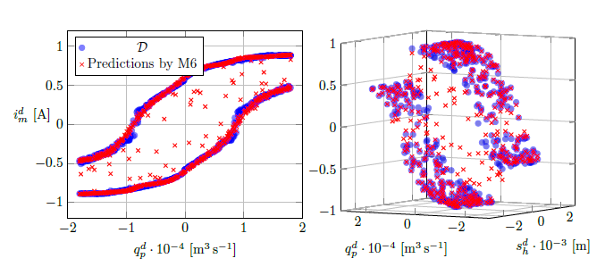
Best Model
$M6 =s\left(s_{h}^{d}\right)+t \left(q_{p}^{d}, s_{h}^{d}\right)$, with monotonicity for both dimensions

Slide 40
summary
Linear models & theory for function approximation
Extension to nonlinear functions approximation using B-splines
Optimal smoothness using P-splines
Incorporation of a priori domain knowledge through shape-constraint P-splines
Multi-dim through additive models

Slide 41
Thank you! Questions?
Jakob Weber

