Slide 1
Possible ways forward
5-Minute Presentations Augusta Conference
PCA on Current Results (Feature Engineering) – ID Most Important – John
How different between algorithms?
Would need to do inner join of data (number of observations in code complexity xls bigger than in certificate feature xls)
Certificate feature examine source – Emma
Splitting between well-known and obscure (19th Feature – True/False)
Ranking source popularity / trustworthiness
Fine Tune Algorithms – Austin / Jorge
Need to do research on good values / factors for random seeds
Parsing Organizational Units in Text File
Confusion Matrices – Sensitivity / Specificity / Other Metrics and What Those Mean (Type I / II Errors) - All
Rank Best Algorithm
Ask for More – HTTP Features
Write Down Results- All
Talk to UNCW IT for Data
Notes:
https://machinelearningmastery.com/gentle-introduction-xgboost-applied-machine-learning/

Slide 2
XGBOOSt: eXtreme Gradient Boosting
BY: John Tomaselli

Slide 3
What is Gradeint Boosting?
Branch of AdaBoost Machine Learning Algorithm
Both attempt to convert weak learners into strong learners.
Starting with equal weights on all observations, subsequent rounds assign:
More weight to observations that are difficult to classify.
Weaker weights to observations that are easy to classify.
Subsequent trees are produced for the desired number of iterations.
Where the algorithms branch: How the two algorithms identify the shortcomings of weak learners.
Adaboost: Uses high weight data points.
Gradient Boosting: Uses gradients in the loss function.
Notes:
https://towardsdatascience.com/understanding-gradient-boosting-machines-9be756fe76ab

Slide 4
What is XGBOOST?
Implementation of Gradient Boosting.
Baseline, stochastic, and regularized gradient boosting all supported.
Multiple programming language interfaces (C++, Python, R, Java)
Oriented to, “…push the limit of computations resources for boosted tree algorithms.”
Reasons to use XGBoost over other algorithms:
Speed
Performance.
Notes:
https://machinelearningmastery.com/gentle-introduction-xgboost-applied-machine-learning/

Slide 5
XGBOOST Features
System Features
Parallelization of tree construction using all of your CPU cores during training.
Distributed Computing for training very large models using a cluster of machines.
Out-of-Core Computing for very large datasets that don’t fit into memory.
Cache Optimization of data structures and algorithm to make best use of hardware.
Algorithm Features
Sparse Aware implementation with automatic handling of missing data values.
Block Structure to support the parallelization of tree construction.
Continued Training so that you can further boost an already fitted model on new data.
Notes:
https://machinelearningmastery.com/gentle-introduction-xgboost-applied-machine-learning/

Slide 6
XGBOOST Results
Code Complexity Features
# All Variables: 87.27%
# average cyclomatic complexity: 82.72%
# average number of external blocks: 86.22%
# proprietary code count: 82.38%
# average number of inline blocks: 80.33%
# number of DOM on-event handlers: 86.31%
Notes:
https://machinelearningmastery.com/gentle-introduction-xgboost-applied-machine-learning/

Slide 7
XGBOOST Results
Certificate Features
# All Variables: 87.27%
# Has x.509 Certificate: 84.2%
# Certificate Longevity: 86.98%
# Is a Valid Certificate: 84.2%
# Certificate Age: 87.7%
# Valid on Multiple 2-Level Domain Names: 84.2%
Notes:
https://machinelearningmastery.com/gentle-introduction-xgboost-applied-machine-learning/

Slide 8
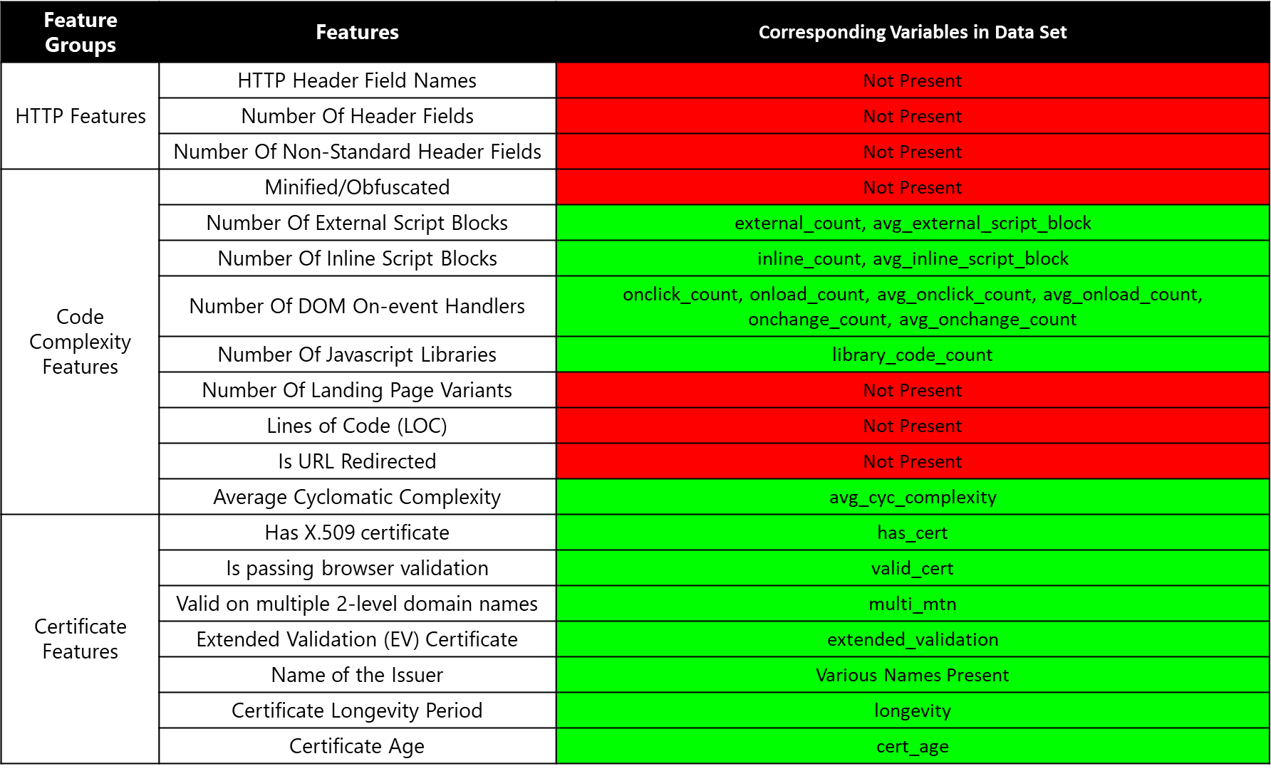
Provided data

