Slide 1
Applying Principle Component analysis and Dominance Analysis to Phishmon Variables
BY: John Tomaselli

Slide 2
What is Principle Component Analysis (PCA)?
A method of narrowing the number of variables in consideration in order to more easily consider their interactions and reduce overfitting.
Said more directly, PCA reduces the dimensionality of the feature space.
PCA is a technique for feature extraction, or the creation of new, independent variables that are combinations of the original data set.
Note that this is different from feature elimination, where a subset or portion of the original variables are considered.
The principal components produced by PCA are NOT directly correlated with any individual variable from the original data set.
When is PCA used?
When you want to reduce the number of variables, but aren’t able to identify variables to completely remove from consideration.
When you want to ensure your variables are independent of one another.
When you are comfortable making your independent variables less interpretable.
Notes:
https://towardsdatascience.com/a-one-stop-shop-for-principal-component-analysis-5582fb7e0a9c

Slide 3
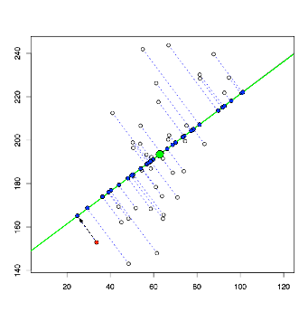

Slide 4
Scaling Definitions
MinMax Scaler
For each value in a feature, MinMaxScaler subtracts the minimum value in the feature and then divides by the range.
MinMaxScaler preserves the shape of the original distribution.
The default range for the feature returned by MinMaxScaler is 0 to 1.
Standard Scaler
Standardizes each value by subtracting the mean and then dividing by the standard deviation.
This is the default setting for python’s Scale() function.
StandardScaler results in a distribution with a standard deviation and variance both equal to 1 (Normal Distribution).
StandardScaler makes the mean of the distribution 0.
Notes:
https://towardsdatascience.com/scale-standardize-or-normalize-with-scikit-learn-6ccc7d176a02

Slide 5
Scaling results
All the below values were achieved using a variance rate set to 99% and XGBoost (Gradient Boosting)
MinMax Scaler
 | Original # of Variables | # Principle Components Created | Accuracy Rate Achieved With PCA | Original Accuracy Rate Without PCA | Execution Time without PCA | Execution Time with PCA
All Available Variables (Code Complexity + Certificate) | 19 | 12 | 89.84% | 91.95% | 187ms | 232ms
Code Complexity Features | 13 | 7 | 87.32% | 87.50% | 740ms | 783ms
Certificate Features | 6 | 4 | 92.24% | 92.24% | 213ms | 181ms

Slide 6
Scaling results
All the below values were achieved using a variance rate set to 99% and XGBoost (Gradient Boosting)
Standard Scaler
 | Original # of Variables | # Principle Components Created | Accuracy Rate Achieved With PCA | Original Accuracy Rate Without PCA | Execution Time without PCA | Execution Time with PCA
All Available Variables (Code Complexity + Certificate) | 19 | 15 | 90.23% | 91.95% | 187ms | 297ms
Code Complexity Features | 13 | 11 | 87.48% | 87.50% | 725ms | 1.08s
Certificate Features | 6 | 5 | 89.07% | 92.24% | 193ms | 240ms

Slide 7
Conclusions from PCA with Scaling
Overarching Theme: PCA does not appear to offer any utility in this problem.
Some co-linearity was present with each data set, as indicated by the drop in the number of principle components created.
Accuracy with PCA decreased slightly with each variable set.
The execution times were surprising.
PCA is supposed to decrease execution time. Instead, all the PCAs calculated were significantly slower.
Also, just executing the code complexity features was markedly slower than executing all available variables (code complexity features + certificate features). Odd.
d
Notes:
https://towardsdatascience.com/scale-standardize-or-normalize-with-scikit-learn-6ccc7d176a02

Slide 8
Dominance analysis: Possibly A better solution
Instead of creating principal components, which are composite values from several variables, we could simply identify which variables are least important and eliminate those from processing.
Dominance analysis accomplishes the above task, showing both the individual and relative importance of each dependent variable to the response variable.
Executed using the Dominance-Analysis third party Python library.
Notes:
https://dominance-analysis.readthedocs.io/en/latest/Dominance-Statistics.html

Slide 9
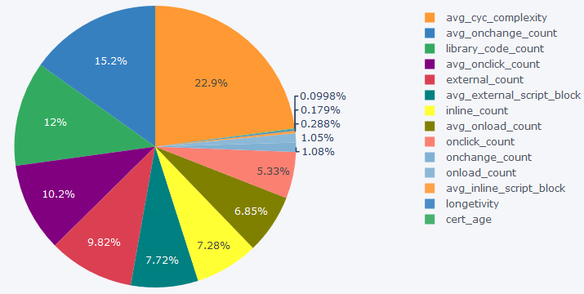
% relative importance for the top 12 variables

Slide 10
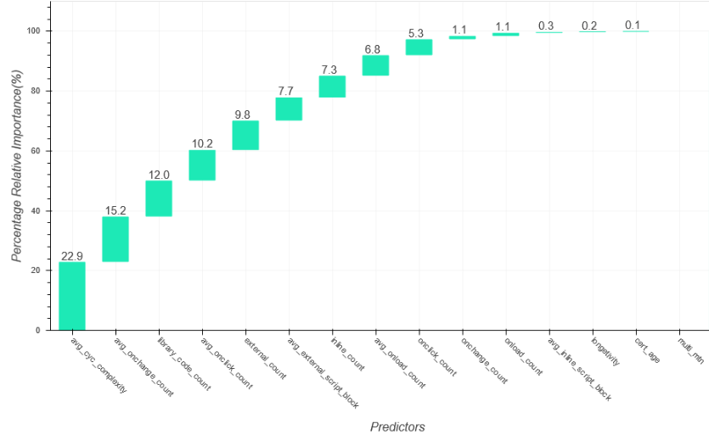
% relative importance waterfall
Rather Low
Relative Importance Values

Slide 11
Dominance statistics definitions (Results on Next slide)
Interactional Dominance: This measure gives an idea about the predictor’s incremental impact in the presence of all other predictors. It is arrived at by subtracting the R-square value of a model with all other predictors from the R-square value of the complete model.
Individual Dominance: This measure shows the variability explained by the predictor alone in the absence of all other predictors. Mathematically, the individual dominance of a predictor is the R-square of the model between the dependent variable and the predictor variable.
Average Partial Dominance: This measure is the average of average incremental R-square contributions of the predictor to all subset models except complete model and bi-variate (when only one predictor is present) model. Hence, this can be interpreted as the average impact that a predictor has when it is available in all possible combinations with other predictors except the combination when all predictors are available.
Total Dominance: This measure of dominance summarizes the additional contributions of each predictor to all subset models by averaging all the conditional values.
Notes:
https://towardsdatascience.com/scale-standardize-or-normalize-with-scikit-learn-6ccc7d176a02

Slide 12
Dominance statistics
 | Interactional Dominance | Individual Dominance | Average Partial Dominance | Total Dominance | Percentage Relative Importance
avg_cyc_complexity | 0.051263 | 0.1523 | 7.01E-02 | 0.074323 | 22.9162
avg_onchange_count | 0.014103 | 0.19049 | 4.10E-02 | 0.049137 | 15.1506
library_code_count | 0.003024 | 0.184212 | 3.06E-02 | 0.039012 | 12.0287
avg_onclick_count | 0.001244 | 0.14827 | 2.67E-02 | 0.033121 | 10.2124
external_count | 5.18E-05 | 0.15258 | 2.50E-02 | 0.031863 | 9.82424
avg_external_script_block | 0.005812 | 0.060707 | 2.38E-02 | 0.025028 | 7.71699
inline_count | 0.001297 | 0.11895 | 1.80E-02 | 0.023611 | 7.27989
avg_onload_count | 0.004676 | 0.092548 | 1.81E-02 | 0.022203 | 6.84582
onclick_count | 0.00495 | 0.066358 | 1.45E-02 | 0.01729 | 5.33099
onchange_count | 0.001611 | 0.012301 | 2.96E-03 | 0.003491 | 1.07643
onload_count | 0.002053 | 0.008983 | 3.08E-03 | 0.003409 | 1.05106
avg_inline_script_block | 0.000608 | 0.001904 | 8.83E-04 | 0.000933 | 0.287702
longetivity | 0.000685 | 0.00052 | 5.78E-04 | 0.000581 | 0.179246
cert_age | 0.000216 | 0.000246 | 3.38E-04 | 0.000324 | 0.099762
multi_mtn | 0 | 0 | -2.80E-18 | -2.42E-18 | -7.47E-16

Slide 13
Dominance statistics Comparison with Paper results
Two notes of caution when comparing these two lists:
The relative importance ranking is not the same as the MDI, although they are similar enough to meaningfully put side-by-side
The relative importance ranking was done only with the variables we have, not all of them as presumably occurred with MDI
The above being said, note how many of the most important variables are part of the number of DOM on-event handlers.
Collectively, they contribute 49.49% of the relative importance.
Relative Importance Ranking | Table V List of Top 10 Most Important Features Based on Mean Decrease Impurity (MDI)
Average Cyclomatic Complexity | Average Cyclomatic Complexity
avg_onchange_count (Part of Number of DOM On-Event Handlers) | Lines of Code (LOC) of External Script Blocks
library_code_count (Number of JavaScript Libraries) | Number of External Script Blocks
avg_onclick_count (Part of Number of DOM On-Event Handlers) | Set-Cookie HTTP
external_count (Part of Number of DOM On-Event Handlers) | Number of Landing Page Variants
avg_external_script_block (Part of Number of External Script Blocks) | Number of HTTP Headers
inline_count (Part of Number of Inline Script Blocks) | Proprietary Code Count
avg_onload_count (Part of Number of DOM On-Event Handlers) | Is URL Redirected
onclick_count (Part of Number of DOM On-Event Handlers) | Average Number of Inline Script Blocks
onchange_count (Part of Number of DOM On-Event Handlers) | Keep-Alive HTTP

Slide 14
Dominance statistics Conclusions
Very heavy emphasis on variables associated with the number of DOM on-event handlers.
The onchange_count, onload_count, avg_inline_script_block, longevity, cert_age, and multi_mtn variables can be removed from the overall dataset with 97.2% of the relative importance remaining.
The relative importance ranking appears to conflict with table V provided in the Phishmon paper.
Again, relative importance and MDI are not the same, so this may go some way in explaining the difference.
One final note of caution: Using dominance analysis, I was only able to get a 0.3243 R-Squared value. This is far lower than the example datasets also in my code folder.
This could be due to scaling, although neither of the example sets were scaled.
My attempts at scaling all returned weird errors that I could not overcome.

Slide 15
Questions?

Slide 16
Possible ways forward
5-Minute Presentations Augusta Conference
PCA on Current Results (Feature Engineering) – ID Most Important – John
How different between algorithms?
Would need to do inner join of data (number of observations in code complexity xls bigger than in certificate feature xls)
Certificate feature examine source – Emma
Splitting between well-known and obscure (19th Feature – True/False)
Ranking source popularity / trustworthiness
Fine Tune Algorithms – Austin / Jorge
Need to do research on good values / factors for random seeds
Parsing Organizational Units in Text File
Confusion Matrices – Sensitivity / Specificity / Other Metrics and What Those Mean (Type I / II Errors) - All
Rank Best Algorithm
Ask for More – HTTP Features
Write Down Results- All
Talk to UNCW IT for Data
Notes:
https://machinelearningmastery.com/gentle-introduction-xgboost-applied-machine-learning/

Slide 17
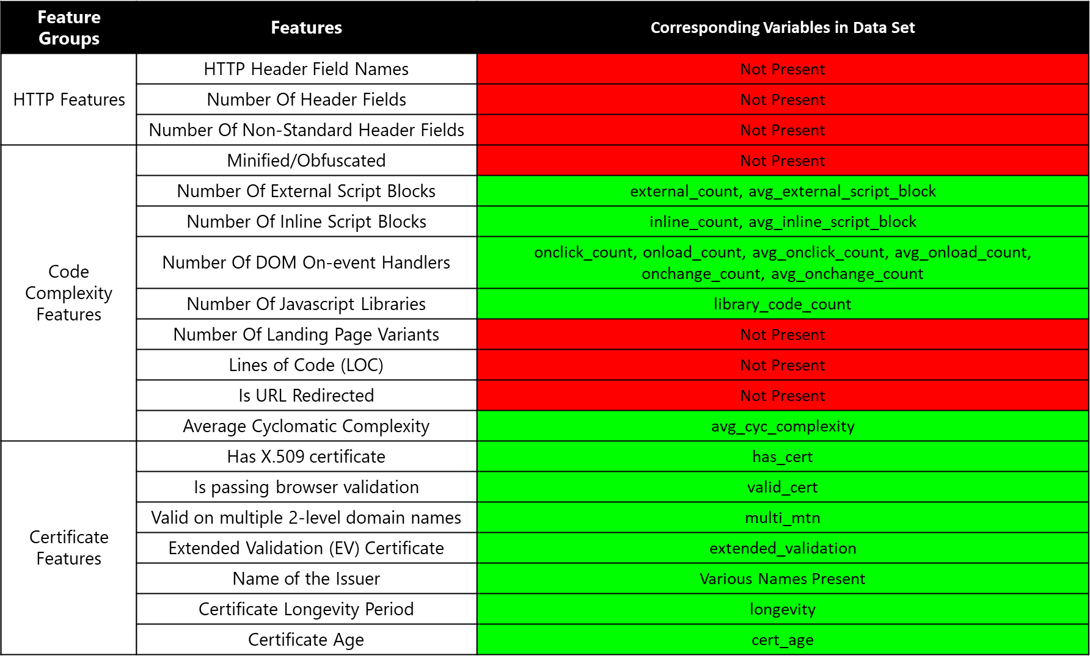
Provided data

Slide 18
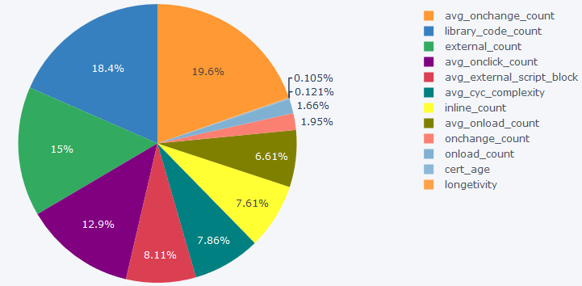
Original % relative importance for the top 12 variables

Slide 19
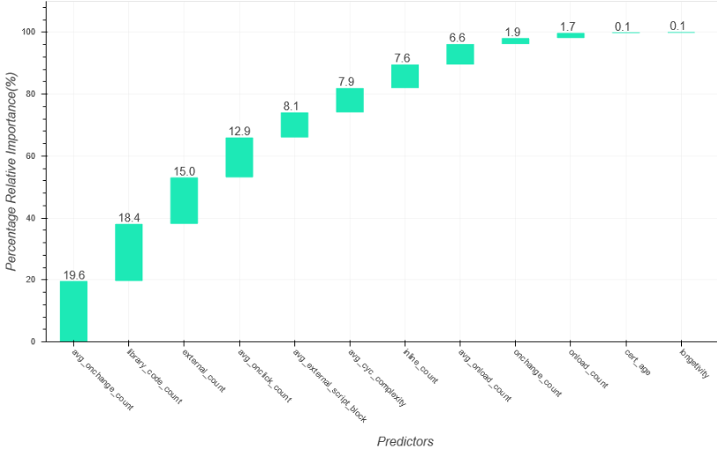
Original % relative importance waterfall

Slide 20
Original Dominance statistics
 | Interactional Dominance | Individual Dominance | Average Partial Dominance | Total Dominance | Percentage Relative Importance
avg_onchange_count | 0.00676151 | 0.300547 | 0.052794 | 0.0696042 | 19.6174
library_code_count | 0.000248457 | 0.303542 | 0.048137 | 0.0654299 | 18.4409
external_count | 6.81E-06 | 0.252971 | 0.038692 | 0.0533245 | 15.0291
avg_onclick_count | 1.78E-05 | 0.233812 | 0.031519 | 0.0457515 | 12.8947
avg_external_script_block | 0.007372 | 0.107044 | 0.023075 | 0.028764 | 8.10691
avg_cyc_complexity | 0.00540191 | 0.118376 | 0.021085 | 0.0278857 | 7.85936
inline_count | 2.03E-05 | 0.164459 | 0.01594 | 0.0269897 | 7.60684
avg_onload_count | 0.000650123 | 0.12181 | 0.015886 | 0.0234437 | 6.60742
onchange_count | 0.00348049 | 0.0278686 | 0.005155 | 0.00690829 | 1.94705
onload_count | 0.00382267 | 0.0177286 | 0.00493 | 0.00590394 | 1.66398
cert_age | 0.000595454 | 0.000193047 | 0.000437 | 0.000429834 | 0.121145
longetivity | 0.000442299 | 0.000408162 | 0.000363 | 0.000373507 | 0.10527

Slide 21
Original Dominance statistics Comparison with Paper results
Relative Importance Ranking | Table V List of Top 10 Most Important Features Based on Mean Decrease Impurity (MDI)
avg_onchange_count (Part of Number of DOM On-Event Handlers) | Average Cyclomatic Complexity
library_code_count (Number of JavaScript Libraries) | Lines of Code (LOC) of External Script Blocks
external_count (Part of Number of DOM On-Event Handlers) | Number of External Script Blocks
avg_onclick_count (Part of Number of DOM On-Event Handlers) | Set-Cookie HTTP
avg_external_script_block (Part of Number of External Script Blocks) | Number of Landing Page Variants
avg_cyc_complexity (Average Cyclomatic Complexity) | Number of HTTP Headers
inline_count (Part of Number of Inline Script Blocks) | Proprietary Code Count
avg_onload_count (Part of Number of DOM On-Event Handlers) | Is URL Redirected
onchange_count (Part of Number of DOM On-Event Handlers) | Average Number of Inline Script Blocks
onload_count (Part of Number of DOM On-Event Handlers) | Keep-Alive HTTP

