Slide 1


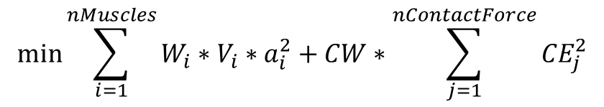



$$\min{\sum_{i=1}^{nMuscles}{W_{i}∗V_{i}∗a_{i}^{2}+CW∗\sum_{j=1}^{nContactForce}{{CE}_{j}^{2}}}}$$
$$W_{i}=Muscle Weight$$
$$V_{i}=Muscle Volume$$
$$a_{i}=Muscle Activation$$
$$CW=Contact Energy Weight$$
$$CE=Articular Contact Energy$$

Slide 2
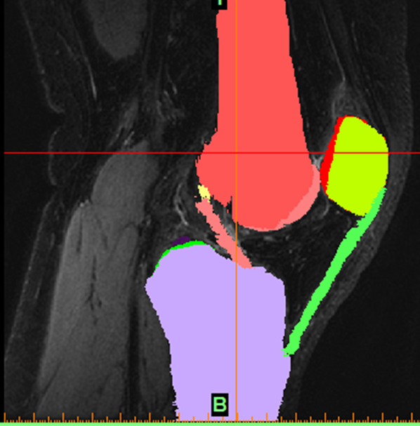
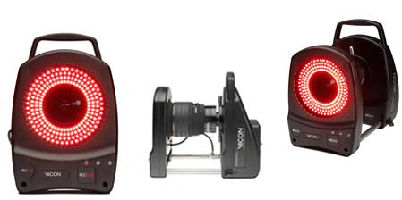
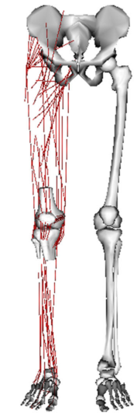
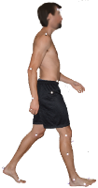

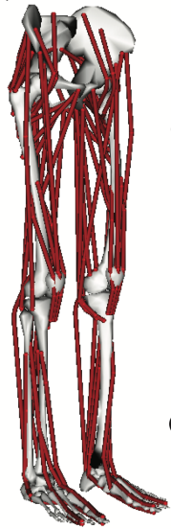
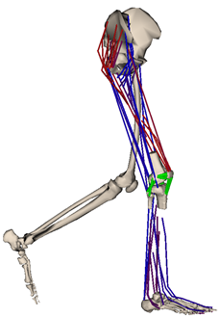
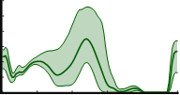




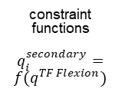







Knee Model
Construction
Personalized
Model
Experimental Data
scale
factors
ground
reactions
COMAK
$$F^{ext}(t)$$
Musculoskeletal
Model
marker
trajectories
Predicted
Probabilistic
Knee Mechanics
Inverse
Kinematics
output
constraint
functions
$$q_{i}^{secondary}=$$
$$f(q^{TF Flexion})$$
${\left(q,\dot{q},\ddot{q}\right)}^{primary}(t)$
gait cycle
Prescribed Flexion
Forward Simulation
$$q^{secondary}(t)$$
$$F^{muscle}(t)$$
$$F^{ligament}(t)$$
${\left(q\right)}^{primary}(t_{0})$
$$F^{contact}(t)$$
Initialization
Forward Simulation
Monte Carlo
Neuromuscular
Coordination
$$q^{secondary}$$
$$q^{secondary}(t_{0})$$
$$t_{0}−t_{settle}$$
$$t_{0}$$
parallel simulations
High Throughput
Computing (HTC)

Slide 3
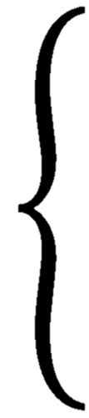
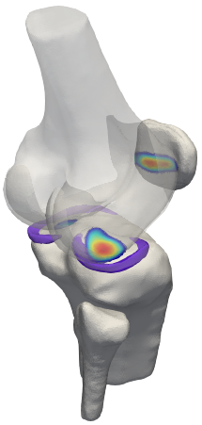










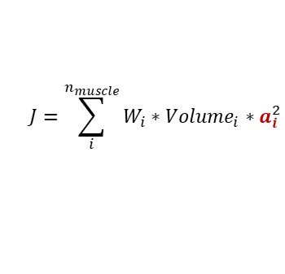

































Concurrent Optimization of Muscle Activations and Kinematics (COMAK)
Optimization
Find:
Minimize:
Constraints:
secondary coordinates
$$J=\sum_{i}^{n_{muscle}}{W_{i}∗Volume_{i}∗a_{i}^{2}}$$
$$0<a_{i}<1$$
$$secondary$$
$$q$$
$$primary$$
$$=$$
$$primary$$
$$simulated$$
$$\ddot{q}$$
$$\ddot{q}$$
muscle activations
$$a_{i}$$
$$observed$$
$$simulated$$
$$0=$$
$$\left(\dot{q},\ddot{q}\right)$$
$$secondary$$
$$simulated$$
Multibody Dynamics
1) Set States:
2) Calculate Forces:
3) Solve Equations of Motion:
$$F_{i}^{muscle}=a_{i}∗F_{i}^{max}$$
$$prescribed$$
$$(q,\dot{q})$$
$$prescribed$$
$$\ddot{q}$$
$$observed$$
$$F^{ligament}(q,\dot{q})$$
$$observed$$
$$primary$$
$$=$$
$$primary$$
$$(a_{i},q,\dot{q,}F^{ext})$$
$$=$$
$$\ddot{q}$$
$$(q,\dot{q})$$
$$(q,\dot{q})$$
$$observed$$
$$F^{contact}(q)$$
$$\ddot{q}$$
$$simulated$$
$$secondary$$
$$(a_{i},q,\dot{q},F^{ext})$$
$$secondary$$
$$\ddot{q}$$
$$(q,\dot{q})$$
$$simulated$$
$$F^{damping}(\dot{q})$$
$$simulated$$
$$F^{ext}$$
prescribed
Inputs
Outputs
primary
ground reactions
$$F^{ext}$$
secondary coordinates
muscle activations
ligament forces
articular contact pressures
inverse kinematics
$$q,\dot{q},{\ddot{q}}^{observed}$$
secondary
Observed Measurements

