Slide 1
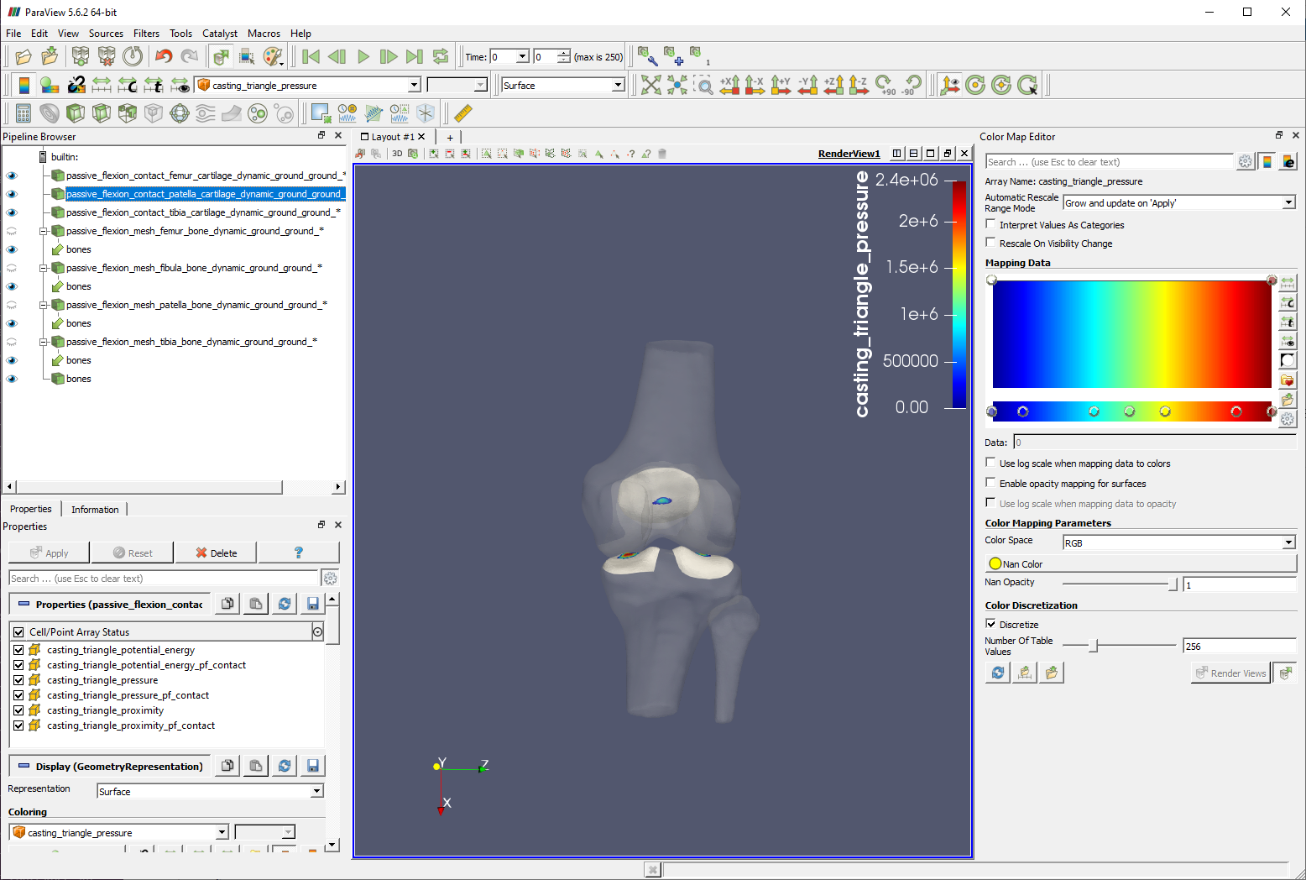
Change coloring source
Color map editor
Group
Pipeline Browser
Properties
panel

