Slide 1
Tesper
Tesper helps to study English well. In order to help to study, It provides dictation and typing test

Slide 2
스테이터 헤어핀 검사(확관 후 핀 이탈 검사)
*Index
Index
Researchers
Revision History
-terms
Description
- work information
- Inspection specification
- DFD
- flow
- Vision System Design
- Vision system information
- Equipment Design
- H/w Design
- H/W information
- Factory Design
Policy
- Directory
Set up Process
List of Screen

Slide 3
스테이터 헤어핀 검사(확관 후 핀 이탈 검사)
*Researchers
Researcher | company | Division | In charge of
조동인 |  | s/w | Project Leader

Slide 4
Tesper
*Revision History
Version | Data | Author | Index | Description
0.1 | 24.08.14 | 조동인 |  | -기본 사항 정리 passing index process is added in compare process
 | 08.15 |  |  | add wpm and log system
 | 08.16 |  |  | I should add study data like image…
 | 08.21 |  |  | create sentence helper dialog, random function.

Slide 5
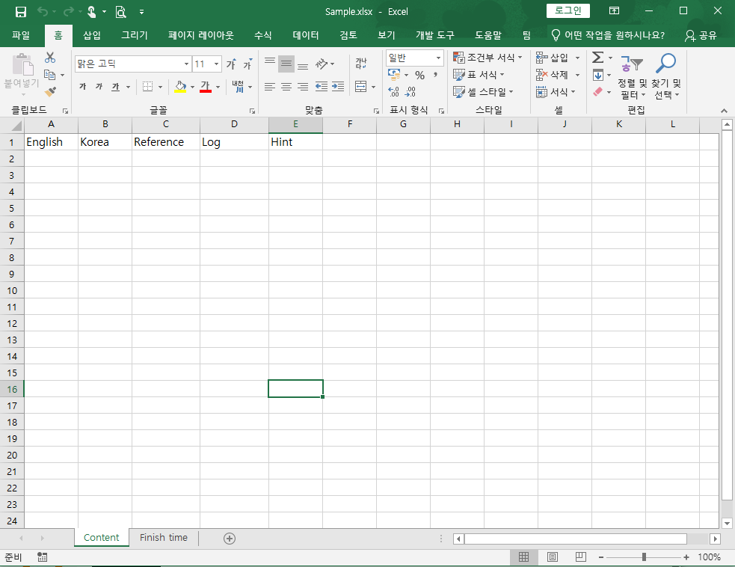
Data structure
education data should consist of excel. Because it is easier to edit context than ini file.
-Hint : is data about file
Finish time : is Log about file
- Reference : is hit relevant to question
- Korean : question data
- English : question data
- Log : is log about question.
excel content row – about question
log’s cell is written with mistake syntax.

Slide 6
Function
education data should consist of excel. Because it is easier to edit context than ini file.

Slide 7
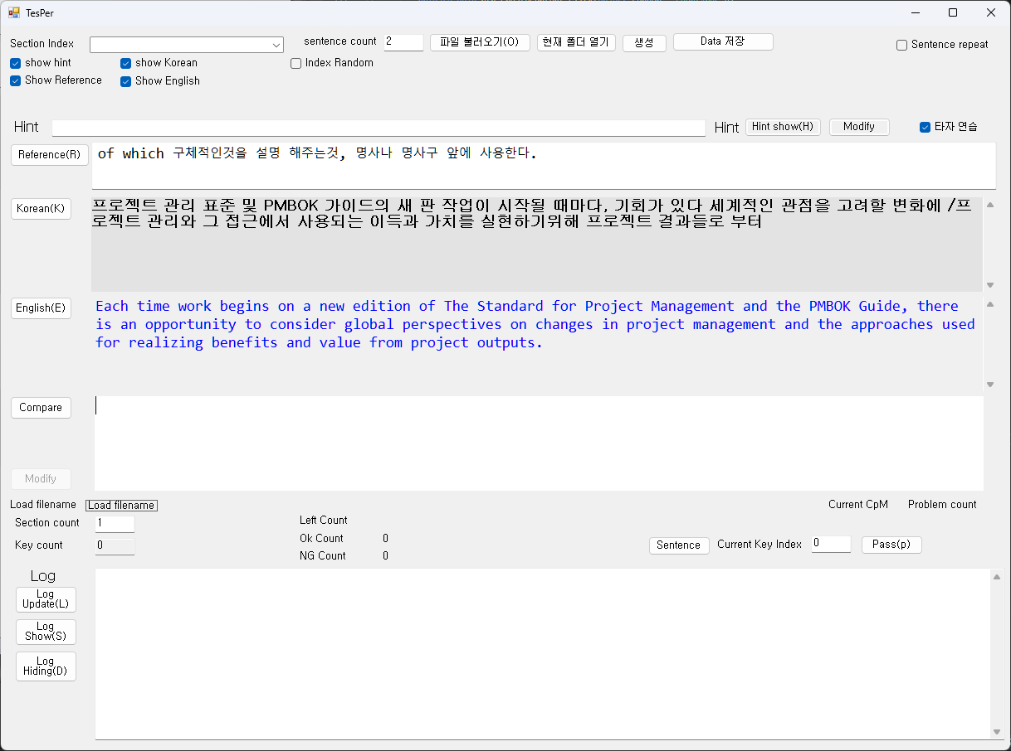
Tesper
Authority
if sentence count is over 1, modify is disable.
For example, sentence is over 1, The system does not know the boundary between the first and second sentences.

Slide 8
CTesPerSystem class
In this article
Definition
Remarks
constructors
Fields
Properties
MEthods
Definition
This class is main control class.
Remarks
constructors
CPLC(string strInputDevice, int nInputBufferSize) | PLC 읽기 디바이스 시작점과 읽기 디바이스 사이즈를 설정합니다.

Slide 9
CTesPerSystem class
field
Type | Name | Description
int | M_QuestionCnt | Count of questions to show
property
Type | Name | Description
메서드
Type | Name | Description

Slide 10
CEduContent class
In this article
Definition
Remarks
constructors
Fields
Properties
MEthods
Definition
This class is for question data or configulation to save
Remarks
constructors
CPLC(string strInputDevice, int nInputBufferSize) | PLC 읽기 디바이스 시작점과 읽기 디바이스 사이즈를 설정합니다.

Slide 11
Tesper
* compare flow
Compare
Load Data
Compare
Load Data
same
NO
Testion
same
NO
Testion
Yes
Initialize
Yes
Initialize
CTestSection.M_nCurrentRandomIdx = 0
finish
Yes
finish
Yes
NO
NO
Next sequence
Next sequence
CTestSection.M_nCurrentRandomIdx++
CTestSection.M_nCurrentRandomIdx++
PassesNext
PassesNext
Testion
CompareEvent
Testion
CompareEvent
Get data(ERK)
Get data(ERK)
Get data(ERK)
Get data(ERK)
Display
Display

Slide 12
Tesper
* compare Long Text
Load Data
Compare
Compare
Load Data
same
NO
Testion
same
NO
Testion
Yes
Initialize
Yes
Initialize
CTestSection.M_nCurrentRandomIdx = 0
CTestSection.M_nCurrentRandomIdx = 0
finish
Yes
finish
Yes
NO
Next sequence
NO
count 5
Next sequence
CTestSection.M_nCurrentRandomIdx++
Next sequence
NO
CTestSection.M_nCurrentRandomIdx++
PassesNext
CTestSection.M_nCurrentRandomIdx++
Yes
PassesNext
PassesNext
PassesNext
Testion
Testion
CompareEvent
CompareEvent
Get data(ERK)
Get data(ERK)
Get data(ERK)
Get data(ERK)
Display
Display

Slide 13
Tesper
In case problem is shown multiply

Slide 14
스테이터 헤어핀 검사(확관 후 핀 이탈 검사)
*Description
항 목 |  | 2D 광학계
Cycle Time | Cycle Time | 50 초 이내
Resolution | Resolution | 0.020 mm/pixel
 | 광학계 | Area Scan Camera
MV | 측정 정확도 | ± 0.1 mm
 | 측정 가능 핀 개수 | All Pin
-Way of Inspection
During one turn, perform inspection
-Inspection list
1) Missing the number of pins
2) pin out of ROI

Slide 15
스테이터 헤어핀 검사
* Inspection specification
Two rotation inspection flow
Specification
tolerance
±1 mm because of the play between the stator and the palette

Slide 16
스테이터 헤어핀 검사
Vision system design
등각 투상도
<<plane figure>>
*Vision system design
Lens
W.D =
F.O.V =
Resolution =
<<front view>>
work
<<vision plate 위치 결정 브라켓>>
lens
Light
Light
camera
* Vision plate 위치를 맞출 때 장비 좌표 x 축을 맞춘 후 y 좌표 작업
당김 멈춤
밀림 멈춤

Slide 17
스테이터 헤어핀 검사
image process
* Inspection flow
Trim image
by using pylon viewer program
Pylon viewer-> AOI controls -> offset setting
(click the continuous shot button to check the image)
Affine Transform Image
with Cognex
Grab procedure
Inspection procedure
DeepLearning
of View On
ClsBasler.OnGrabEvent
ClsThreadManager.Vision_Proc
(VISION_CORE_SCAN_START)
ClsThreadManager.Vision_Proc
(VISION_INSP_START)
ClsResultManager.IsClsResultConfigs[_iPointIndex].
IsCogImage8GreyCore
Blob of Cognex
<<Image process>>
ClsThreadWorker.Loop()
종료
Detect center point of each row
Make LRL (Linear Regression Line)

Slide 18
스테이터 헤어핀 검사
*Vision system design
Vision system specification
Camera =
Lens =
Light =

Slide 19
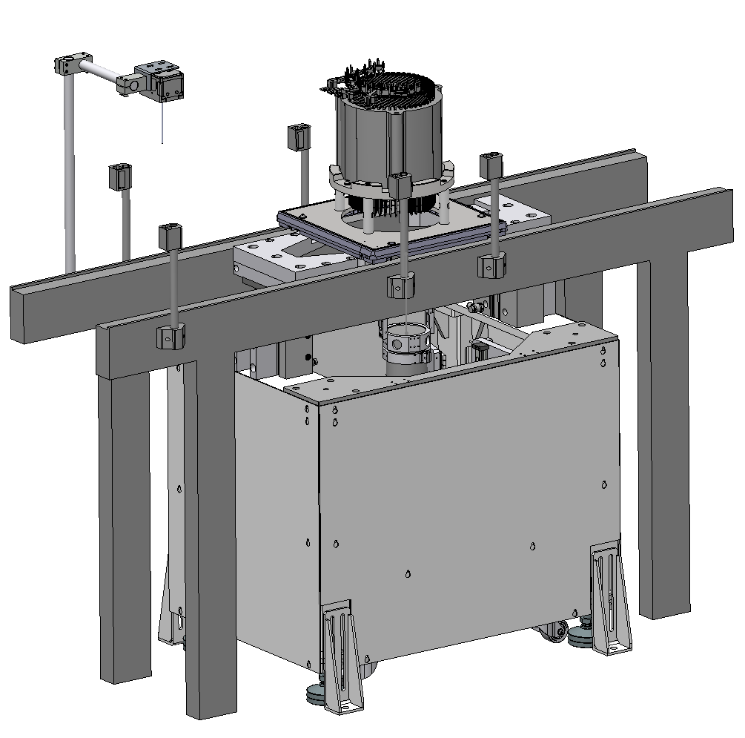
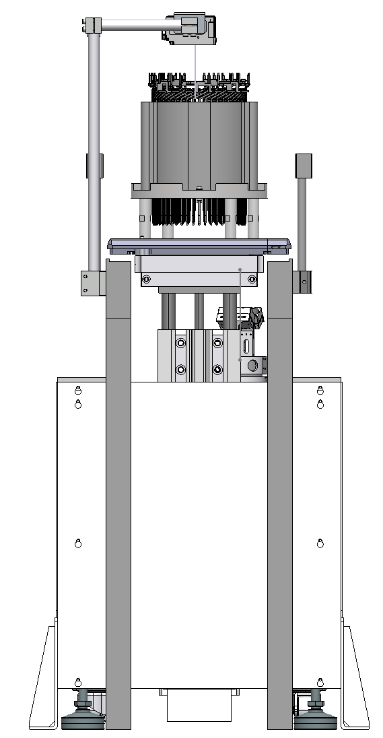
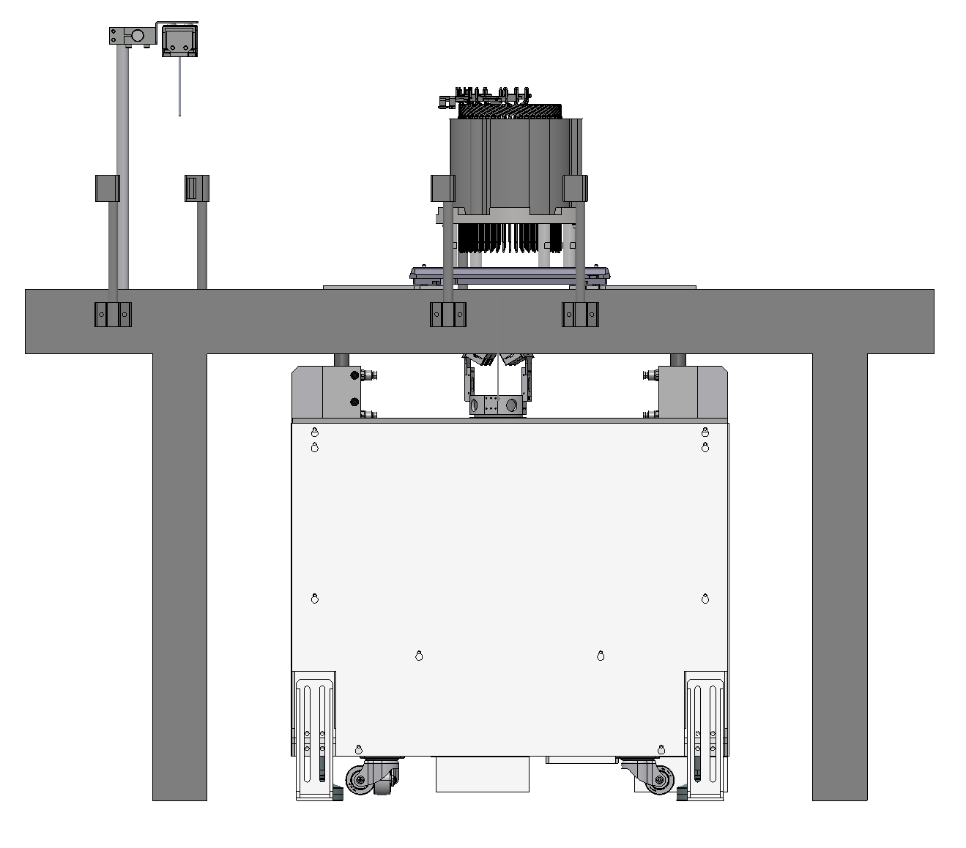
스테이터 헤어핀 검사(확관 후 핀 이탈 검사)
*Equipment design
Y
모니터
X
Main Machine
Equipment coordination
PC, Light controller, 전장,
in this Panel
Added palette sensor
Added palette sensor
Initial Machine
It can be opened
(Panel box)

Slide 20
스테이터 헤어핀 검사
*Equipment flow (Input Machine)
Yes
Sense work
NO
팔레트 감지
Read Barcode
Sense a work in the Input MachineEquipment flow
Check a barcode
Convey the work to the Main Machine
Sense the work in the Main Machine
Lift the work
Inspect the work
Lower the work
Pass the work
Yes
Empty
USE MES
USE MES
Yes
Yes
NO
SEND MES
NO
! PalletBuffer
Receive MES
NO
착공 제품 확인
NO
투입부 스탑퍼 실린더 하강
Yes

Slide 21
스테이터 헤어핀 검사
*Equipment flow
Sense barcord
Sense a work in the Input MachineEquipment flow
Check a barcode
Convey the work to the Main Machine
Sense the work in the Main Machine
Lift the work
Inspect the work
Lower the work
Pass the work
Convey the work to the Main Machine
Make LRL (Linear Regression Line)

Slide 22
스테이터 헤어핀 검사
*Equipment design
Equipment specification
Pc
Ip = 192.168.100.200
ID = admin
P.W = 1234

Slide 23
스테이터 헤어핀 검사
*Factory design
conveyer
MES
확관 장비
반전기
트위스트 장비
This Equipment
수동 조립 장

Slide 24
스테이터 헤어핀 검사(확관 후 핀 이탈 검사)
*HW Panel Control
Manu
Auto
E.M.O
Light
button
Light
Button
Light
button
Button
Key
Power
Ready
Mode
Home Position
Reset
Start
Stop
When problem occur, press stop button
After problem is solved, switch the mode into Manu
Press Ready
Check Home position signal.
If Home position is lighted up, press Ready.
Press start button. So equipment start running.

Slide 25
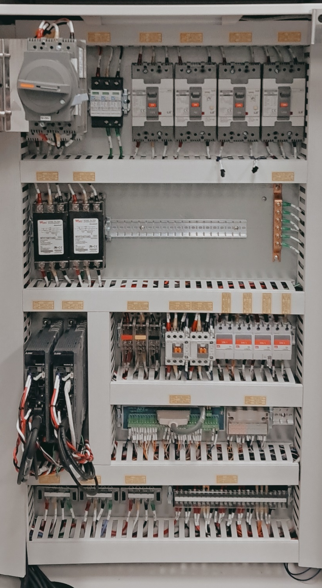
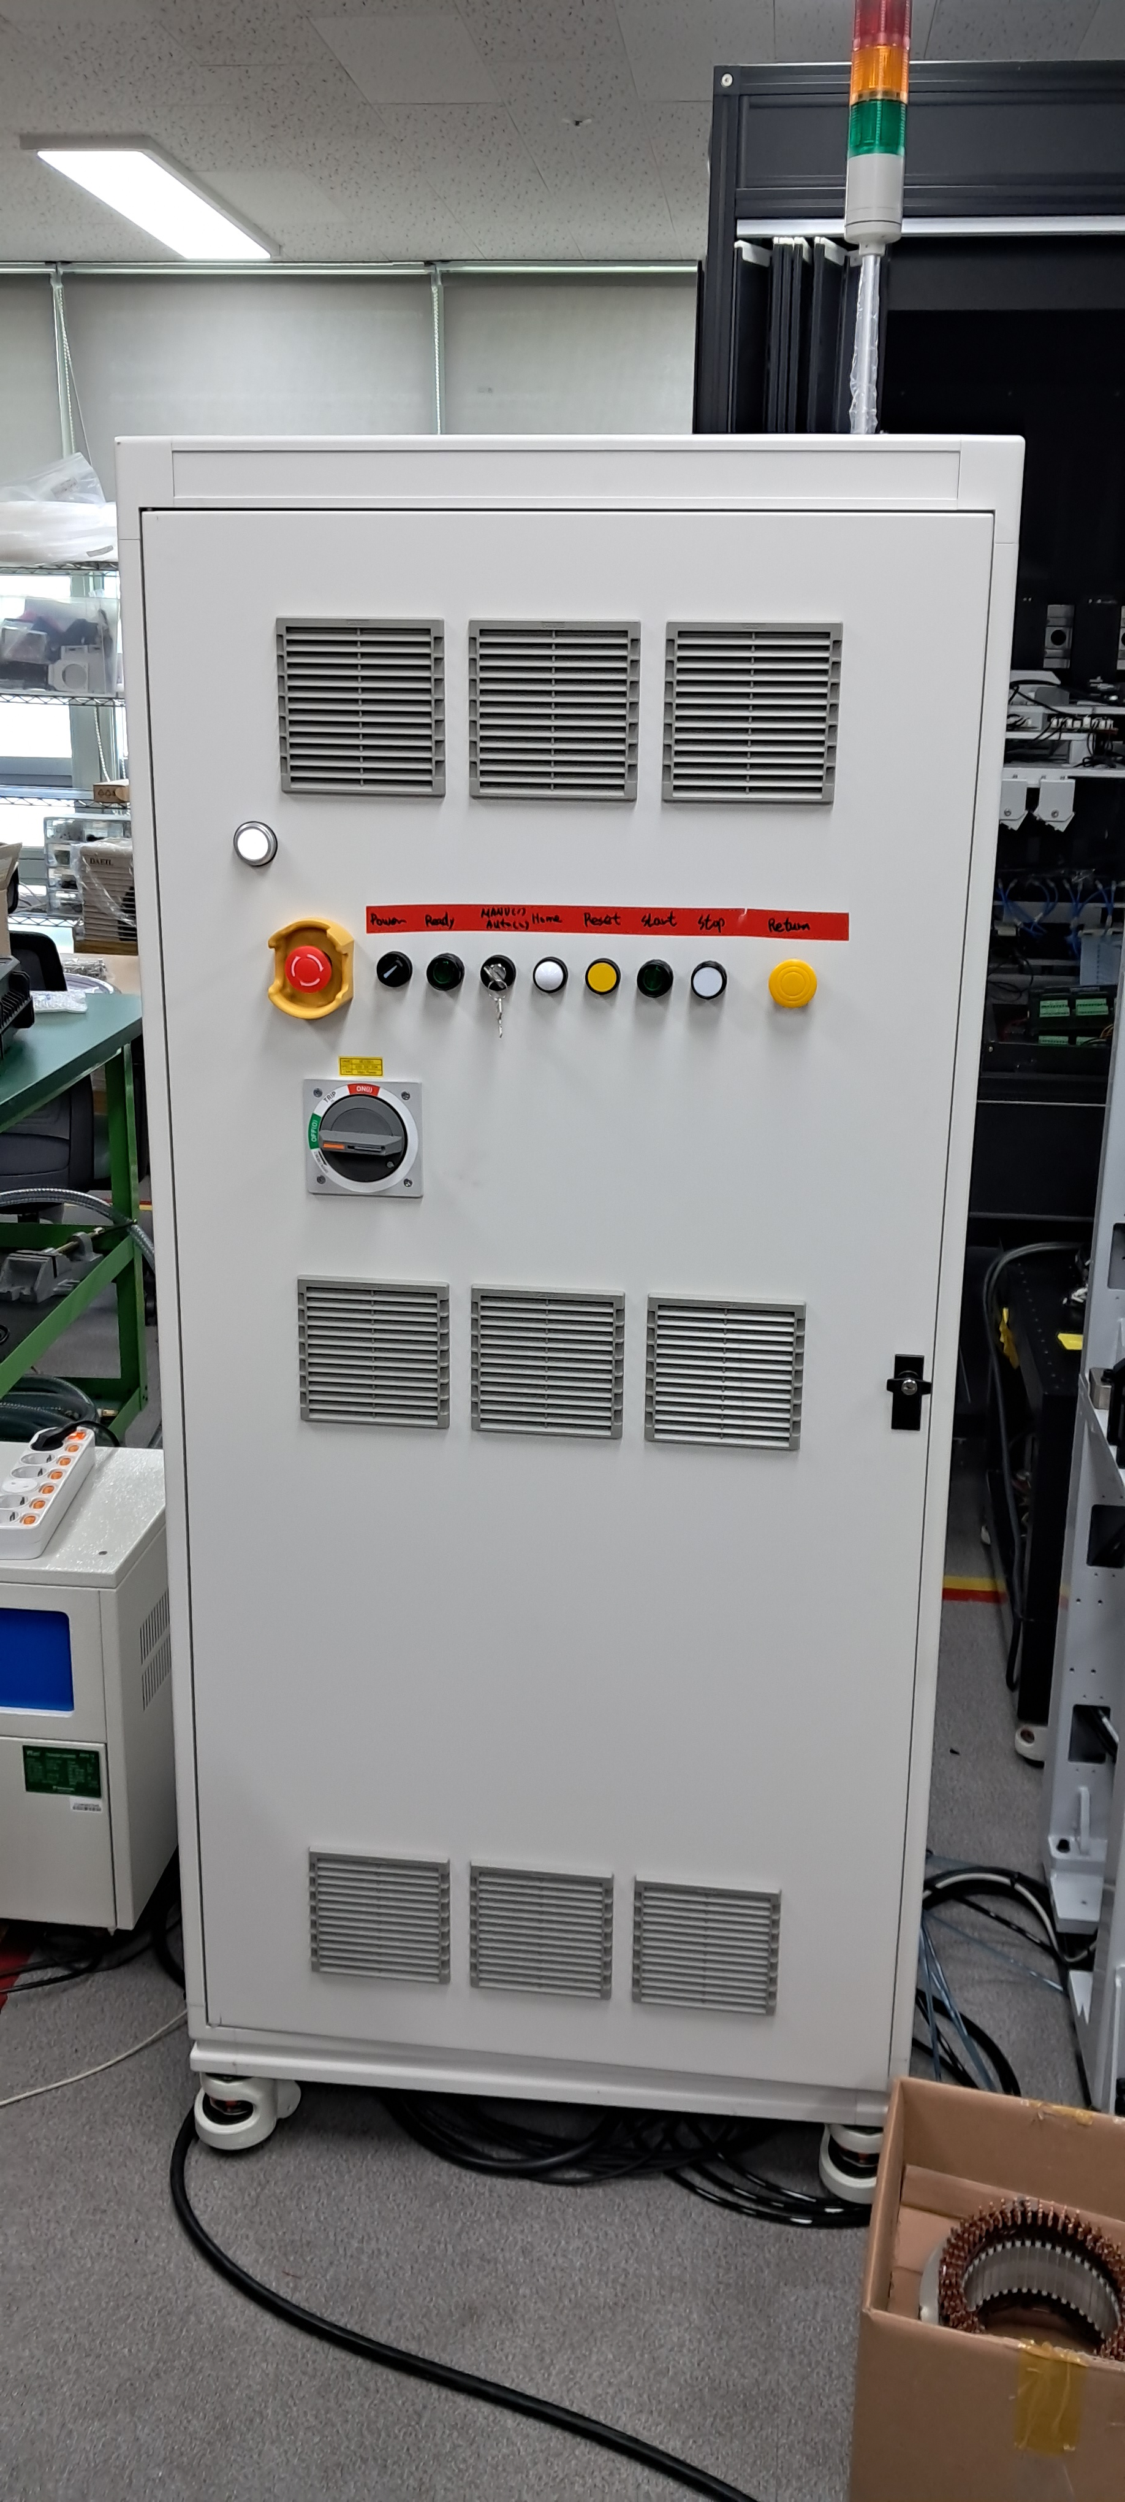
스테이터 헤어핀 검사(확관 후 핀 이탈 검사)
*HW Panel Control
서보 전원 연결
MC 확인 주황색 버튼이 들어가 있어야 On 나와있으면 Off(평평함)
Amplifier 에 ALE9.1 표시 뜸
전압이 떨어졌을때 CP 껏다 킴(프로그램 껏다킴)
Amplifier Al 10.2 표시

Slide 26
스테이터 헤어핀 검사
* DFD 0_Level DFD
json
json
Barcode
Reader
Configuration
Model recirpy
Work ID
Equipment Output
Equipment
0.0
Inspected Data
Camera
Image
MES
DataBase

Slide 27
스테이터 헤어핀 검사
* DFD 1_Level DFD
Camera
Equipment Output
1.0
In put Machine
System
2.0
Main Machine
System
Barcode
information
Inspected ResultData
work
MES
DataBase

Slide 28
스테이터 헤어핀 검사
* DFD 2_Level DFD
2
In Main Machine System
1
In put Machine System
2.1
Image grab processing
Work sense
sensor
Sensing check
Barcode reader
Barcode
information
Equipment Output
buffer
Sense
Read Barcode
2.2
Image processing
Inspected ResultData
work
MES
2.3
Inspection
setting
DataBase
2.3
judge
setting
Model Information
3
Searching process

Slide 29
스테이터 헤어핀 검사
2.1
Grab Sequence
* DFD 3_Level DFD
Work sense
sensor
Sensing check
camera
Sense
Take picture
1
In put Machine System
work
Equipment Output
Work sense
sensor
Sensing check
Barcode reader
Image buffer
Sense
Read Barcode
DataBase
2.2
Image processing
work
Inspected ResultData
2.2
Searching process
ClsToolConfig
Barcode
information
1
MES receive
MES
S1F2
Confirm Model ID Ack
S1F4
S2F3
Result
Manager
2.2
Inspection setting
2.3
Judge setting
S2F31
Cognex Setting : u
ClsModelConfig: c
MES Check ID
IsMESCheckIDComplete
S6F12

Slide 30
스테이터 헤어핀 검사
*Directory structure
<Project Name>
Model
Backup
Motion
*n
Motion<yyyyMMddHHmmss>.mot
Config
Logs
Config
Config.json
Model
*n
Database
System.json

Slide 31
스테이터 헤어핀 검사
* Database Entity

Slide 32
스테이터 헤어핀 검사
* MES

Slide 33
스테이터 헤어핀 검사
*UI Controll
Equipment flow
Sense a work in initial Machine
Check a barcode
Convey the work to the Main Machine
Sense the work in the Main Machine
Lift the work
Inspect the work
Lower the work
Pass the work

Slide 34
스테이터 헤어핀 검사
* alarm
Model entity
*n
이미지
*n
검사항목

Slide 35
스테이터 헤어핀 검사
* User Sequence
Main from
-Defaltclass
On/off
disable
Vision setting
Motion setting
disable
Inspection setting
disable

Slide 36
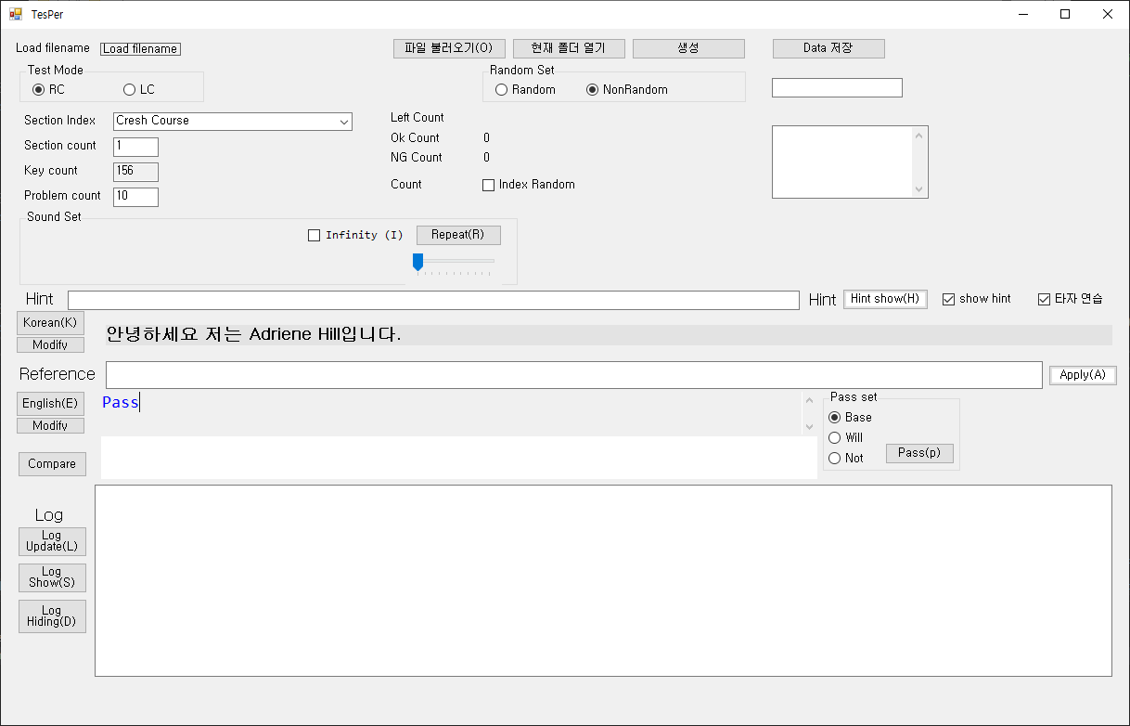
스테이터 헤어핀 검사
* Inspection specification

Slide 37
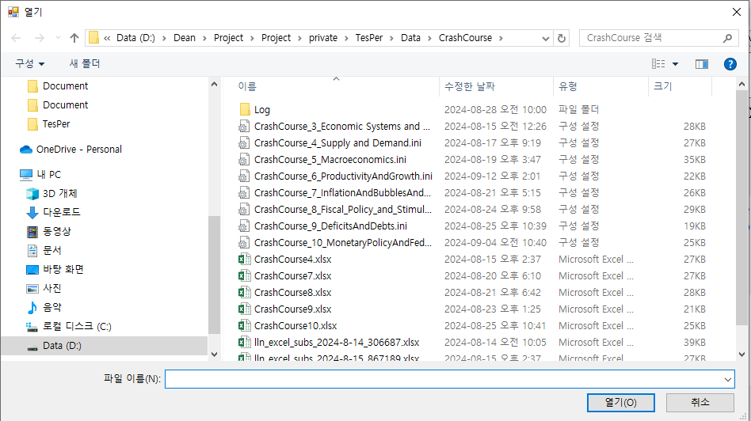
스테이터 헤어핀 검사
* Inspection specification

Slide 38
스테이터 헤어핀 검사
시작
파일 불러오기 선택
ini 파일 선택

Slide 39
스테이터 헤어핀 검사(확관 후 핀 이탈 검사)
*Revision History

Slide 40
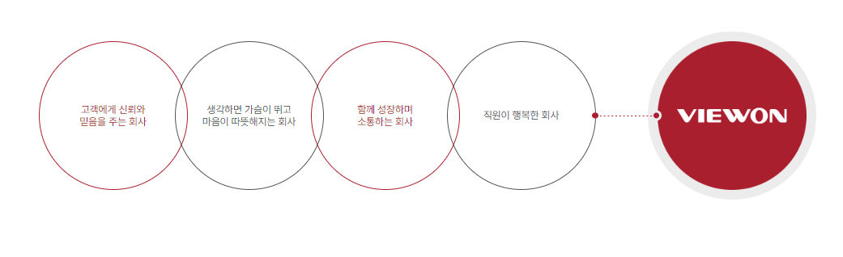

THANK YOU

