Slide 1
Crop physiology service of cropFact
2022-06-05
Contacts: Thomas Galinier

Slide 2
What is the scope of the Crop physiology of cropFact?
Objective: Give access to standard descriptors of Environmental conditions for field crops, globally
Execution options: Pre-season, in-season, post season
Geographical coverage: Global
Temporal coverage: 2000 to 2023
Execution time: less than 4 seconds per scenario
Supported crops:
Corn grain
Corn silage
Soybean
Sunflower
Winter wheat
Winter barley

Slide 3
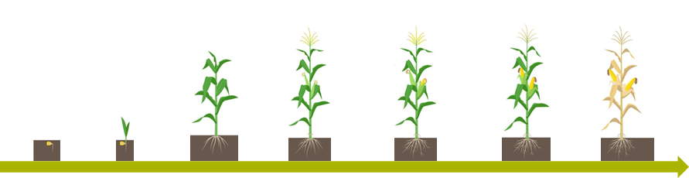











cropFact – 3 services
Crop calendar service
Environmental classification service
Sowing
1 Leaves
V1
Floral Initiation
V6
Flowering
VT
Fruit Development
R2
Physiological Maturity
R6
Harvest
Stress indicators
Environment Type
Crop Physiology service

Slide 4






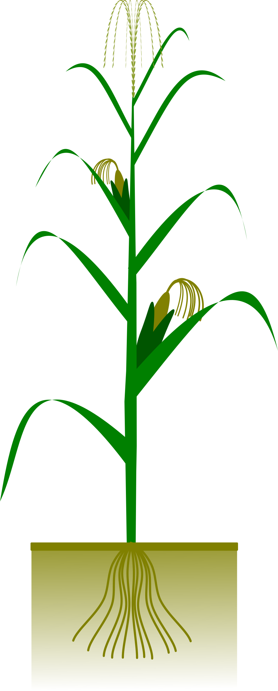

cropFact Crop Physiology service overview
Primary objective: Simulation of potential yield and plant stress indicators per growing stage
Business value:
Provide holistic diagnosis of the growing season
Easy access to outputs of complex models
Potential usage:
Post-season replay of the growing season
Pre-season to get prepared for the growing season
In-season prediction of stresses
From raw environmental data…
…to abiotic & biotic stress and crop performance indicators
Weather
Biotic pressure
Environmental & Crop Modeling
Soil water deficit & excess
Soil
Heat & Cold
On site weather station & soil sensors
Photo thermal ratio
Crop practices
Biomass production
Phenology
Potential yield
Atmospheric drought
Resources interception
Organ expansion
Yield
Crop efficiency
Notes:
Raw hourly/sub-hourly environmental data do not describe the environment that the plant experiences in physiological terms
Hourly/sub-hourly environmental data is difficult to analyze, generating unbalanced datasets with billions of datapoints describing the environment on one hand and limited phenotypic observations on the other hand

Slide 5
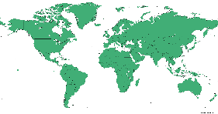
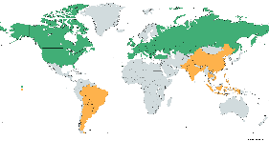
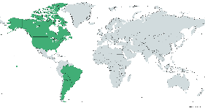
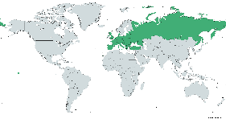
cropFact service availability as API (2022-05-10)
Services (API) |  | Corn Grain | Soybean | Corn Silage | Sunflower | Winter Wheat | Winter Barley
Calendar & Physiology | planting and harvest dates available
 | planting or harvest date not available
Available
Q3/Q4 2022
TBD
Documentation: https://syngenta.sharepoint.com/sites/cropFactdocuments/SitePages/Crop-Physiology-Service-Documentation.aspx

Slide 6
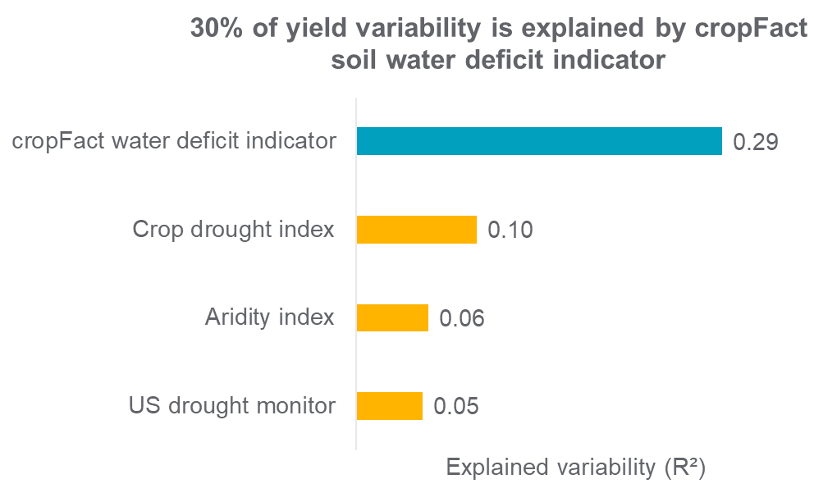
Evaluation of abiotic stress indicator: example of soil water deficit
Evaluation type:
“How much of yield variability is explained by soil water deficit indicators?"
Approach:
4 different soil water deficit indicators have been evaluated by the Modeling Solutions team, considering cropFact as one of the candidates.
Dataset:
corn NA water optimization dataset
1110 trials : ~ 87,000 yield observations
Irrigated and non irrigated scenarios
From 2012 to 2018
Source: Spirit
30% of the observed yield variability can be explained by the soil water deficit indicator of cropFact
1
2
3
¹ Diodato & Bellocchi, 2008
² UNEP, 1992
³ https://droughtmonitor.unl.edu/
Adapted from Wanwan Liang (Modeling Solutions, 2021)

