Slide 1

Village Software Data Quest
Team: Kadane Combinatorics
Jiri Dohnalek & Edward Barker
Selecting the 3 optimal plots of resources to maximise prosperity!

Slide 2
Analysis of price trends

Slide 3
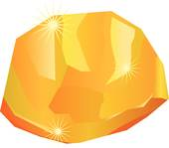

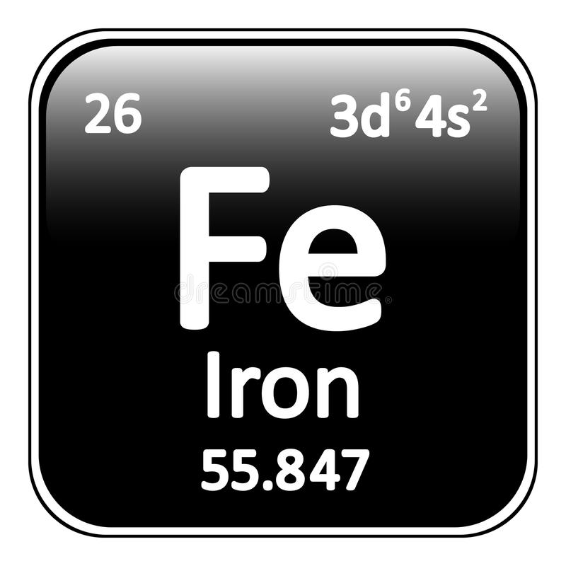


Normalising range of values
X is based upon future sale price prediction.
Iron has maximum sales price, wheat has minimum.
GOLD = (10 – 2.5)/(10.7-2.5) = 0.91
OIL = (10.5 – 2.5)/(10.7-2.5) = 0.98
WHEAT = (2.5-2.5)/(10.7-2.5) = 0.12
IRON = (10.7 – 2.5)/(10.7-2.5) = 1.00
Use normalised values to transform arrays
to reflect relative values

Slide 4
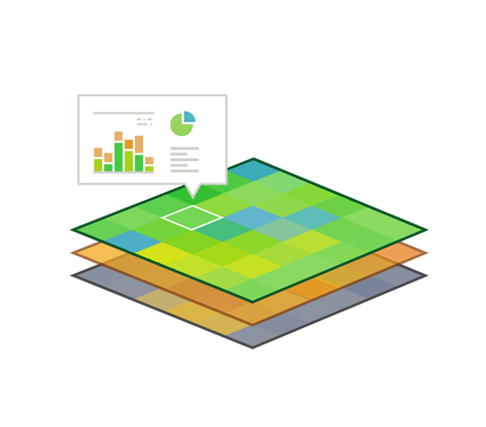
Problem
Given 1000 x 1000 square matrix, find 3 highest sub-squares of 10 x 10
Find highest combination of squares such that sub-squares do not overlap

Slide 5
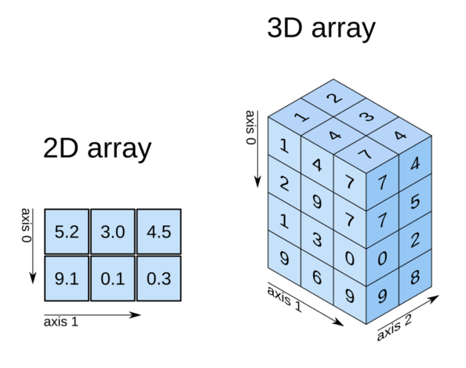
Algorithm approach
Apply weighting to each array based upon relative values
Stack each 2D 1000 x 1000 array into 1 3D array.
“Flatten” 3D array by summing “z-axis”.

Slide 6
Kadane’s algorithm
Brute force approach would be time complexity of at least n^3
Kadane’s algorithm allows n^2 time
  Preprocess matrix
    Calculate sum of all vertical strips of size k x 1 (k=10)
    Calculate first sub-square in row as sum of first k strips
    For remaining sub-squares, calculate sum in O(1) time by removing leftmost strip of previous square and adding rightmost strip of new square.

Slide 7
K-combinatorics
Highest squares may be overlapping (as may share same high resource tiles)
  Must ensure that top squares do not overlap, but also that the top 3 squares are the optimum combination. For instance, 2nd and 3rd highest squares taking the place of the 1st highest square will have a higher total.
  Using combinatorics, generate all combinations, for each combination
  Must choose 3 squares from 35, as 35 overlapping squares is the minimum number of squares to ensure that the three optimum squares are non-overlapping.
    Check for overlap
    Store highest sum of 3 squares.

