Slide 1

Best Practices (Web) at EBMUD
..and why they are a good idea
Jonathan Driller 1/08
Notes:
I am going to focus on best practices today as it sounded like this would be useful based on the last meeting and a look at the sites.
Handout BPs

Slide 2


Definition of Best Practices:
Processes and activities that have been proven in practice to be the most effective over time by large numbers of people.
Notes:
The goal of the web is enable people to access information as they never could before.
Following BP allows us to do this most effectively

Slide 3
Disclaimer:
This is a work in progress and could use your input…
Some Best Practices are often specific to a particular demographic (e.g. disabled users might have some different BPs).
I AM going to overwhelm you here…
I am not suggesting you adopt this ALL now. Read this over and let it sink in and ask questions.
Some of this (Design Guide, New global CSS, etc is not even ready yet)
Some of this may not be relevent to you *yet*
Notes:
PLEASE let me know if you have additional ideas – this was drafted a few days before I left and is almost certainly NOT complete
Each company is different – each audience is different

Slide 4
Goals:
Improve usability
Ease maintenance
Improve performance
Enable scalability
Notes:
BP makes it easier for users to get the information they are searching for…
Make maintaining the site easier for us and sytems administrators and developers…(change css vs searching all over to make changes)
Improve the actual performance of the site (smaller images or fewer repeated elements etc)
Make possible expanding the site across a server farm

Slide 5
Mantra:
“GIVE USERS WHAT THEY WANT”
Best Practices lead to consistency which is what users want.
Consistency
Consistency
Consistency
Consistency
Consistency
Consistency
Consistency
Consistency
Consistency
Consistency
Consistency
Consistency
Notes:
If there is nothing else you here: Give users what they want – make it easy for them
Consistency gives users an expectation that what works in one place will work elsewhere, it is easier on the eye and brain
Web paradigms dictate best practices
Nobody ever said you MUST put the company logo in the upper left and it
Must link to the home page…

Slide 6
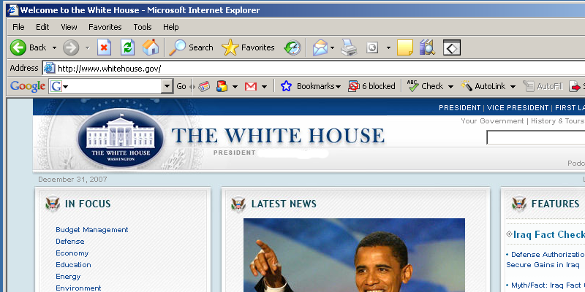
Search and Home - Example 1:
Based on User Testing and web stats

Slide 7
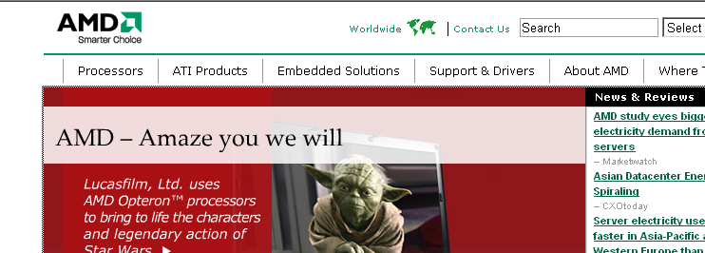
Search and Home - Example 2:
Notes:
And nobody said search MUST be in the upper right…

Slide 8
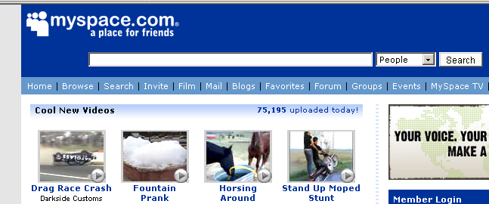
Search and Home - Example 3:
Notes:
But if you do not follow what users expect you do it at your peril….
Consistency across the web AND across your site is the key

Slide 9
Areas:
Design
Coding
Content
Accessibility
Navigation
Miscellaneous
Notes:
These are the areas I have broken BP into – but you could do it anyway
Design focuses on CSS and layout and branding
Coding centers on naming conventions, commenting, organizing files
Content focuses around the differences between web and book and voice and style
Accessibility focuses on making things easy for our users who have different abilities
Navigation centers on making consistent movement through the site possible with the shortest path

Slide 10
Design:
CSS
Branding
  Colors
  Layout
Handled by templates mostly
Notes:
CSS is the biggest thing – consistency through enforcement of stylistic paradigms:
“all lists have square dot on left indented 12 px”
“all emergency links are bold red underlined and 16point font italic”
“all headers are Green bold Verdana 24 point”
Best done globally with an external library
Non-global changes should be done with an INTERNAL NOT INLINE sheet
Good branding means EVERYTHING that you associate with a brand is consistent: color, font, size relationship ratios, positioning
Pass around Visa PLEASE RETURN THIS
We do this on the web now by using Frontpage templates.
Later we will enforce consistent page layout paradigms with a content management system
Colors and other branding will be with CSS

Slide 11
CSS Example:
Import in head:
  <link rel="Stylesheet" href="/inc/core.css">
  Or – for non-global styles – use an internal sheet
Review style sheets available and pick styles:
  tr.odd {
  background-color: #ddd;
  }
Specify generic or specific style in page code:
  <tr class=“odd”>
Notes:
Here is how CSS works for those who do not know much about it
Cascading style sheets
We will use mostly external or in the head
We tie the rules to the code via HTML tags or ids or classes

Slide 12
CSS Example 2:
h3 {
font-family: Arial, Helvetica, sans-serif;
font-size: 1.15em;
background-color: #006666;
color: #DCDCDC
}
h4 {
color: #000000
}
table {
color: #FFFFFF
}
td, th {
font-family: Arial, Helvetica, sans-serif;
font-size: 1em;
line-height: 2em;
color: #333333
}
textarea {
font-family: Arial, Helvetica, sans-serif;
font-size: 1em
}
ul {
font-family: Arial, Helvetica, sans-serif;
font-size: 1em;
list-style-type: square;
list-style-position: outside
}
Notes:
Here is a piece of a typical style sheet (with little droplets by accident)

Slide 13
Design:
CSS, templates…
Use the style sheets as a guide – if a class is available for an element you MUST use it.
All text must be either within a <p></p> tags or use CSS classes for subHead, headline, etc.
Do NOT use inline styles if possible. If you find you want to use an inline style for something over and over please request an addition to the global style sheets.
Do NOT use HTML attributes to set style (e.g. font=“”).
Do NOT use tables for layout; use CSS positioning. Use tables for tabular data.
Use the design templates and the design guide for all pages.
Notes:
So now on to specifics…..feel free to ask questions as I go….
Basically, there is a lot here but if we all follow these guidelines and mentally check each item off for every page we do
(this becomes easy after awhile) the sites will become easier to use and maintain.
No one expects you to get everything here at first – or to go back and make the changes to your site tomorrow…
We do not have a finished style sheet for the intranet OR internet yet.

Slide 14
Design/Images:
Naming, Sizing, Licensing…
Shrink images in terms of file size (you should never need an image more than 100kb).
Always size your image for its use.
Do not use borders around your images.
Name your images in descriptive camelCase by appearance e.g. storkChimney.jpg.
For images that confer necessary information include an alt attribute. Do NOT use empty alt attributes.
Photos should be in color.
Non-standard logos and icons must be approved before use. Get standard logos from the design repository or check if already on site. http://ebmudnet/graphic-design/Default.htm.
Make sure all images that get used are properly licensed.
No moving images, or sounds, may be used without approval (contact Faye).

Slide 15
Coding/HTML:
Formatting, XHTML, styles, architecture…
Avoid nesting tables.
Style tables with CSS not attributes; do not override styles without permission.
Place common elements (images and content) in a common directory – do not repeat static content if possible.
Avoid frames. There are some situations when frames are justified – but very rare.
Indent/nest tags – ideally set your editor with a 2 space tab.
Name classes and IDs by their function, not by their presentation: call a class “.listDot vs .smallBlueDot, because later it will change to big and red
Comments are good – <!-- //but remember EVERYONE can see HTML comments -- >. Use special language comments for privacy e.g. <!--- ColdFusion --- >
Set taborder on forms.
[Create forms with usability in mind; consider using <label>, <fieldset> and <legend> tags as appropriate.] maybe…
Your pages will live within an app under a particular directory structure. All your files should be in there unless you have been given prior approval to add elements that will be used by other apps. If you use images (or other files) that are already in use on the site do NOT add them; link to the existing ones. The same thing goes for scripts. For images unique to your app put them in a /images directory under your app directory. You may add additional directories under your app directory.
Always have a doctype definition as the first line of the page. Use this transitional one for now (case sensitive): <!DOCTYPE html PUBLIC "-//W3C//DTD XHTML 1.0 Transitional//EN""http://www.w3.org/TR/xhtml1/DTD/xhtml1-transitional.dtd">
ALWAYS close your tags. If a tag does not require a matching closing tag, use it formally e.g. <br /> or <img src’”” />
Always put double quotes around HTML values and attributes (single are ok if nesting).
Always use lowercase for tag names and attribute names, use camelCase for values. <html><body width=”800px”> vs <HTML><BODY WIDTH=”800px”>
Use CSS width or positioning vs spacer gifs – but if you feel compelled do NOT add additional ones – we have a 1pxl transparent spacer called spacer.gif in /common /images /spacer.gif
Do not specify fixed font sizes. Mimic what we do in the CSS.
Only use full paths for links to external sites (http://www.bla.com/service/index.html). You should link to external sites only if you absolutely must.
Do not use relative links (images/bob.gif or ../styles/bob.css)
Avoid image maps.
Avoid mailto. Ask for instruction on alternatives.

Slide 16
Coding/Scripts:
Comments, naming, architecture…
Comment above the script so anyone will know what it does and what arguments it takes. Include your login name (NOT email address) and date last modified:
/**************************************
// windowOpen(url, szHt, szWdt) pops open a new browser window of
// a given size and no menu or status bar and takes the focus
// author = jdriller modified = Dec 24, 2007 by sclaus
**************************************/
windowOpen(….
Name your scripts in descriptive camelCase by function.
There should be very few inline scripts. Put them in a global script page (ALL scripts require PRIOR approval)
Notes:
Here we are mostly talking about client side scripts like javascript

Slide 17
Content 1:
Voice, web style, metainfo…
Write succinctly.
Put the important content up above the fold (above where a user has to scroll to see more). Usually in the first paragraph.
More short paragraphs are better than fewer long ones.
Introductory paragaraph should summarize what follows
Descriptive sub-headings keep users interest.
Always use the same writing “voice”; active voice with conversational style e.g. “Get quality water here” vs “You can get quality water here” (the subject performs the action).
NJOA “No Jargon Or Acronyms”.
Always fill in a USEFUL descriptive title in the head’s title tag. Start with “EBMUD – description”. This goes into the bookmark description.
Always fill in the < meta name=”author” content="Liam Quinn">
Always fill in the <meta name="revised" content="ContentDescription, 9/1/2007" />
Notes:
The writing in the page also needs to be consistent – voice, grammar, spelling etc.
Writing is different on the web – people do not read – they scan and get bored instantly.
Give them what they want quickly and with minimal clicks and thought

Slide 18
Content 2:
Style, files…
Do not underline plain text unless it is a link.
Links should be descriptive; “Click here for x file” vs “Click here for x file”
Never put special characters in your content. Refer to the ASCII equivalent codes and use those.
All links that open a pdf, or non-HTML file, should have an indication of what file type will open and the size. This should be a small icon to the right of the link. The new page may not have a back button so should open in a separate window using the the openNewPage() function and passing the file as an argument. The link should have icons for the file type; /common/images/ icons/pdf.gif, /common /images /icons/word.gif, /common /images/icons/xl.gif.
Do not use PDFs without a reason; use PDFs for content a user might want to download.
Do not use Word documents without a reason; use Word docs only for items a user would want to keep in Word after saving the file locally.
All downloadable files should have EBMUD branding.
Do not use Excel documents without a reason; use Excel where data needs to be downloaded by a user as a spreadsheet.
Emphasize ideas with short sentences. Put subordinate, backup information, in a following compound sentence.

Slide 19
Content/Discrimination:
Use non-discriminatory language
Use neutral titles/descriptions:
No: Chairman
Yes: Chairperson
Avoid demeaning or stereotypical terms:
No: After the girls in the office receive an order, our office fills it within 24
hours.
Yes: When orders are received from the office, they are filled within 24 hours.
Avoid words and phrases that unnecessarily imply gender.
No: Executives and their wives
Yes: Executives and their spouses
Omit information about group membership.
No: Connie Green performed the job well for her age.
Yes: Connie Green performed the job well.
Do not use masculine pronouns.
No: Each student must provide his own lab jacket.
Yes: Students must provide their own lab jackets. Or Each student must provide his or her own lab jacket.
Notes:
As a semi-governmental entity we have additional rules to live by – we MUST be more sensitive to our users.
We are supposed to make things easy for even our handicapped users.
we have an obligation to enable our site for blind users or users who cannot use a mouse.

Slide 20
Accessibility:
Legal, moral, structure…
508 Compliance
  1194.22 Web based Internet Information and Applications
For images that confer necessary information include an alt attribute. Do NOT use empty alt attributes.
Set taborder on forms.
Do not rely on color to differentiate ‘things’
Content should be readable, and in the correct placement, WITHOUT stylesheets
Row and column headers should be listed for all tables with data
Essential features should still be available for users who have disabled Javascript and cookies.
Links to plugin downloads should be available near where they are needed (Reader download near PDF links).

Slide 21
Navigation:
Templates, CSS…
Every page must use the standard header and footer and general navigation.
Secondary navigation should not circumvent, or repeat, site navigation and should follow the principle of chunking similar content together in the same way the parent site does.
Notes:
Most of this is handled by templates – but we often impose other navigation

Slide 22
General:
Simple is beautiful, quick, backup, generalize…
Minimize clicks.
Design cleanly; bells and whistles detract. No gratuitous elements.
Do NOT use movement except for very specific things (ask).
Test your pages in our SLA browsers (currently IE5+ and Mozilla2+)
In situations where you are replacing a file with a new one (and do NOT have a version control system): first rename the old file with a date suffix and then put in the replacement e.g. bob.html changes to bob090108.html when I change this file on September 1, 2008. Once you know the new file is correct, delete the dated one.
Contacts – all email and phone numbers should point to a general number or mailbox, not a personal one e.g. webmaster@ebmud.com vs jdriller@ebmud.com These can be set up as needed, if they do not exist, and aliased to a particular user/number.

Slide 23
Questions?
Comments?
jdriller@ebmud.com x0165
Wiki = http://wikimud/mediawiki/index.php
Notes:
Thanks –
Please let me know what I missed. This will go up on the wiki soon along with the design guide and CSS for intranet and external site…..not sure when yet
This will probably go on the wiki too

