Slide 1


Wiki Wiki Talk
The “quick” way to publish interactively on the Web
Notes:
Presentation Title Slide
Title: 40 pt Arial Bold, Centered
Subtitle/Speaker: 32 pt Arial, Centered

Slide 2


What is a wiki?
Coined by Ward Cunningham in 1995
The first Hawaiian word he encountered on a visit it meant “quick”
Pronounced WEEKY and is an abbreviation (NOT an acronym) for “wikiwikiweb” – designed to “make a web page quickly”.
Blogs are like solo wikis…
Notes:
History – he was trying to get from the airport to his hotel and was told to get on the wiki wiki bus

Slide 3

Why are they useful?
Easy interaction – not one way presentation, two way communication
  (unlike standard intranet)
Often used by dispersed work groups for specification generation and other iterative/interactive teamwork
Notes:
Great collaboration tool – easy set up and publishing for non-tech folk

Slide 4
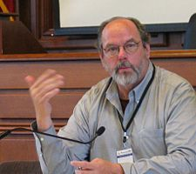
Who is Mr. Cunningham?
A big evangelist behind Extreme Programming
Helped with making Eclipse paramount as an Opensource development environment.

Slide 5
Where is our wiki?
Not just one – we are in the forefront of wikidom at EBMUD: we have 3
http://wiki/applications
http://wiki/itsecurity
http://wiki/datacenter
And we are just getting started…

Slide 6
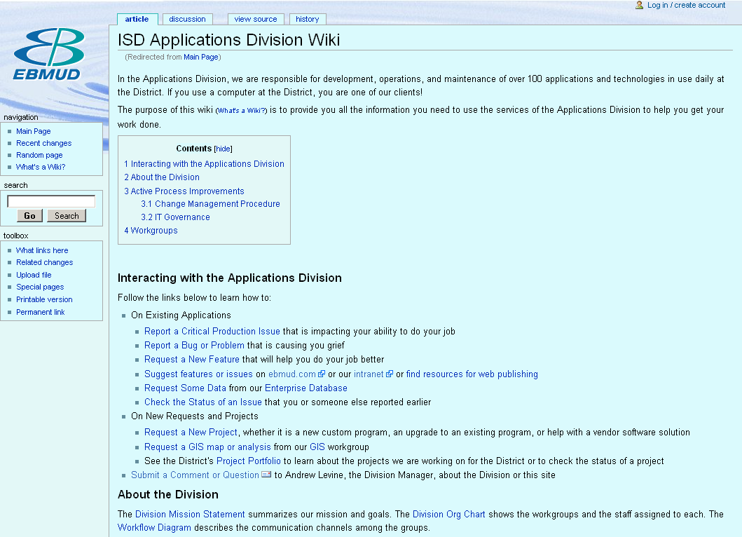
Notes:
Call your attention to the arrows
Article tab is where most content is but don’t forget to check out the others
Discussion lets you comment
History let’s you see who has edited what
Login – wikis are driven by PHP the PHP Hypertext Preprocessor an Opensource server side language much like Coldfusion php.net
You have to login to edit and add
Special pages allow you to do/see interesting things.
People write extensions like our LDAP authentication which queries our LDAP server and Mudnet

Slide 7
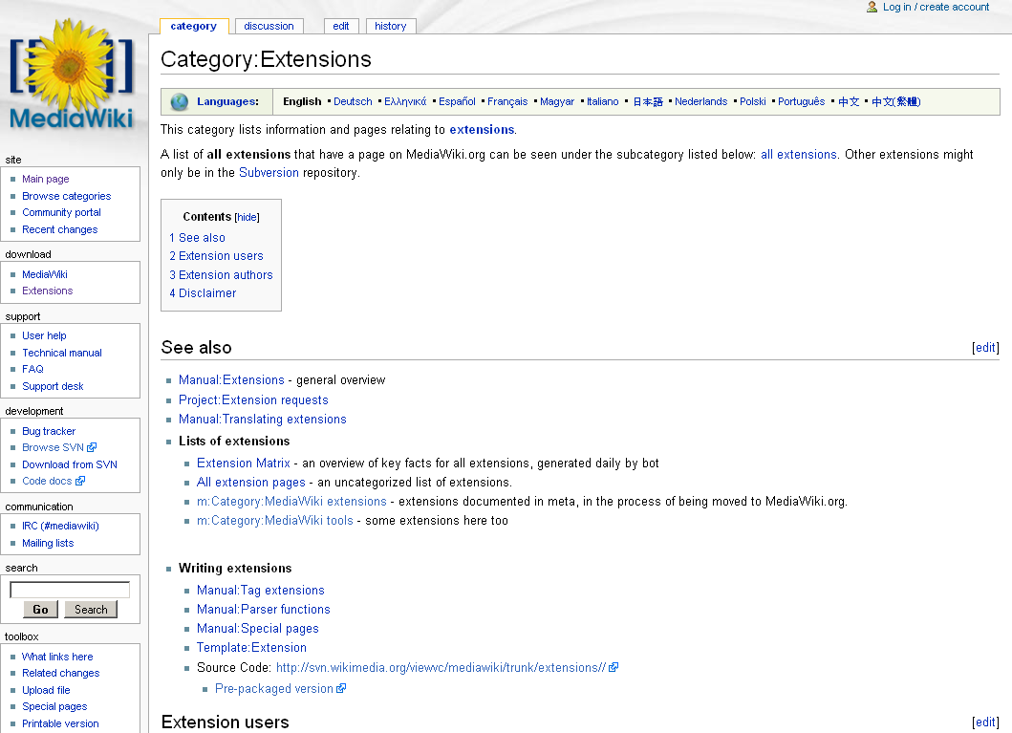
Notes:
Lots of PHP based extensions that for the most part you just drop in to the extensions directory in the wiki application root.
And add them to the main configuration file LocalSettings.php
require_once("extensions/Calendar.php");
require_once("extensions/SpecialEvents.php");

Slide 8
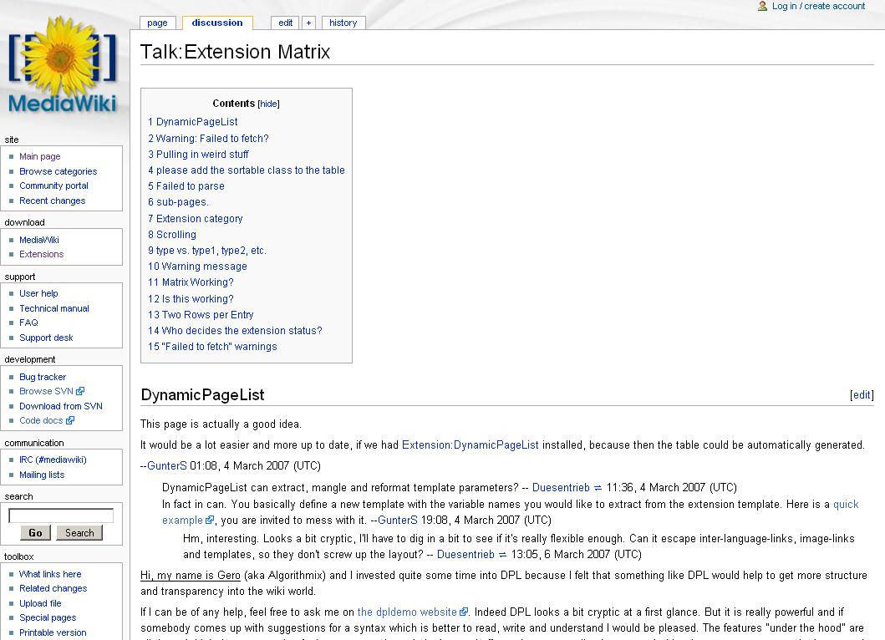
Notes:
Discussion tab – you can talk about what ever is posted – be Careful and Kind – what you write can be seen by all and commented on and cannot really be undone AND is TIED to you!

Slide 9
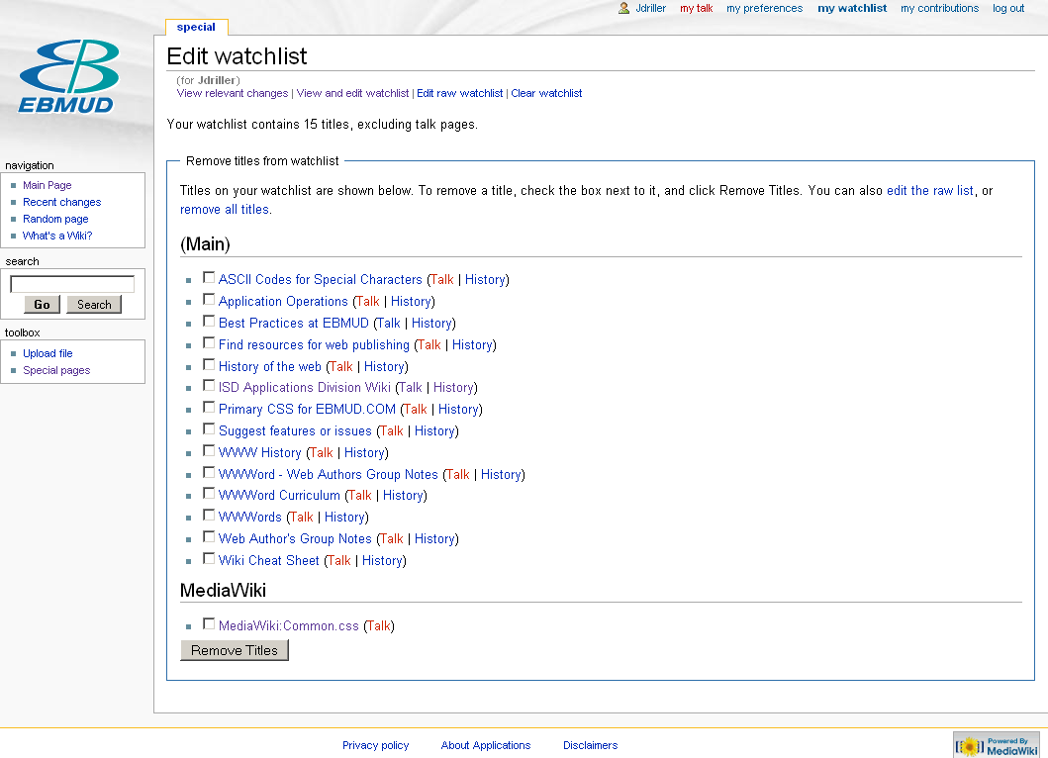
Notes:
This is my watchlist – all the pages I am watching.
I can ask that an email be sent to me when a page changes etc – set My Preferences

Slide 10
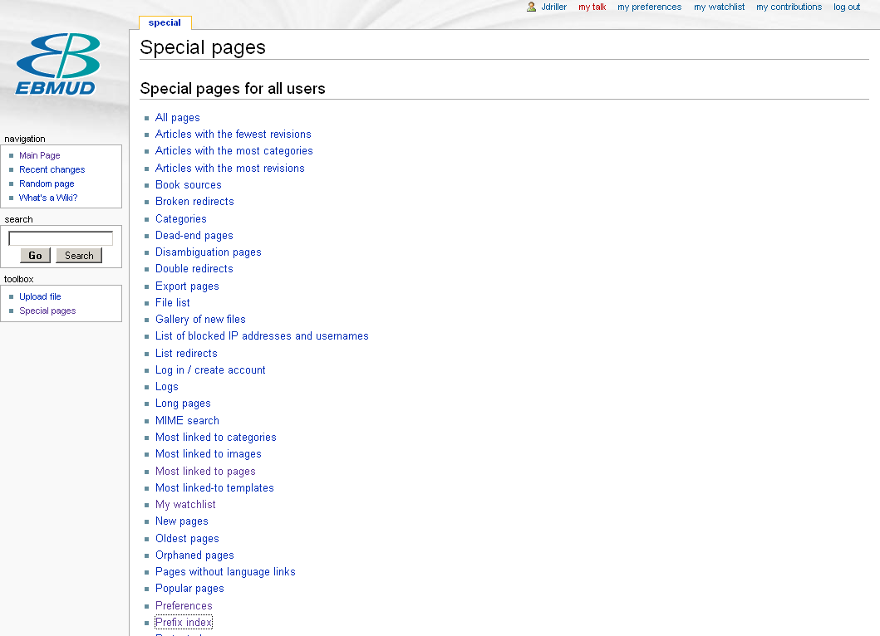
Notes:
Special pages – check it out – can do all sorts of nifty things
Upload files – only certain types – we can add more

Slide 11
Limitations?
Yes there are…
It may be quick but it IS different
A wiki is not the be all end all
  Formatting is more constrained
  Skinning is via templates and not trivial
    And special pages…MediaWiki:Common.css
  Hard to really delete
  Designed for open communication
  We have a “wiki family” and like our own family communication between members sometimes has to be mediated…
Notes:
It’s a whole new ball of wax – not really html – not really straight PHP
Weird to learn
All wikis are different – we use mediawiki same as Wikipedia

Slide 12
Will Wikis replace sliced bread?
No – they are useful for certain things

Slide 13
Can I edit other peoples stuff?
Yes – and they, yours…
Can I comment on anything – Yes!
Can anyone see it was me that said that? – Yes
Can I protect pages – Yes-ish (admins can)
Yes Yes Yes!!!

Slide 14
Work in Progress…
Please let me know if there are problems (like the styles not being uniform, or missing pages…)
We will try and get cross workgroup searching via Google search appliance

Slide 15
Move to demonstration part of presentation…
A Volunteer?
Remember What’s a Wiki>>Help:editing and Wiki Cheat Sheet…
Notes:
Now we see Harry Richardson edit his new wiki….

Slide 16
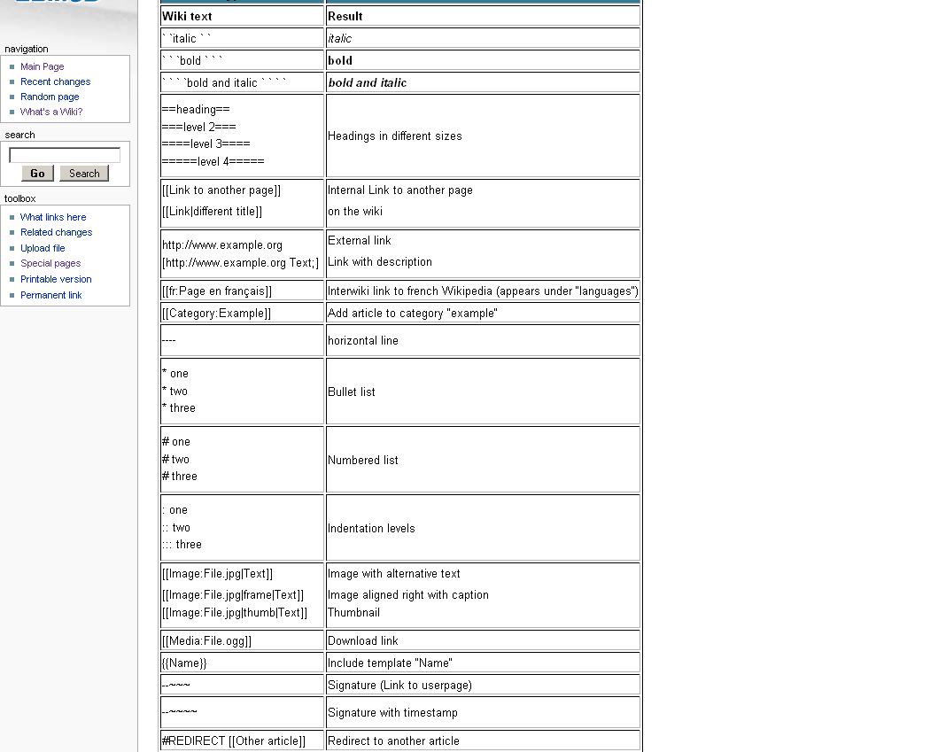
Notes:
Go Harry!

Slide 17
LocalSettings.php = config file
In wikitest /var/www/wikis/wiki1.11
Notes:
Its on Susi Linux here and lives here running under Apache2 tied to MySQL -

