Slide 1
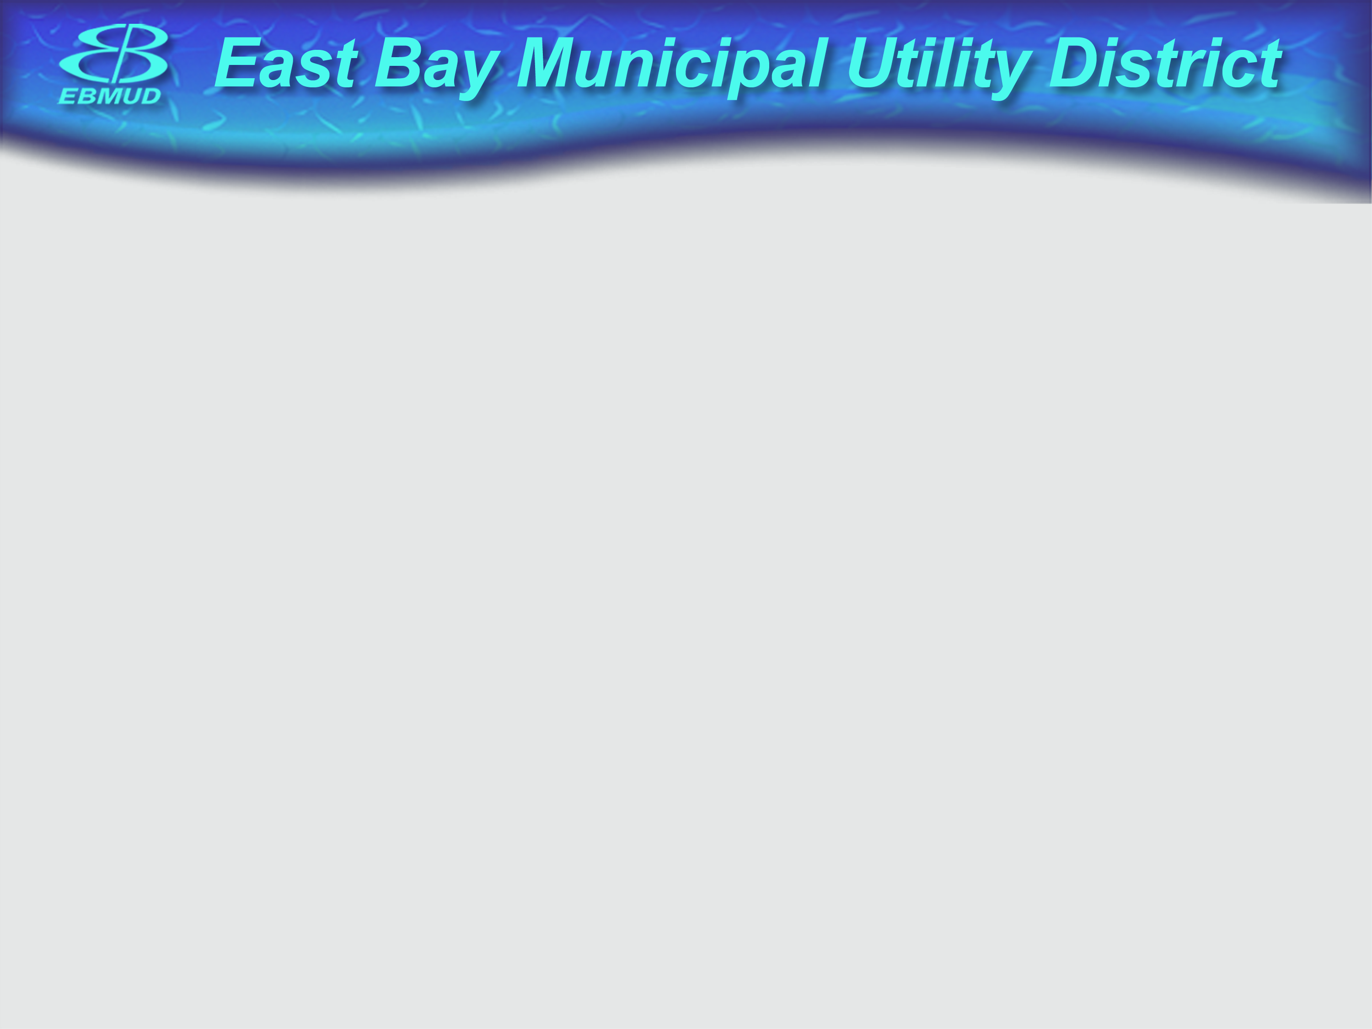
SGML
Standard Generalized Markup Language

Slide 2
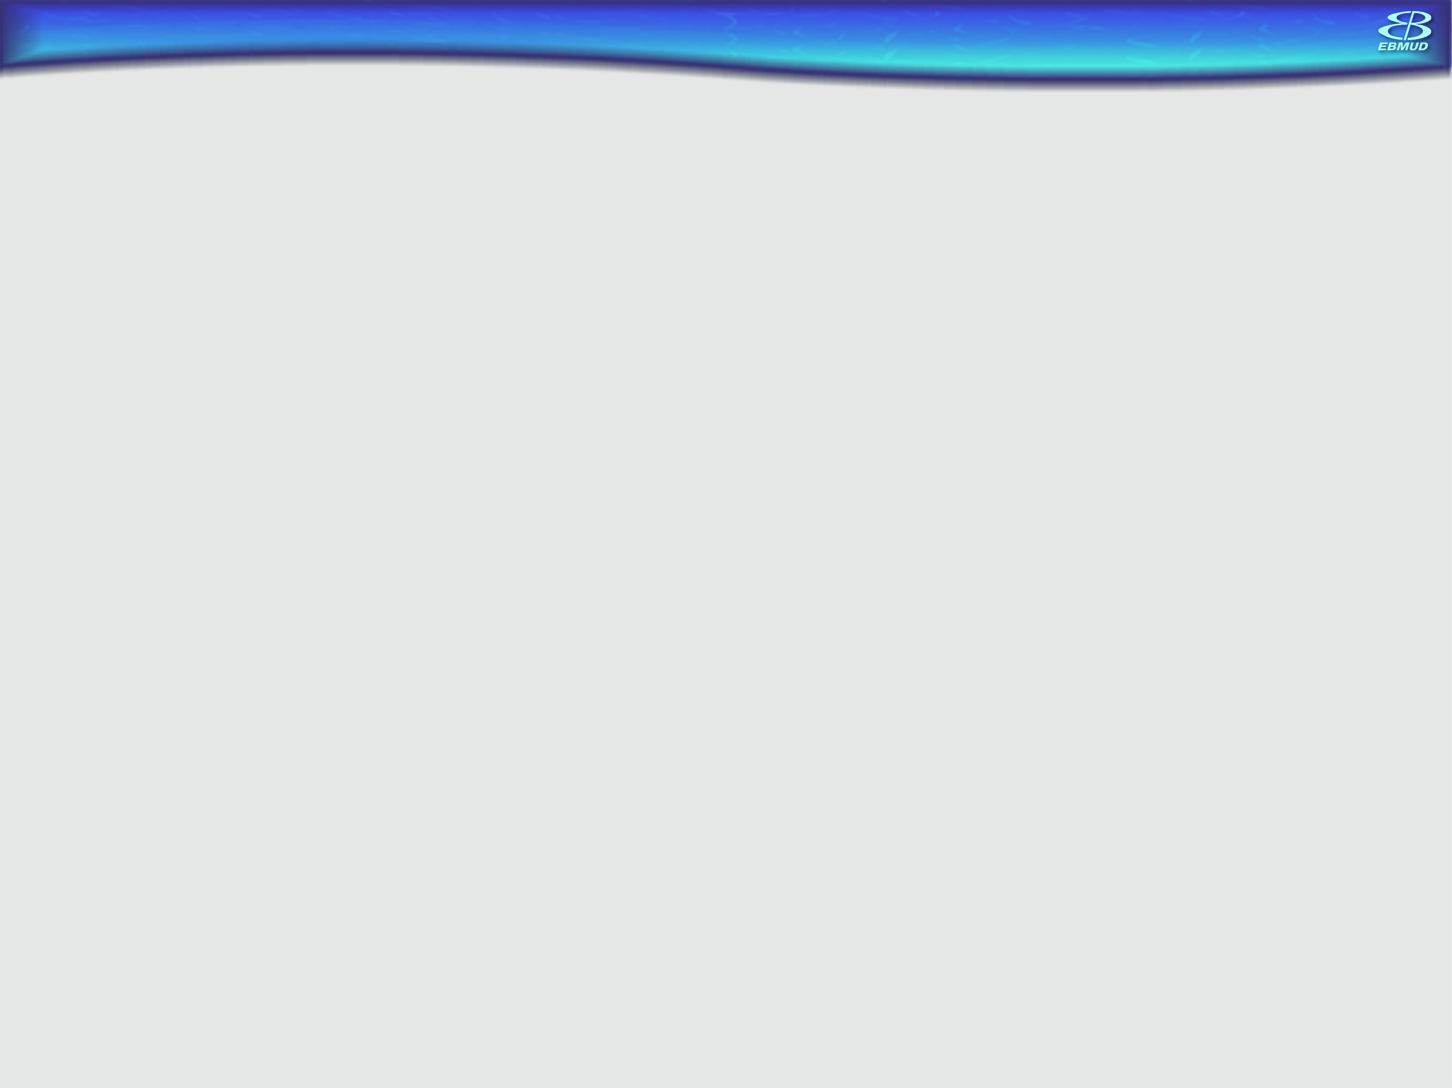
Note that this is a VERY generalized overview of SGML
Largely stolen from reference…

Slide 3

Who Cares?
SGML is the primary precursor of HTML – what Tim Berners Lee used to develop HTML.
What we learn here carries over to HTML, xHTML and XML
International standard for device and OS independent representation of electronic text
No – you don’t really need to learn it

Slide 4
What is it?
Metalanguage – a language describing a language.
Developed from IBMs GML – general markup language (Goldfarb, Mosher and Lorie developers)
Historically markup described annotation that would tell a printer how to replicate/show some print text
Read by a parser…like a browser

Slide 5
Structure
VERY strict- every piece of doc described – compare to HTML but…
You make up your own tags and attributes
DTD – Document Type Definition
  Each document can have a different type described in header which a parser evaluates
  Sets nesting rules for tags etc..
Tags – the annotation that describes how to present text within
Attributes – descriptor of tag pieces
Comments – guess where <!- - bla - - > came from?
Entities – ‘stuff’ that might be coded differently by different languages and machines – most common & or ®ي♫☺- (variables) – could be any file

Slide 6
“Hello World”
Why? Tradition!
You will see this a lot here…

Slide 7
HTML Example
<!DOCTYPE HTML PUBLIC "-//W3C//DTD HTML 4.01 Transitional//EN" "http://www.w3.org/TR/html4/loose.dtd">
<HTML>
<HEAD>
<TITLE></TITLE>
<SCRIPT></SCRIPT>
</HEAD>
<BODY>
<P>Hello World!</P>
</BODY>
</HTML>

Slide 8
A VERY simple DTD
<!ELEMENT anthology - - (poem+)>
<!ELEMENT poem - - (title?, stanza+)
status (draft|revised|published) #current>
<!ELEMENT title - O (#PCDATA) >
<!ELEMENT stanza - O (line+) >
<!ELEMENT line O O (#PCDATA) >
Element/tag identifier
Rules for tag syntax -=req’d o=optnl
Rules for tag nesting/contents anth+poem
Attributes of tag status and options
PCDATA = Parsed Character Data: any valid character data (text)
You don’t need to remember these…

Slide 9
SGML Example (partial)
<anthology>
<poem>
<title>The SICK ROSE
<stanza>
<line>O Rose thou art sick.
<line>The invisible worm,
<line>That flies in the night
<line>In the howling storm:
<stanza>
<line>Has found out thy bed
<line>Of crimson joy:
<line>And his dark secret love
<line>Does thy life destroy.
<poem>
<!-- more poems go here -->
</anthology>
Note – no HTML like tags

Slide 10
SGML Howdy
<!ELEMENT story - - (title?, body+)>
<!ELEMENT title - - (#PCDATA)>
<!ELEMENT body - - (paragraph+)>
<!ELEMENT paragraph - -(#PCDATA)>
<!ELEMENT picture - - (align?)>
<!ENTITY english "Hello world"> <!- - creating an entity - ->
<story>
<title>Hello Whorled</title>
<body>
<paragraph>Bonjour monde!<paragraph>
<paragraph>&english;<paragraph> <!- - does this look familiar? - ->
<!--paragraph>
<picture align=“left”> </picture>
<paragraph- ->
</body>
</story>

Slide 11
Summary
Goal was to show you the underpinnings of how HTML was designed, what it sprang from, and what it evolved into (later).
SGML is a very complex and heavy cross platform means to describe textual data.
HTML is a very lightweight means to portray (initially) textual data and other data (later).

Slide 12
Assignment for Next WAG
That’s right…an assignment!
Go to the wiki and look at this presentation and find the dtd used in the HTML page example – or use any HTML dtd. Look at that dtd (not just the reference to it) and bring the body tag info next time. Does this remind you of anything?
Create an sgml page from the example and open it in IE (browser). What do you see?

Slide 13
References:
http://www.isgmlug.org/sgmlhelp/g-sg.htm
A parser: SP http://www.jclark.com/sp/
A parser: OpenSP http://search.cpan.org/dist/SGML-Parser-OpenSP/

