Slide 1
Goal of “Words”
A “tour” of the web – very high level
Show some of what goes on behind the curtain
Get your curiosity aroused and interest piqued
Give you hooks for your own discovery & to request more info on topics of interest
These notes will be on the ISD/Applications wiki
Suggestions? Please let Faye or me know..
Want to talk? This could be you…
Notes:
This is part of a series of short talks on the Web given to the Web Authors Group.
So first a plug:
You too could be a part and present – if you would like to present a talk on ColdFusion, dotnet, SQL, xml, javascript or java please let Faye or I know…

Slide 2
Future Agenda
Subject to Change..
History of the Web
Resources for Developers
Client Side Language Tour
  HMTL
  XML
  CSS
  ECMAscript
  Flash ?
Server Side Languages
  CF
  PHP
  .NET
  Java
  Ruby
Dynamic Sites
  SQL
Tools
  Freeware editors
  Website tools
  graphics
Notes:
Notes:

Slide 3
First Talk=WWW History
This is just looking back till now. NO prognostication.
The future is up to you…
Notes:
Hi, in this month's inaugural “Words from the Webmaster” I want to start us off with a very brief history of the web. Basically, I am going to talk about 3 things: the Internet, the Web and the people who started us off. I am not going to prognosticate and suggest where we are going – that is up to you.

Slide 4
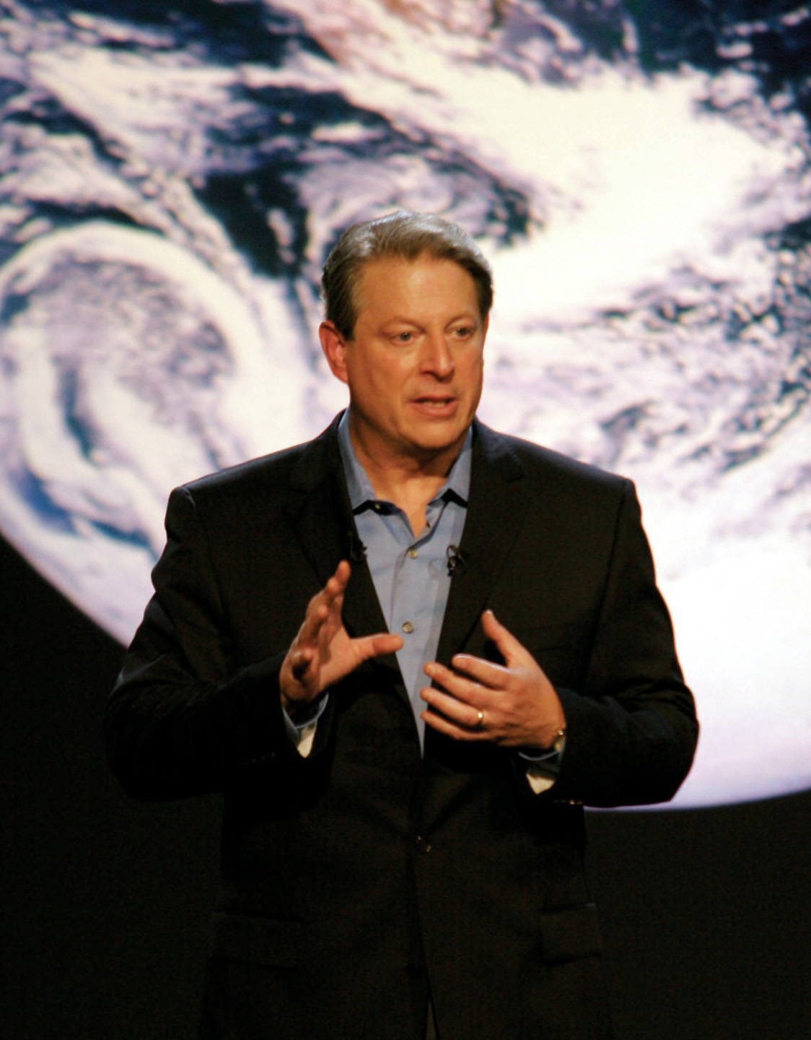
How did it all start?
Notes:
Lots of people were involved (and Al Gore was NOT really one of them) – and this is something to emphasize: the people were all geeks of the highest order. These were technical gods with skills that matched their visions. I am only going to mention a tiny few – many never get mentioned – but they deserve the credit.
In 1999 on CNN Gore proclaimed he “I took the initiative in creating the Internet “ – he DID have a part but he did not create the internet. He did sponsor and push through the High Performance Computing Act that became law in 1991 which funded the rapid growth of the internet through NSF
And if anyone thinks I am suggesting I am in this illustrious club..let me just say this explicitly: These people were visionary gods – I am not anywhere close to being in the same league.

Slide 5
Backstory
WW2
  Prosperity
  Lots of educated people and lots of new researchers with “nothing” to work on
  Desire for peace and brotherhood
Cold War
  Communists get The Bomb
  Sputnik
  USA Hegemony
Monster Computers
  Huge and $$$
  Very few; limiting resource
Notes:
So lets go back a bit…and start at the beginning:
Think 1945 we have just given our all and worked together as a country to triumph over the evil of Hitler and his allies. We have brought all of our nations resources, our greatest brains and talents, to create the atom bomb. We are at the top of our game and then – sputnik.

Slide 6
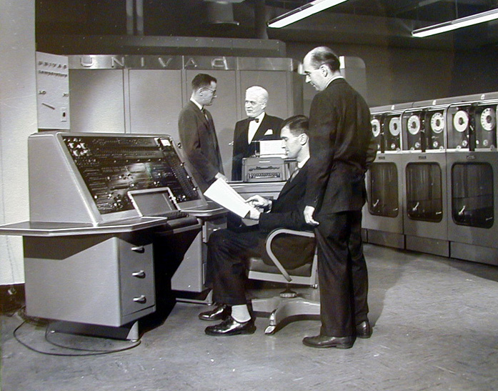
Univac 1
Notes:
Univac first commercial computer
1951
12 k ram – butit had ram so computer not a calculator

Slide 7
Univac1
First US programmable digital computer was actually in 1946; ENIAC several rooms
1951 first commercial computer; UNIVAC
25 feet by 50 feet
Computer not calculator; it had memory
12,000 characters (12k RAM)
processing speed 0.525 milliseconds for arithmetic functions, 2.15 milliseconds for multiplication and 3.9 Milliseconds for division

Slide 8
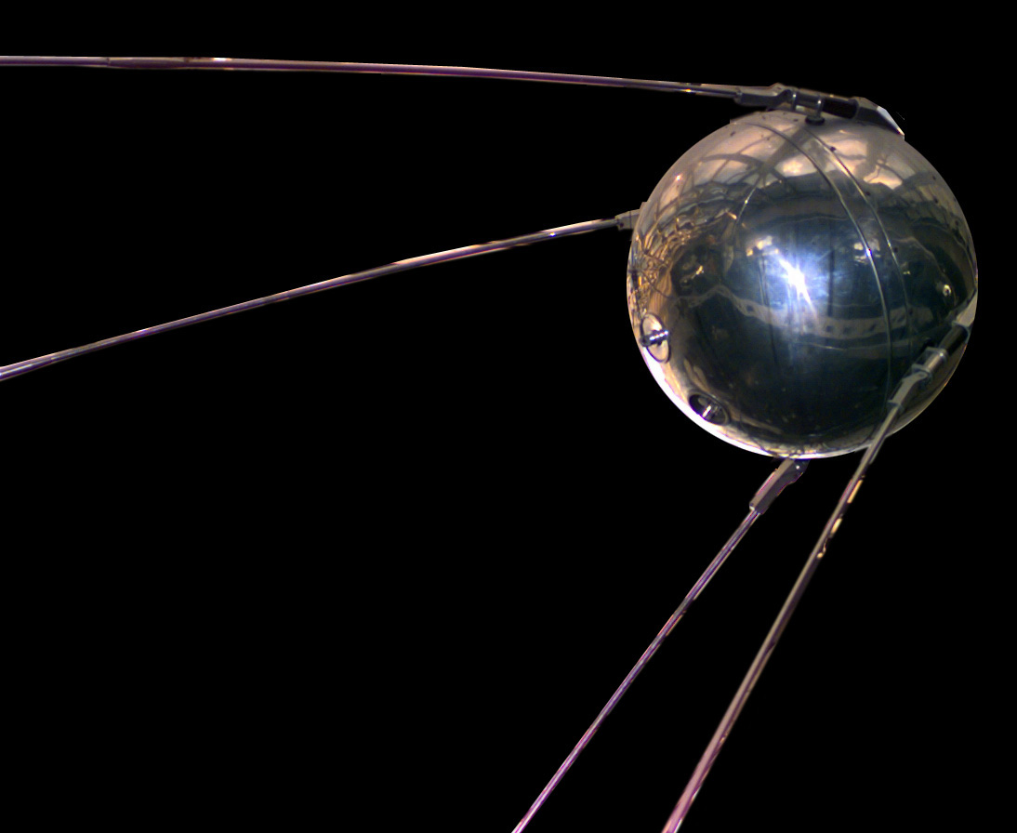
Notes:
1957 What does not kill us makes us stronger
the Soviets strap together a bunch of old war rockets and shoot a basketball into space – they have beat us into space – the final frontier. This is the first man-made satelite. Our moment when we all thought we were technologically invincible is over. We, as a nation, are terrified. If they can beat us into space AND have The Bomb then we are in trouble. Some of you here know this better than I; this was a very real fear.
Soon after Sputnik President Eisenhower created the Advanced Research Projects Agency which was tasked, among other things, with creating a bombproof (nuclear) communications mechanism so the military could communicate across the country (Licklider & Klienrock). At that point there was just the ATT phone system and radio. Either too vulnerable or insecure. ATT wanted to pursue the picturephone as the way of the future – and promoted it through the Worlds Fair as late as 1964.

Slide 9
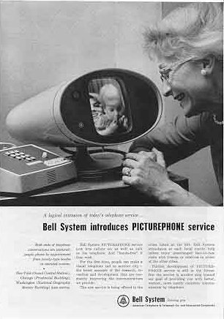
I coulda been a contenda…
Notes:
The alternative…1964

Slide 10
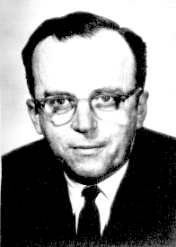
JCR Licklider
“Man-Computer Symbiosis”
Notes:
Soon after Sputnik President Eisenhower created the Advanced Research Projects Agency which was tasked, among other things, with creating a bombproof (nuclear) communications mechanism so the military could communicate across the country (Licklider & Klienrock). At that point there was just the ATT phone system and radio. Either too vulnerable or insecure. ATT wanted to pursue the picturephone as the way of the future – and promoted it through the Worlds Fair as late as 1964.
Licklider Galactic Network and Kleinrock packets Barrens packets Lick hired roberts who used Barrans ideas to build a network Kahn & Cerf create tcp/ip due to difficulties having all computers and networks with diff protocols talk to each other
Licklider was interested in doing things better – to him Batch Processing (punch cards) was not functional and people needed to be able to better interact with the computers – and time sharing could be done more efficiently if people from all over could hook up. This was also a time of huge scientific gains in all fields and the amount of information out there was getting lost because people could not find or access it -this was a recurrent problem in all scientific communities.
Licklider, unlike many in industry and even academia, saw the potential for computers (as part of networks) to improve COMMUNICATION, not just crunch vast numbers. Lastly, Licklider was someone who believed that government (EBMUD) has a responsibility to do what is right vs expedient and so felt Universities should be given funds to develop things independently vs business to come up with ideas that worked for them (punch cards).

Slide 11
Timeline 0-1960s
1949 Soviets test their first atom bomb – just lucky and our stolen idea anyway…
1951 Remington-Rand entered the market with the UNIVAC computer
1955 Eisenhower announces USA hopes to launch a small Earth orbiting satellite
1957 Sputnik launched
1958/59, the first 'integrated circuit'
1961 IBM introduced a 'Compatible Time Sharing System' into its 7090/94 series which allowed separate terminals in different offices to access the same hardware – still VERY expensive so why not have lots of people across the country access one computer
1962 JCR Licklider forms Information Processing Techniques Office (IPTO) of the ARPA there are about 10000 computers in the world – he is from BBN goes to MIT
1963 ASCII standard accepted first network started - "The ARPA theme is that the promise offered by the computer as a communication medium between people, dwarfs into relative insignificance the historical beginnings of the computer as an arithmetic engine."
1964 Paul Baran, Donald Davies, Leonard Kleinrock develop early packet switched network concept. IBM comes out with 8 bit byte vs competing 16 & 32
1965 MIT & RAND (or Berkeley) create first WAN with telephone lines connect 2 computers
Ted Nelson coined the terms "hypertext" =nonsequential writing - text that branches and allows choice to the reader, best read at an interactive screen.
1966 Taylor (head of IPTO) complains that he has three computers on his desk and cant communicate with any others by phone – gets a million to fix it.
1967 Larry Roberts sets up Interface Message Processors (routers) to manage information travel on the network. SRI improves modem to work at 50kbps – he pushes the network thing at the annual arpa big meeting and proposes ways to connect disparate systems
1968 Kleinrock sets up first node at UCLA – Engelbart of SRI invents mouse and NLS which uses hyperlinks for cross references
1969 Ben Barker, Bernie Cosell, Will Crowther, Bob Kahn, Severo Ornstein, and Dave Walden. on first team at UCLA. Vint Cerf, Steve Crocker, and Jon Postel. SRI has Elizabeth (Jake) Feinler and Don Nielson. Doug Engelbart – first network communication on the planet October 29 between UCLA and SRI. “L” and “O” are transmitted successfully before network crashes – confirmed by simultaneous phone call. They were trying to logon...originally NCP later pushed to TCP/IP by Postel By December Uof Utah, UCLA, SRI, UCSB.

Slide 12

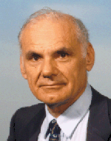
Bob Taylor
“3 computers – no connection”
L Roberts
“first computer link”
Notes:
Soon after Sputnik President Eisenhower created the Advanced Research Projects Agency which was tasked, among other things, with creating a bombproof (nuclear) communications mechanism so the military could communicate across the country (Licklider & Klienrock). At that point there was just the ATT phone system and radio. Either too vulnerable or insecure. ATT wanted to pursue the picturephone as the way of the future – and promoted it through the Worlds Fair as late as 1964.
Licklider Galactic Network and Kleinrock packets Barrens packets Lick hired roberts who used Barrans ideas to build a network Kahn & Cerf create tcp/ip due to difficulties having all computers and networks with diff protocols talk to each other
Licklider was interested in doing things better – to him Batch Processing (punch cards) was not functional and people needed to be able to better interact with the computers – and time sharing could be done more efficiently if people from all over could hook up. This was also a time of huge scientific gains in all fields and the amount of information out there was getting lost because people could not find or access it -this was a recurrent problem in all scientific communities.
Licklider, unlike many in industry and even academia, saw the potential for computers (as part of networks) to improve COMMUNICATION, not just crunch vast numbers. Lastly, Licklider was someone who believed that government (EBMUD) has a responsibility to do what is right vs expedient and so felt Universities should be given funds to develop things independently vs business to come up with ideas that worked for them (punch cards).

Slide 13
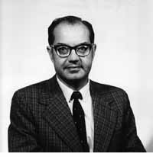
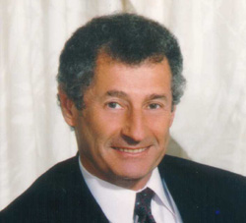
L Kleinrock & P Baran
“packet switching”
Notes:
Break stuff into little pieces, send them all over to different nodes, then gather and reassemble at one node. Resend if some are lost or damaged.
Wrap the little pieces into bundles that have information on their assembly order,size and where they are going

Slide 14
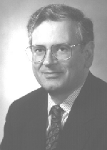
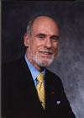
R Kahn & V Cerf
TCP/IP Protocol
Notes:
How do we get different computers with different languages to talk to each other? Lets set a standard everyone agrees on and is separate from computers language.
NCR came first but then these guys came up with Transmission Control Protocol and Internet Protocol

Slide 15
Timeline 1970s
1970 UNIX created by Dennis Ritchie and Kenneth Thompson at Bell
1971 23 hosts at Universities and military – intel creates first microprocessor computer on chip and telnet created FTP started
1972 email created –Ray Tomlinson does ray@bbn.com writes email program
1973 37 hosts including Norway and England
1974 TCP/IP created 62 hosts
and remember – at this point no one was expecting cheap computers for the masses or BILLIONS of nodes – but the prescient design allows that...
1976 a Unix-to-Unix protocol was developed by AT&T Bell laboratories and was freely distributed to all Unix computer users (since Unix was the main operating system employed by universities, this opened up networking to the broader academic community).
1977 111 hosts – apple 2, commodore and tandy personal computers introduced
In 1979 Usenet was established, an open system focusing on e-mail communication and devoted to 'newsgroups'

Slide 16
Timeline 1980s
1981 Bitnet (Because it's Time..) was developed City University New York to link university scientists using IBM computers, regardless of discipline, in the Eastern US. CSNet, funded by the US national Science Foundation was established to facilitate communication for Computer Scientists in universities, industry and government. Osborne and PC (IBM/Microsoft) introduced
1982 TCP/IP adopted for internet . a European version of the Unix network, Eunet, was established, linking networks in the UK, Scandinavia and the Netherlands.
1983 Military leaves ARPANET to milnet/
1984 Over 1000 hosts – DNS starts John Postel Paul Mockapetris of USC/ISI and Craig Partridge of BBN Bill Joy of UCB ports tcp/ip into BSD. Apple Macintosh ships
1985 2000 hosts
1986 5000 hosts
1987 28000 hosts First commercial internet provider UUNET
1988 US Gov expands funding and has NSF takeover and do free metering but excluded "purposes not in support of research and education". First Virus infects computers (Morris Worm)
1989 100000 hosts Tim Berners Lee writes first webserver, and language called HTML (Hypertext Markup Language subset of SGML. Nicola Pellow, working for TBLee writes first browser. He wants information to transcend the rapid turnover of people doing research on a topic so hypertext will connect people on dif systems as they move around.

Slide 17
Timeline 1990-Now
1990 300000 hosts first search engine created at McGill – Archie – Arpanet shuts down. ARCHIE Gopher and WAIS appear.
1991 NSF removes non research prohibition from backbone – Al Gore introduces High Performance Computing Act to fund more network growth. First webserver launched info.cern.ch THE WEB IS BORN!
1992 50 websites in world – Joseph Hardin and Dave Thompson show group at NCSA TBLee's browser and web and Students at U of I Champagne create NCSA (National Center for Supercomputer Applications), Mosaic...
1993 150 websites in world Marc Andreeson & Eric Bina create Mosaic 3 and gives it away
1994 www starts to take off 3.2 million hosts 3000 websites – http traffic surpasses telnet traffic for first time... Jim Clark and Mosaic crew start Netscape. UofI sues Netscape.
1995 6.5 million hosts 25000 websites Netscape IPO. Jonathan loses thousands...
1996 13 million hosts 250K websites
Now - it is up to you…

Slide 18
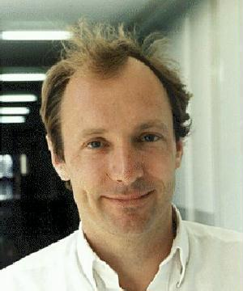
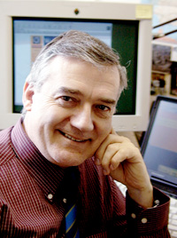
Tim Berners Lee & Robert Cailliau
Notes:
The first webbies first webserver http://info.cern.ch

Slide 19
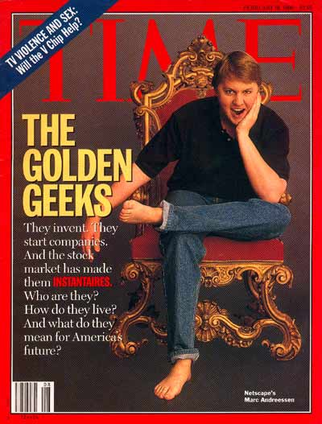
Marc Andreesen
Notes:
Netscape NSCA developer but don’t forget Eric Bina and the rest

Slide 20
“There have always been things which people are good at, and things computers have been good at, and little overlap between the two…computers have not [been good at] be[ing] able to store random associations between disparate things, although this is something the brain has always done relatively well. “

Slide 21
History of the Web
The Motivation
  $$$
  Inability to Share
  Conflicting forces: Altruism and Domination
The Pieces
  The internet – a network of networks
  The Web
  The Browser
  New Stuff
    Flash
    Video
    Sound
    Voice
    Games
The Lessons
  A mere heartbeat of time…
  All you need is an idea, timing and money (but not too much)
  Resource limitation is good
Notes:
The web has grown out of conflicting forces - broad vision, focused greed, World hegemony, and the quest for peace and equality for all. It started with the building of the internet – providing a canvas upon which the Web could be painted.

Slide 22
References:
www.W3c.org
www.livinginternet.com
http://info.cern.ch/
Just do a search on “History” & “Web” – that is what this is all about…now you can.

