Slide 1
Approxposterior (BAPE) Convergence issue
After the meeting on 15th March 2021 we decided to look into few things to check the convergence issue of the BAPE implementation in Approxpoeterior.

Slide 2
Convergence of posterior issue: When we change the number of re optimizations in the GP hyperparameter optimization the final posterior changes significantly.
Simon suggested increasing the number of design points to see if the convergence of posterior issue is still there.

Slide 3
All the plots shown below have 50 initial design points from a Min Max Lattin Hypercube Sampling. Active sampling has been done in batches of 5.

Slide 4
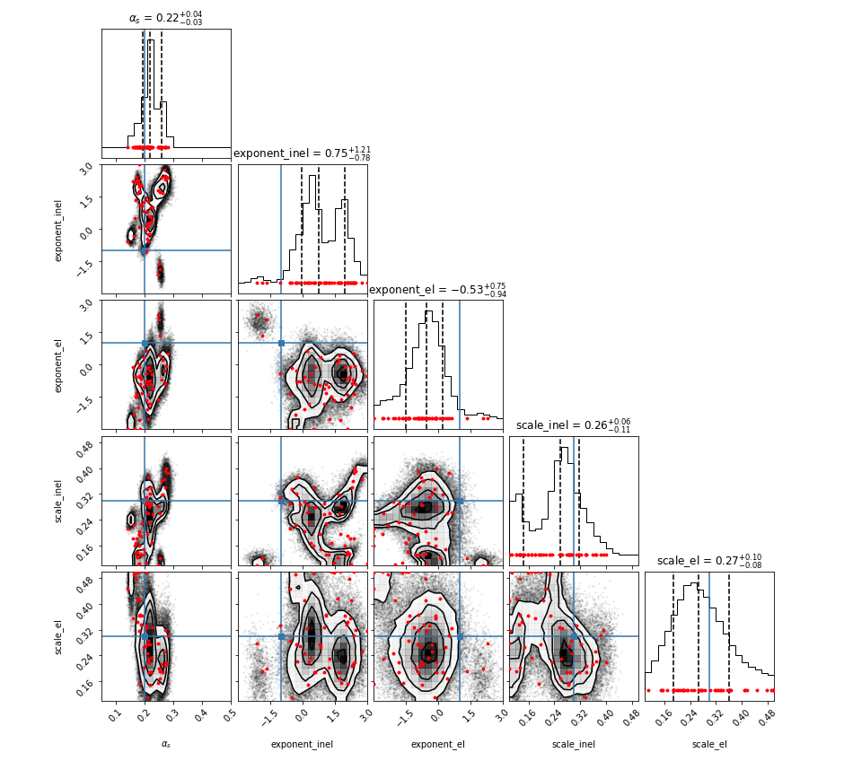
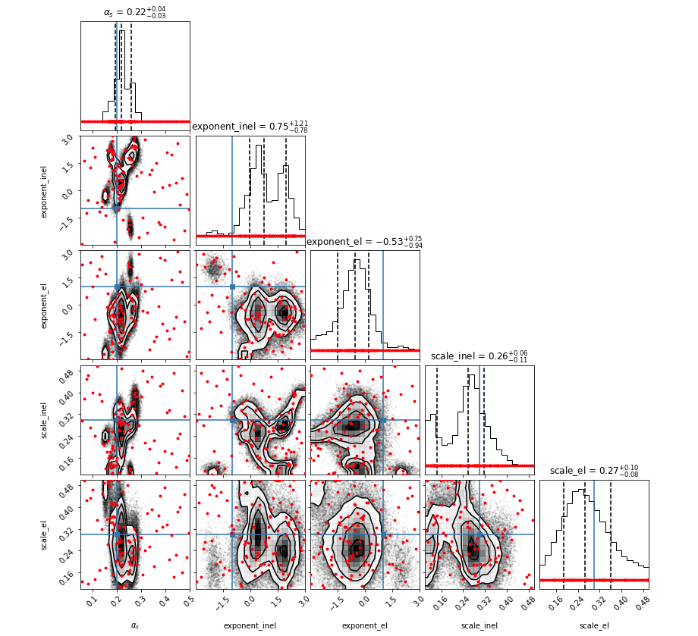
20 n_gp_restarts , 5 nMinObjRestarts
All design points
Only Actively found
design points

Slide 5
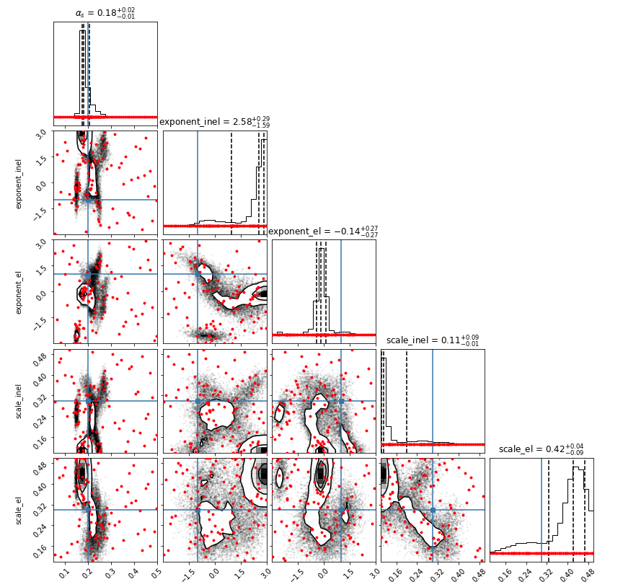
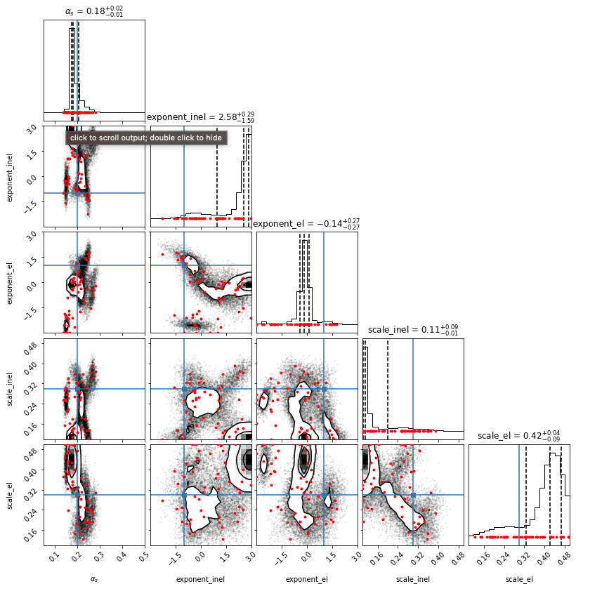
30 n_gp_restart, 5 nMinObjRestarts
All design points
Only Actively found
design points

Slide 6
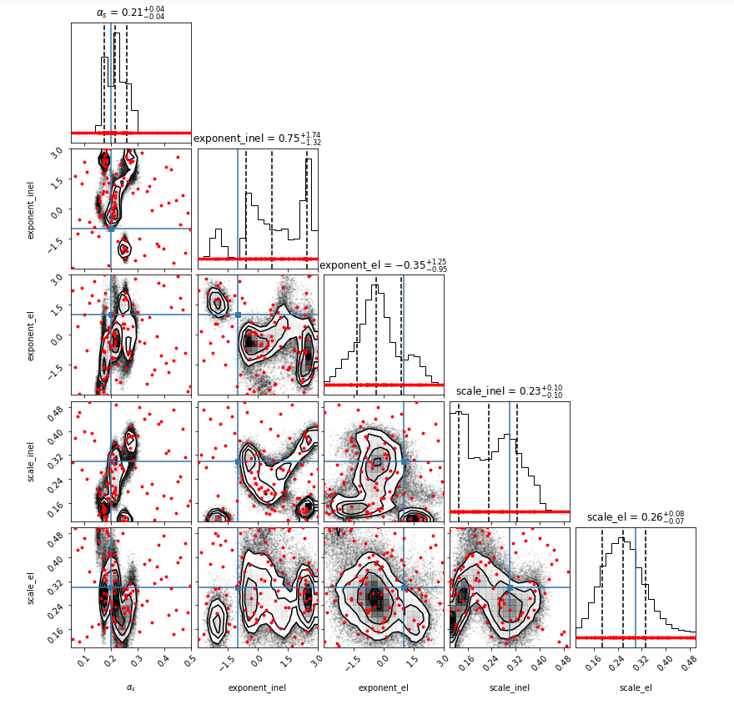
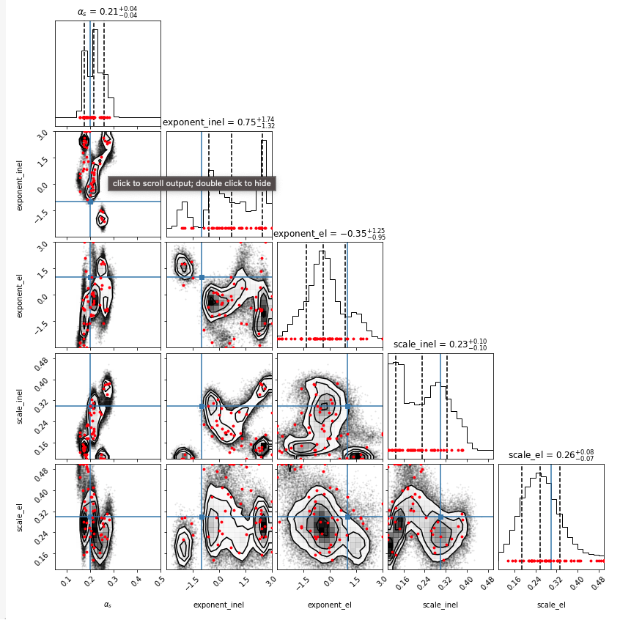
50 n_gp_restart, 5 nMinObjRestarts
All design points
Only Actively found
design points

Slide 7
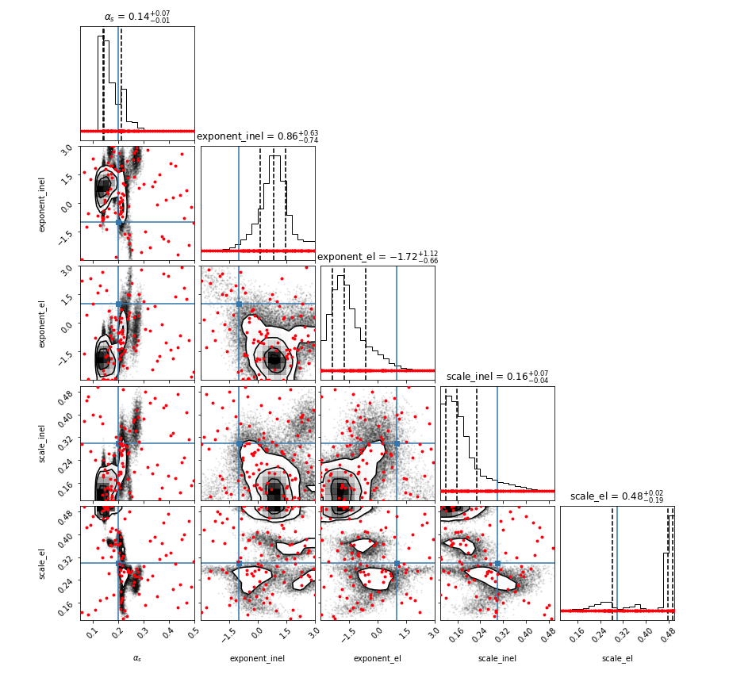
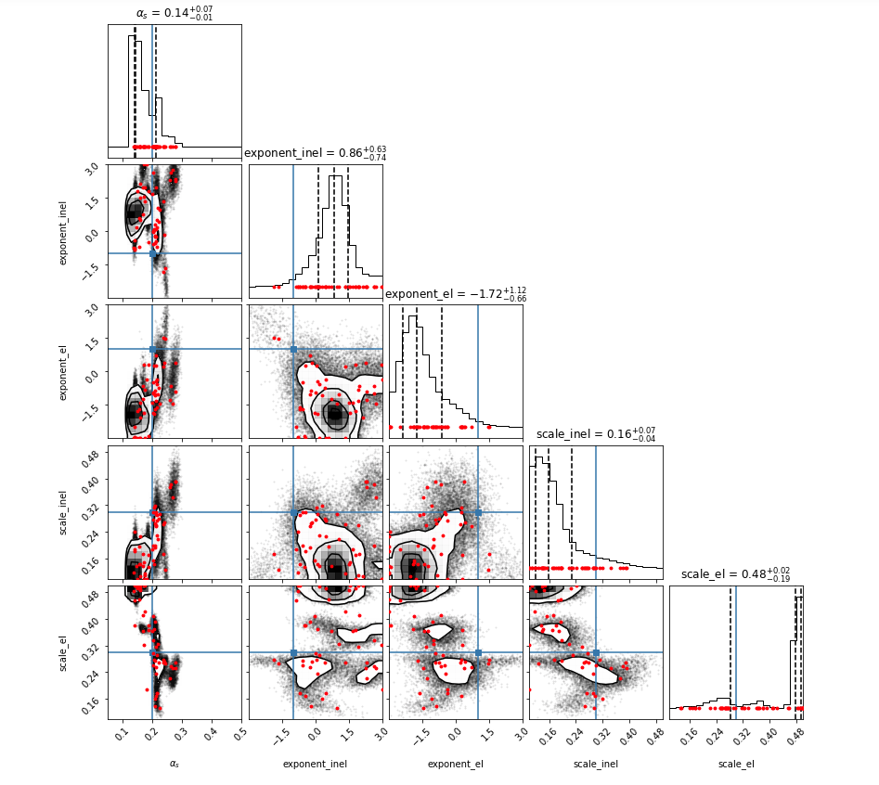
100 n_gp_restart, 5 nMinObjRestarts
All design points
Only Actively found
design points

Slide 8
Convergence of posterior issue: When we change the number of re optimizations in the GP hyperparameter optimization the final posterior changes significantly.
Simon suggested increasing the number of design points to see if the convergence of posterior issue is still there.
I also tried to increase the number of re optimizations in the active learning batch points finding algorithm.
I rerun all the previous n_gp_restart but now with 50 nminobjectRestarts instead of default 5.

Slide 9
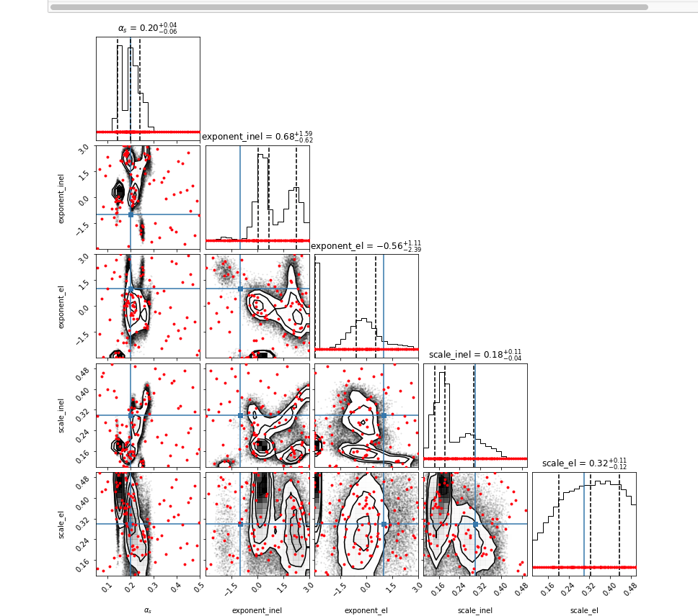
100 n_gp_restarts, 50 nMinObjRestarts

Slide 10
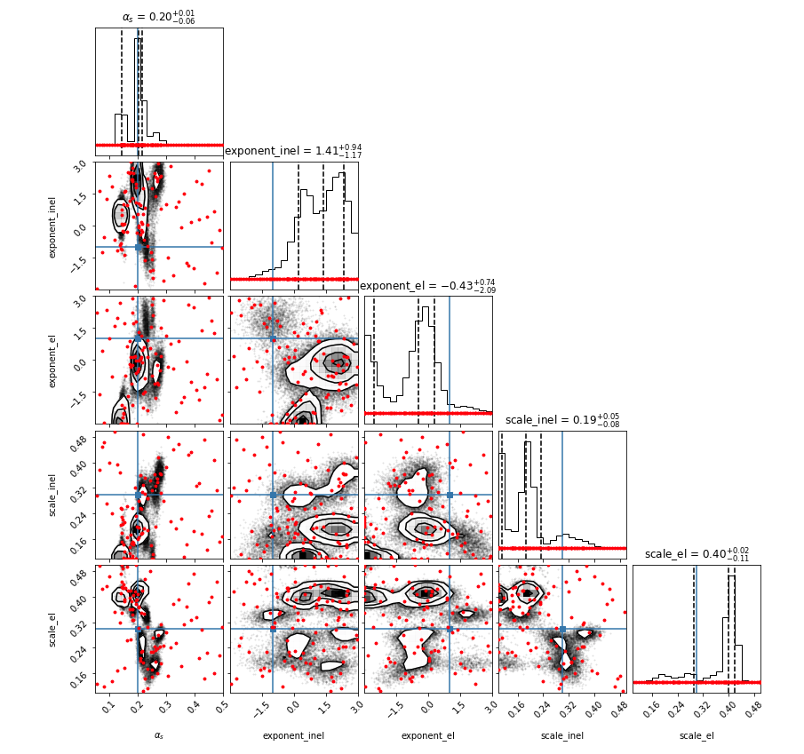
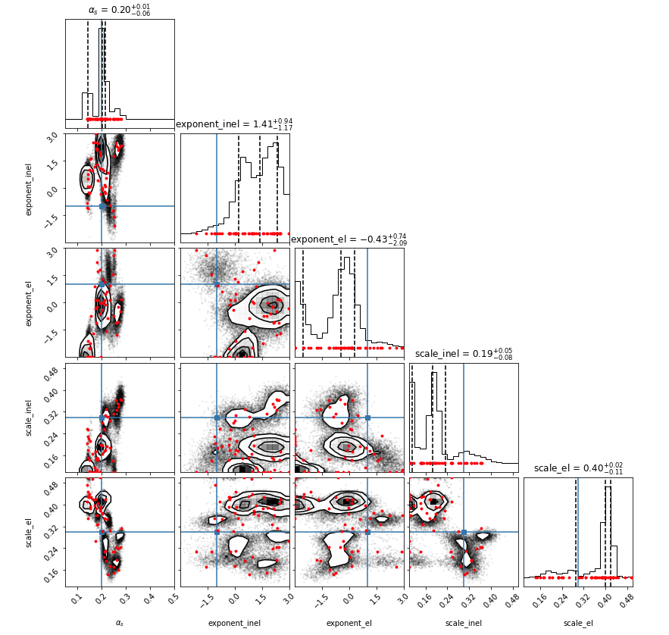
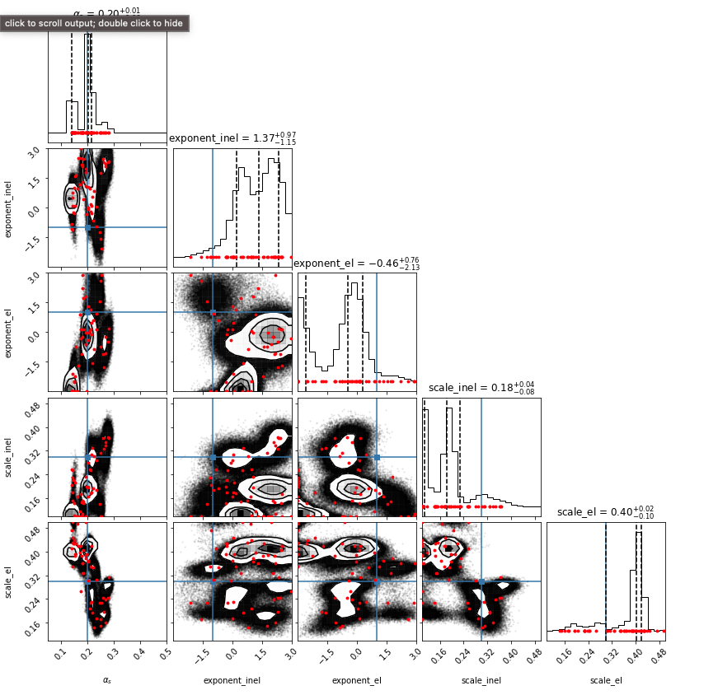
50 N_gp_restarts, 50 nMinObjRestarts
Wanted to cjeck if this is
A MCMC issue. So got
10 times more
MCMC samples.

Slide 11
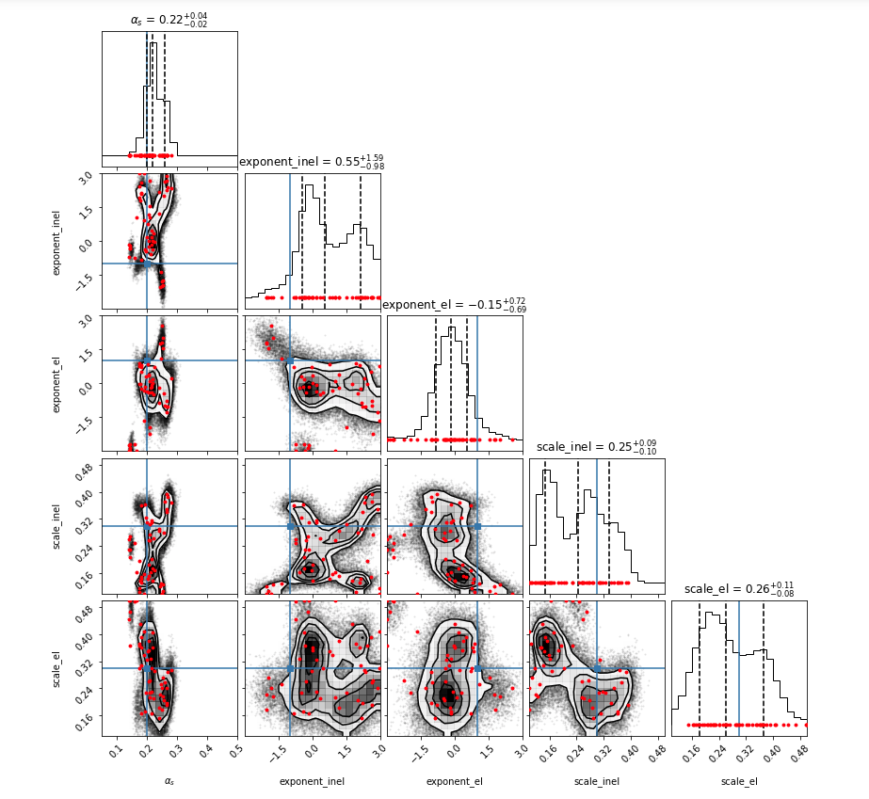
30 n_gp_restarts, 50 nMinObjRestarts

Slide 12
Summary of all the Plots

Slide 13
20, 5
30, 5
50, 5
100, 5
In the top row we only change n_gp_restarts and keep noptimizationrestarts fixed to 5. The bottom row is the same but now we fix noptimizationrestart to 50.
Conclusion:
Now the posteriors are not completely different from one another. There is a common structure. But still there are differences. How do we improve this and get a convergent posterior?
30, 50
50 , 50
100 , 50

