Slide 1
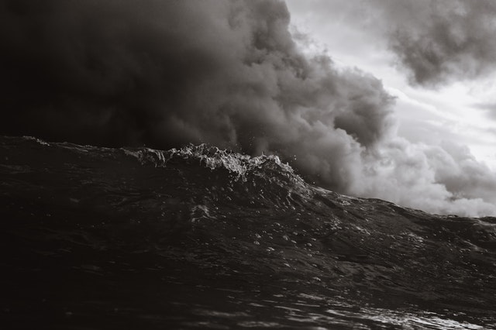
Tittle - Ship wreck

Slide 2
Scene 1
You’re traveling in the bearing sea on a fishing boat wish your crew
Its been a long three weeks at sea and it’s finally time to come back home
You're looking forward to seeing your your new born son who you haven't met yet, and to seeing a doctor to see what to do about your leg that was injured while working during a storm.
Your crew of of 8 meet for dinner and you all disperse for the night.
Smoke a cigarette before shower ?
Go strait to the shower.

Slide 3
Scene 2a – from Cigarette
You head out to the deck with you last cigarette and think about your family back home
You notice that it’s a cloudy, gray, rainy night. It’s not uncommon so you don’t think much of it other than it’s making it hard for you to enjoy your cigarette.
All of a sudden, lightening strikes and one of the communication antennas on the superstructure falls from above you.
You hear Joe shout expletives from inside and you head in.
Check Things Out

Slide 4
Scene 2b – from shower

