Slide 1
Subject – Database Management System
Batch - AS-4
Presentation on topic -
postgresql

Slide 2
Group Members
63 –
64 –
65 –
66 –
Gayatri Jadhav
Pratiksha Jadhav
Rajwardhan Jadhav
Shravani Jadhav

Slide 3
Introduction
postgreSQl is a Highly stable, object-oriented relational Database management system.
It is Open source and free to use.
It is platform independent (can run on all operating systems).
postgreSQL was firstly came into picture in 1995.
Its latest version is 9.1

Slide 4
Features
Supports procedural languages (plSQL, plPHP)
Used in other programming language except sql and c
Supports multiversion control
Used in application building
Protects data integrity
Manages data
Highly extensible

Slide 5
Create / delete Database
Commands –
CREATE DATABASE database-name
Database name can be upto 63 characters
It should start with alphabet
DROP DATABASE database-name

Slide 6
Identifiers
It is used to identify names of database objects such as table and column.
Must start with letter or underscore ( _ )
Name upto 63 characters (if >63 , then it is truncated)
Cannot use space
Case insensitive

Slide 7
Keywords
Have fixed meaning
Does not change
Keywords cannot be used as identifier
If keyword is to be used as identifier, then it should be quoted ( “ ” )
Quoted identifiers are case – sensitive

Slide 8
Comments
Single line comment –
- - content
Multiline comment –
/* content */

Slide 9
Data types
There are different type of data type available in PostgreSQL :-
Numeric data types
Character data types
Date and time data types
Boolean data types

Slide 10
1.Numeric data types
Integer –
Save whole numbers
Numbers that do not have fractional components
Ex - 2,7,18
Floating point –
Includes real and double precision
Real – atleast 6 precision decimal digits
Doible – atleast 15 precision decimal digits
Also accepts infinity (♾️), -infinity (-♾️) and NaN (not a number)

Slide 11
2.Character data types
Char or character
Character varying or varchar
Text
When using char or varchar, we need to specify values / number of characters
i.e. CHAR (10) , VARCHAR (10)
Text can store strings of any length
Enclosed in single quotes . Ex- ‘database’

Slide 12
3.Date and time data types
Timestamp without time zone
Timestamp with time zone
Date
Time without time zone
Time with time zone
Interval
For time, timestamp and interval (that includes seconds) we can specify precision (no. of fractional digits in seconds’ field)

Slide 13
DATE is enclosed in single quotes
Ex – DATE ‘2023-05-15’
We can use 24 hour or 12 hour
Ex – TIME WITHOUT TIME ZONE ‘12:25 AM’ or ’00:25’
If time zone is to be included –
Ex – TIME WITH TIME ZONE ‘12:25 AM IST ’
Special values –
Infinity, -infinity, now, today, tomorrow and yesterday.Datestyle parameter –

Slide 14
Intervals –
Repeats duration of timr
To define interval, use signed no. Followed by unit
UNITS –
DAY, HOUR, MINUTE, SECOND, YEAR TO MONTH, DAY TO HOUR, DAY TO MINUTE, DAY TO SECOND, HOUR TO MINUTE, HOUR TO SECOND, MINUTE TO SECOND.
Ex – INTERVAL ‘1 DAY 4 HOUR 2 MINUTE ’
If interval has only days, hour, minute and seconds, then no need to specify.
Ex – INTERVAL ‘1 14.50.32’
If it has year, month and days, then specify by dash (-)
Ex – INTERVAL ‘50-23-1’

Slide 15
4.Boolean data types
It can be TRUE, FALSE or UNKNOWN
TRUE - T, 1,Yes, Y, on
FALSE – F, No, N, 0,off
UNKNOWN - NULL
In table, true and false will be shown by t and f and NULL by empty space

Slide 16
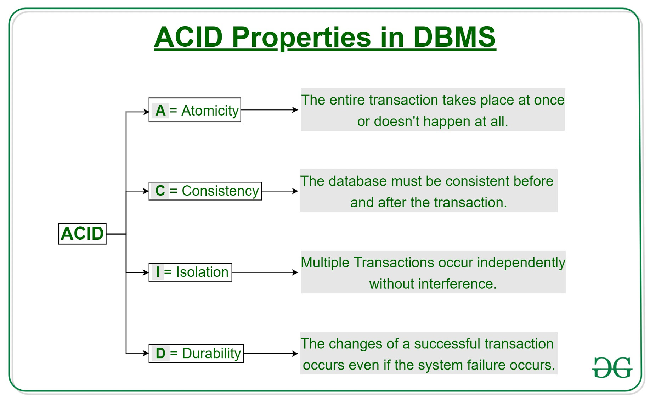
Transactions
A transaction is a single logical unit of work that accesses and possibly modifies the contents of a database. Transactions access data using read and write operations. In order to maintain consistency in a database, before and after the transaction, certain properties are followed. These are called ACID properties.

Slide 17
ROLLBACK Command :-
ROLLBACK command is used to undo the changes done in transactions
Savepoints :-
• Learn to control transaction allow to commit part of transaction and discrete other parts
After ROLLBACK :-
• All operations upto save point:-committed
• Operations after save point :- Discarded
DEADLOCKS

Slide 18
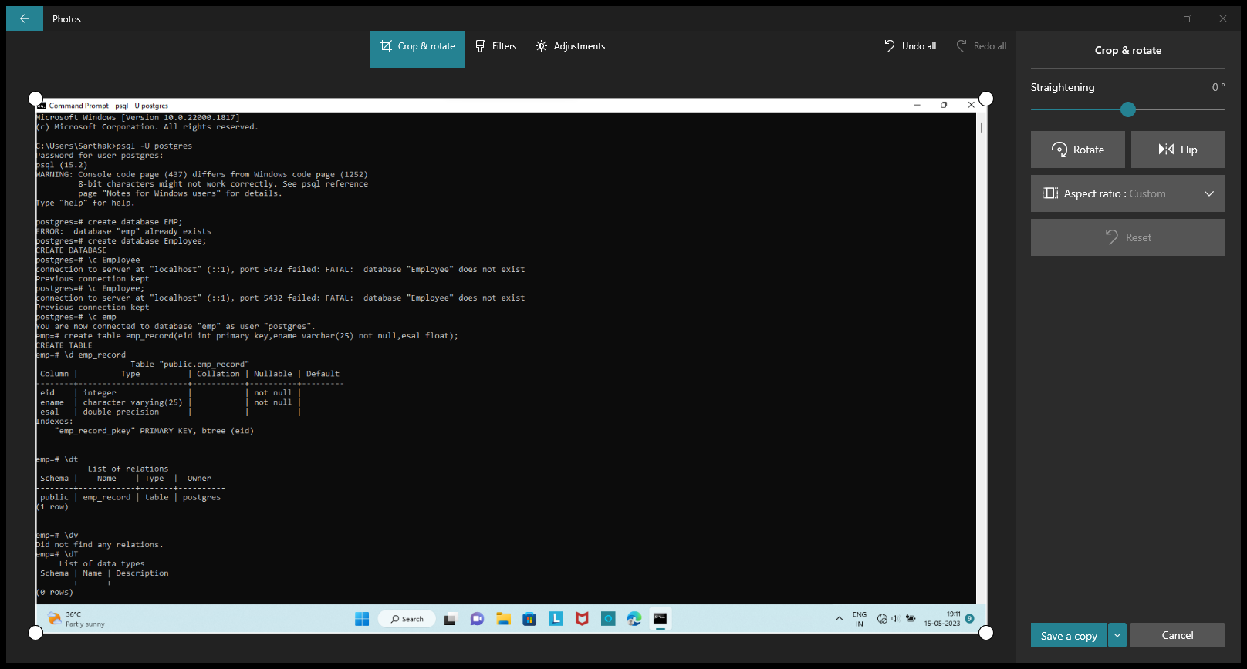
Some Functionality Of Postgre SQL Over SQL
1] Connect to database :
\c database _name
2] Gives the list of table view :
\d
3] To list Only table :
\dt
4] To list datatypes :
\dT
5] Connected Database information :
\conninfo
6] To change the format :
\pset

Slide 19
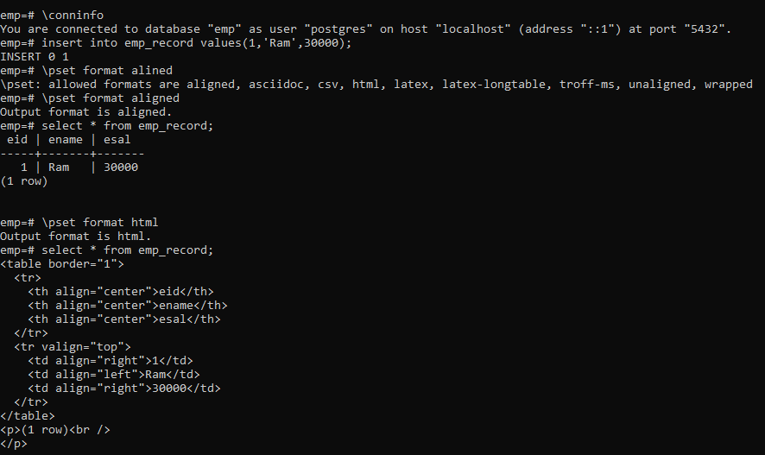
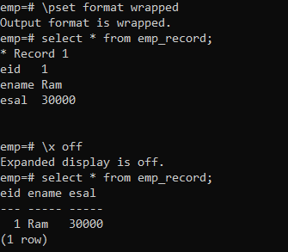
1] \pset format 2] \pset border 3] \pset title

Slide 20
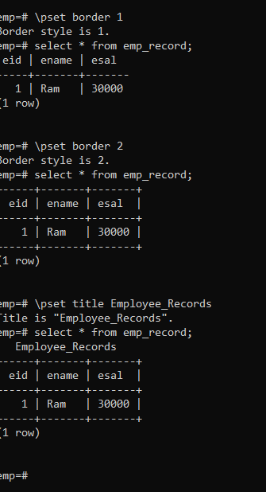
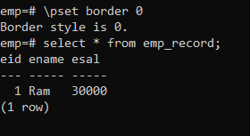

Slide 21
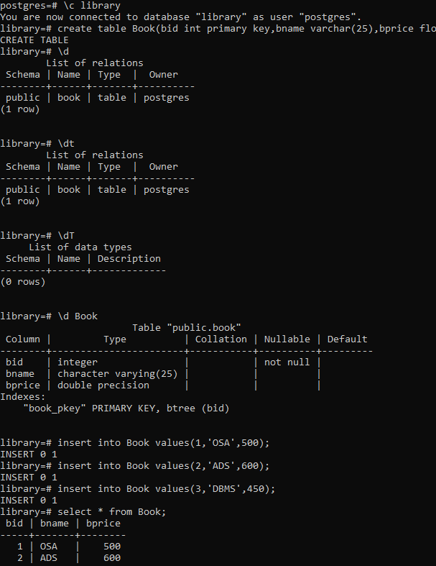

Slide 22
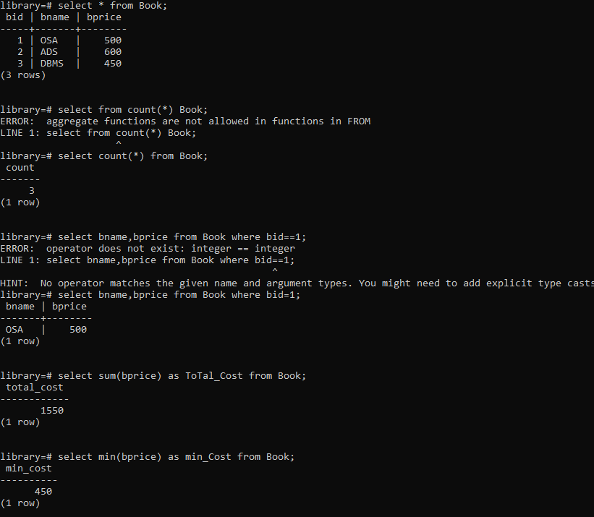
Aggregate Functions :

Slide 23
Cascade Option :
CASCADE specifies that when a referenced row is deleted, row(s) referencing it should be automatically deleted as well.
Let’s say, we have used employee_id as a foreign key.
When defining the employee_id in the child table, the delete cascade is set to ON as shown below:
employee_id INTEGER REFERENCES employees (id) ON delete cascade
The id is being fetched from the employees table and now, if the Postgres DELETE operation is applied on the parent table, the associated data will be deleted from respective child tables too.

Slide 24
Changing A column data type and default value
Changing the data type of a column using the ALTER TABLE statement in PostgreSQL.
Syntax to change column data type :
ALTER TABLE table_name ALTER COLUMN column_name [SET DATA] TYPE new_data_type;
To set a default value for a column :
ALTER TABLE <table_name> ALTER COLUMN <column_name> SET DEFAULT <value>

Slide 25
Adding and removing column
To add a new column to an existing table, you use the ALTER TABLE ADD COLUMN statement as follows:
ALTER TABLE table_name ADD COLUMN new_column_name data_type ;
The syntax to drop a column is as follows;
ALTER TABLE table_name
DROP COLUMN column_name;

Slide 26
Adding and removing constrint
Constraint :- Constraints are the rules enforced on data columns on table.
These are used to prevent invalid data from being entered into the database.
Syntax :
ALTER TABLE table_name ADD CONSTRAINT constraint_name UNIQUE constraint defination;
To remove constraint :
ALTER TABLE tbl_name DROP CONSTRAINT constraint_name UNIQUE (col_name);

Slide 27
operators
There are different type of operator available in PostgreSQL:-
Logical operator
Comparison operator
Mathematical operator

Slide 28
Schema
A schema is a named collection of tables. A schema can also contain views, indexes, sequences, data types, operators, and functions. Schemas are analogous to directories at the operating system level, except that schemas cannot be nested.
The basic syntax of CREATE SCHEMA is as follows −
CREATE SCHEMA name;
Syntax to Drop Schema To drop a schema if it is empty (all objects in it have been dropped), use the command − DROP SCHEMA myschema;

Slide 29
Create Table in Schema The basic syntax to create table in schema is as follows − CREATE TABLE myschema.mytable (...);
Advantages of using a Schema It allows many users to use one database without interfering with each other. It organizes database objects into logical groups to make them more manageable. Third-party applications can be put into separate schemas so they do not collide with the names of other objects.

Slide 30
Privileges
When an object is created, it is assigned an owner. The owner is normally the role that executed the creation statement. For most kinds of objects, the initial state is that only the owner (or a superuser) can do anything with the object. To allow other roles to use it, privileges must be granted.
There are several different kinds of privilege:
SELECT, INSERT, UPDATE, DELETE, TRUNCATE, REFERENCES, TRIGGER, CREATE, . CONNECT, TEMPORARY, EXECUTE, and USAGE.

Slide 31
Grant and Revoke privileges
Grant Privileges
To assign privileges, the GRANT command is used. So, if joe is an existing role, and accounts is an existing table, the privilege to update the table can be granted with: GRANT UPDATE ON accounts TO joe;
Revoke Privileges The special name PUBLIC can be used to grant a privilege to every role on the system. Writing ALL in place of a specific privilege specifies that all privileges that apply to the object will be granted. To revoke a privilege, use the fittingly named REVOKE command: REVOKE ALL ON accounts FROM PUBLIC;

Slide 32
Indexes
Indexes are a common way to enhance database performance. An index allows the database server to find and retrieve specific rows much faster than it could do without an index
The basic syntax of CREATE INDEX is as follows − CREATE INDEX index_name ON table_name;
Types of indexes
1) B-Tree 2) Hash
3) GIN – Generalized Inverted Index 4) BRIN – Block Range Index (only in v9.5 and above) 5) GiST – Generalized Inverted Search Tree 6) SP-GiST – Space Partitioned GiST

Slide 33
indexes
Single-Column Indexes A single-column index is one that is created based on only one table column.
The basic syntax is as follows
CREATE INDEX index_name ON table_name (column_name);
Multicolumn Indexes:- A multicolumn index is defined on more than one column of a table.
The basic syntax is as follows −
CREATE INDEX index_name ON table_name (column1_name, column2_name);

Slide 34
Unique Indexes Unique indexes are used not only for performance, but also for data integrity.
A unique index does not allow any duplicate values to be inserted into the table.
The basic syntax is as follows
CREATE UNIQUE INDEX index_name on table_name (column_name);
Partial Index
A partial index is an index built over a subset of a table
The basic syntax is as follows −
CREATE INDEX index_name on table_name (conditional_expression);

