Slide 1
ANOMALY DETECTION IN MACHINE DATA
FEBRUARY 3, 2018

Slide 2


THE TEAM
THE TEAM
MEMBERS
Garrett Cheung
Data Engineer
Michael Galarnyk
Bookkeeper
Jared Goldsmith
Record Keeper
Jillian Jarrett
External Team Coordinator
Orysya Stus
Internal Team Coordinator
ADVISORS
Dr. Yoav Freund
University of California, San Diego
Dr. Chad Holcomb
Solar Turbines

Slide 3
THE CHALLENGE

Slide 4
To detect and differentiate anomalies and ultimately predict machine failures

Slide 5
BUSINESS CASE
Allow customers to take preventative actions and reduce major failures and unplanned downtime
Save customers and Solar Turbines money: a $100,000 spent on early repairs could prevent a $1 million catastrophic failures
Help save the planet by facilitating more efficient and effective running of gas turbines
Notes:
Order of magnitude

Slide 6
SOLAR TURBINES
Manufacturing company: one of the world's leading producers of industrial gas turbines
Offers Equipment Health Management (EHM) to its customers: a technology platform designed to deliver advanced remote capabilities and decision support tools
Employer of two team members: Jillian and Garrett, who work on new capabilities for EHM
One goal of EHM is to predict and alert customers of impending machine failures
Notes:
Tie back into

Slide 7
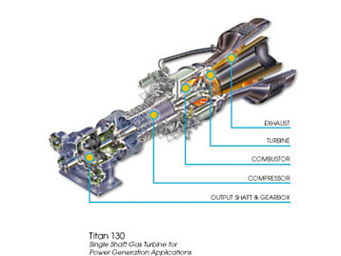
THE MACHINERY
‘Packages’ are units comprised of compressors, combustors, turbines and application specific components
Extremely complex machines with hundreds of moving parts
Single package has 200-600 features, time series data, events data, alerts data, etc
While there are over 1,900 connected packages worldwide, we are focusing on 72 packages of two different engine models
#
Notes:
A gas turbine engine is a type of internal combustion engine. Essentially, the engine can be viewed as an energy conversion device that converts energy stored in the fuel to useful mechanical energy in the form of rotational power. The term “gas” refers to the ambient air that is taken into the engine and used as the working medium in the energy conversion process.
This air is first drawn into the engine where it is compressed, mixed with fuel and ignited. The resulting hot gas expands at high velocity through a series of airfoil-shaped blades transferring energy created from combustion to turn an output shaft. The residual thermal energy in the hot exhaust gas can be harnessed for a variety of industrial processes.
Basic Components
Compressor
The compressor takes in outside air and then compacts and pressurizes the air molecules through a series of rotating and stationary compressor blades.
Combustor
In the combustor, fuel is added to the pressurized air molecules and ignited.
The heated molecules expand and move at high velocity into the turbine section.
Turbine
The turbine converts the energy from the high velocity gas into useful rotational power though expansion of the heated compressed gas over a series of turbine rotor blades.
Output Shaft & Gearbox
Rotational power from the turbine section is delivered to driven equipment through the output shaft via a speed reduction gearbox.
Exhaust: The engine’s exhaust section directs the spent gas out of the turbine section and into the atmosphere

Slide 8
THE APPROACH
Data Engineering |  |  | Computational Data Science
Data Acquisition | Preprocessing | Exploration | Comprehension | Machine Learning | Visualizing and Reporting
Identify data sources Request data Get permission from Solar | Filtering Anonymization Normalization | Data Forensics Determine correlations Identify potential anomalies | Consult domain experts Rank/assess anomaly severity Create labels | Construct a classification model using the labels we created Validate model | Summarize findings Document code and methodology

Slide 9
THE DATA

Slide 10
THE DATA
MACHINE DATA
72 packages over a 2 year timeframe (Dec 2015 - Dec 2017)
10 minute and 1 hour resolution
Primarily sensor readings: temperature, pressure, speed, displacement values
Programmable Logic Controller(PLC) commands: signals sent to the machine through the control system
Package basics: timestamps, engine hours, package serial numbers, etc
FAILURE DATA
Format and composition to be determined

Slide 11
DATA EXPLORATION
Understanding Data Format
Column headers define a tag - SUBSYSTEM_C_TAGTYPECOUNTER
SUBSYSTEM refers to the turbine section it is usually associated with
C denoted whether or not a tag is calculated versus measured (C means calculated, as is an optional argument)
TAGTYPE refers to the type of measurement being recorded
COUNTER is an incremental counter to differentiate tags with the same subsystem and tagtype. This data format will be referenced throughout this project.

Slide 12
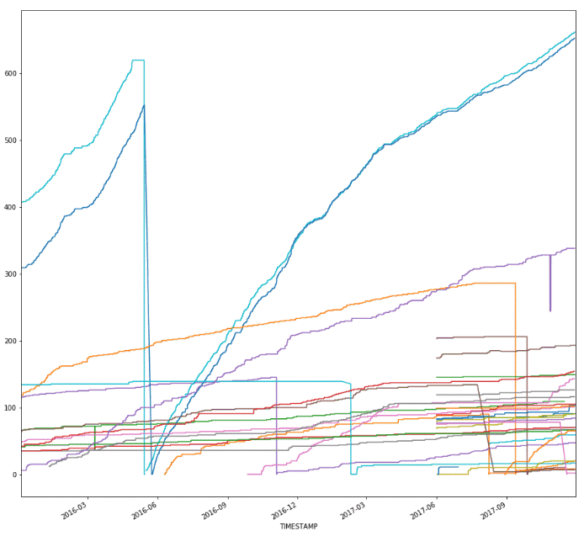
DATA EXPLORATION
Data Quality and Cleaning
 | Model1 | Model2
# records | 163544 | 257732
# tags | 145 | 77
% complete | 46.5% | 64.6%
A feature plot of SUM_ENG_ST (engine starts) is shown from model1. Each line represents a distinct package in the model.

Slide 13
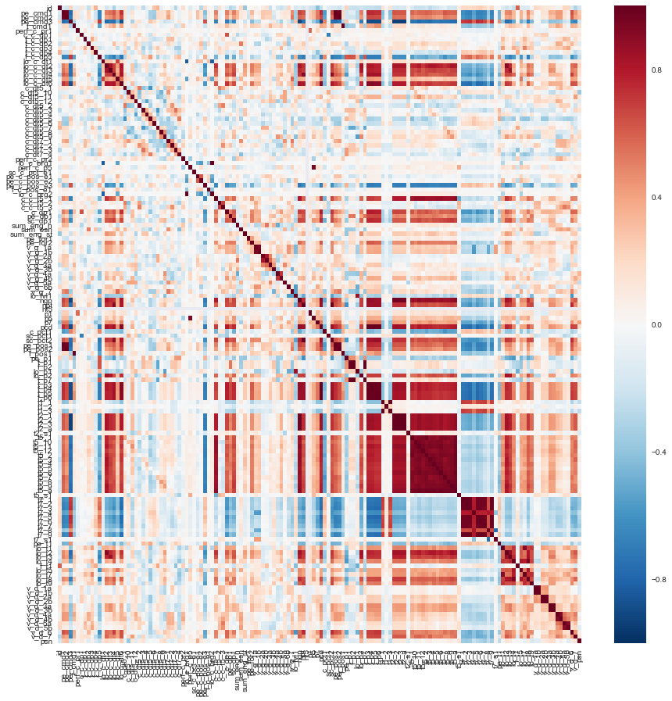
DATA EXPLORATION
Feature Correlations
Top 10 correlating pairs were mostly comprised of temperature tags, which is expected considered the temperatures should rise simultaneously
Correlation Heatmap Generated for Model1.

Slide 14
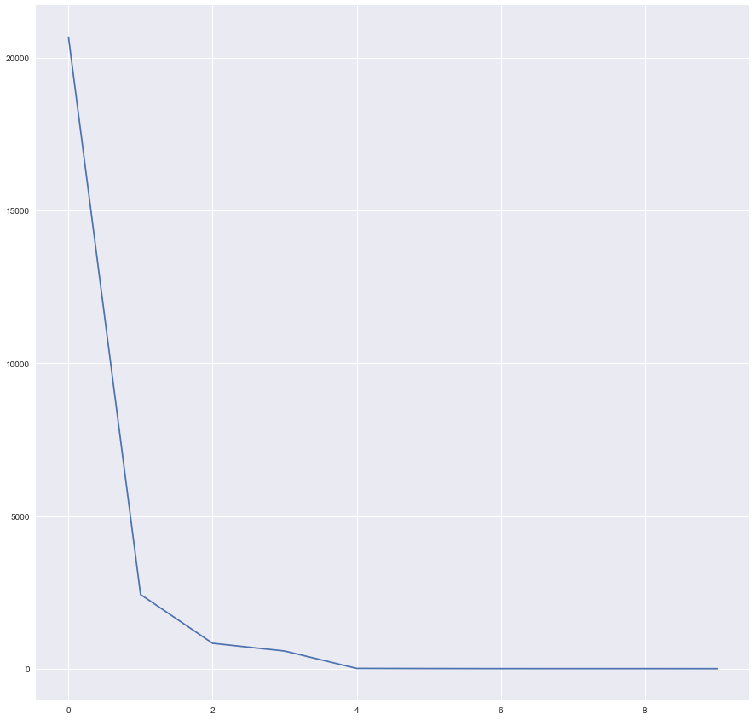
DATA EXPLORATION
Initial PCA Results
Null data was dropped
Are PCA results an artifact of the normalization completed when moving the data off of the Solar network (all the tags were normalized to be between 0 and 1 (excluding outliers), with the exception of one tag (engine starts))
PCA will be recomputed
PCA Results for Model1. The first eigenvector explains a majority of the variance.

Slide 15
THE INFRASTRUCTURE

Slide 16
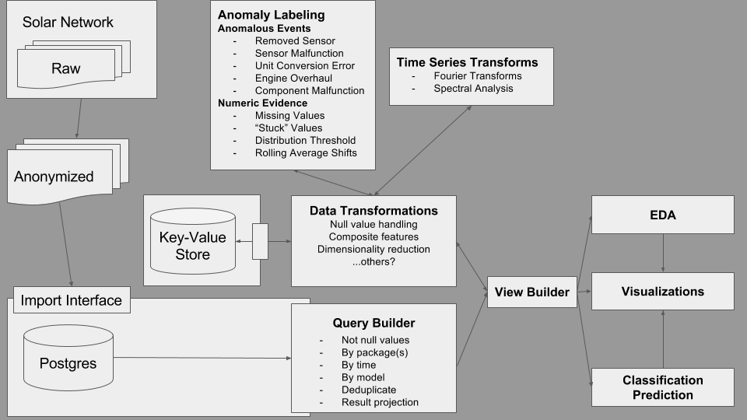
OUR PIPELINE

Slide 17
OUR DATA ENVIRONMENT
Google Colaboratory for live notebook sharing
Drawback: Virtual Machine is reset after 90 idle minutes making it extremely difficult to work with flat files
Solution: Put data into PostgreSQL Database on AWS EC2 to allow for querying of data into notebook.

Slide 18
THANK YOU

