Slide 1
H-1B JOB MARKET EXPLORER
Akshit Bhatnagar
Jared Goldsmith
Jillian Jarrett

Slide 2
BACKGROUND
The H-1B is a visa in the United States under the Immigration and Nationality Act, section 101(a)(15)(H) which allows U.S. employers to employ foreign workers in specialty occupations
Due to its accessibility and convenience, it is one of the most popular and widely sought specialty occupation visas

Slide 3
THE DATASET
Tabular dataset with details of employers’ Labor Condition Applications
https://www.kaggle.com/jonamjar/h1b-data-set-2017
Categorical Attributes
Quantitative Attributes
CASE_NUMBER
CASE_STATUS
VISA_CLASS
EMPLOYER_NAME
EMPLOYER_CITY
EMPLOYER_STATE
EMPLOYER_POSTAL_CODE
JOB_TITLE
SOC_CODE
SOC_NAME
FULL_TIME_POSITION
PW_UNIT_OF_PAY
CASE_SUBMITTED
DECISION_DATE
EMPLOYMENT_START_DATE
EMPLOYMENT_END_DATE
TOTAL_WORKERS
PREVAILING_WAGE
PW_SOURCE_YEAR
WAGE_RATE_OF_PAY_FROM
WAGE_RATE_OF_PAY_TO
ORIGINAL_CERT_DATE
NEW_EMPLOYMENT
CONTINUED_EMPLOYMENT
CHANGE_PREVIOUS_EMPLOYMENT
NEW_CONCURRENT_EMPLOYMENT
CHANGE_EMPLOYER
AMENDED_PETITION
PW_WAGE_LEVEL
PW_SOURCE
PW_SOURCE_OTHER
WAGE_UNIT_OF_PAY
H1B_DEPENDENT
WILLFUL_VIOLATOR
SUPPORT_H1B
LABOR_CON_AGREE
WORKSITE_CITY
WORKSITE_COUNTY
WORKSITE_STATE
WORKSITE_POSTAL_CODE

Slide 4
DATA FILTERING AND CLEANING
Subset of Records
Raw data: 624, 650 rows
Applied conditions detailed in table
Filtered data: 486, 755 rows
Subset of Features
Raw data: 54 columns
Filtered data: 8 columns
Data Reduction
Raw: 33,731,100 values
Filtered: 3,894,040 values
Dataset reduced by ~89%
Filters
Attribute |  | Condition
All |  | Not Null
CASE_STATUS |  | ‘Certified’
WAGE_UNIT_OF_PAY |  | ‘Year’
SOC_CODE |  | Is Valid*
VISA_CLASS |  | ‘H1-B’
WORKSITE_STATE |  | Is Valid
*SOC Code first 2 letters in https://www.bls.gov/oes/current/oes_nat.htm

Slide 5
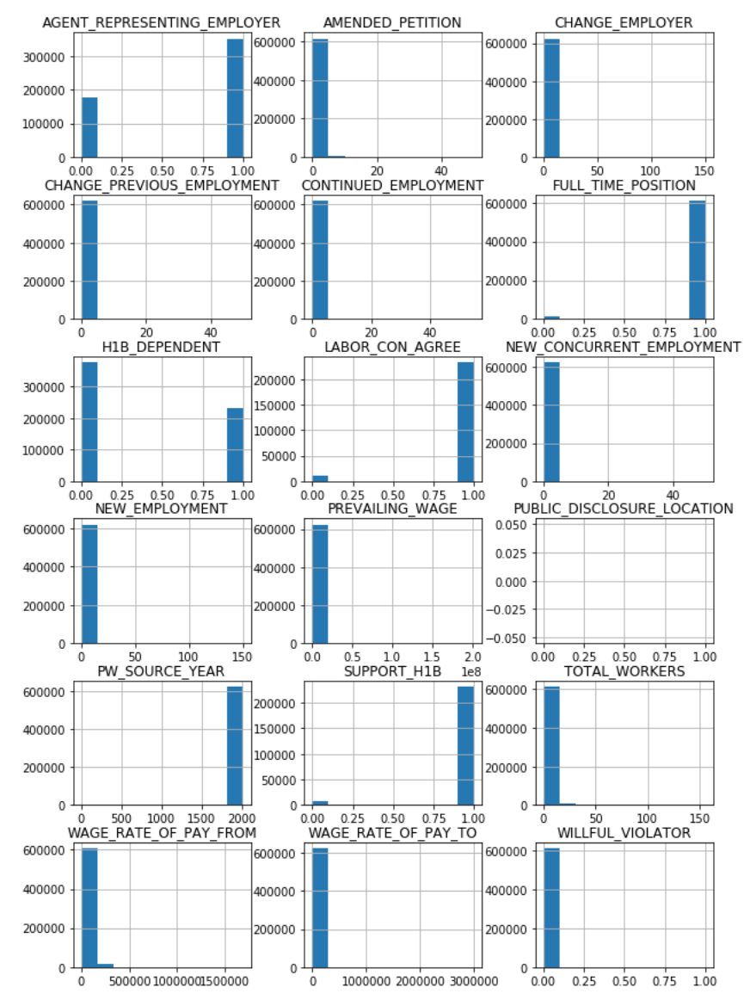
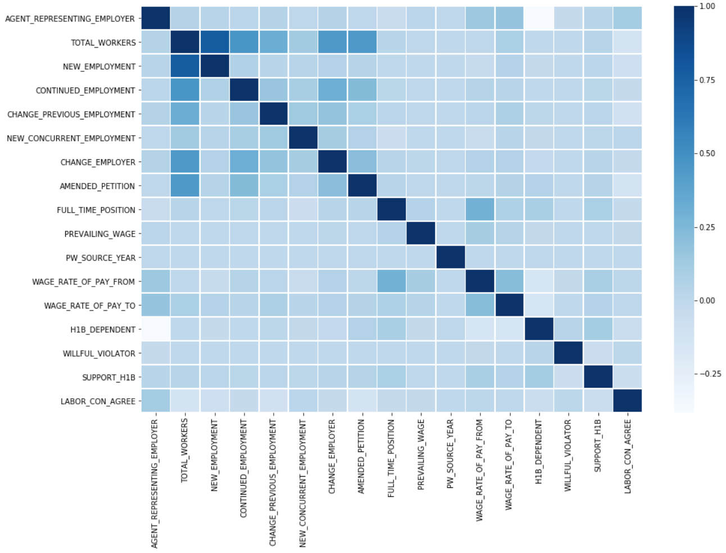
THE STRUGGLE
Correlation heatmap of raw features
Histogram of raw features
Notes:
While we wanted to unlock the mysteries of H1Bs, our dataset didn’t have the attributes to do as much as we’d initially hoped.

Slide 6
THE GOAL: BUILD AN H-1B JOB EXPLORATION TOOL

Slide 7
STAKEHOLDERS
INDIVIDUALS SEEKING TO UNDERSTAND THE H-1B JOB MARKET
SKILLED FOREIGN WORKERS
THOSE ALREADY LIVING IN THE U.S. SEEKING NEW EMPLOYMENT OR HOPING TO RELOCATE
THOSE SEEKING TO MOVE TO THE U.S.
MEMBERS OF OUR COHORT
FOREIGN WORKERS
THOSE INVESTIGATING WHICH CAREER PATHS TO PURSUE
Notes:
STAKEHOLDERS: ANALYSTS
AMERICAN CORPORATIONS (INCLUDING THEIR EMPLOYEES AND STOCKHOLDERS, CONSUMERS)

Slide 8
TASKS & TARGETS
Analyze
Consume
Discover
Distributions |  | Outliers
Similarity |  | Shape
H-1B Job Count Aggregations
Average Wages
Job Type Comparisons
By Region
By Employer
Employer Comparisons
By Job Type
By Region
Region Comparisons
By Employer
By Job Type
Search
Lookup | Locate | Browse
Query
Identify | Compare | Summarize

Slide 9
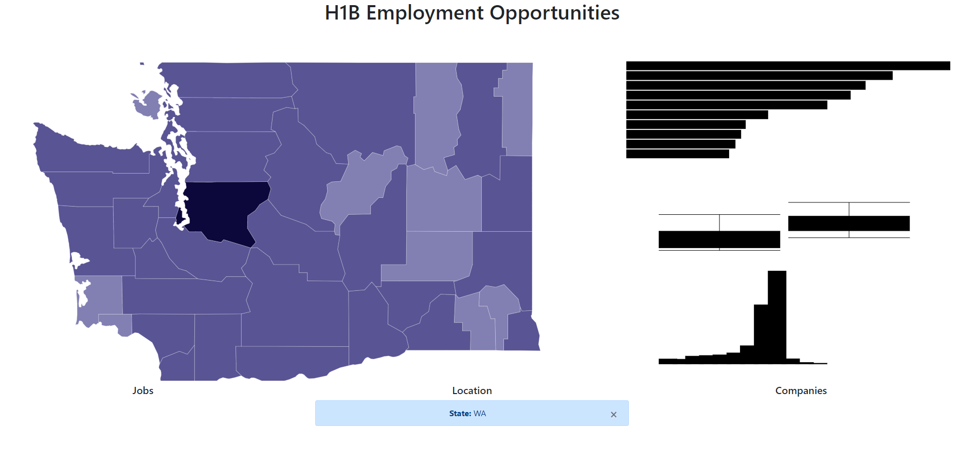
EARLY PROTOTYPE

Slide 10
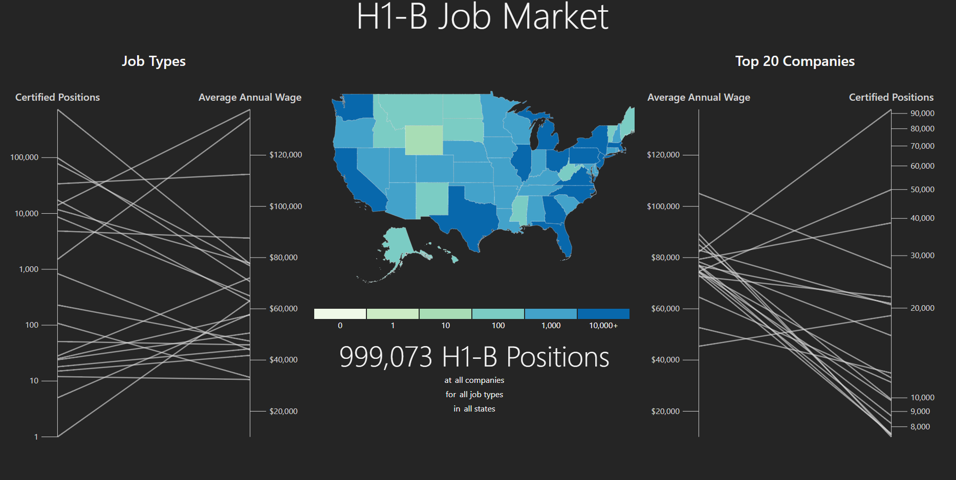
Reworked Design

Slide 11
VISUALIZATION DESIGN
Dynamic Log Scale
Shared Scale
Dynamic Log Scale

Slide 12
HOW
Interaction Capabilities
Manipulate |  | Facet | Reduce
Selecting | Navigating | Juxtapose | Filter | Aggregate | Embed
Employer Job Type Region | Region | Employer Job Type Region | Employer Job Type Region | Employer Job Type Region | Hover Over for Attribute Details

Slide 13
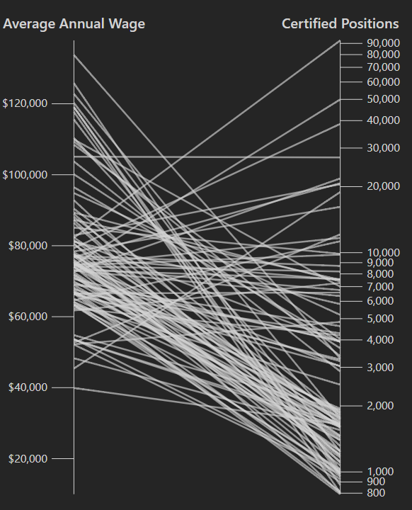
Design Limitations
Top 20 Companies by number of jobs. What about small businesses?
Individual job listings
Tick mark overlap
Bivariate choropleth?
Job Type subcategories
Direct comparisons. Needs more faceting.

Slide 14
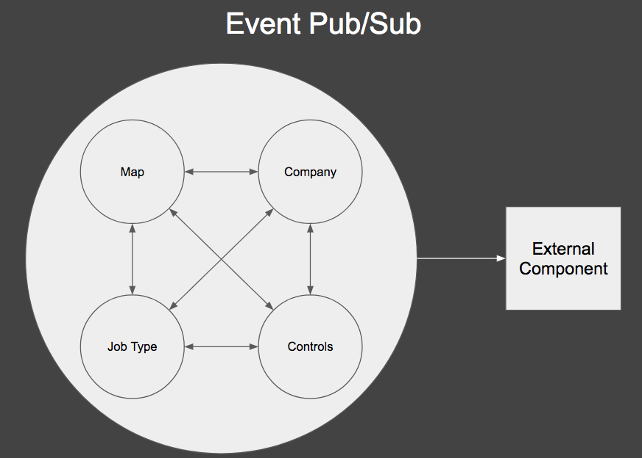
IMPLEMENTATION
CSS Styling - Bootstrap https://getbootstrap.com/
DOM Manipulation - D3 https://d3js.org/
Timestamps - Momentjs https://momentjs.com/
Topojson Data - https://github.com/deldersveld/topojson
Data Filtering - Underscore.js http://underscorejs.org/

Slide 15
FINDINGS
Highest paying jobs tend to be in Management , Legal and Healthcare Practitioners and Technical Occupations
The most plentiful jobs are in Computer and Mathematical Occupations and Architecture and Engineering Occupations
In San Diego, for example, Qualcomm applies for the most H1Bs but Synopsis Inc, pays the highest wages (on average, of the Top 20 companies shown in the dashboard)

Slide 16
DEMO

Slide 17
THANK YOU

