Slide 1
SAME GAME

Slide 2
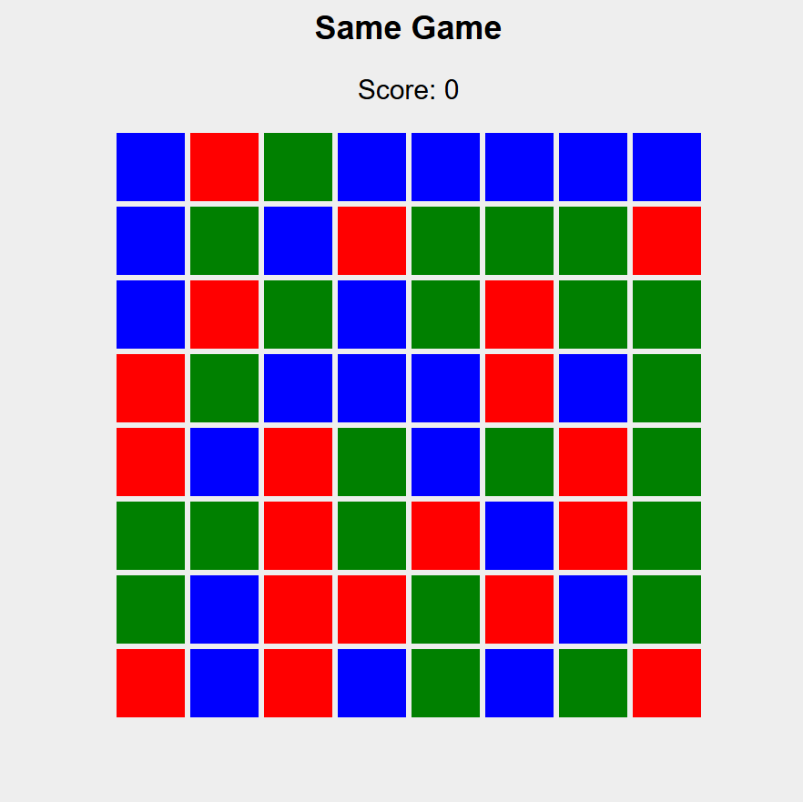
What is same game ?
Same Game is a puzzle game where:
The board has colored blocks.
You can remove connected regions of the same color (minimum size = 2).
Score depends on the size of the region removed.
After removal:
  Blocks fall down (gravity)
  Empty columns shift left
Game ends when no more valid moves exist.
👉 Goal: Maximize total score.

Slide 3
The cpu:
Finds connected regions (Graph + DFS)
Evaluates possible moves
Chooses best move using Greedy + Divide & Conquer
Repeats until no moves left

Slide 4
Graph And merge sort
Find all connected regions
Know the size of each region
Using DFS
We use DFS because the requirement for this problem is just to find the connected regions and their sizes
Then we use merge sort to arrange descending order of size

Slide 5

Greedy Algorithm
How Greedy Works in Your Game:
At every move:
CPU prefers bigger connected regions
Because bigger regions → higher score
This is a Greedy choice (best immediate reward)
In the new algorithm it gets the scores that each region present will give and arranges it in the increasing order where the largest points region is given more prefers to be removed

Slide 6
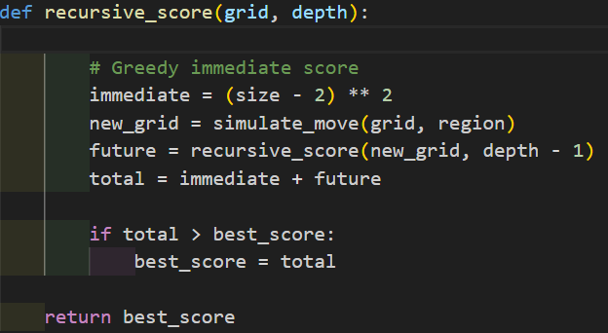

DIVIDE AND CONQUER
For each region R in sorted order:
4.1 Compute immediate score of R.
4.2 Simulate the move by removing R and applying gravity and column shift.
4.3 Recursively evaluate future score on the new board using Divide & Conquer with depth d-1.
4.4 Compute total score = immediate score + future score.
T(D)=R⋅T(D−1)+O(RN)
IN GAME:
Divide → Try one region as a move
Conquer → Solve the remaining game recursively for depth of 2
Combine → Add current score + future score
After divide and conquer the region which give the best score after combining will be removed

Slide 7

suMMARY
Greedy: Chooses the move with the highest immediate score (largest region).
Divide & Conquer: Recursively evaluates future game states to maximize total score.
Together: The AI makes locally good decisions with global awareness.

