Slide 1
Covid Deaths – An Historical Analysis
File created on: 2/15/26 9:46:52 PM EST

Slide 2
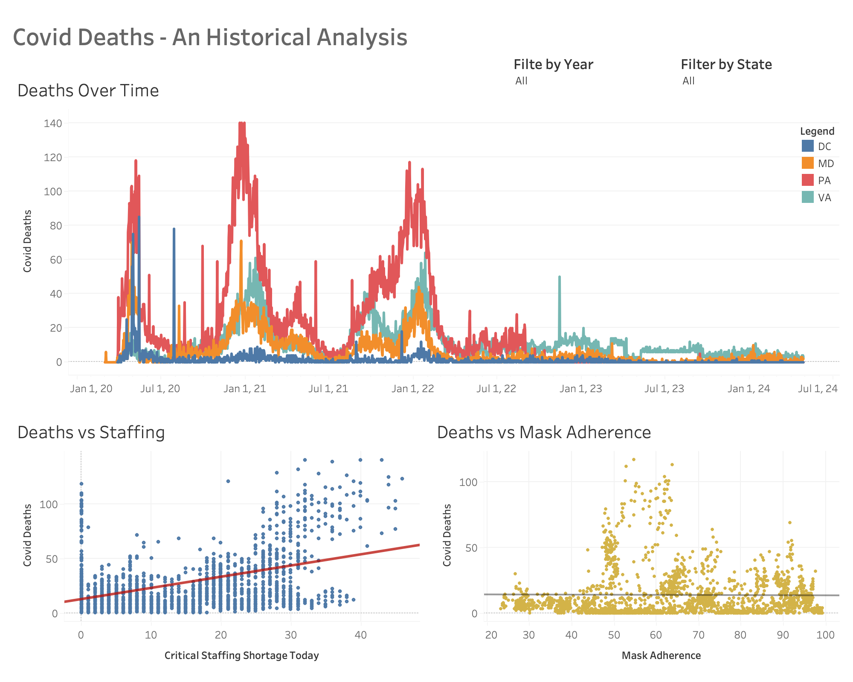

Slide 3
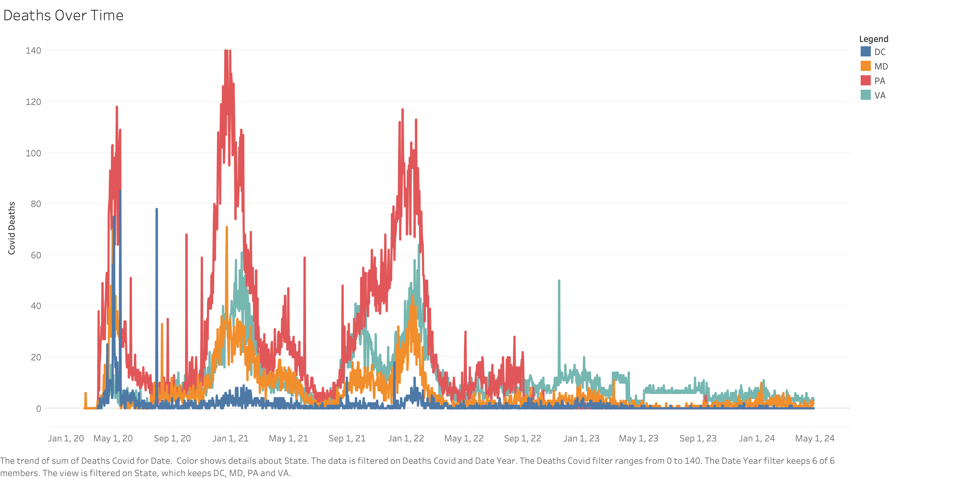

Slide 4
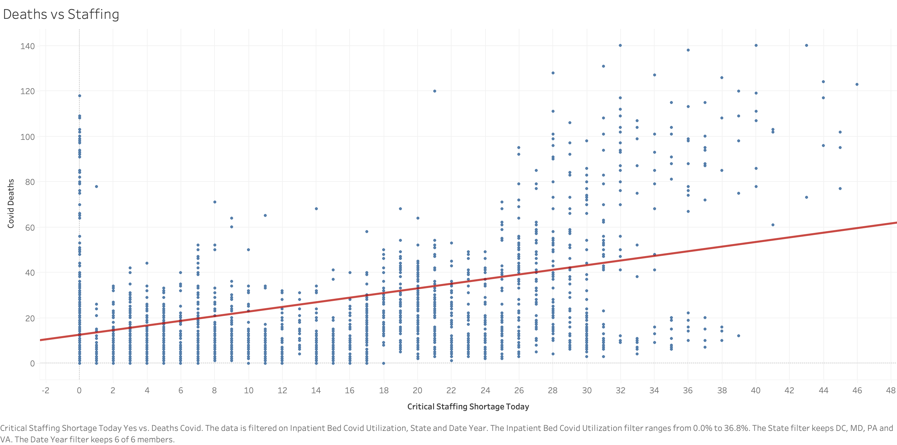

Slide 5
