Slide 1
k-Means Extensions
Big Data Systems
School of Data Science
University of Virginia
Last updated: October 1, 2025

Slide 2
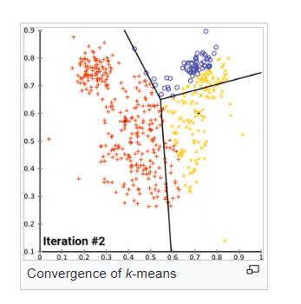
k-means
Given N observations, assign each to k groups
Each group has a centroid or balance point
Initialization is essential to result
One method is to randomly assign k points as centroids
source: Wikipedia

Slide 3
k-means Limitations
k-means does not perform well in terms of efficiency or quality
Runtime can be exponential
Can be far from global optimum even under repeated random optimization
Better initialization leads to better quality and convergence

Slide 4
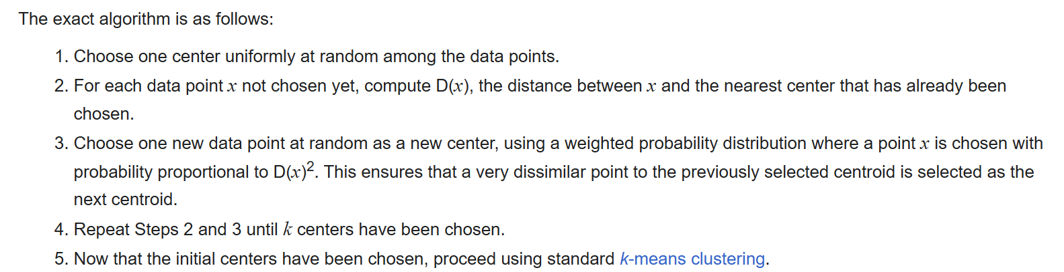
k-means++
Choose centers in a controlled fashion
Current set of centers will stochastically bias the choice of next center
Source: Wikipedia

Slide 5
k-means++ Limitation
Shortcoming: sequential in nature
Makes k passes over data to produce initial centers

Slide 6
k-means|| Overview

Slide 7
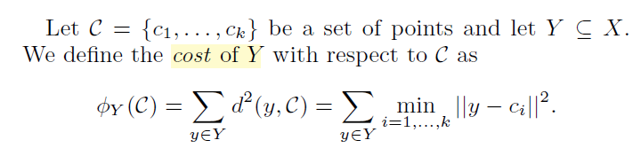
k-means|| Centroids
Note: The goal of k-means is to select centroids C that minimize cost (SSE)

Slide 8
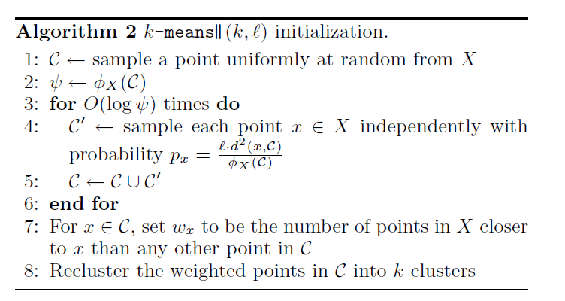

k-means|| Algorithm
Same as k-means++,
select each C to be “far” from other C’s
is an oversampling factor
that gives extra points

Slide 9
k-means|| Algorithm
Cull Cs down to size k
by weighting and clustering
Weighting:
- How many points are closest to each x in C?
- Use this value as weight for each sampled point
- After reclustering into k clusters, compute final centroids
- Note: Final centroids from averaging points in cluster. These may be different from sampled points.

Slide 10
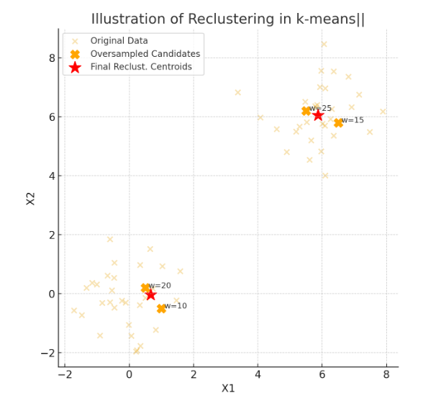
k-means|| Algorithm
Final centroids are different from sampled points

Slide 11
k-means|| Parallel Implementation
Paper uses MapReduce model for implementation
Many opportunities to parallelize:
Line 4: each mapper can independently sample
Line 7: can divide points among mappers
Calculating cost (sum of squared distances):
Distribute chunks of X to mappers
Mappers compute squared distances
Reducer adds squared distances from mappers

