Slide 1
CAP Theorem
Big Data Systems
School of Data Science
University of Virginia
Last updated: June 17, 2026

Slide 2
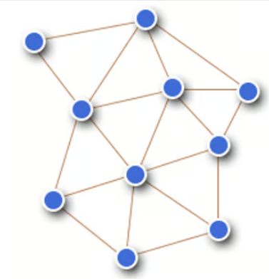
Scaling and its Challenges
When we scale from single machine to distributed system,
it makes partitions inevitable (breaks in network)
We are faced with tradeoff explained by CAP Theorem

Slide 3
Partition Tolerance
Data processing system must continue to work even if
network partition causes communication errors
between subsystems

Slide 4
Partition Tolerance
Failure causes disconnect between N3 and N4
Service 1
N1
N4
Service 2
X
N2
N3
Request by Service 2 at N4 gets stale data

Slide 5
Background on DB Transaction Models

Slide 6
Database Transactions
Transactions are a change of state performed against db
Useful for preventing issues:
- System failure prevents some work from completing

Slide 7
Database Transactions
Transactions are a change of state performed against db
Useful for preventing issues:
- System failure prevents some work from completing
- Provide isolation between programs accessing db concurrently

Slide 8
ACID
Atomicity
All steps in db transaction fully completed or reverted to
original state. Avoids partial completions.
Consistency
Guarantees that data meets predefined integrity rules

Slide 9
ACID
Isolation
New transaction waits until previous transaction finishes
before starting
Durability
db maintains all committed records even if system fails

Slide 10
BASE
Basically available
Focus on concurrent accessibility by users at all times
Soft state
Data can have transient states that may change over time
e.g., several applications may update a record simultaneously
Eventually consistent
Record will be consistent when all concurrent updates complete

Slide 11
ACID vs. BASE
ACID databases
Prioritize strict data consistency for critical transactions
Examples: Most SQL databases e.g., MySQL, PostgreSQL,
Oracle, SQL Server

Slide 12
ACID vs. BASE
ACID databases
Prioritize strict data consistency for critical transactions
Examples: Most SQL databases e.g., MySQL, PostgreSQL,
Oracle, SQL Server
BASE databases
Prioritize scalability and availability
Suitable for large-scale, distributed systems
Examples: MongoDB, Cassandra, DynamoDB, Redis

Slide 13
CAP Theorem

Slide 14
CAP Theorem
A tradeoff faced by distributed data store
Can only guarantee two of these three:
Consistency: Each read receives most recent write or an error.
All users see same data at same time.
Availability: Each request receives response.
No guarantee it contains most recent write.
Partition tolerance: System operates despite dropped/delayed
messages by network between nodes

Slide 15
CAP Theorem, contd.
When network partition happens, must decide between:
- Cancel the operation (decrease availability, ensure consistency)
- Proceed with operation (ensure availability, risk inconsistency)

Slide 16
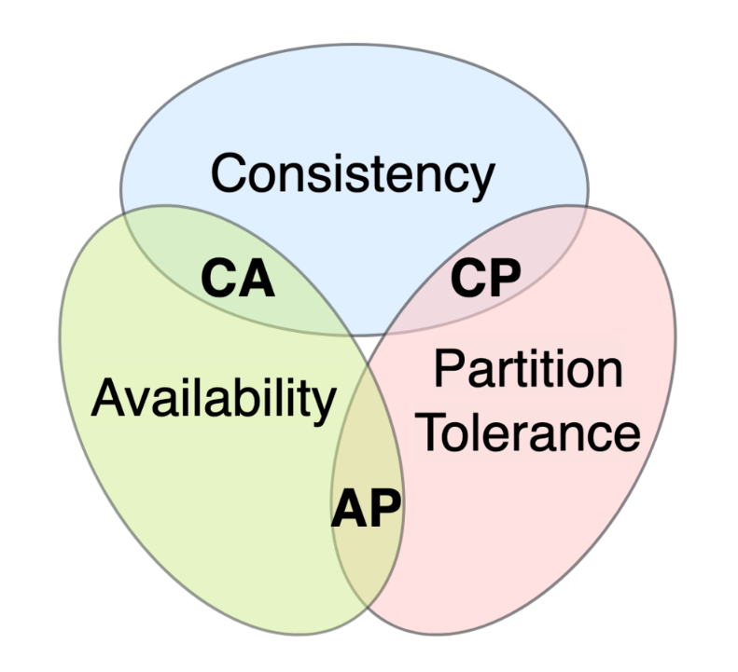
Options
Option CA: Data is not partitioned
In practice, CA distributed database cannot exist.

Slide 17
CP and AP Databases
CP: Consistency over Availability.
Traditional ACID guarantees.
Guarantee validity using transactions.
This is RDBMS like Postgres, MySQL, etc.
AP: Availability over Consistency. BASE philosophy.
BASE centers on eventual consistency.
Common in NoSQL (non-relational) database systems.

Slide 18
CP and AP Databases, contd.
What is required and what is the downside...
For CP?
For AP?

Slide 19
References
https://aws.amazon.com/compare/the-difference-between-acid-and-base-database/
https://en.wikipedia.org/wiki/CAP_theorem
https://www.linkedin.com/pulse/introduction-cap-theorem-rupesh-tiwari/
https://www.ibm.com/topics/cap-theorem

