Slide 1
Nike Financial Review (2022-2024)
Prepared by: Jade Herman, Business Analyst
JUNE 2025

Slide 2
Executive Summary:
Nike Financial Analysis (2022-2024)
Strong margins and ROE (40%) despite minimal revenue growth
EPS rose 15% YoY, driven by internal cost discipline
SG&A outpaced revenue (+5.9% vs +0.3%), pressuring margins
Liquidity and debt metrics remained strong
Key priority: control SG&A and re-accelerate top-line growth

Slide 3
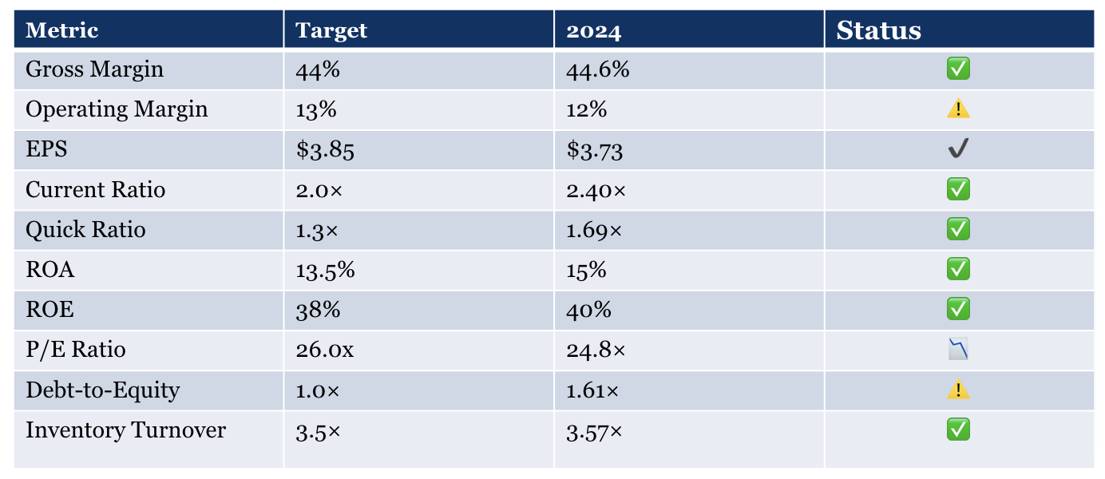
Nike KPI Scorecard – FY2024
✅ Margins remain solid
and operations are
efficient
✅ Liquidity is strong and
debt is manageable
✅ Profit growth reflects
strong internal
discipline
✅ Going forward, the
focus must shift to
revenue acceleration

Slide 4
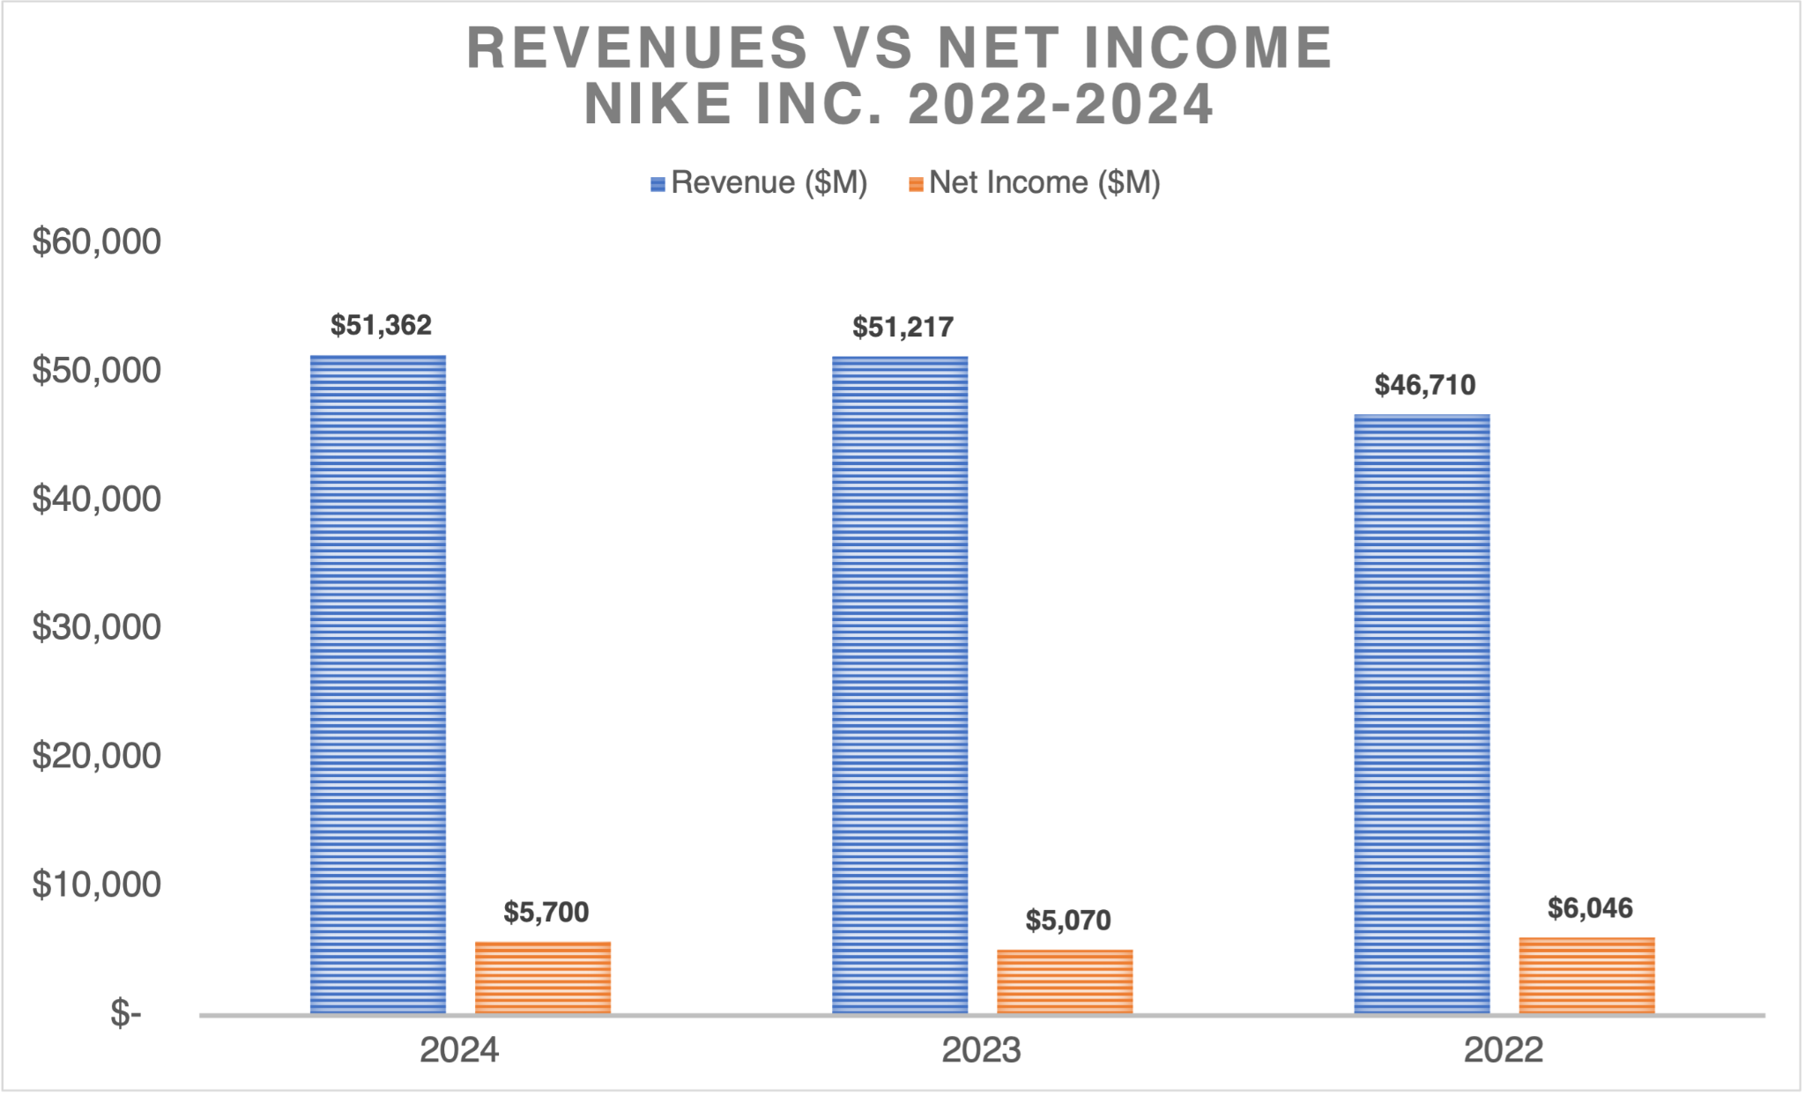
Profitability Trends
FY2022-FY2024
NIKE INC.
Margins held steady due to cost control
EPS improved despite minimal top-line growth
SG&A grew 5.9% while revenue only grew 0.3%
Earnings growth was cost-driven, not revenue-driven
📌Profit growth was powered by internal discipline
— not revenue expansion.

Slide 5
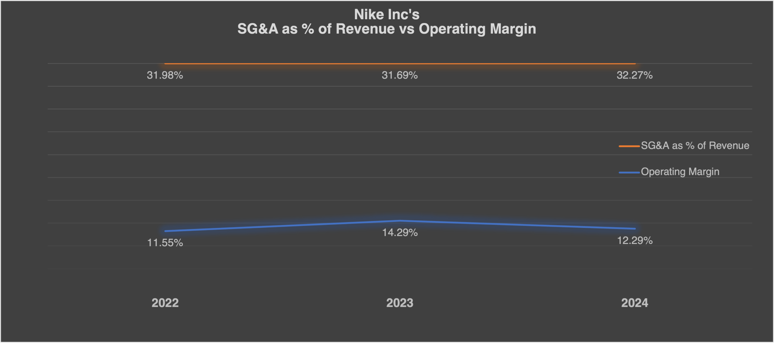
Rising SG&A Impact on Margins
FY2022-FY2024
NIKE INC.
Operating margin declined slightly in 2024
SG&A costs rose as a share of revenue
The widening gap signals rising pressure on profits
Improving SG&A efficiency is key to protecting margins

Slide 6
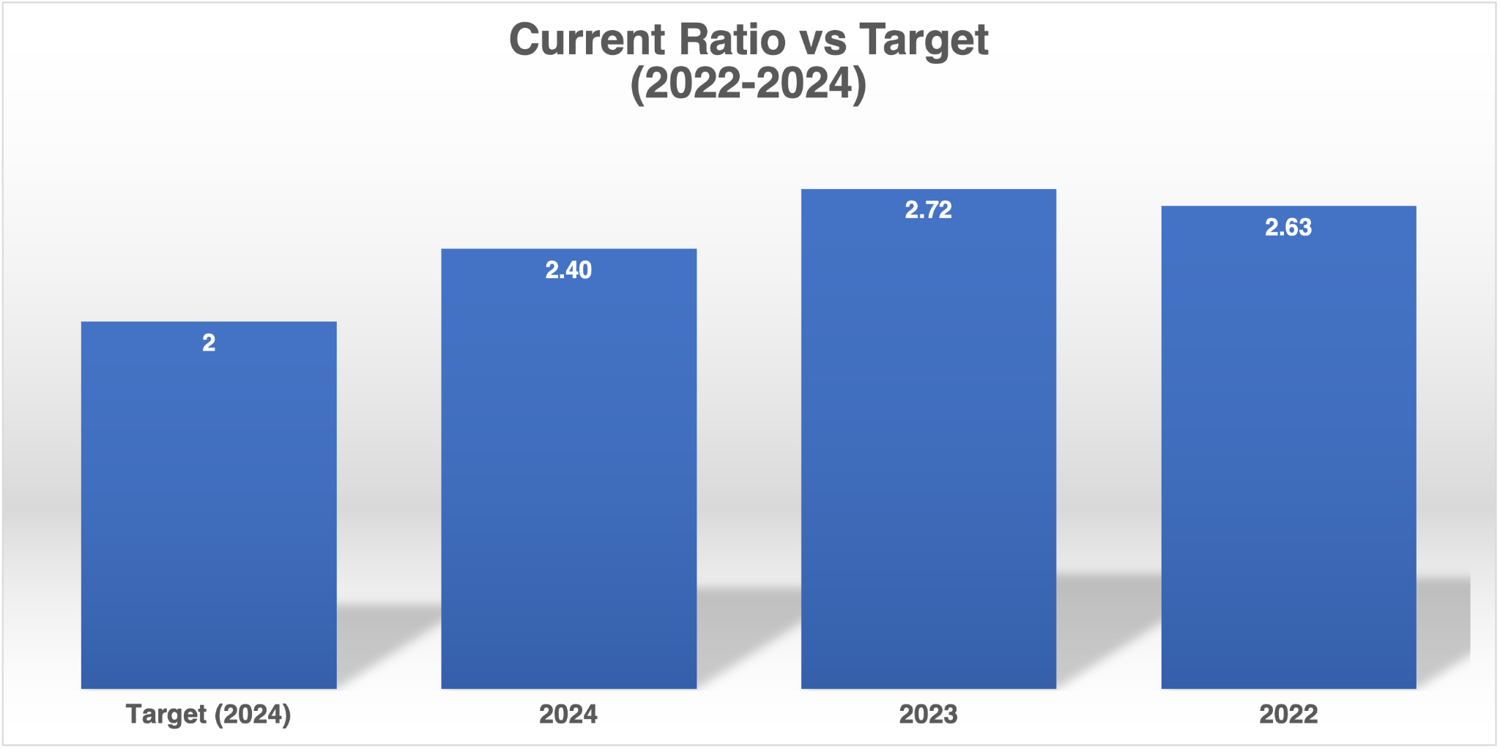
Liquidity & Efficiency
FY2022-FY2024
NIKE INC.
Current ratio: 2.40×
indicates strong short-term financial health
Inventory turnover improved to 3.6×
– stronger product flow
Quick ratio: 1.69×
– dipped slightly but remains healthy

Slide 7
Leverage & Risk Management
FY2022-FY2025
NIKE INC.
Debt-to-equity: 1.61× – moderate, stable leverage
Interest coverage: 41.6× – excellent ability to service debt
Overall leverage remains well-controlled

Slide 8
Valuation & Shareholder Focus
FY2022-FY2024
NIKE INC.
EPS up from $3.23 to $3.73 in FY2024
P/E ratio at 24.8 → investors pay ~$25 for $1 of earnings
Dividend Yield rose to 1.9% in 2024
ROE strong (40%) via DuPont: Margin × Turnover × Leverage

Slide 9
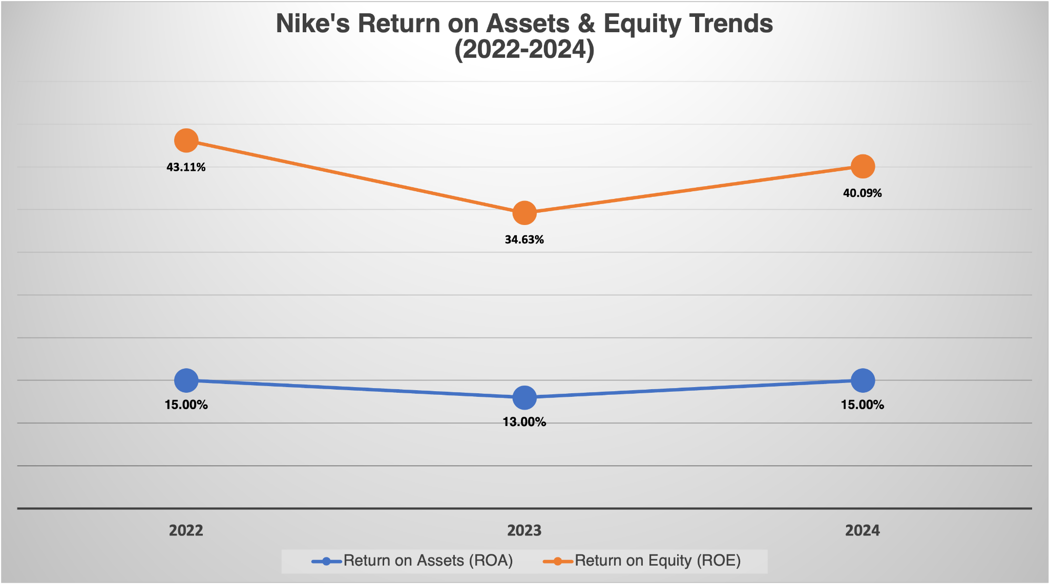
ROA vs ROE Trends
FY2022-FY2024
NIKE INC.

Slide 10
Strategic Recommendations
FY2022-FY2024
NIKE INC.
Tighten SG&A spend: focus on ROI-driven activities
Safeguard margins via pricing and supply chain efficiency
Maintain capital allocation balance
Reinvigorate revenue via DTC, innovation, digital
Monitor inventory strategy as GMROI and turnover rise

Slide 11
Final Takeaways
FY2022-FY2024
NIKE INC.
Nike showed strong financial discipline & solid shareholder returns
Next phase: re-accelerate revenue while protecting margins
The brand is well-positioned — success depends on execution

