Slide 1



Moodle-helper
Jermaine Martin • Madinakhon Makhkamboeva • Noah Forchner • Jannis schwarz

Slide 2
Key Features
Enrolment key
Favorize links
Check links

Slide 3
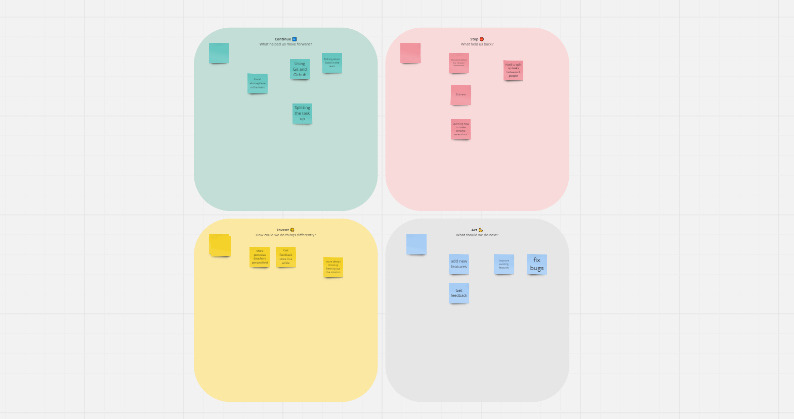
Key Features

Slide 4
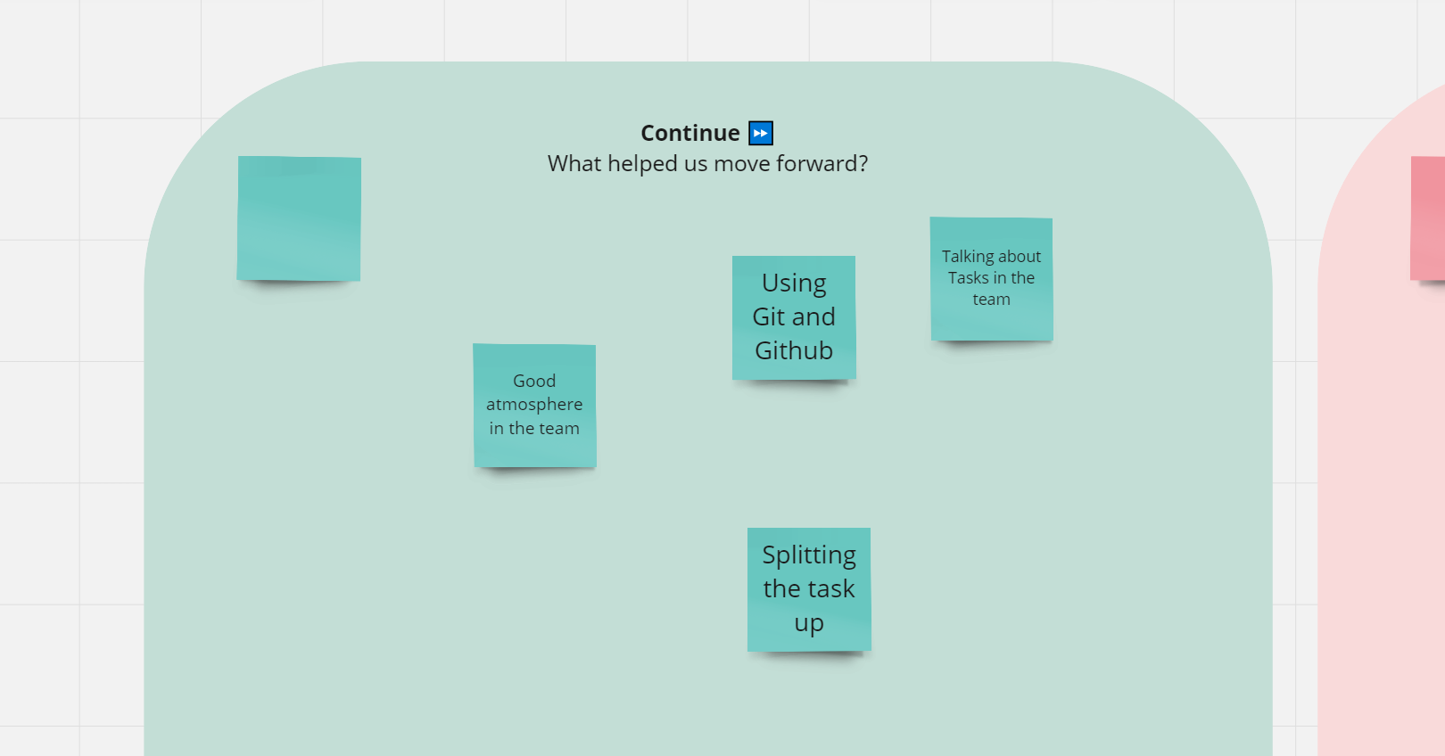
Key Features

Slide 5
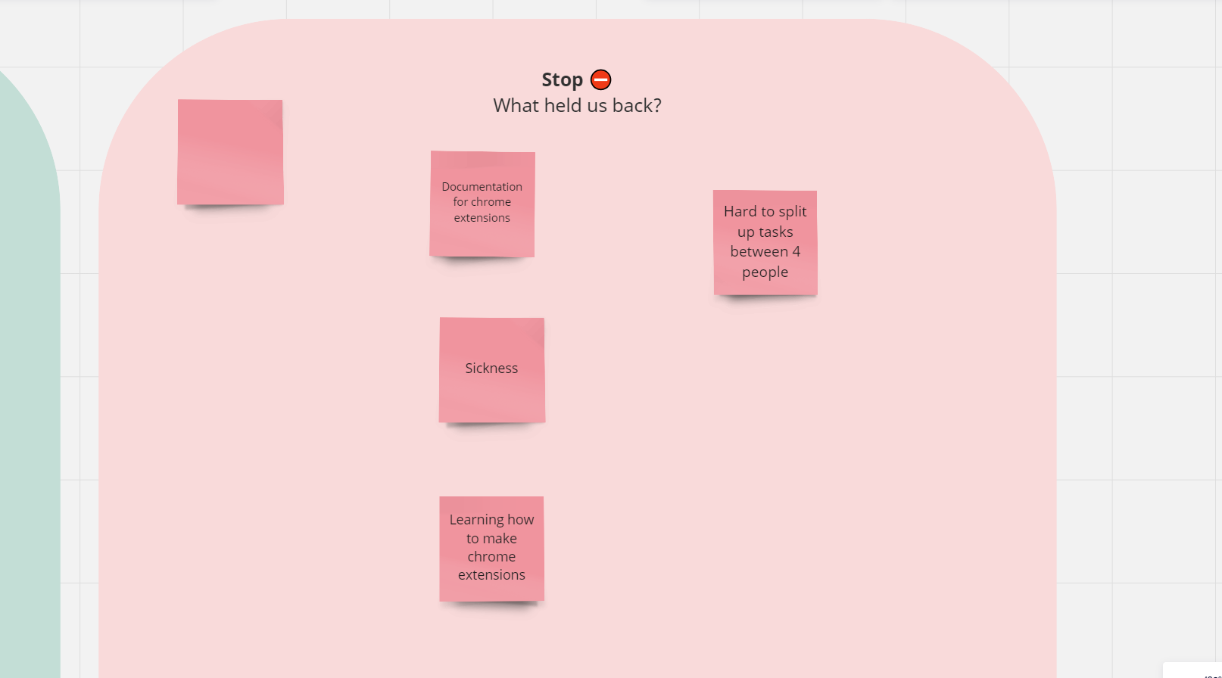
Key Features

Slide 6
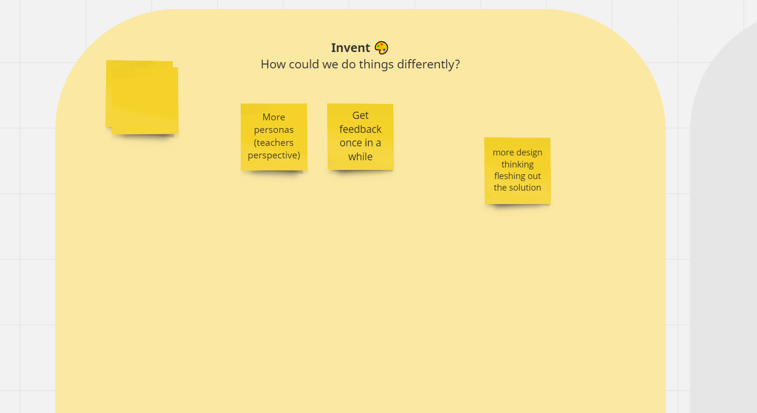
Key Features

Slide 7
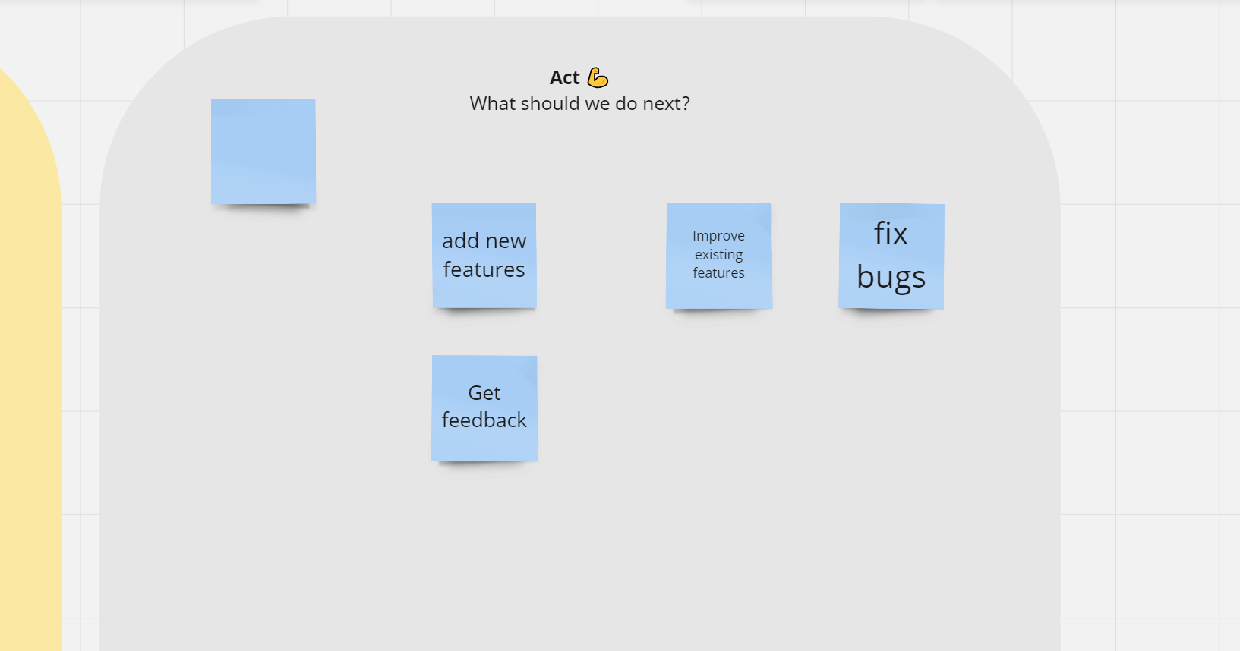
Key Features

Slide 8

What we‘ve learned
Chrome extension
Using feedback
Valuable product

Slide 9
What we‘ve learned

Slide 10

Thank you

