Slide 1
Pitstop 1 – Group 19

Slide 2
Learning goal Jermaine:
My learning goal is to be able to find an innovative solution to a real problem and to create real value for the people around us. As for now, I want to be able to write a chrome extension as well.

Slide 3
Learning goal Noah:
My learning goal for this block is, to try out something new in the space of software development and to combine that with creating something useful that may help people to be more efficient and less frustrated while learning and working with moodle. Also I want to learn a bit more about the design thinking process and how to define a Problem witch is worth creating a solution for.

Slide 4
Learning goal Jannis:
My goal for this block is to learn the process of finding a problem, working on a solution and then implementing that solution. The skills I want to improve considering our problem are working with websites and creating a Chrome web extention.

Slide 5
Think & Feel
„Learning this stuff is fun“
„Moodle is really hard to use“
„Where were the right requirements again?“
„Use the requirements on page x, not y.“
„Why do i always have to use the enrollment phrase?“
Moodle
„Finish the task until the end of the block.“
Classmates
Hear
Teachers
See
„Do we have to include this in the final product?“
Learning Material
„Can we go earlier today?“
Distracting noises
Presentations
Works on tasks
Say and do
Gain
Pain
Clear tasks
Good Education
Bad internet
Moodle is confusing

Slide 6
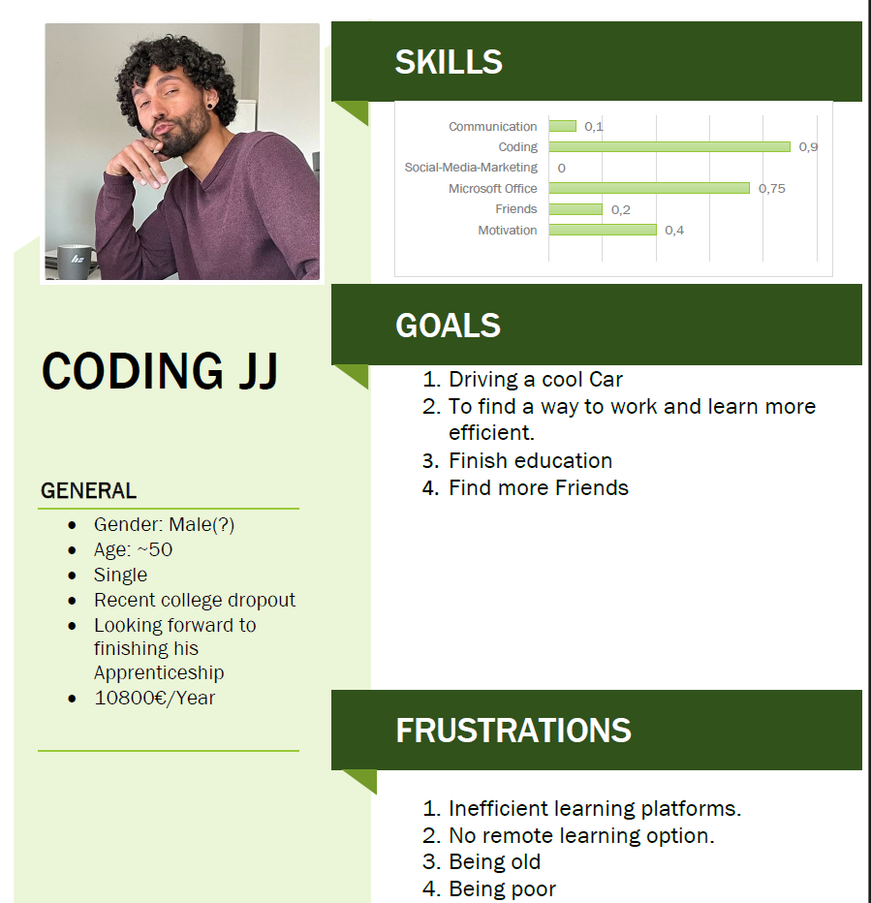

Slide 7

School is less fun than it could be
Sometimes important information gets overlooked
Navigating takes a lot of time
Discomfort
Navigating takes up brain capacity
Moodle is hard to use
Enrollment phrase is needed and hard to remember
There is no option for personalized organisation of things
Messy organisation
Behaviour of links is not predictable
Relevant links are all over the place

Slide 8
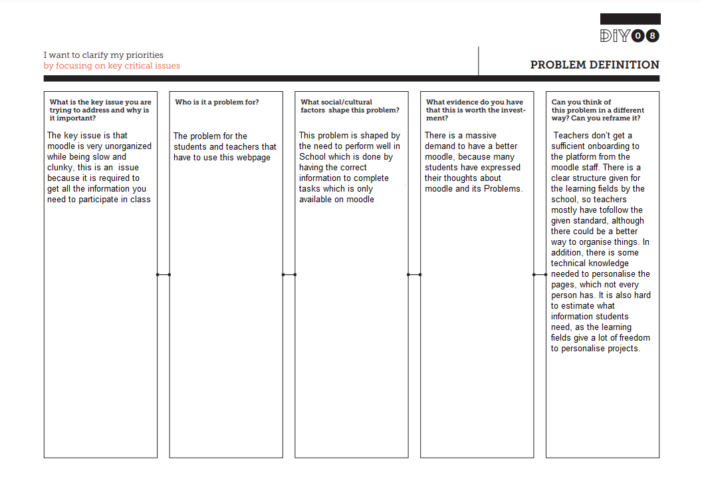

Slide 9
Problem Definition Feeback:
The project under consideration is incredibly intriguing as it seeks to address the challenges associated with enhancing the Moodle learning platform. What sets this particular project apart is its dedication to improving an essential educational tool that plays a significant role in the lives of students and educators. This endeavor holds real-world significance, resonating deeply within the field of online education and e-learning. The commitment to finding alternatives and solutions for making Moodle more effective and user-friendly is commendable. This technical innovation aimed at enhancing the Moodle experience is not only interesting but also visionary, as it has the potential to positively impact the education sector. Your efforts in this direction make this project particularly exciting and promising.

