Slide 1
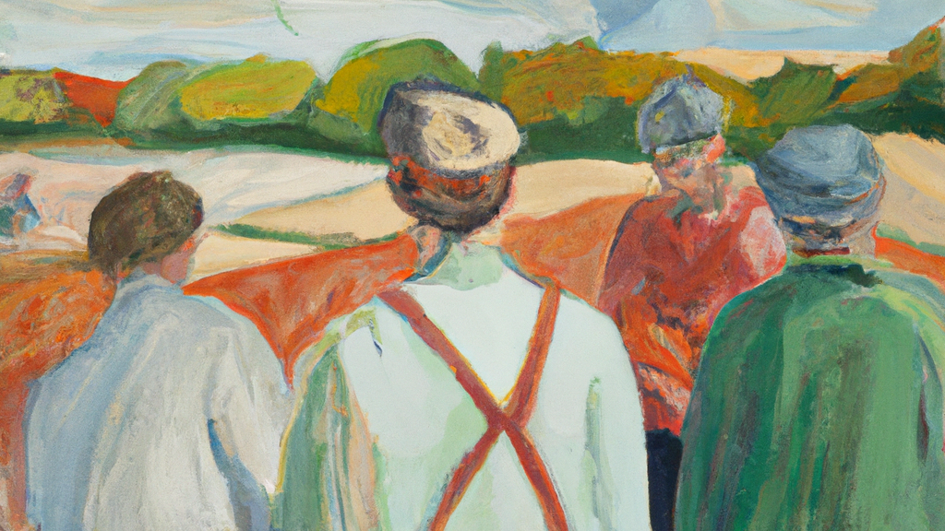
Who is Who
Natural Language Processing applied to Swedish Historical BIographies

Slide 2
Outline
Purpose
Source
Steps
Examples
Descriptive statistics

Slide 3
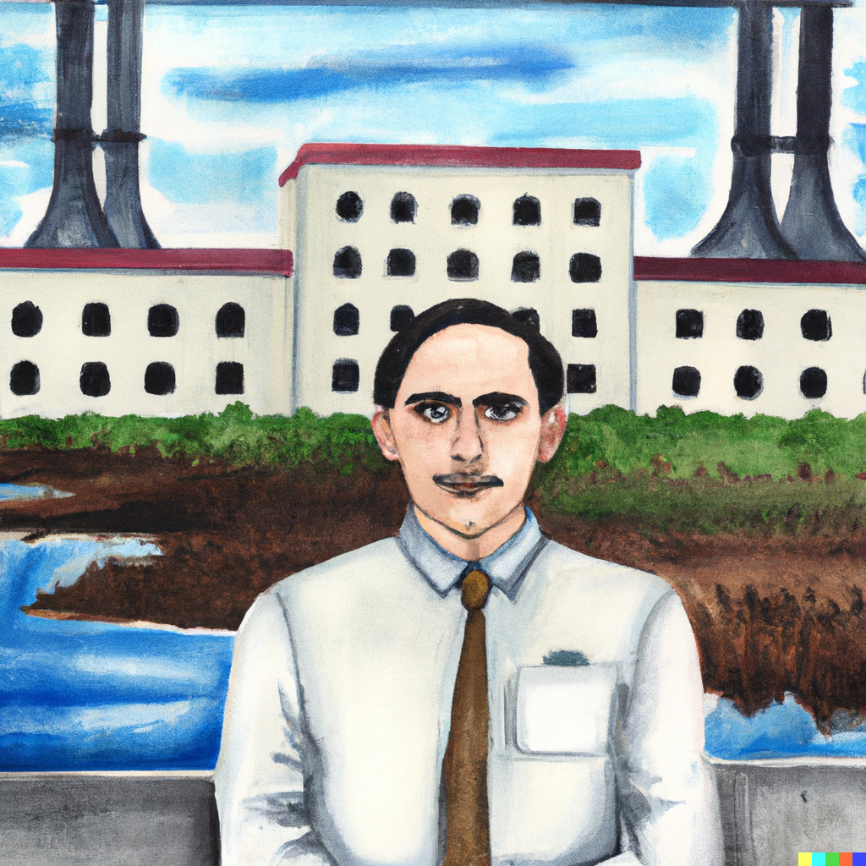
Purpose
How important is specific education or training during the second industrial revolution in Sweden?
Notes:
We know that to be a doctor and a dentist you need to have a university degree from a medical school.
We know that there are many surveyors and engineers produced.
But for electricity, how much on the job training can you get that can take the place of electricity?

Slide 4
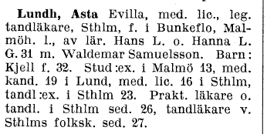
Source of historical biographies
Vem är Vem is a Swedish biographical encyclopedia that was published in two editions of five volumes each in 1945–1950 and 1962–1968 by Bokförlaget Vem är Vem.
The intention was, according to the publishers, to draw attention to people who were at the height of their activities, even if they were younger in influential or otherwise noted positions in different areas
We get career trajectories!
Digitized by librarians in Uppsala

Slide 5
NLP Challenges
Many abbreviations
Similar structure for each entry but not exactly the same information in the same order

Slide 6
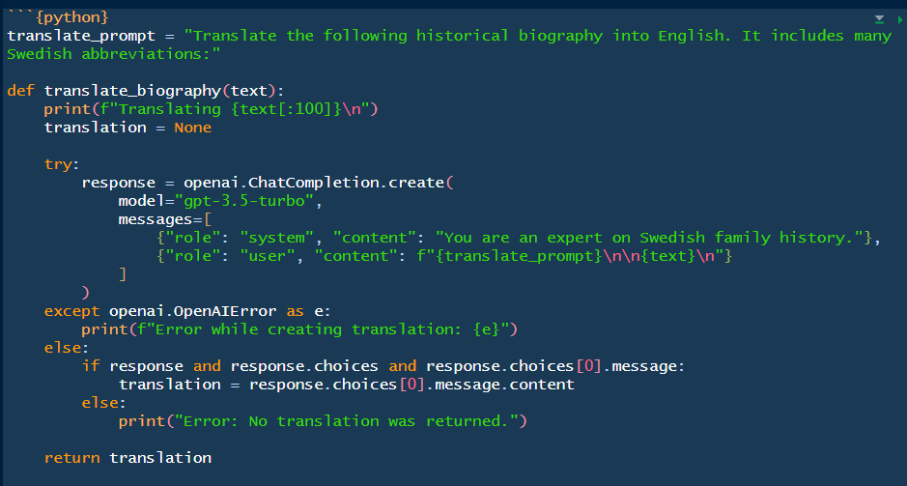
Steps
Translate
Structure
Augment

Slide 7
Translate
OCR - text
Lundh, Asta Evilla, med. lic., leg. tandläkare, Sthlm, f. i Bunkeflo, Malmöh. l., av lär. Hans L. o. Hanna L. G. 31 m. Waldemar Samuelsson. Barn : Kjell f. 32. Stud:ex. i Malmö 13, med. kand. 19 i Lund, med. lic. 16 i Sthlm, tandlrex. i Sthlm 23. Prakt, läkare o. tandl. i Sthlm sed. 26, tandläkare v. Sthlms folksk. sed. 27.
English Translation
Lundh, Asta Evilla, M.D., licensed dentist, Stockholm, born in Bunkeflo, Malmöhus County, daughter of the teachers Hans L. and Hanna L. G., married to Waldemar Samuelsson. Children: Kjell (born 1932). She passed her high school exam in Malmö in 1913, received her medical degree in Lund in 1919, obtained her license to practice medicine in Stockholm in 1916, and received her dentistry diploma in Stockholm in 1923. She practiced as a medical doctor and dentist in Stockholm from 1926 and worked as a dentist at Stockholm's Public School since 1927.

Slide 8
Tips for getting the GPT to work well
Give context
“You are an expert in Swedish family history”
Improved the translation of contractions and abbreviations
Provide structure
Be specific in the content that you want to get back
“* Include startDate and endDate wherever possible.”
“* Only provide a RFC8259 compliant JSON response”

