Slide 1
GENED 1079 Section 4

Slide 2
Agenda
Review of economics of pharmaceuticals (~30 min)
Practice problem (~45 min)

Slide 3
Quick pulse check – who has taken Ec10?
Notes:
For the TF

Slide 4
Economics of pharmaceuticals: Basics
Price – what the drug company receives for each unit sold.
Copay – what an insured patient pays out of pocket for each unit sold. The insurer pays the rest (price – copay).
Willingness to pay – the most a person would be willing to pay for that drug. Above that price, they won’t buy.
  Depends on how much they value the drug
  … and on what they can afford: money spent on a drug can’t go towards rent or food (opportunity cost)
  Also includes willingness to let others (i.e. insurance) pay

Slide 5
Economics of pharmaceuticals: Basics
Demand: How many units people will buy at each price (based on willingness-to-pay)
Supply: How many units the company will sell at each price.
Companies want to maximize (expected) profits:
Π=(𝑃− 𝑀)∗𝑄−𝐹
P = price that the company charges per units
M = marginal cost, i.e., the cost to make one more unit
Q = number of units sold at that price
F = fixed costs, i.e., upfront costs (R&D, clinical trials) paid no matter how many units sell

Slide 6
Understanding the Profit Formula
Profits of pharmaceutical companies: Π=(𝑃−𝑀)∗𝑄−𝐹
P = price, M = marginal cost, Q = quantity demanded/supplied, F = fixed costs
What are examples of fixed costs?
What are examples of marginal costs?
Which costs matter for deciding whether to develop a drug?
Which costs matter for deciding how to price a drug?

Slide 7
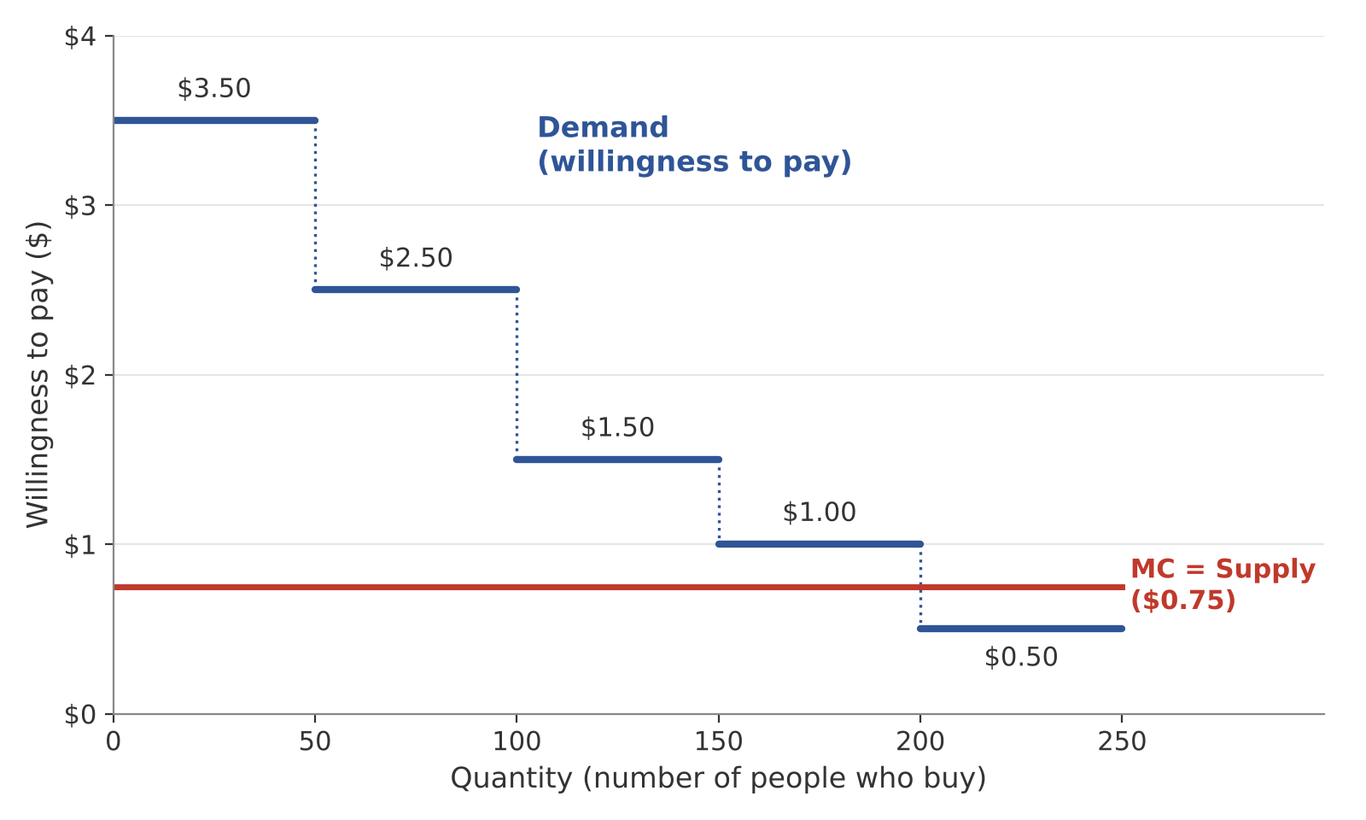
Understanding “Willingness to Pay”
Imagine 250 people, lined up from highest to lowest willingness-to-pay. (Assume each person wants to buy 1 unit.)
Each step = a group of 50 people with the same WTP.
The red line (MC) = the cost to make one more unit

Slide 8
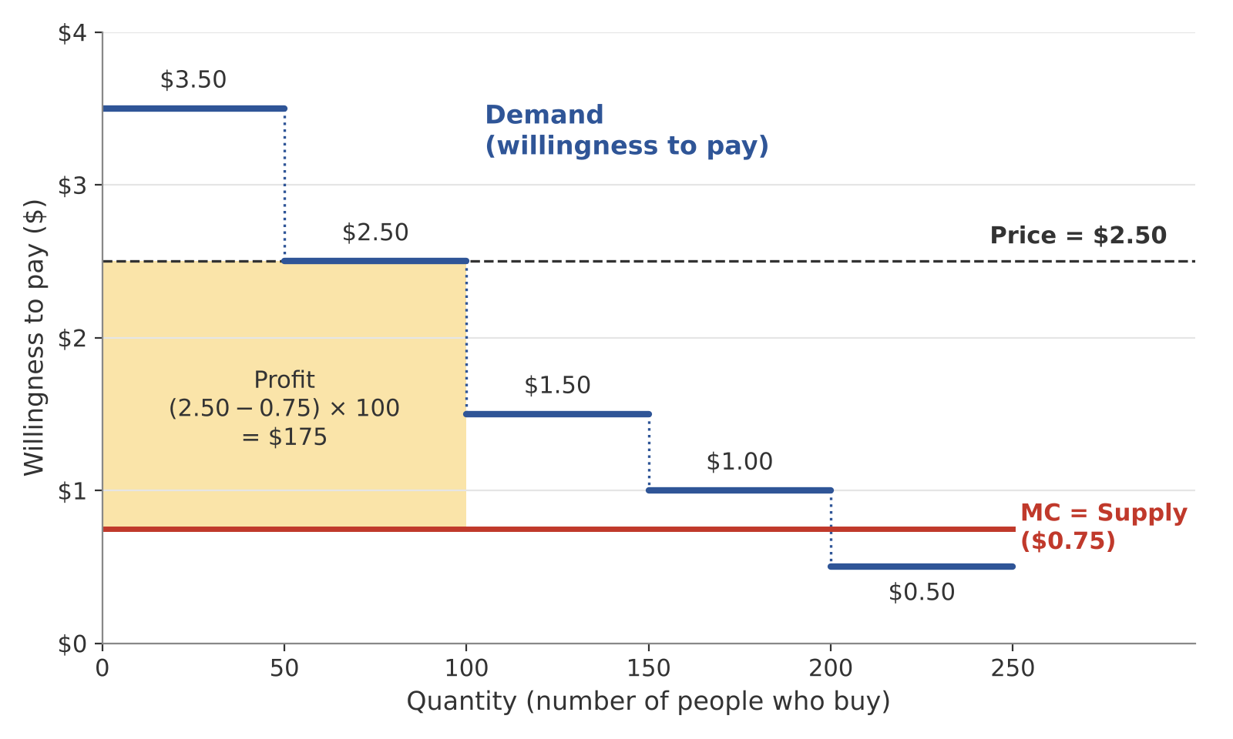
Choosing one price
The company usually can’t charge each person a different price, so it picks one price for everyone.
Price | Units | Profit = (Price- MC) * Units
$3.50 | 50 | $137.50
$2.50 | 100 | $175 ← best
$1.50 | 150 | $112.50
$1.00 | 200 | $50
$0.50 | 250 | Loses money
Tradeoff: a higher price means more profit on each unit, but fewer buyers.

Slide 9
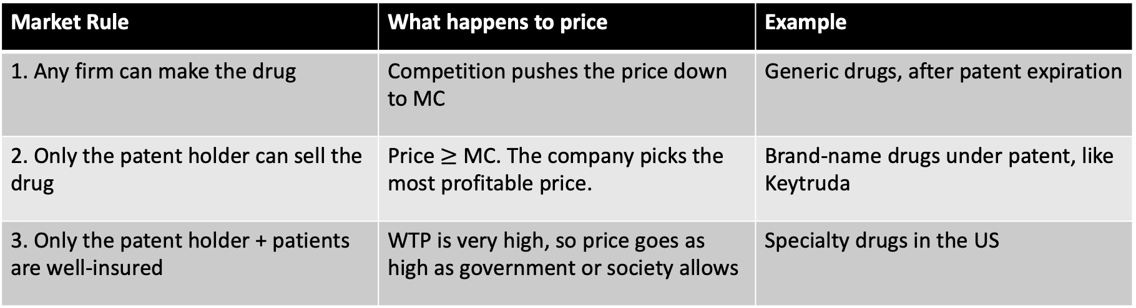
Who sets the price?
Recall market rules from lecture:
Company’s dream: Charge each person their own WTP.
  → We’ll explore this in the practice problem!
Market Rule | What happens to price | Example
1. Any firm can make the drug | Competition pushes the price down to MC | Generic drugs, after patent expiration
2. Only the patent holder can sell the drug | Price $≥$ MC. The company picks the most profitable price. | Brand-name drugs under patent, like Keytruda
3. Only the patent holder + patients are well-insured | WTP is very high, so price goes as high as government or society allows | Specialty drugs in the US

Slide 10
Is a drug worth its price?: cost-effectiveness
Value of a statistical life year in the US?
  Common rule of thumb: $100,000 per year in perfect health (i.e., change in health)
Two ways to ask the same question:
Example from lecture: Provenge costs $93,000 and adds 4 months (⅓ year) of life
  Benefit = ⅓ × $100K ≈ $33K, which is less than the $93K price ✗
  Cost per year = $93K ÷ ⅓ = $279K, which is more than $100K ✗
  → Not cost-effective, and both methods agree
 | Calculate | Worth it if…
Benefit vs. price (lecture) | Benefit = Years Gained x $100k | Benefit > Price
Cost per year gained | Price + Years Gained | Cost per year < $100k

Slide 11
Practice Problem Prompt
There are about 1-2 million of people living with melanoma (skin cancer) in the US. One person dies of melanoma every hour. New cancer drugs, called checkpoint inhibitors, remove the ability of some cancer cells to hide from the immune system. One checkpoint inhibitor, Keytruda, manufactured by Merck, increases survival of cancer patients significantly. In a clinical trial using Keytruda against melanoma, while the life expectancy of people not taking the drug was about 1 year, people taking the drug lived on average 3 years (this is simplified here for the purpose of this exercise). Some patients have been completely cured.
Assume that the development cost (the fixed cost) for Keytruda was $2.6 billion and the manufacturing cost is $1000 for the entire course of treatment. Assume that people’s willingness to pay for Keytruda varies with the seriousness of the disease in the following way: for people with advanced metastatic cancer, Keytruda may be the only promising treatment option, and they are willing to pay more than people with less advanced forms of the disease.

Slide 12
Part 1: Merck can only charge one price
In the following exercise, consider a population of 10,000 people and ignore the fixed costs.
  400 have advanced metastatic cancer and are willing to pay $300,000
  600 have a less advanced form of cancer and are willing to pay $100,000
  1,000 have a less advanced form of the disease and they are not insured and are willing to pay $1,000.
  1,000 have a less advanced form of the disease and they are not insured and are willing to pay $500.
Q1: On a graph with quantity on the X axis and price on the Y axis, draw the supply and demand curves.
Q2: What price will Merck charge? Who gets Keytruda?

Slide 13
Part 2: Merck can charge different prices
Now, Merck can charge different prices to different groups for the same drug. Assume Merck can stop people from reselling it.
In the following exercise, consider a population of 10000 people and ignore the fixed costs.
  400 have advanced metastatic cancer and are willing to pay $300,000
  600 have a less advanced form of cancer and are willing to pay $100,000
  1,000 have a less advanced form of the disease and they are not insured and are willing to pay $1,000.
  1,000 have a less advanced form of the disease and they are not insured and are willing to pay $500.
Q1: What price will Merck charge each group? What are its total profits? Who gets Keytruda now?
Q2: Does Merck make more profits when it can charge one price or differentiated prices?
Q3: Give one pro and one con of differentiated pricing for Merck, and one each for patients.

Slide 14
Part 3: Is Keytruda cost-effective?
Recall:
  Price is $300k (from Part 1)
  Life expectancy without Keytruda: 1 year
  Life expectancy with Keytruda: 3 years
Q1: Calculate the cost per year of life gained
Q2: Is Keytruda cost-effective, based on the value of a statistical life from class (~$100k per year)?
Q3: What are the pros and cons of an insurer or national health plan using cost-effectiveness to decide whether to cover Keytruda?

Slide 15
Wrap up
Any questions?
Reminders:
  Problem set 2 is due on Oct 12 (Mon) at 5pm.
  Unit 2 assignment is due on Oct 23 (Fri) at 5pm.

Slide 16
Appendix

Slide 17
Understanding “Willingness to Pay”
Willingness to pay (dollars)
W_{rich}
Willingness to pay of rich
Imagine that the X-axis is a group of 100 people, ordered by the amount of money they’d pay for your product:
the left-most person would offer to pay the most and the right-most person would offer to pay the least
W_{poor}
Willingness to pay of poor
MC
Quantity

Slide 18
Understanding “Willingness to Pay”
Willingness to pay (dollars)
W_{rich}
Willingness to pay of rich
Our firm can’t sell for less than MC (marginal cost); otherwise, we will lose money at any quantity
W_{poor}
Willingness to pay of poor
MC
Quantity

