Slide 1
GENED 1079 Section 3 Confidence Intervals

Slide 2
Agenda
Review of confidence interval concepts
Confidence interval practice questions
  Practice Question 1
  Practice Question 2
Group Activity

Slide 3
Confidence Intervals – Review
95% confidence interval is:
The range of values we are 95% sure some true population parameter lies in between, given our assumptions about the data we observe (e.g., it was randomly collected).
  Or: the range of values that is likely to include a parameter that we are trying to estimate from a sample. It means that there if the experiment or test was repeated 100 times, 95 of those would contain the true population parameter we are trying to estimate.
It is based on 3 elements:
  (1) The estimate, (2) how much the data varies, and (3) the sample size.
How can you get a more accurate estimate of the confidence interval:
  Increase the sample size
Notes:
A confidence interval gives us a range of plausible values for the true population parameter. It’s not saying there’s a 95% chance the parameter itself moves around; the parameter is fixed, but our interval from the sample varies.
The estimate: mean, proportion, etc.

Slide 4
Central Limit Theorem – Review
Central Limit Theorem (CLT) states that…
  As the sample size grows, the distribution of sample means converges to a normal distribution. This is what we typically use to calculate confidence intervals.
What do we use CLT and confidence intervals for?
  We can use confidence intervals for statistical tests (e.g., are patients taking drug X more likely to experience viral suppression from HIV than patients taking drug Y?)
  To tell how “good” an estimate is → larger CI means more caution must be taken
Notes:
Intuition: CLT connects sample data to population inference. It’s the bridge that lets us do inference in practice.

Slide 5
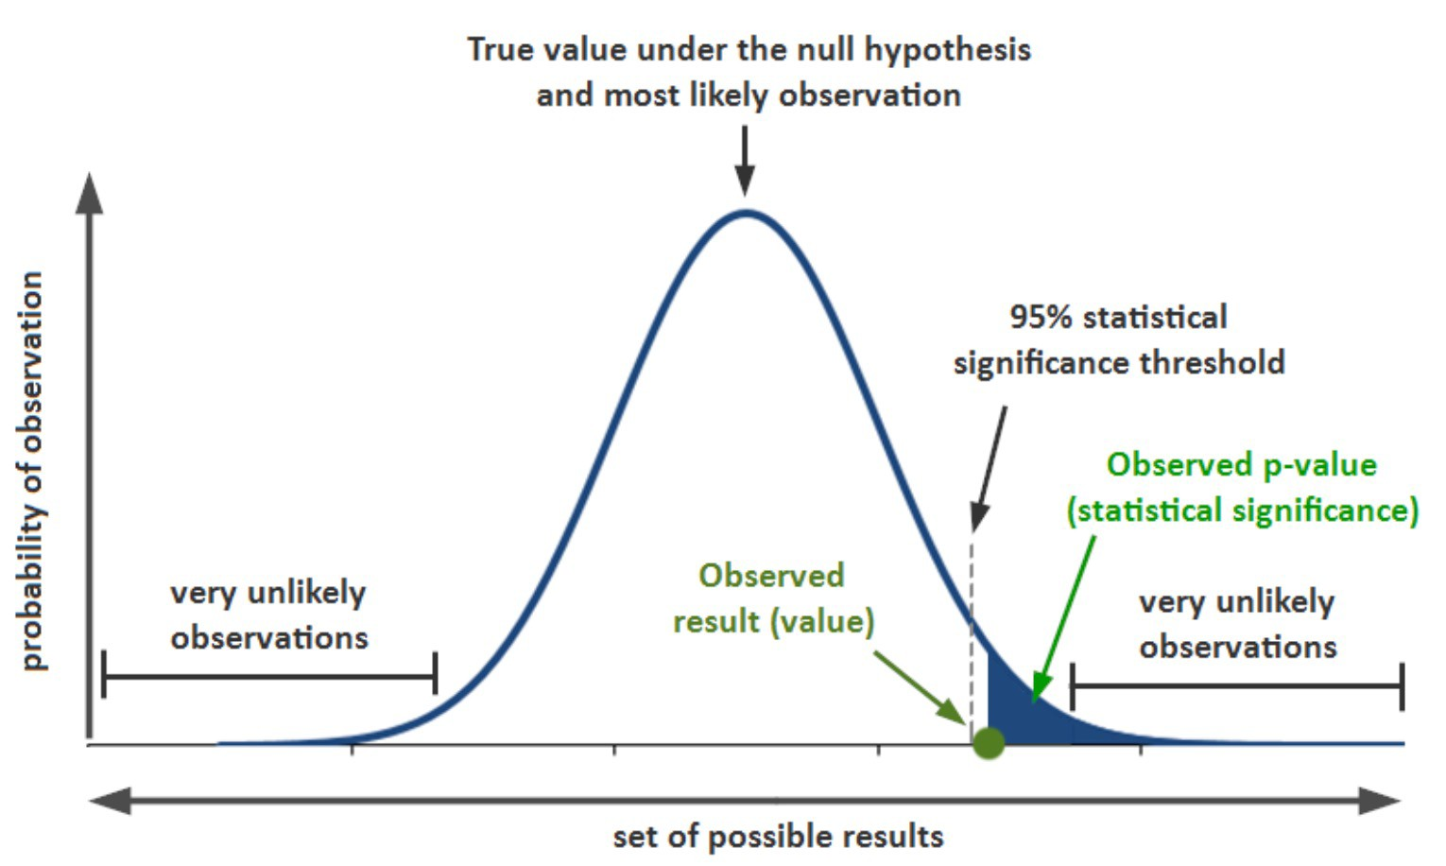
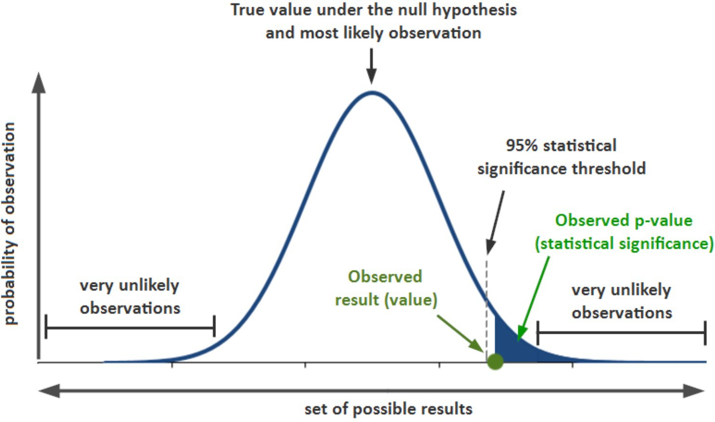
Confidence Intervals and CLT - Review

Slide 6
Practice Question 1
A sample of college students was surveyed about whether they have ever pulled an all- nighter to study for an exam or finish an assignment. A 95% confidence interval for the proportion of all college students who have ever pulled an all-nighter was computed to be [0.512, 0.668]. How would you interpret this confidence interval?

Slide 7
Practice Question 2
In 2016, pollsters routinely reported confidence intervals for support for Trump ranging between 40 and 46 percent. Ignoring electoral college issues, what might explain their incorrect predictions in the election outcome?
Notes:
Confidence intervals account for random error but not for systematic error (bad sampling, biased methods).

Slide 8
Confidence Intervals and Statistical Significance
If the two confidence intervals do not overlap, we can conclude that there is a statistically significant difference in the two population values at the given level of confidence
  Note: if the confidence intervals *do* overlap, it does not prove there is *not* a statistically significant difference
  Use overlapping CI as a “rule of thumb” only
If the confidence interval for the difference does not contain zero, we can conclude that there is a statistically significant difference in the two population values at the given level of confidence.
Notes:
Example:
Group A: Mean = 10, 95% CI = [8, 12]
Group B: Mean = 12, 95% CI = [10, 14]
These intervals overlap (10–12).
But if we compute the difference (A–B = –2), its 95% CI might be [–3.5, –0.5].
This CI does not include 0 → significant difference
So even though the original CIs overlap, the groups are still statistically different.

Slide 9
Statistical Significance vs Substantive Significance
What is the difference between statistical and substantive significance?
What are some examples that highlight the difference?
Notes:
Medical example: A drug reduces blood pressure by 1 mmHg with p < 0.001 (statistically significant). But in practice, that reduction is too small to improve patient health → not substantively significant.
Education example: A new teaching method raises test scores by 10 points on average, but the p-value = 0.12. Substantively, that effect could be meaningful for students, but the study didn’t have enough power.

Slide 10
Confidence Intervals: Group Activity
The abstracts for two studies social media use and mental health are on the next two slides. For each study, answer the following question:
What are the primary outcomes?
What is the treatment?
What treatment effects do they find for each outcome? Report the 95% CI for each outcome.
What are two potential explanations that can explain why the studies arrived at different results?
Notes:
Break into groups in 3 or 4

Slide 11
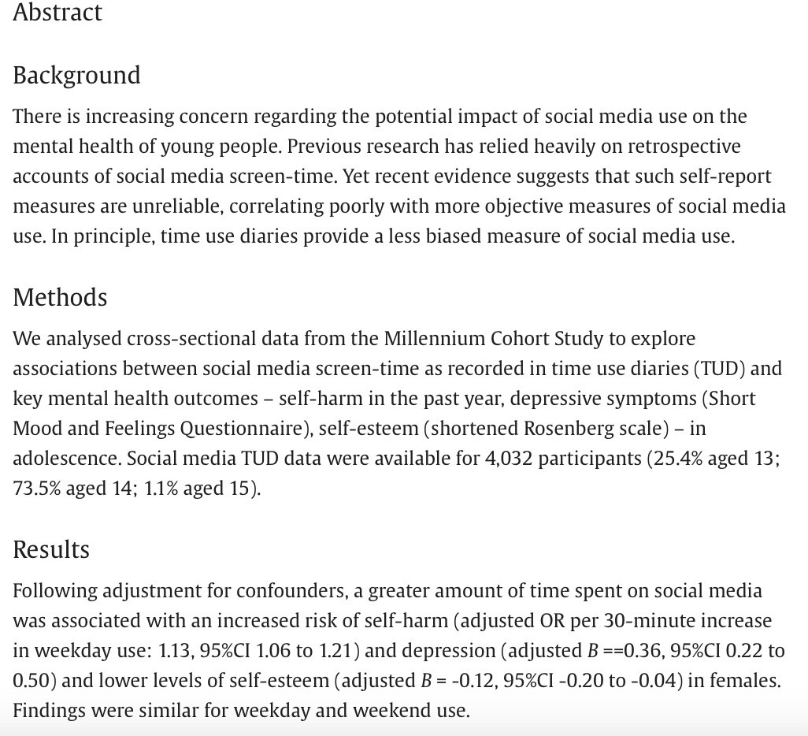
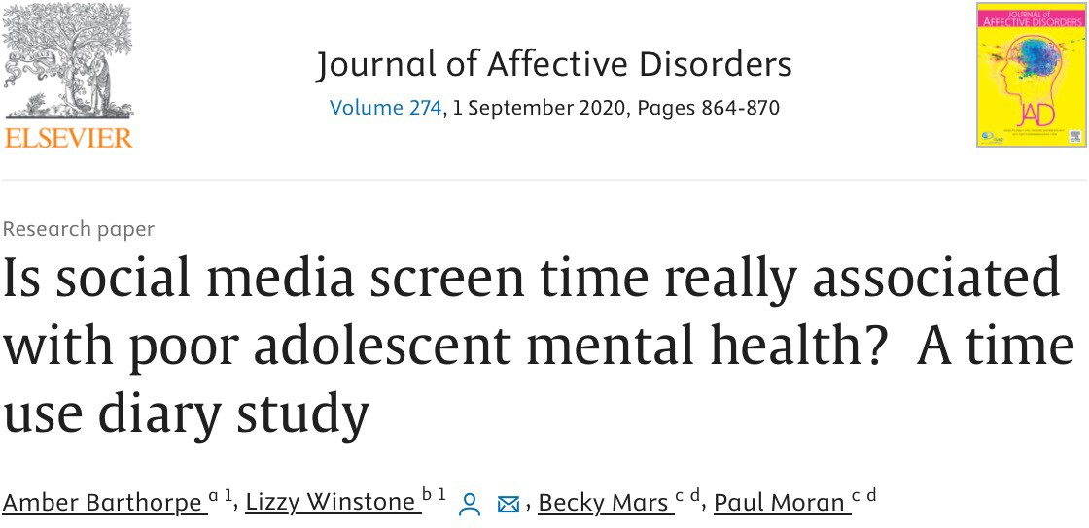
Study 1
Barthorpe, Amber, et al. "Is social media screen time really associated with poor adolescent mental health? A time use diary study." Journal of affective disorders 274 (2020): 864-870.

Slide 12
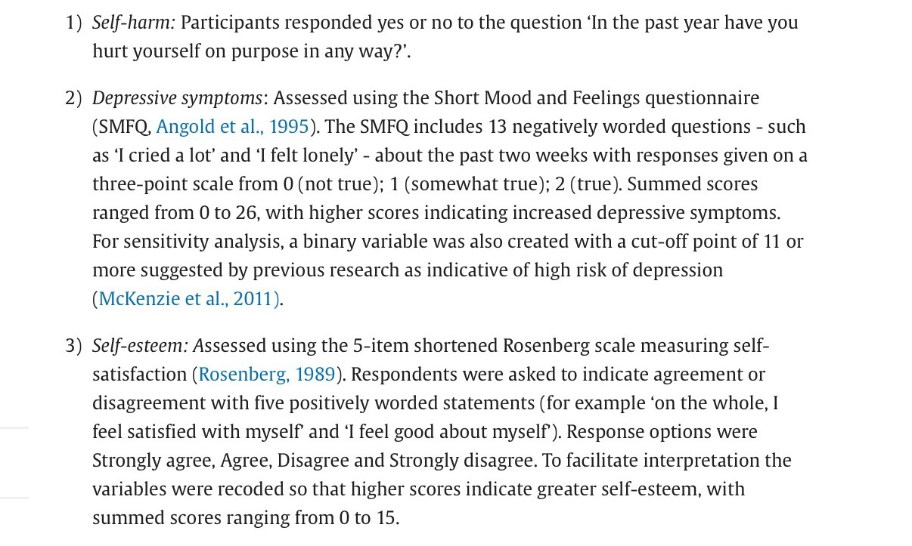

Slide 13
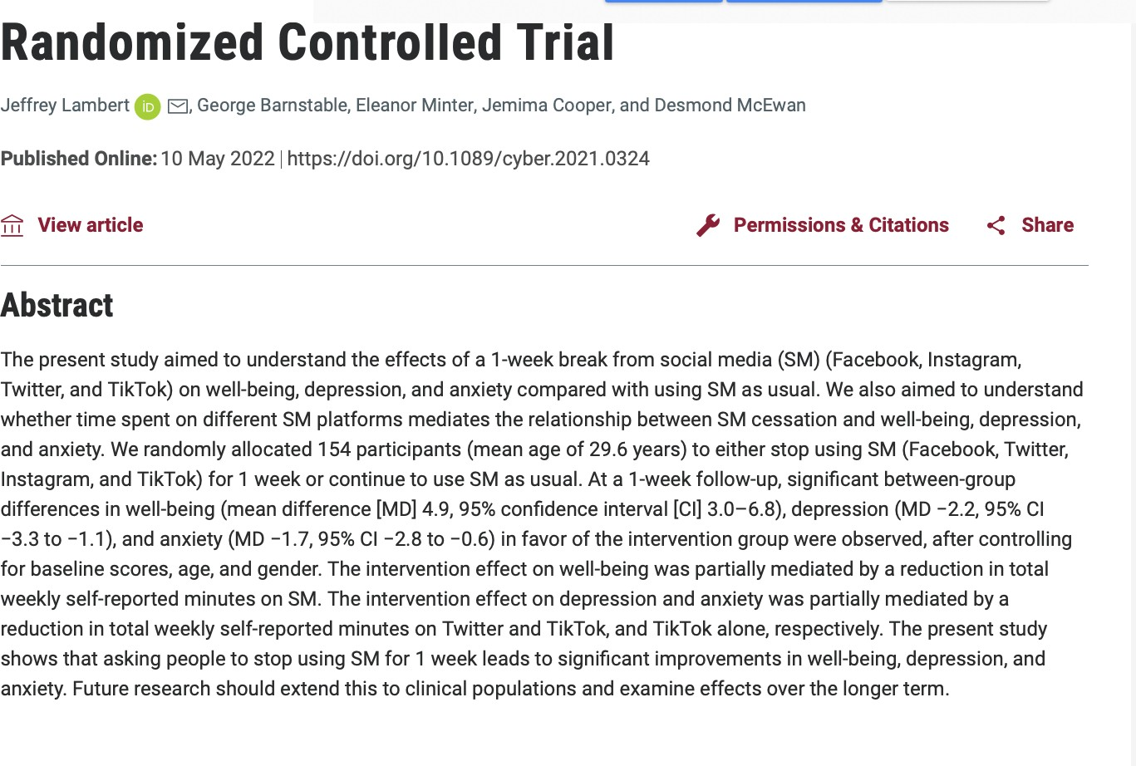
Study 2
Lambert, Jeffrey, et al. "Taking a one-week break from social media improves well- being, depression, and anxiety: a randomized controlled
trial." Cyberpsychology, Behavior, and Social
Networking 25.5 (2022): 287-293

Slide 14
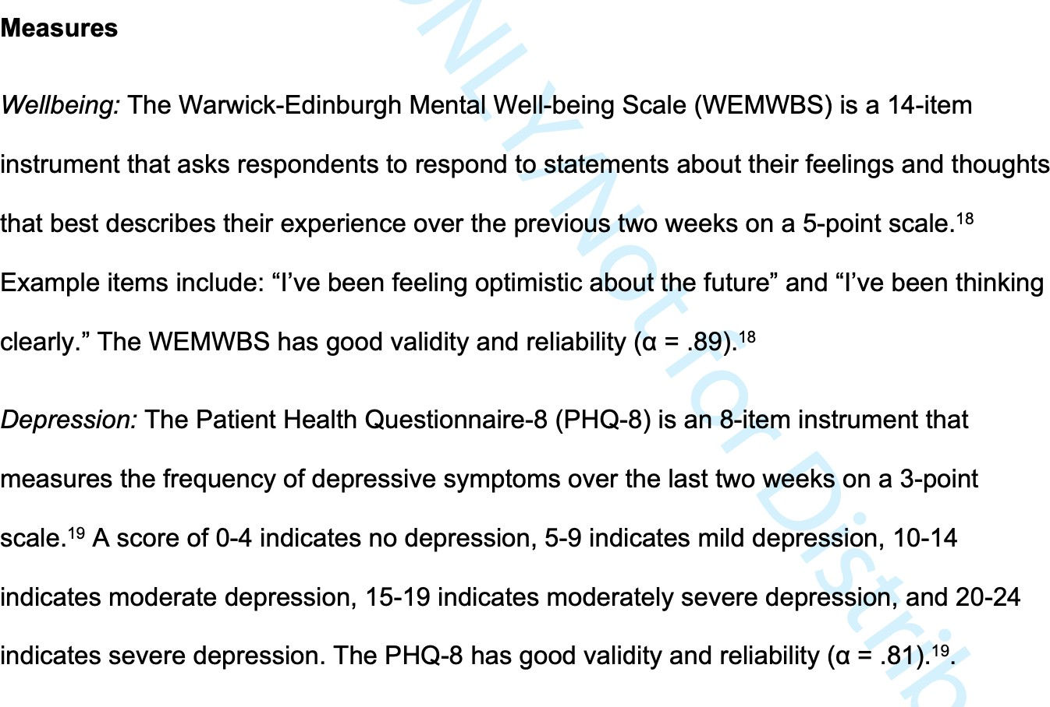

Slide 15
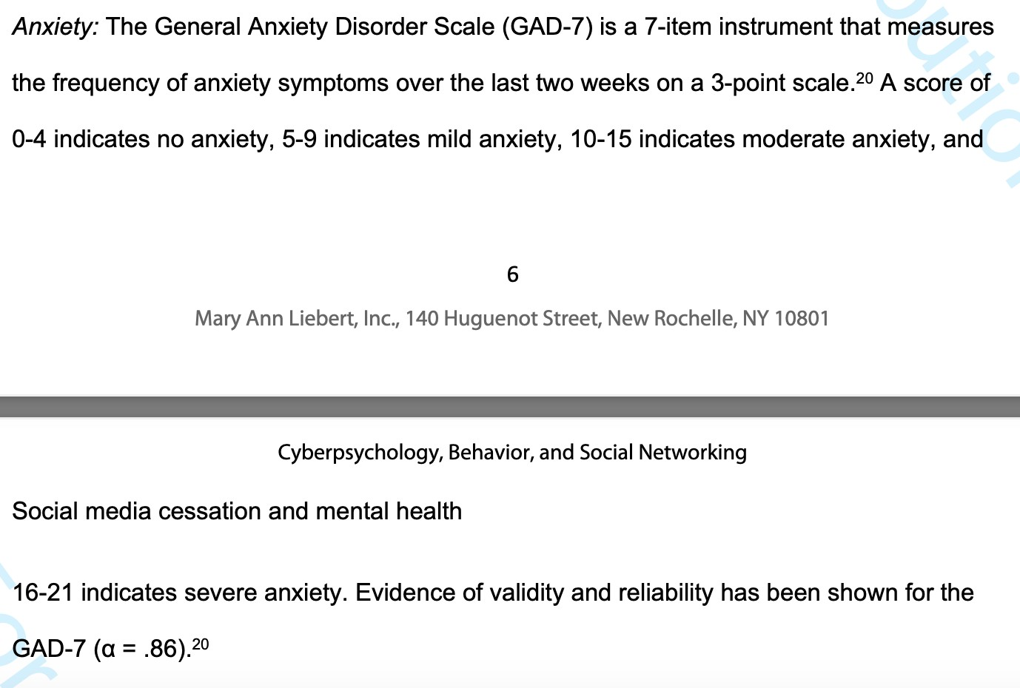

Slide 16
Study 1 Answers
“Is social media screen time really associated with poor adolescent mental health? A time use diary study.”

Slide 17
Study 2 Answers
"Taking a one-week break from social media improves well-being, depression, and anxiety: a randomized controlled trial."

Slide 18
Why might the study results differ?

Slide 19
Final Questions
Based on these two studies, does social media use have a significant effect on the likelihood of depression, anxiety, and low-self esteem?
Based on these two studies, does social media use have a substantive effect on the likelihood of depression, anxiety, and low-self esteem?
Do you believe these findings?
Which study do you think is better?

Slide 20
Upcoming / Reminders
Unit Assignment 1: due Sept 25 (Friday) at 5pm ET on Canvas

