Slide 1
GENED 1079 Section 2

Slide 2
Upcoming / Reminders
Janice’s office hour: TODAY 6-7pm @ Sever 104
Problem set working space:
  Sunday, Sept 20 at 10:00-11:00AM in Lamont Library 230
  Sunday, Sept 20 at 7:00-8:00PM in Lamont Library 230 & 240
Problem Set 1: due Monday, Sept 21 at 5:00pm on Canvas
Unit Assignment 1: due Sept 25 (Friday) at 5pm ET on Canvas

Slide 3
Agenda
Review SIR Model
Infectious diseases around the world
Unit assignment: What makes a good slide?
Brainstorm and present domestic HIV/AIDS policy proposals

Slide 4
Agenda
Review SIR Model
Infectious diseases around the world
Unit assignment: What makes a good slide?
Brainstorm and present domestic HIV/AIDS policy proposals

Slide 5
When will disease spread? - Refresher
Change in = Inflow - Outflow
prevalence
β ∙ N ∙ s ∙ i - δ ∙ i
At the start of an epidemic, s ≈ 1. Thus, the change in prevalence is positive if:
β ∙ N / δ ≡ R₀ > 1
Transmission
Recover/remove
R-naught
Notes:
Recall lowercase s and I are proportions.
JJ: whiteboard

Slide 6
Breakout groups: Let’s parameterize a single group model. Here is some information to do so.
“Whenever a susceptible individual comes into contact with an infectious individual on a given day, transmission of the virus occurs with probability 1.6%. For a well-mixed population, each individual has an average of 20 contacts per day.”
“The probability that a person who has COVID dies in a given day is one-half of one percent. The probability that they recover is 14 percent per day.”
“No one is wearing a mask.”
What is R₀?

Slide 7
Breakout groups: Let’s parameterize a single group model. Here is some information to do so.
“Whenever a susceptible individual comes into contact with an infectious individual on a given day, transmission of the virus occurs with probability 1.6%. For a well-mixed population, each individual has an average of 20 contacts per day.”
“The probability that a person who has COVID dies in a given day is one-half of one percent. The probability that they recover is 14 percent per day.”
“No one is wearing a mask.”
What is R₀? R₀=2.207 → disease spread is growing

Slide 8
Spreadsheet Questions – Part 1
Consider two policies. Define a successful policy as 10 or fewer total cases between day 0 and day 75 (the population size is 100). How many people would need to adhere to the policy to be successful?
  Mask wearing – assume that wearing a mask makes a person 70% less likely to contract COVID after contact with a COVID+ person
  Vaccination – assume that a COVID vaccination is 95% effective
Notes:
Review of in-class activity

Slide 9
Questions – Part 1
Consider two policies. Define a successful policy as 10 or fewer total cases between day 0 and day 75 (the population size is 100). How many people would need to adhere to the policy to be successful?
  Mask wearing – assume that wearing a mask makes a person 70% less likely to contract COVID after contact with a COVID+ person
    ~ 73% or 73 people
  Vaccination – assume that a COVID vaccination is 95% effective
    ~ 52% or 52 people

Slide 10
Questions – Part 2
A new variant of COVID-19 is about 3 times as communicable as the original variant. How would your answers to the questions in part 1 change for this new variant?

Slide 11
Questions – Part 2
A new variant of COVID-19 is about 3 times as communicable as the original variant. How would your answers to the questions in part 1 change for this new variant?
  3 * 0.016 = 0.048
  Mask Wearing: The whole population could be masked and would not be a ”successful” policy
  Vaccination: ~ 84% or 84 people vaccinated

Slide 12
Questions – Part 3
In Louisiana, 55% of people are fully vaccinated. In Massachusetts, it is 85%. No data exist on the share of people who wear a mask by state.
Would increasing the vaccination rate in LA materially reduce the number of COVID infections in MA?
  Use the heterogeneous agent model to make a determination, including what “materially reduce” might mean.
  You should decide what other parameters you think are sensible.

Slide 13
Questions – Part 3
In Louisiana, 55% of people are fully vaccinated. In Massachusetts, it is 85%. No data exist on the share of people who wear a mask by state.
Would increasing the vaccination rate in LA materially reduce the number of COVID infections in MA?
  Use the heterogeneous agent model to make a determination, including what “materially reduce” might mean.
  You should decide what other parameters you think are sensible.
Set the proportion of population vaccinated to the specified amounts.
Assume no one mask.
Now adjust the vaccination rate of Louisiana to see if # of infections go down in Massachusetts.
Sensible Parameters: contacts between groups and probability of becoming infected if come in contact with the other group.

Slide 14
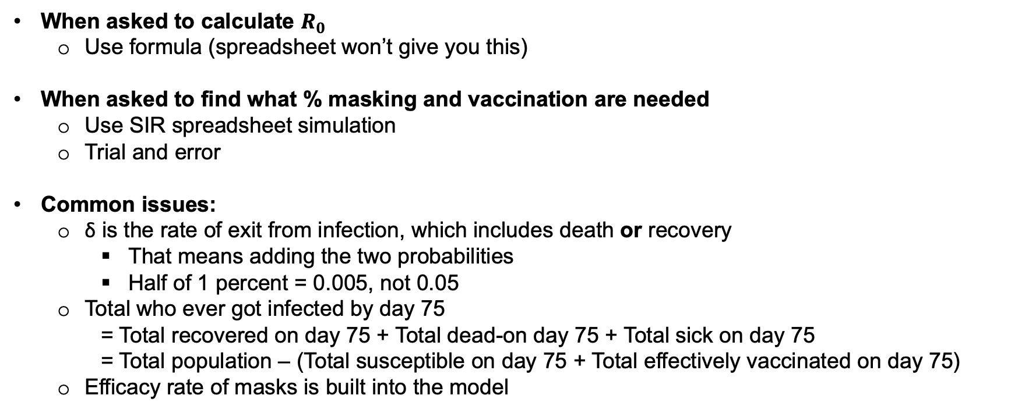
Review of 9/10 Class Activity
When asked to calculate $R_{0}$
  Use formula (spreadsheet won’t give you this)
When asked to find what % masking and vaccination are needed
  Use SIR spreadsheet simulation
  Trial and error
Common issues:
  δ is the rate of exit from infection, which includes death or recovery
    That means adding the two probabilities
    Half of 1 percent = 0.005, not 0.05
  Total who ever got infected by day 75
    = Total recovered on day 75 + Total dead-on day 75 + Total sick on day 75
    = Total population – (Total susceptible on day 75 + Total effectively vaccinated on day 75)
  Efficacy rate of masks is built into the model

Slide 15
Agenda
Review SIR Model
Infectious diseases around the world
Unit assignment: What makes a good slide?
Brainstorm and present domestic HIV/AIDS policy proposals

Slide 16
Infectious Diseases Around the World
Option to skip
For your state or country, please research the following:
  What infectious disease poses a threat to public health? (Can be Covid-19, can be something else)
  What are the incidence, prevalence, and mortality rate (per 100,000 population) for this infectious disease? (use the most recent data you can find)
  What mitigation policies for this infectious disease are and are not currently in place? Are vaccinations available? What percent of the population is or is not vaccinated?
  Is your state or country doing a good job with this infectious disease? Why or why not? What are the most pressing issues?
Nominate the person who woke up the latest this morning to summarize what you found in 3-5 minutes.
Notes:
Give groups ~ 15 minutes to research and discuss and each 3 minutes to report back to the class.
Feel free to get creative with where you want to assign people to. For example, could have students volunteer suggestions and then divvy up groups.
Might be good to assign groups to interesting place that will provide different political environment and responses:
My list: Mississippi, Massachusetts, India, and the United Kingdom

Slide 17
Agenda
Review SIR Model
Infectious diseases around the world
Unit assignment: What makes a good slide?
Brainstorm and present domestic HIV/AIDS policy proposals

Slide 18
What makes a “good” slide?
For the unit 1 assignment, the rubric section on structure and clarity has three components. The slides:
  Are well-organized, readable, and not too busy.
  Contain writing that is succinct and clear with minimal typos.
  Do not exceed 7 slides (including title slide and references).
The goal of this activity is to talk through what makes a well-organized, readable, and not-too-busy slide deck
We will go through sample slides describing HIV/AIDS activism. For each slide, think about:
  What helps you understand the content on the slide?
  What do you find confusing or difficult to read/understand?
Notes:
Idea here is to show that for the unit 1 assignments there is a balance between providing sufficient information, but not little. This may not look different from other presentations.

Slide 19
A few caveats…
None of these example slides are perfect; they are all meant to prompt discussion about what makes a slide easy to read and understand.
There are also many more ways to organize slides well than are shown here, so don’t limit yourself to these formats.
  For example, these slides don’t use images/color, but images and color can be very helpful!
This advice applies to slide decks that are meant to be read. In other contexts, when you’re presenting, you might have less content on slides because you can speak some of the content.
Also remember: the point of these slides is not the content! It’s how the content is presented. Your slides for the unit assignment will have different goals and therefore different types of content.

Slide 20
Activism
Example slide 1
Community-based health organizations provided care such as crisis counseling and legal aid¹
Civil disobedience brought attention to the inequities in funding and access to care²
Science activism resulted in faster clinical trials and greater funding for research³
Notes:
Good: use of bold to provide structure, concise bullets
Bad: too little content, unclear header
This might be great for a presentation, but for a unit assignment slide, it likely has too little content and is unclear

Slide 21
Activists responded to the HIV/AIDS crisis in three main ways
Example slide 2
Community-Based Health Organizations
Civil Disobedience
Science Activism
Community-based health organizations offered services like:
  Legal aid
  Crisis counseling
  Social workers¹
These organizations helped improve HIV/AIDS care and continue to do so in the present day.
For example, at the Gay Men’s Health Crisis in New York City:
  91% of patients who test positive are linked to care
  89% of clients are adherent to their HIV medications
  94% of clients are virally supressed²
Protesting brought attention to the government’s slow response to HIV/AIDS
Activists targeted:
  Wall Street: to encourage private companies to research treatments
  FDA: to push FDA to approve treatments more quickly
  NIH: to encourage the NIH to fund more research into HIV/AIDS treatment
  Catholic Church: to protest opposition to condom distribution³
Activists became involved in the research process. They were no longer leaving science to the scientists.
Celebrities, like Rock Hudson and Elizabeth Taylor, funded research into HIV/AIDS treatment.⁴
  This reduced HIV/AIDS stigma⁵
Activism also led to faster approval times for HIV/AIDS treatment.
  Pushing for rapid trials led AZT to be approved in 20 months.⁶
  This was much faster than prior approval times, which were around 10 years.⁷
Notes:
Good: clear, brief header with topic sentence, use of bolding, sub-bullets, dividing into 3 sections
In the unit assignments, all the citations would have to link to a reference slide!

Slide 22
Activists responded to the HIV/AIDS crisis in three main ways
Example slide 3
Community–based health organizations offered services such as legal aid, crisis counseling, and access to social workers.¹ Now, they also provide testing treatment for HIV/AIDS. For example, at the Gay Men’s Health Crisis in New York City:
  91% of patients who test positive are linked to care.
  89% of clients are adherent to their HIV medications.
  94% of clients are virally suppressed.²
Protesting brought attention to the government’s slow response to HIV/AIDS.
  Activists, such as those in the AIDS Coalition to Unleash Power (ACT-UP) targeted Wall Street, the FDA, and the NIH. They wanted to push these organizations to devote more resources to HIV/AIDS research.³
  They also protested the Catholic Church’s opposition to condom distribution.³
Science activism led to increased effort to develop treatment and to speed up the research process.
  Celebrities, like Rock Hudson and Elizabeth Taylor, funded research into HIV/AIDS treatment, which reduced stigma around HIV/AIDS.⁴
  Activism also led to faster approval times for treatments that were being developed. Pushing for rapid trials led AZT to be approved in 20 months, which was much faster than prior approval times, which were around 10 years.^{5,6}
Notes:
Good: clear, brief header with topic sentence, use of bolding, sub-bullets, dividing into 3 sections
This is very similar to the prior slide, goal is to show different ways of formatting

Slide 23
Activists responded to the HIV/AIDS crisis in three main ways: community-based health organizations, civil disobedience, and science activism.
Example slide 4
Community–based health organizations offered services such as legal aid, crisis counseling, and access to social workers. They stepped in in place of government social services.
Community-based health organization also provided testing and treatment for HIV/AIDS, and they have been successful at providing this healthcare to patients. For example, at the Gay Men’s Health Crisis in New York City, 91% of patients who test positive are linked to care, 89% of clients are adherent to their HIV medications, and 94% of clients are virally suppressed.
Protesting brought attention to the government’s slow response to HIV/AIDS. Activists, such as those in the AIDS Coalition to Unleash Power (ACT-UP), targeted Wall Street to encourage private companies to research treatment FDA. They also targeted the FDA to increase the approval of treatments and the NIH to encourage more research into HIV/AIDS treatments. In addition to the government and private sector organizations, they protested the Catholic Church because of the Church’s opposition to condom distribution.
Science activism led to increased effort to develop treatments and to speed up the research process. Activists became involved in the research process and were no longer “leaving science to the scientists”. Celebrities, like Rock Hudson, Elizabeth Taylor, funded research into HIV/AIDS treatment through the American Foundation for AIDS Research. This both increased the resources used to develop treatments (for example protease inhibitors, vaginal microbicides) and reduced stigma around HIV/AIDS. Activism also led to faster approval times for treatments that were being developed. Pushing for rapid trials led AZT to be approved in 20 months, which was faster than prior approval times, which were around 10 years.
However, the activism around science also raised ethical questions. For example, should very ill individuals be excluded from clinical trials? Is it ethical to randomize individuals with HIV/AIDS to a control group?
Notes:
Bad: long title, bullets are too long & hard to read, title says 3 main ways but there are 5 bullets. Missing citations!

Slide 24
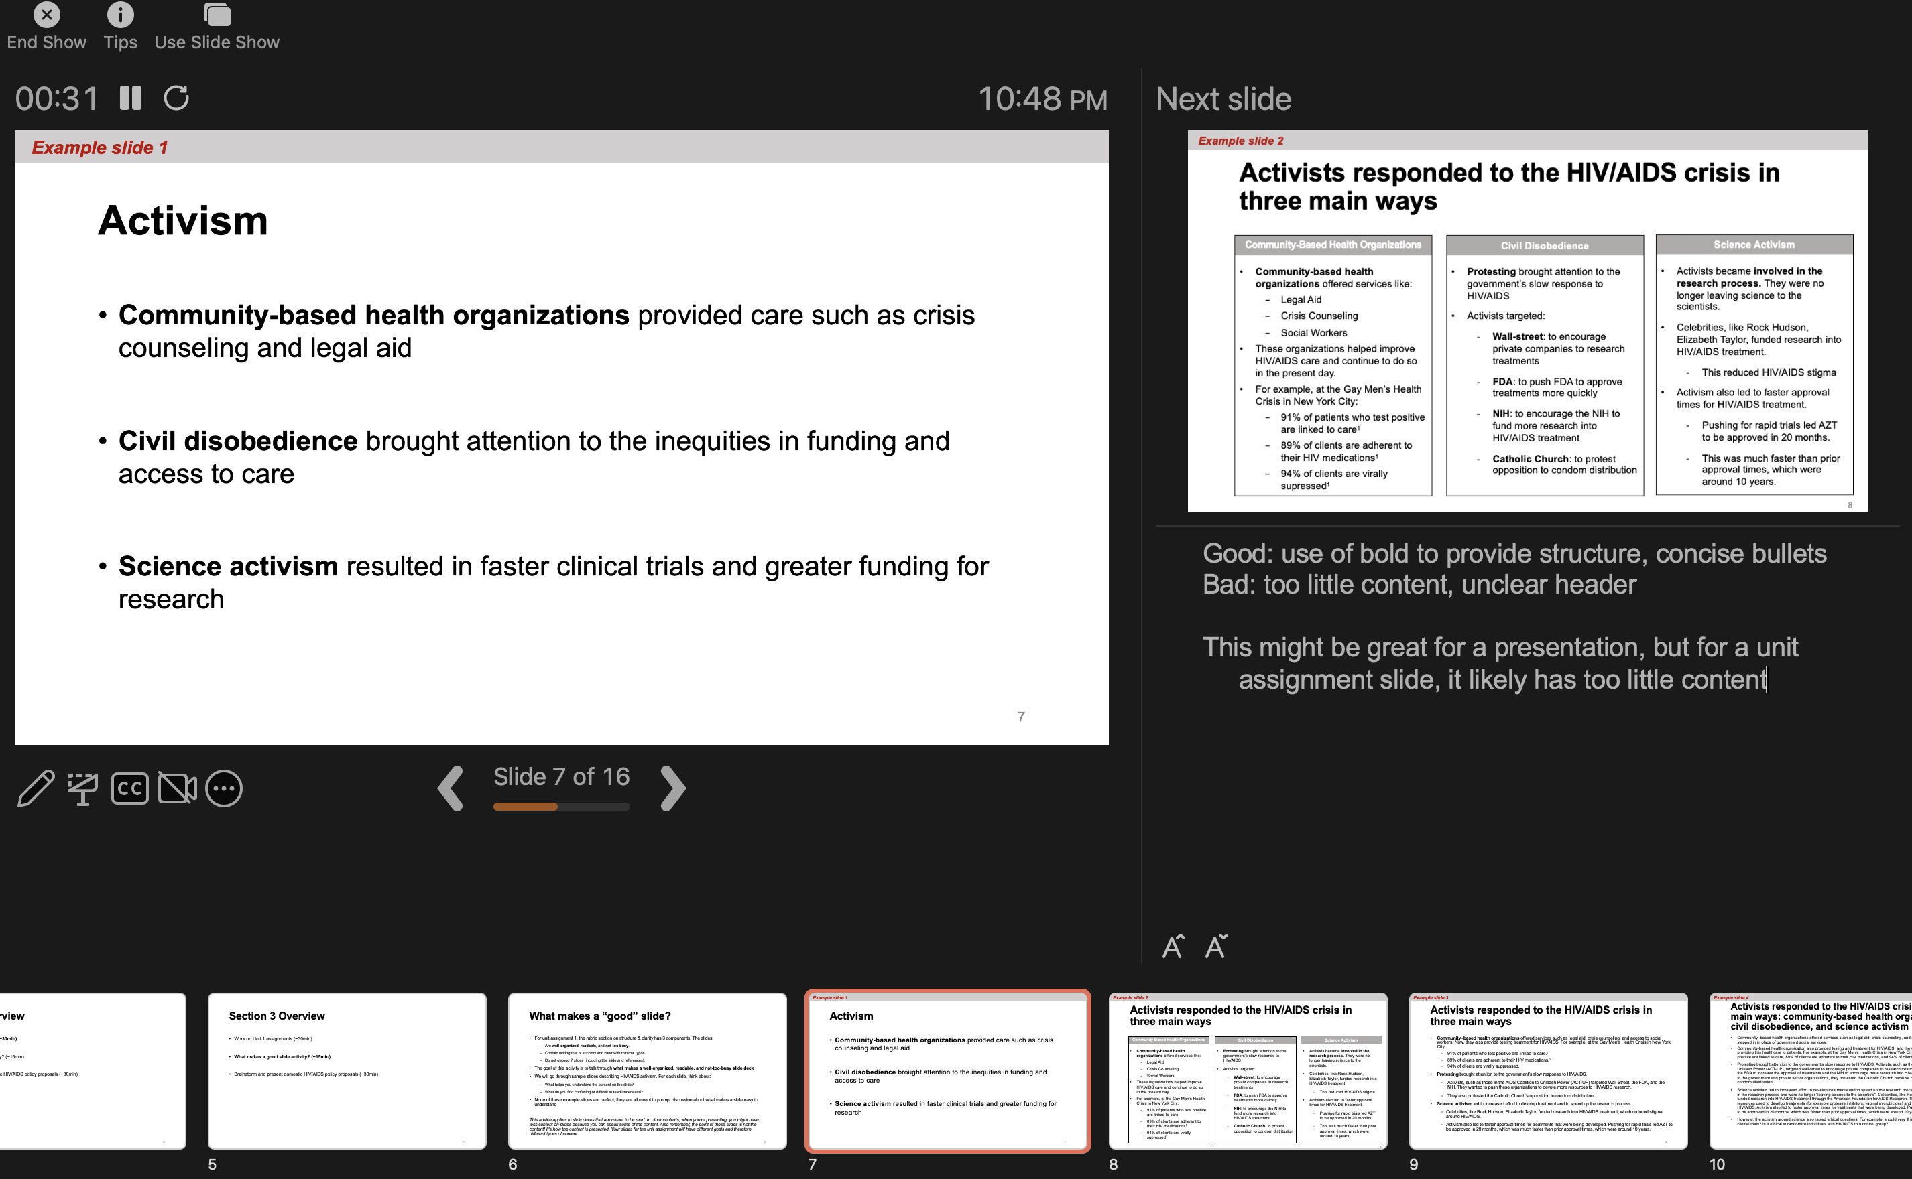
Presenter Notes

Slide 25
Agenda
Review SIR Model
Infectious diseases around the world
Unit assignment: What makes a good slide?
Brainstorm and present domestic HIV/AIDS policy proposals

Slide 26
Unit 1 Assignment Groups

Slide 27
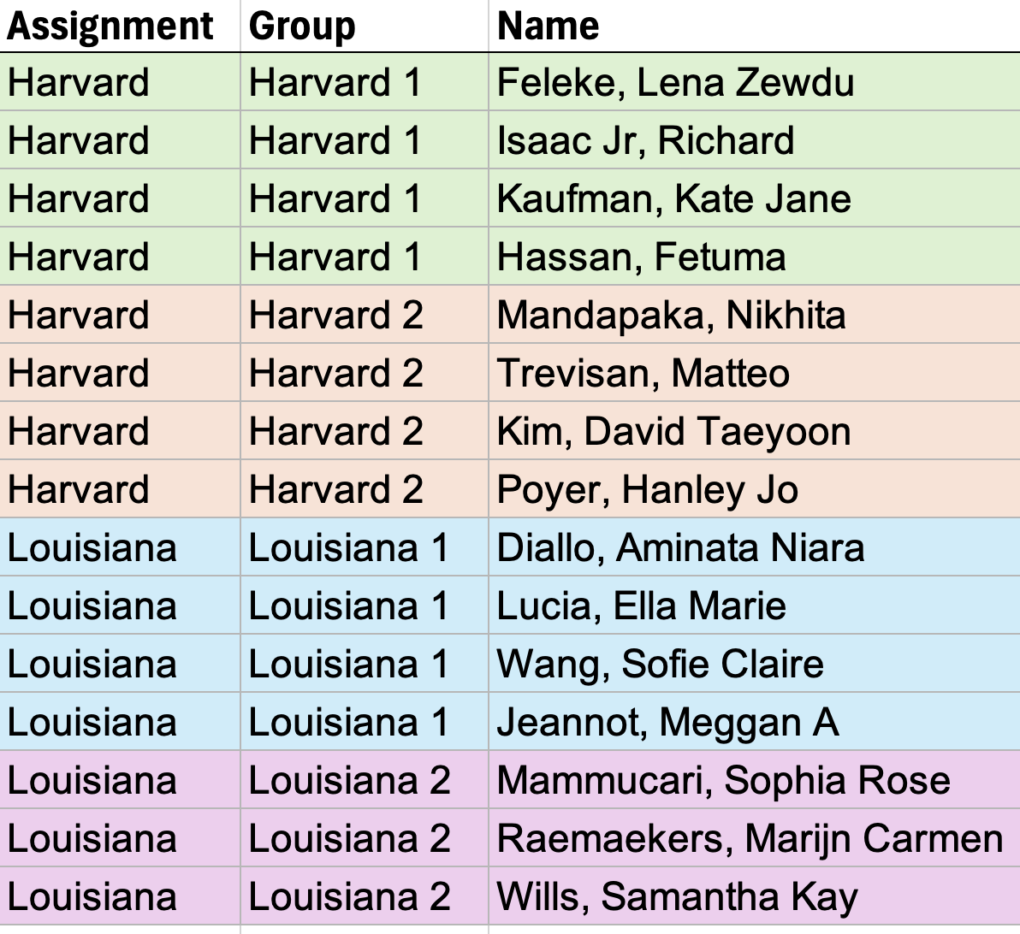
Notes:
12pm section
Get contact info for your groups

Slide 28
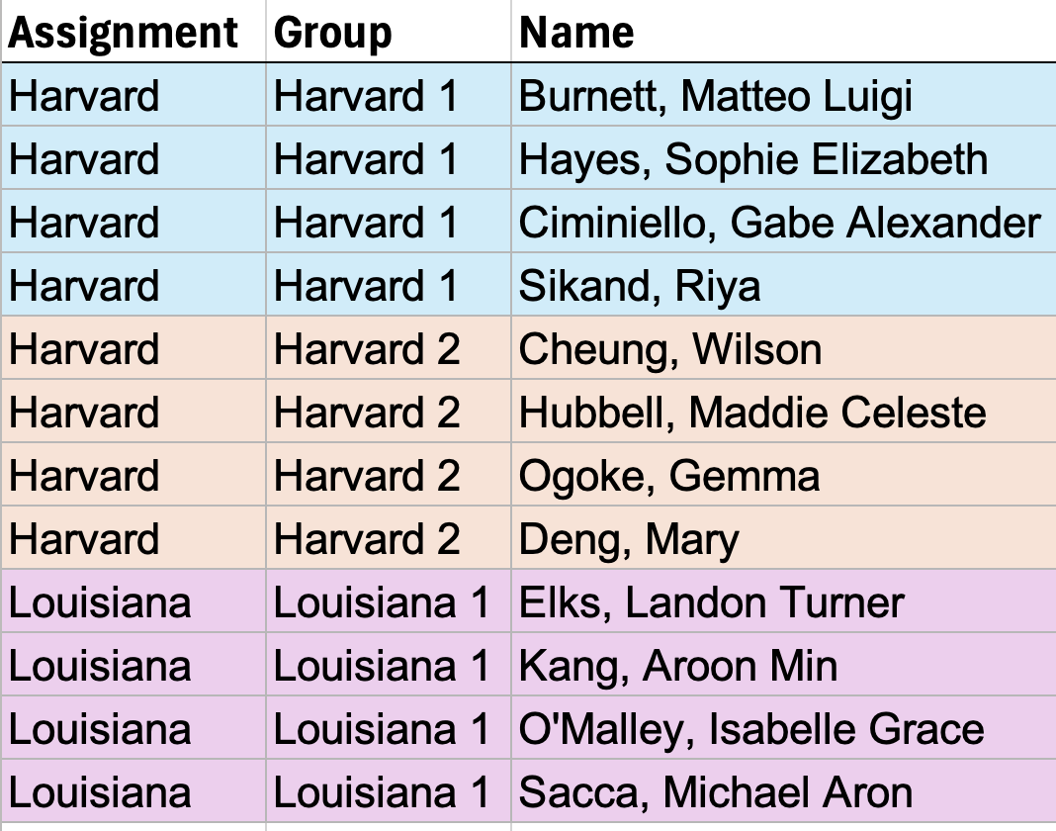
Notes:
1:30pm section
Get contact info for your groups

Slide 29
Domestic HIV/AIDS Policy
The United States has outlined four key strategies to achieve the goal of reducing new HIV infections in the United States by 75% by 2025 and 90% by 2030
      Diagnose all people with HIV as early as possible after infection (improve testing accessibility)
      Treat the infection rapidly and effectively (link individuals diagnosed with HIV/AIDS to care & treatment, re-engage individuals who aren’t receiving care)
      Prevent new HIV transmission by using proven interventions (e.g., pre-exposure prophylaxis (PrEP), syringe services programs)
      Respond quickly to potential HIV outbreaks (identify where HIV is spreading, work with communities to develop locally-tailored plans)
https://www.hiv.gov/federal-response/ending-the-hiv-epidemic/key-strategies

Slide 30
Domestic HIV/AIDS Policy: Slides
    Slide 1
Each group has been assigned one of the 4 strategies (diagnose, treat, prevent, respond)
Brainstorm policies that would address your strategy
  Focus on general policies or a specific subpopulation
Create one slide explaining one or more policies that would address your strategy
    Slide 2
    Answer the following questions (1-2 bullet points per question):
    What are some challenges to or disadvantages of your proposal? What might prevent it from working?
    Would your policy be implementable by 2030?

Slide 31
Domestic HIV/AIDS Policy: Presentation
Prepare 2 slides in groups of 4-5 (~15 minutes)
Present proposals (~15 minutes)
  2 minutes to present proposals to section (will be timed)
  1 minute for section to discuss proposal
Note: 15 minutes is not a lot of time to make slides! We don’t expect these to be as detailed or comprehensive as the unit assignment slides. Think of this as a warm-up for the unit 1 assignment and a chance to ask questions about making slides / presenting.

